Slide 1


2 Fundamental Concepts of Machine Learning: Introduction
Leon Herrmann
Stefan Kollmannsberger
Chair of Data Engineering in Construction
Bauhaus-Universität Weimar
Deep Learning in Computational Mechanics – an introductory course, Herrmann et al. 2025
website
book
Notes:
generated with https://www.the-qrcode-generator.com/

Slide 2
Contents
1 Computational Mechanics Meets Artificial Intelligence (& Introduction to PyTorch)
2.1 Definition
2.2 Data Structure
2.3 Types of Learning
2.4 Machine Learning Tasks
2.5 Linear Regression
2.8.1 Gradient Descent
2.8.1 Stochastic Gradient Descent
2.8 Optimization Techniques
2.6 Overfitting versus Underfitting
2.7 Regularization

Slide 3
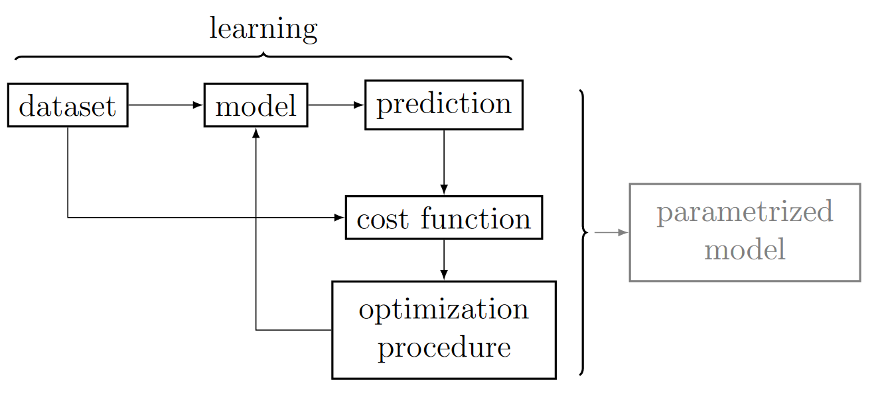
2.1 Definition
Most machine learning algorithms are composed of
Dataset
Parametrized model
Cost function
Optimization procedure
”a computer program is said to learn from experience E with respect to some class of tasks T and performance measure P, if its performance at tasks T, as measured by P, improves with experience E”
Machine Learning, Mitchell 1997

Slide 4
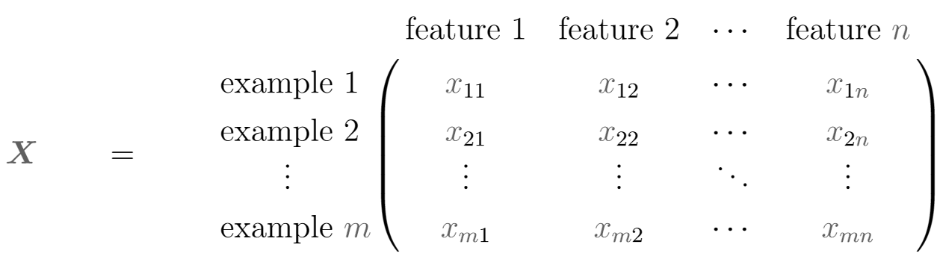

2.2 Data Structure
Specific dataset (sometimes called design matrix)
Examples
Can be different images, where its features are its pixel values, $n=$ channels $×$ pixels
Can be different houses, where its features are ist properties such as area, number of rooms, age
Notation
Design matrix $X$
Design vector of a single example $i$ (1 sample/example) $x_{i}={\left[x_{i1},x_{i2},…,x_{in}\right]}^{T}$

Slide 5
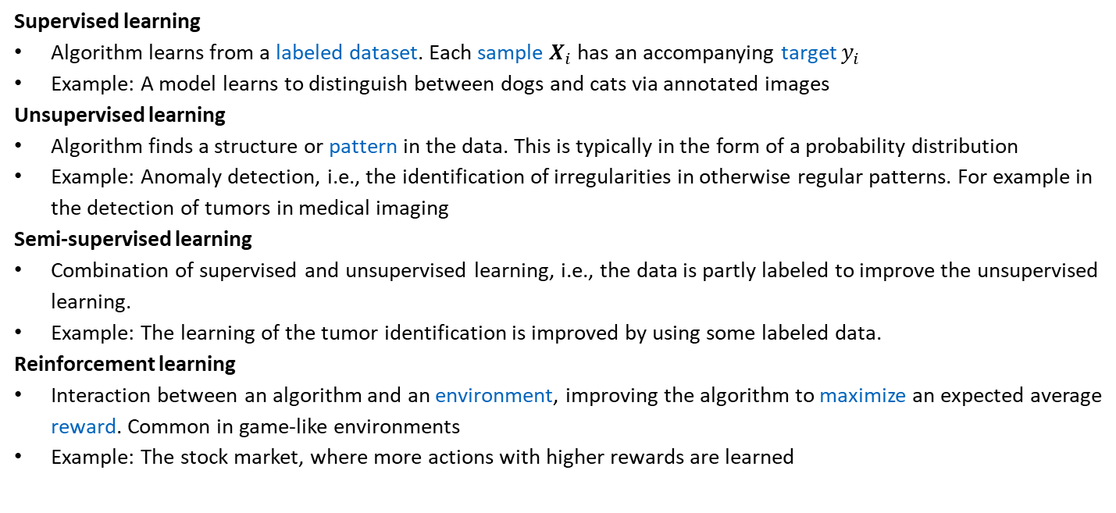
2.3 Types of Learning
Supervised learning
Algorithm learns from a labeled dataset. Each sample $X_{i}$ has an accompanying target $y_{i}$
Example: A model learns to distinguish between dogs and cats via annotated images
Unsupervised learning
Algorithm finds a structure or pattern in the data. This is typically in the form of a probability distribution
Example: Anomaly detection, i.e., the identification of irregularities in otherwise regular patterns. For example in the detection of tumors in medical imaging
Semi-supervised learning
Combination of supervised and unsupervised learning, i.e., the data is partly labeled to improve the unsupervised learning.
Example: The learning of the tumor identification is improved by using some labeled data.
Reinforcement learning
Interaction between an algorithm and an environment, improving the algorithm to maximize an expected average reward. Common in game-like environments
Example: The stock market, where more actions with higher rewards are learned

Slide 6
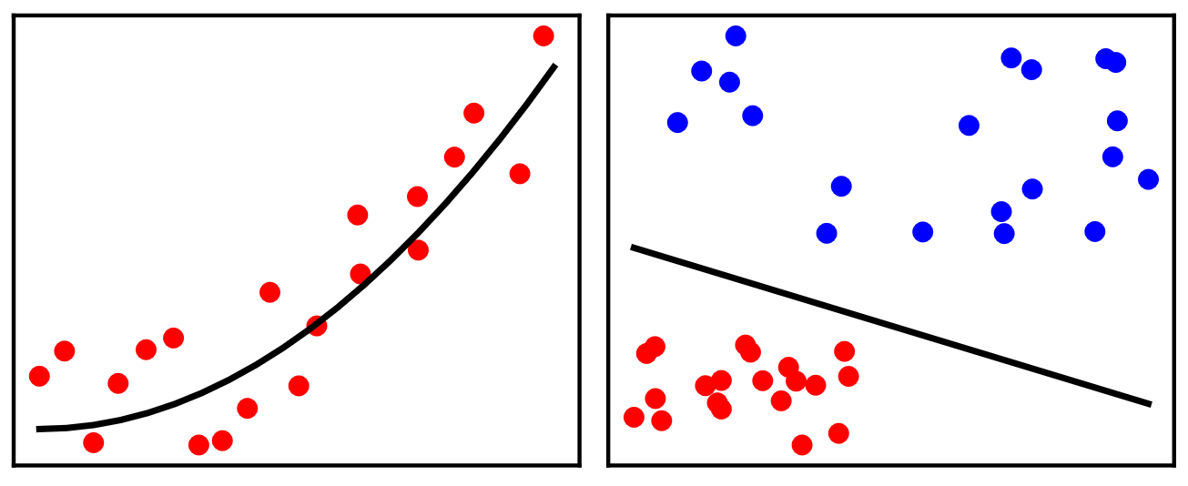
2.4 Machine Learning Tasks
Regression
Prediction of a numerical value via a (real-valued) mapping between input and output
Example: Prediction of house prices from criteria like area, number of rooms, age
Classification
Prediction of a discrete category via a mapping between input and a (discrete) category
Example: Classification of images in cats and dogs
Classification can be regarded as discrete
regression.
Regression
Classification

Slide 7
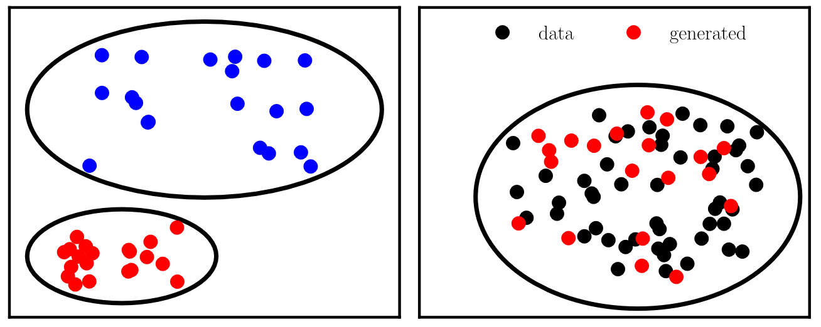
2.4 Machine Learning Tasks
Clustering
Discovers similarities between data and creates discrete clusters (unsupervised)
Example: Identification of similar customer groups
Generative modeling
Generate new data points that resemble a given dataset (without simply reproducing given data points)
Example: Generate new rim designs given a set of rims
Clustering
Generative modeling

Slide 8
Machine Learning Algorithms
Machine Learning in Additive Manufacturing: State-of-the-Art and Perspectives, Wang et al. 2020
Classifications | Algorithms | Tasks
Supervised | Decision trees | Classification
 | Random forest | Classficiation, regression
 | Support vector machines | Classification, regression
 | K-nearest neighbours | Classification
 | Bayesian network | Classification
 | Gaussian process | Regression
 | Multi-gene genetic programming | Regression
 | Hidden semi-Markov model | Classification
 | Multi-layer perceptron | Classification, regression
 | Convolutional neural network | Classification
 | Recurrent neural network | Time series prediction (regression)
 | Adaptive network-based fuzzy inference system | Regression
 | Transformers | Regression, classification, generative modeling
Unsupervised | Self-organizing map | Clustering
 | Deep belief network | Classification
 | K-means clustering | Clustering
 | Reduced order modeling (POD) | Dimensionality reduction
 | Autoencoder | Generative modeling, dimensionality reduction
 | Generative adversarial networks | Generative modeling, (classification)
 | Diffusion model | Generative modeling
Semi-supervised | Gaussian mixture model | Clustering
covered in Chapter 7
covered in Chapter 3
covered in Chapter 8
covered in Chapter 7
covered in Chapter 8

Slide 9
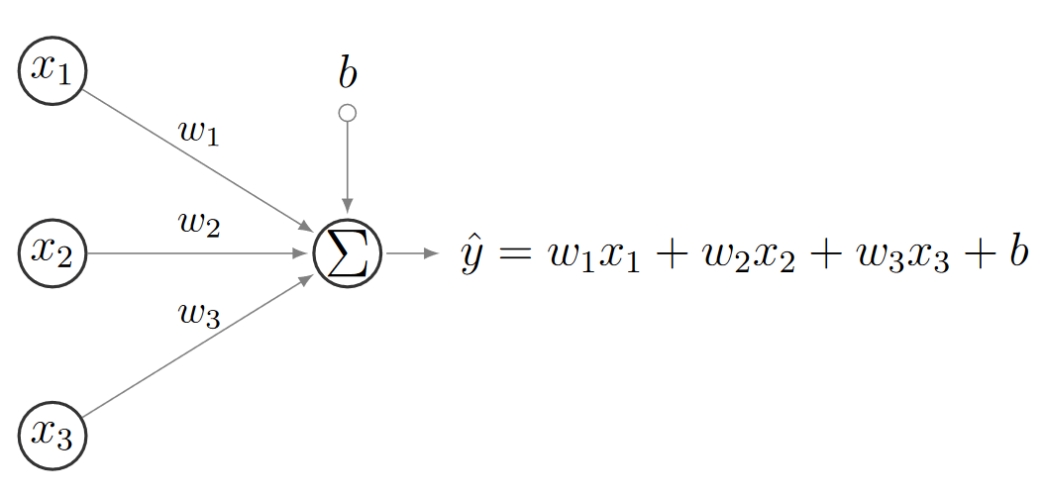
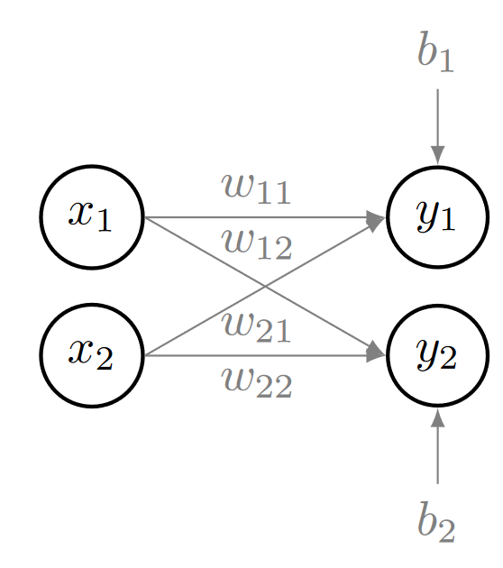
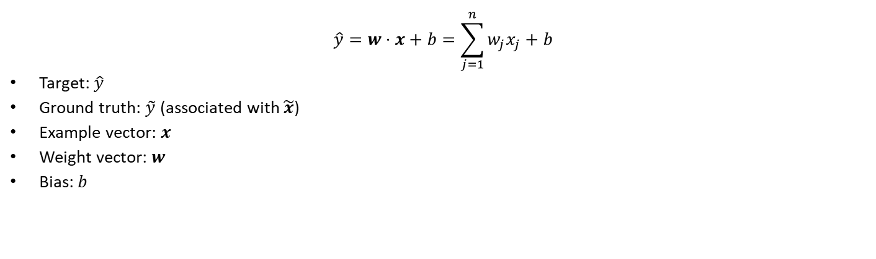
2.5 Linear Regression – Prediction
$$\hat{y}=w⋅x+b=\sum_{j=1}^{n}{w_{j}x_{j}+b}$$
Target: $\hat{y}$
Ground truth: $\tilde{y}$ (associated with $\tilde{x}$)
Example vector: $x$
Weight vector: $w$
Bias: $b$
Remember Exercise 3 (stress field from perceptrons):
the employed perceptron expresses a similar parametrization

Slide 10

2.5 Linear Regression – Performance Measurement
Prediction in $n$d for sample $i$:
$${\hat{y}}_{i}=w⋅x_{i}+b=\sum_{j=1}^{n}{w_{j}x_{ij}+b}$$
$i$is an example/sample and $j$ is a feature
each feature has an associated weight, which is shared across all samples
Remember the design matrix
Where each example vector is defined as $x_{i}={\left(x_{i1},x_{i2},…,x_{in}\right)}^{T}$

Slide 11
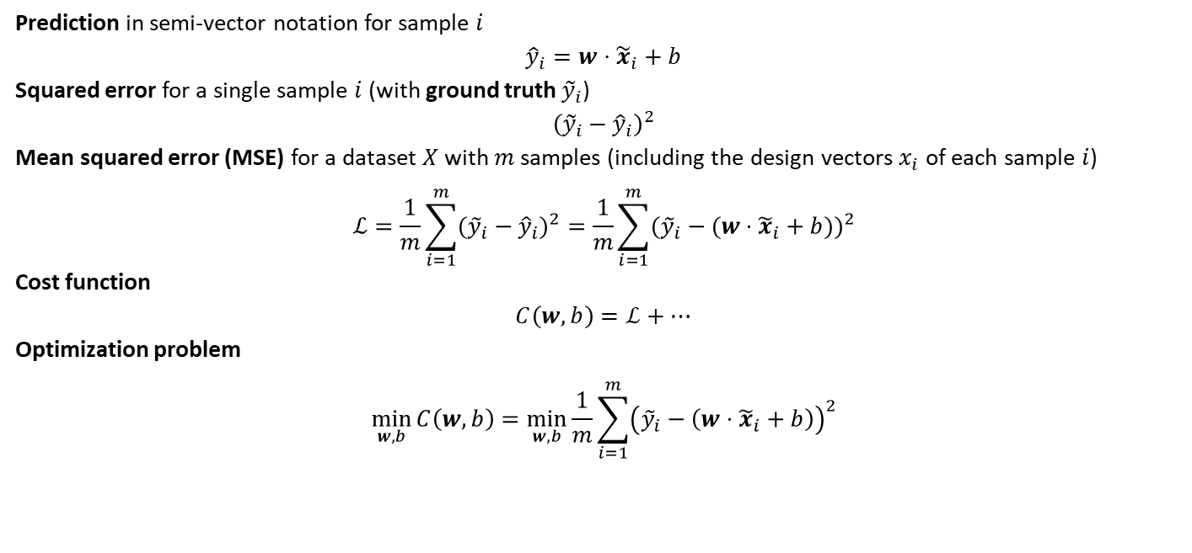
2.5 Linear Regression – Performance Measurement
Prediction in semi-vector notation for sample $i$
$${\hat{y}}_{i}=w⋅{\tilde{x}}_{i}+b$$
Squared error for a single sample $i$(with ground truth ${\tilde{y}}_{i}$)
$${\left({\tilde{y}}_{i}−{\hat{y}}_{i}\right)}^{2}$$
Mean squared error (MSE) for a dataset $X$with $m$samples (including the design vectors $x_{i}$ of each sample $i$)
$$ℒ=\frac{1}{m}\sum_{i=1}^{m}{({\tilde{y}}_{i}}−{\hat{y}}_{i})^{2}=\frac{1}{m}\sum_{i=1}^{m}{({\tilde{y}}_{i}}−(w⋅{\tilde{x}}_{i}+b))^{2}$$
Cost function
$$C\left(w,b\right)=ℒ+⋯$$
Optimization problem
$$\min_{w, b}{C\left(w,b\right)=\min_{w,b}{\frac{1}{m}\sum_{i=1}^{m}{{\left({\tilde{y}}_{i}−\left(w⋅{\tilde{x}}_{i}+b\right)\right)}^{2}}}}$$
In machine learning optimization is referred to as learning when the model is applied to previously unseen problems (i.e., datapoints). This stands in contrast to structural optimization in which one specific design is obtained through optimization.

Slide 12
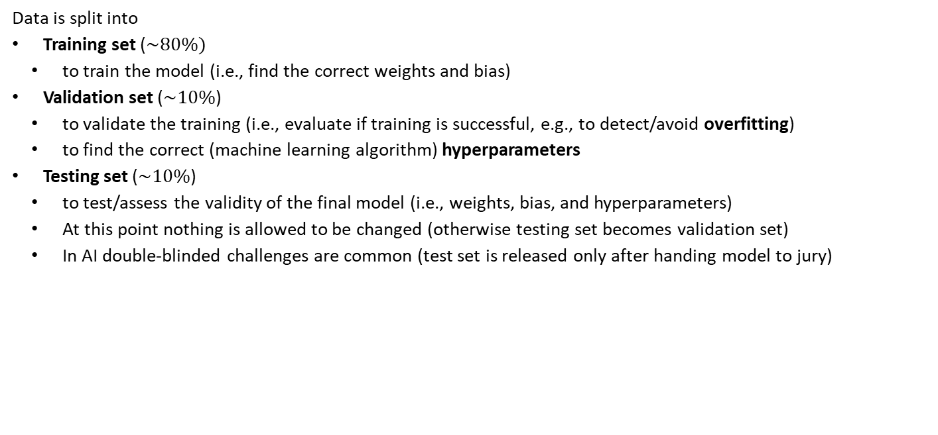
2.5 Linear Regression – Data Split
Data is split into
Training set ($\sim 80\%)$
to train the model (i.e., find the correct weights and bias)
Validation set ($\sim 10\%$)
to validate the training (i.e., evaluate if training is successful, e.g., to detect/avoid overfitting)
to find the correct (machine learning algorithm) hyperparameters
Testing set ($\sim 10\%$)
to test/assess the validity of the final model (i.e., weights, bias, and hyperparameters)
At this point nothing is allowed to be changed (otherwise testing set becomes validation set)
In AI double-blinded challenges are common (test set is released only after handing model to jury)

Slide 13
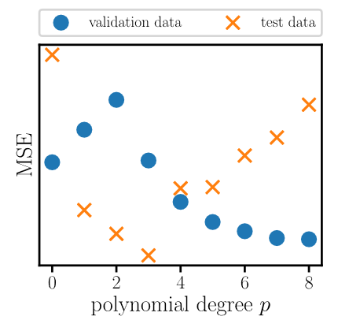
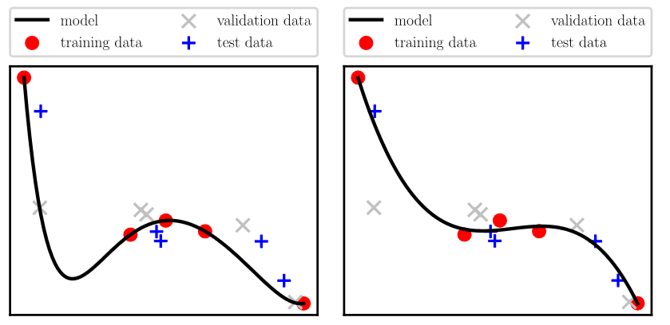



2.5 Linear Regression – Data Split
Example
Fitting of datapoints with a polynomial where the hyperparameter is the polynomial degree $p$
The validation set shows that $p=8$ leads to the lowest validation error for the trained model
The test set shows that some overfitting happened during hyperparameter tuning (this information is not available during/for model development)
The best model would rely on $p=3$
$$p=8$$
$$p=3$$

Slide 14
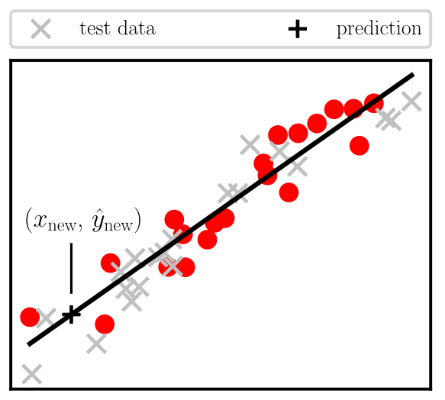
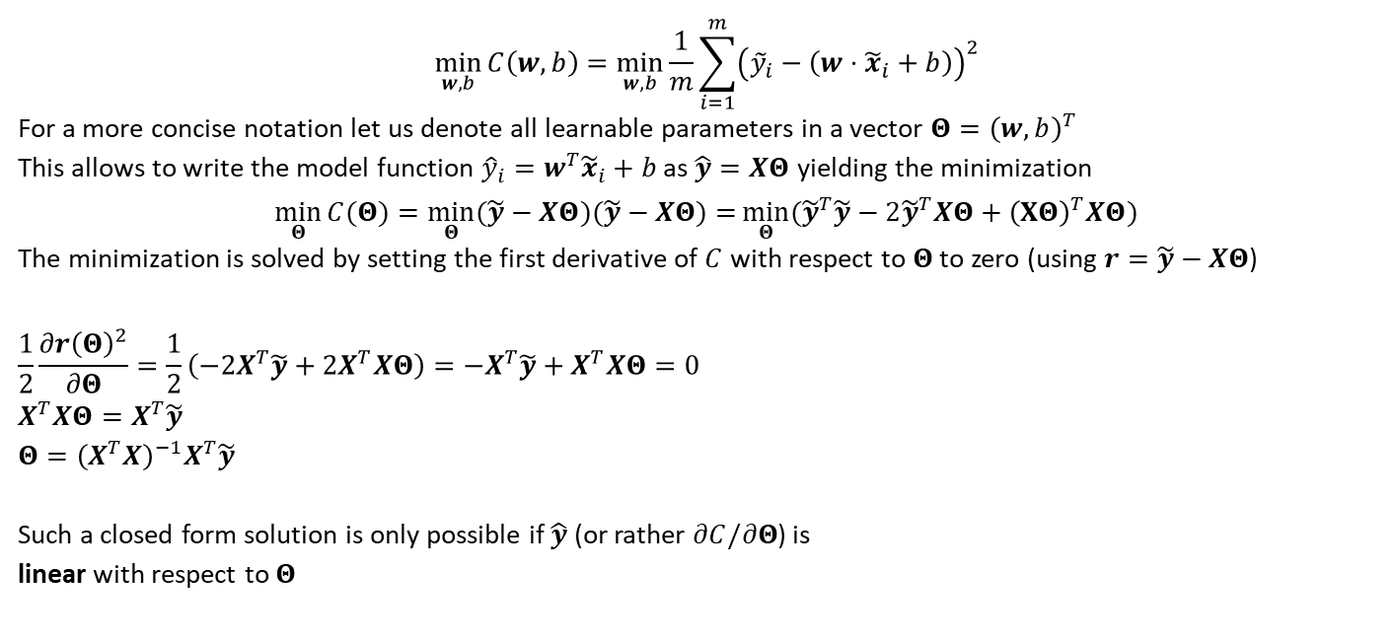


2.5 Linear Regression – Optimization
$$\min_{w, b}{C\left(w,b\right)=\min_{w,b}{\frac{1}{m}\sum_{i=1}^{m}{{\left({\tilde{y}}_{i}−\left(w⋅{\tilde{x}}_{i}+b\right)\right)}^{2}}}}$$
For a more concise notation let us denote all learnable parameters in a vector $Θ={\left(w,b\right)}^{T}$
This allows to write the model function ${\hat{y}}_{i}=w^{T}{\tilde{x}}_{i}+b$ as $\hat{y}=XΘ$ yielding the minimization
$$\min_{Θ}{C(Θ)}=\min_{Θ}{(\tilde{y}−XΘ)(\tilde{y}−XΘ)=}\min_{Θ}{({\tilde{y}}^{T}\tilde{y}−2{\tilde{y}}^{T}XΘ+{\left(XΘ\right)}^{T}XΘ)}$$
The minimization is solved by setting the first derivative of $C$ with respect to $Θ$ to zero (using $r=\tilde{y}−XΘ$)
$$\frac{1}{2}\frac{∂r{\left(Θ\right)}^{2}}{∂Θ}=\frac{1}{2}\left(−2X^{T}\tilde{y}+2X^{T}XΘ\right)=−X^{T}\tilde{y}+X^{T}XΘ=0 \\ X^{T}XΘ=X^{T}\tilde{y} \\ Θ={\left(X^{T}X\right)}^{−1}X^{T}\tilde{y}$$
Such a closed form solution is only possible if $\hat{y}$ (or rather $∂C/∂Θ$) is linear with respect to $Θ$
Note that $X$ requires a column of ones for the bias $b$
All predictions ${\hat{y}}_{i}$ are collected in the vector $\hat{y}$.

Slide 15
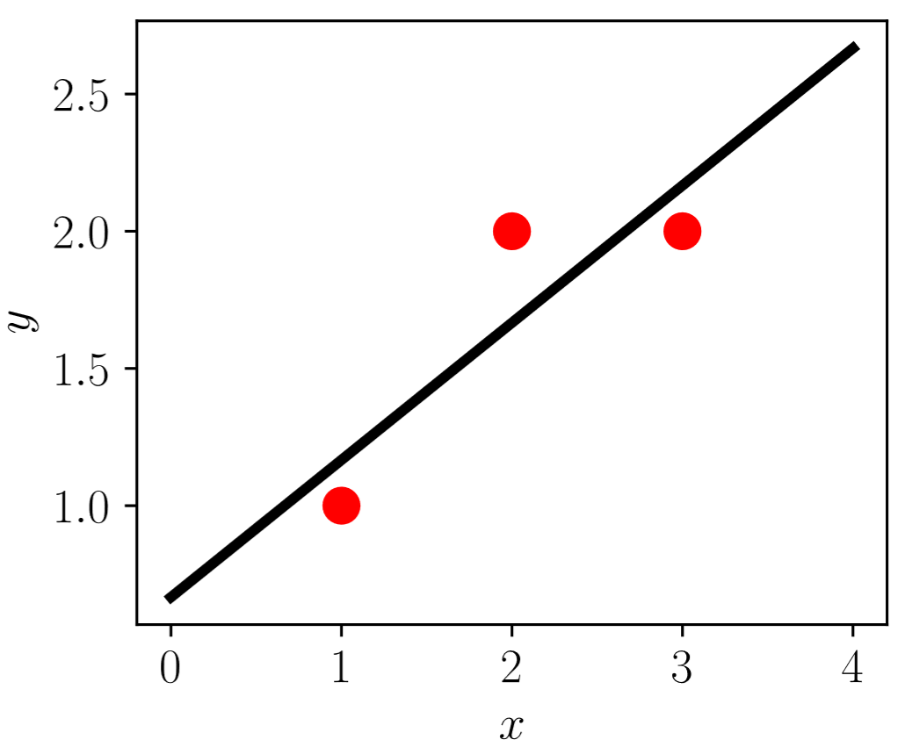

2.5 Linear Regression – Example
$$\hat{y}=XΘ \\ Θ={\left(X^{T}X\right)}^{−1}X^{T}\tilde{y}$$
Given the following values, solve the linear regression
$$x=\left(1,2,3\right), \tilde{y}=\left(1,2,2\right)$$
Example matrix (including column of ones for bias)
$$X=\left(\begin{matrix}1 & 1 \\ 2 & 1 \\ 3 & 1\end{matrix}\right), X^{T}=\left(\begin{matrix}1 & 2 & 3 \\ 1 & 1 & 1\end{matrix}\right) \\ X^{T}X=\left(\begin{matrix}14 & 6 \\ 6 & 3\end{matrix}\right), {\left(X^{T}X\right)}^{−1}=\left(\begin{matrix}0.5 & −1 \\ −1 & 2.333\end{matrix}\right)$$
Optimal weight and bias
$$Θ={\left(X^{T}X\right)}^{−1}X^{T}\tilde{y}={\left(0.5, 0.667\right)}^{T} \\ w=0.5, b=\frac{2}{3}$$

Slide 16
Contents
1 Computational Mechanics Meets Artificial Intelligence (& Introduction to PyTorch)
2.1 Definition
2.2 Data Structure
2.3 Types of Learning
2.4 Machine Learning Tasks
2.5 Linear Regression
2.8.1 Gradient Descent
2.8.1 Stochastic Gradient Descent
2.8 Optimization Techniques
2.6 Overfitting versus Underfitting
2.7 Regularization

Slide 17
2 Fundamental Concepts of Machine Learning: Introduction
Leon Herrmann
Stefan Kollmannsberger
Chair of Data Engineering in Construction
Bauhaus-Universität Weimar
Deep Learning in Computational Mechanics – an introductory course, Herrmann et al. 2025
website
book

