Slide 1
Bee Free 2
Prepared by Caleb Morse
Prepared on 2024-10-20

Slide 2
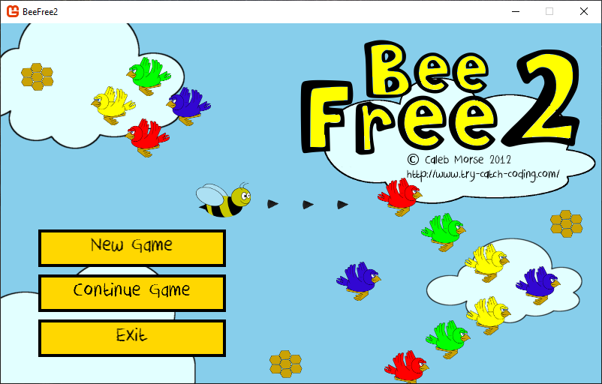
Contents
Background
Technical Overview
Selected Code Review

Slide 3

Background
Original game was written in 2012.
Was my real attempt at making a fully functional game.

Slide 4

Technical Overview
In 2012 the game was written using the Microsoft XNA framework
https://en.wikipedia.org/wiki/Microsoft_XNA
At the time, Unity was still new, and documentation for it was limited. Had pre-existing familiarity with the Visual Studio (VS) IDE toolchain which the XNA framework and associated tooling had first-class support for VS.
The XNA is a very hands-off framework when compared with Unity, it supports a basic game framework, rendering, input support, and content management (fonts, sprites, etc.).
It does not provide ‘scene management’, aka, how do I change from one type of screen to another, or a physics engine.
XNA uses the C# programming language, the same language used by the Unity platform – this was and continued to be my language of choice.

Slide 5
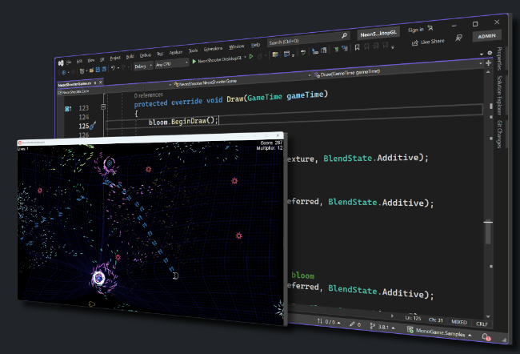

Technical Overview
When reviewing the source code and compiling it in 2024, a lot of the old XNA framework support was long since depreciated, so the game could not build.
The MonoGame (https://monogame.net/) framework was found to be an open-source reimplementation of the XNA framework. It has been used for populate games such as Streets of Rage 4, Carrion, Celeste, Stardew Valley, and more.
Another side effect of such frameworks is that they support cross platform targeting out of the box (PC, Xbox, Switch, PS 4, iOS, Android, etc).

Slide 6
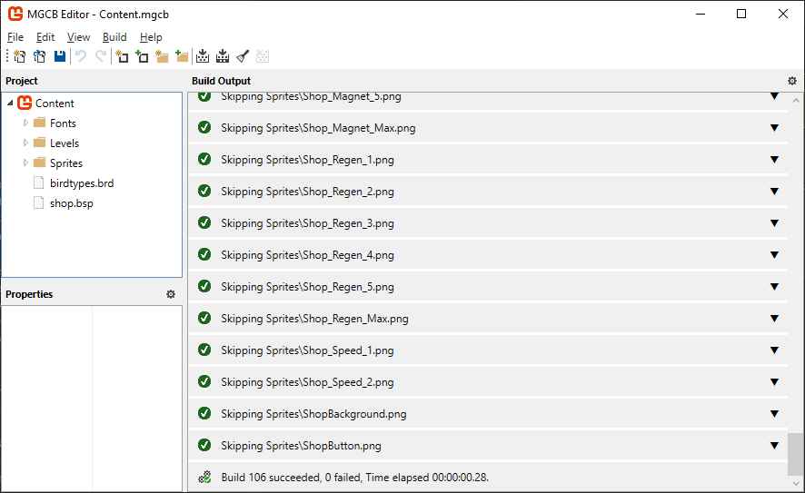
Technical Overview
Porting the game from XNA to MonoGame involved a handful of steps:
Created a new Visual Studio Solution. Trying to update in-place was going to be risky. Creating new projects and copying code and assets into the new structure made it easier to migrate.
The code moved from targeting .NET Framework 4.x to .NET 8.0. Nothing in the code was using framework libraries which had any targeting issues.
Tooling for the content pipelines was changed, so had to figure out how to use those tools and build the content for the deployment – making it available to the code at runtime.

Slide 7

Technical Overview
Be comfortable reading documentation!
This migration was only possible because documentation was read, understood, adapted, and applied to my project’s needs.
Except for very small general software needs, there won’t be exact examples you can copy paste (professionally you must worry about licensing as well). Code generative tooling such as AI/LLM models still need to integrate into your existing code and project so it must be understood.

Slide 8
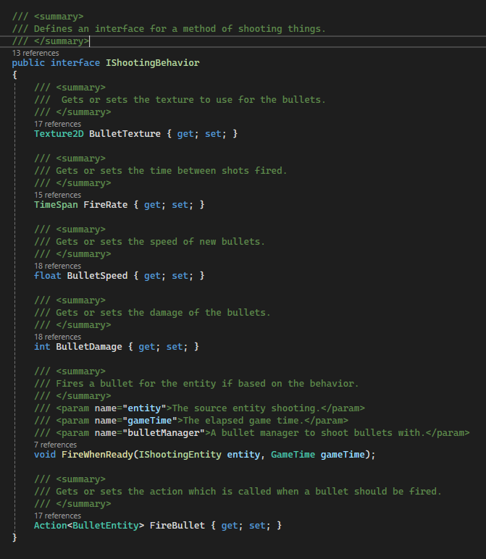
Selected Code Review
Bees and Birds have ‘shooting behavior’ which can be changed while the game is played.
This is how upgrades are handled in the shop.
This is also an example of the Strategy Pattern, a common pattern in software engineering.

Slide 9
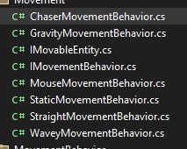
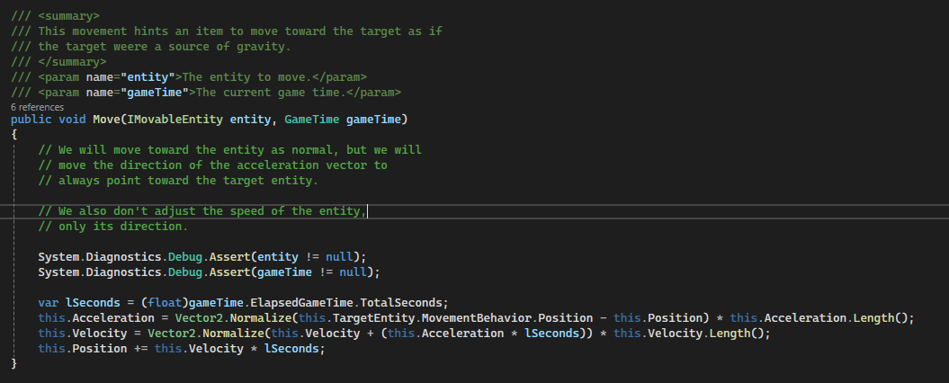
Selected Code Review
Similar behaviors exist for movement, to support different types of bird movement patterns.
There are several locations where you must understand basic 2-d coordinate math.

Slide 10
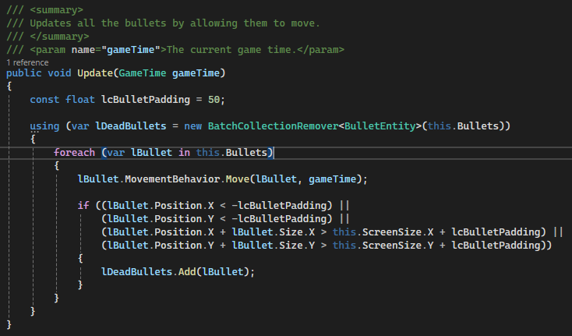
Selected Code Review
Bee stinger ‘bullets’ which go off screen need to be cleaned up to prevent memory leaking.
This is done by checking if the position of the bullet is outside of the bounds of the screen.
This would be harder if bullets moved in non-linear patterns.

Slide 11
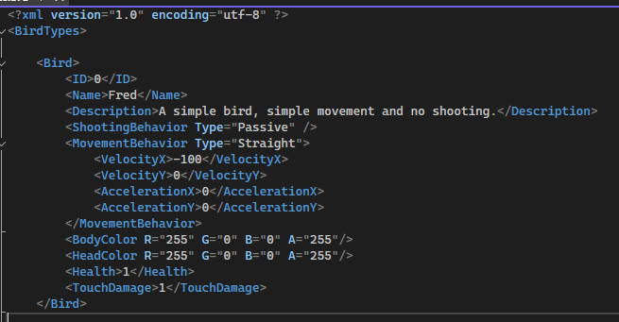
Selected Code Review
Bird data is modeled in code, but the specifics are defined in XML content files.
It is generally good to separate code from configuration and data.
Notice the various behaviors which are associated with the bird.
The body and head color are also all defined in configuration. Base bird assets are white and get colored at runtime.

Slide 12
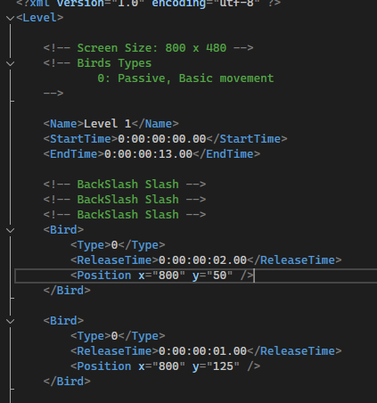
Selected Code Review
Level data is also just content files, each level having its own file.
Levels are defined with a name, a duration for how long the level is, and a list of bird release times.
Harder levels use different bird types and release patterns to simulate increases in difficulty.

