Slide 1
CMPT 370 Intermediate Software Engineering
Tutorial
28-OCT-2014

Slide 2
UML
Stands for the Unified Modeling Language.
Provides a graphical mean to visualize a system.
Still a Language: has symbols, vocabulary and rules for their use.
Creates models from different perspectives.

Slide 3
UML
UML
Structural Models
BehaviouralModels
Class Diagram
Object Diagram
Component Diagram
Composite Structure Diagram
Deployment Diagram
Package Diagram
Profile Diagram
Activity Diagram
Use Case Diagram
State Machine Diagram
Interaction
Sequence Diagram
Communication Diagram
Timing Diagram
Interaction Overview

Slide 4
Structural Diagrams
Describes a static view of the system.
Shows the structure, components, their relation (static) and identities.

Slide 5
Behavioural Diagrams
Describes the dynamics of the system.
Models interactions, sequences, dependency and other stuff that can change as the program executes.

Slide 6
Class Diagram
Shows the classes for the system.
Here, class means a template to create objects.
For each class, marks
Attributes
Methods
Relation with other classes

Slide 7
Class Diagrams: Classes
Class Name
BankAccount
attribute name [:] type type can be a basic data type or
a composite type
owner: String
balance: double
Attributes
[visibility]method-name(parameters)
Visibility:
+ Public
Private
# Protected
~ Package
/ Derived
underline Static
Methods
+ deposit(amount:double)
+ withdrawal(amount:double)
- sync()

Slide 8


Class Diagrams: Association
One class causes another to perform an action.
Bidirectional
Unidirectional
Bidirectional: http://en.wikipedia.org/wiki/File:BidirectionalAssociation.png
Unidirectional: http://en.wikipedia.org/wiki/File:UnidirectionalAssociation.png

Slide 9
Class Diagrams: Association
Association Name
Person
0..*
enrolls into
0..*
Class
+Student
Multiplicity
0..1 -> 0 or 1
0..* -> 0 to more
-> Exactly one
1..* -> One to more.
Roll Name

Slide 10
Class Diagrams: Aggregation
Specifies a “Has a” relation, in a sense of influence
Professor
1
0..*
Student
This entity “has” That entity

Slide 11
Class Diagram: Composition
Signifies a “Ownership” relation
University
1
1..*
Department
This entity “owns” That entity

Slide 12
Class Diagram: Generalization
Person
Generalization
Student
Professor
Specialization
CMPTStudent

Slide 13
Class Diagrams: Dependency
Camera
<<uses>>
Film

Slide 14
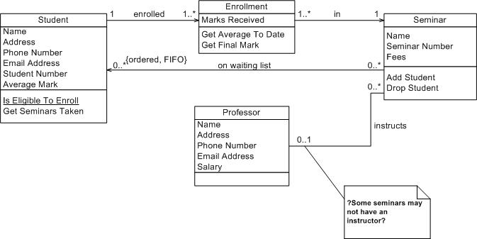
Class Diagram: Example
Source: http://www.agilemodeling.com/artifacts/classDiagram.htm

Slide 15
Classes and Attributes
Separate your elements into different entities.
Every entity belongs to a class.
Everything an entity possesses are attributes of that class.
When you can accommodate something as an attribute, don’t make it another class.
Example, if you model a person, eye colour is an entity. Though you can make eye colour into a separate class with a colour attribute, it will be over engineering.
You will find some other methods in the Design Patterns and GRASP Patterns Lecture.

Slide 16
Use Case Diagrams
Devised to Summarize the already captured Requirements
Provides
Actors
Goals
Dependencies among them

Slide 17

Use Case Diagram Components
System
Actor
Relation
Goal / Requirement

Slide 18
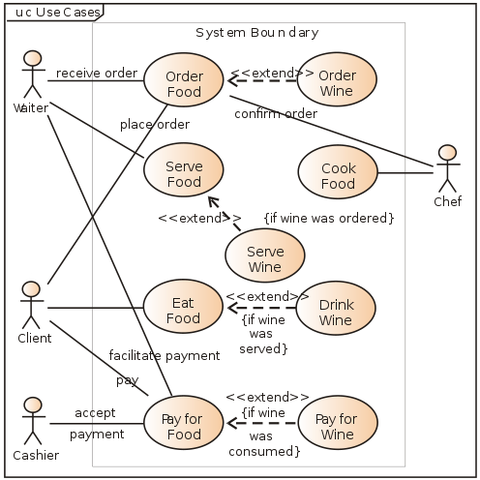
Use Case Diagrams: Example
source: http://en.wikipedia.org/wiki/File:Use_case_restaurant_model.svg

Slide 19
Sequence Diagrams
Captures the ordering of tasks in a process.
Sometimes called “Timing Diagrams”
But UML Contains a whole different type of diagram with that name.

Slide 20
Sequence Diagram: Making
Identify
All tasks in a process.
Their ordering.
Whether they notify one another.
Arrange them in chronological order.

Slide 21
Sequence Diagrams: Components
Objects
These are the performing entities – resides on the top of the diagram.
Lifelines
Vertical dotted lines drawn directly below objects.
Message Boxes
Indicates a task is being performed.
Messages
Indicates interactions.

Slide 22
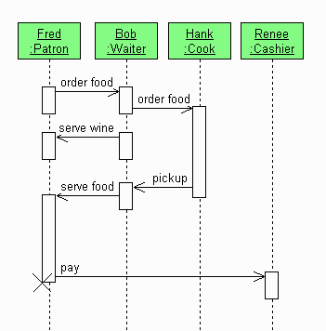
Sequence Diagram: Example
Objects
Lifelines
Boxes
This object ceases
to exist here
Source: http://en.wikipedia.org/wiki/File:Restaurant-UML-SEQ.gif

Slide 23
References for further study
AM
http://www.agilemodeling.com/essays/umlDiagrams.htm
Provides introductory information. Good for beginners.
Wikipedia
http://en.wikipedia.org/wiki/Unified_Modeling_Language
Links to individual diagrams are at the bottom of the page. Provides detailed information.
The UML Mine
http://www.uml.org/
Whatever you want to know about UML.

Slide 24
References for further study
Recommended ONLY IF you have time to spare.
Object oriented analysis and design by Grady Booch.
Available in university libraries. Too much descriptive but can provide concepts on Object Oriented Analysis and Design.
Not about UML in particular.
UML 2.0 in a nutshell by Dan Pilone
Available in the university libraries. Good for beginners.

