Slide 1
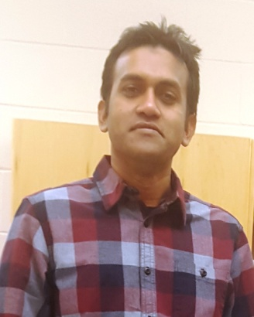
Masud Rahman
(a.k.a., Mohammad Masudur Rahman)
PhD Student
Software Research Lab
Department of Computer Science
University of Saskatchewan, Canada
Email: masud.rahman@usask.ca

Slide 2
Recap
SDLC Phases (6)
Requirement Gathering & Analysis
UML
System Design
Database
Implementation & Coding
Source code documentation
Version control systems
Software Testing
Unit & Integration testing
System Deployment
Build tools
Software Maintenance & Evolution
Clone detection, Concept Location

Slide 3
Recap on Database
Relational database basics
Structured Query Language (SQL) basics
Introduction to MySQL workbench

Slide 4
Today’s Agenda
MySQL setup & configuration
Toy Database + SQL practices
JDBC basics & practices
Technical troubleshooting
More Practices, Less Talks

Slide 5
Part I: MySQL Setup
Windows: https://dev.mysql.com/downloads/installer/
Mac OS X & Ubuntu: https://dev.mysql.com/downloads/mysql/

Slide 6
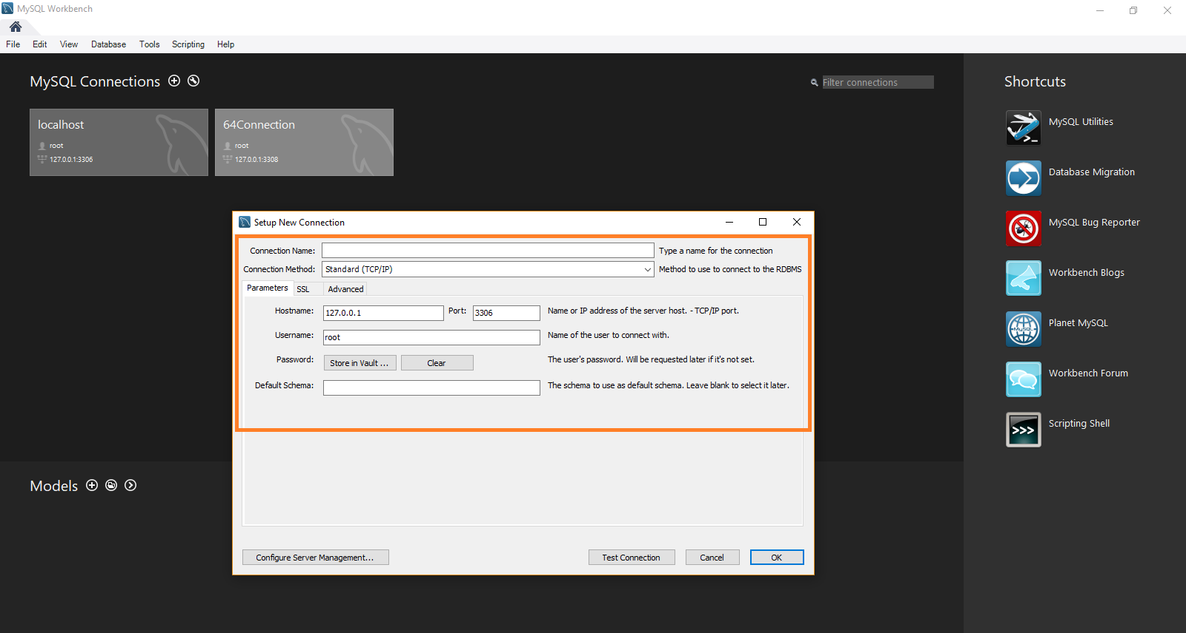
MySQL Configurations

Slide 7
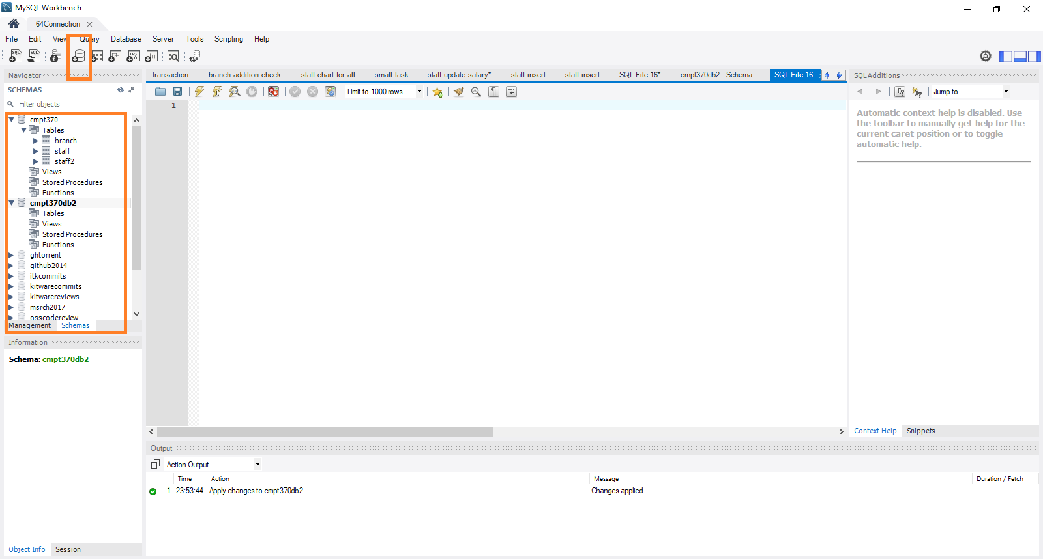
Logged in GUI
Database = Schema

Slide 8
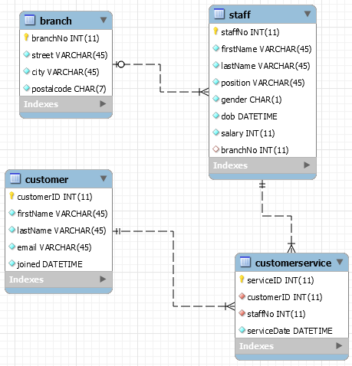
Toy Database (Bank)
https://github.com/masud-technope/CMPT370Public/tree/master/Tutorial-Sep19/toy-database

Slide 9
Develop Toy Database
Create table SQLs
https://github.com/masud-technope/CMPT370Public/tree/master/Tutorial-Sep19/toy-database/create%20tables
Insert table SQLs
https://github.com/masud-technope/CMPT370Public/tree/master/Tutorial-Sep19/toy-database/insert-data

Slide 10
Recap on CRUD
INSERT:
Insert into tableName (col₁,col₂) values (val₁,val₂)
SELECT:
Select col₁,col₂ from tableName where condition
UPDATE:
Update tableName set col₁=val₁ where condition
DELETE:
Delete from tableName where condition

Slide 11
Aggregate Functions
AVG
Select avg(col₁) from tableName where condition
MAX
Select max(col₁) from tableName where condition
MIN
Select min(col₁) from tableName where condition
SUM
Select sum(col₁) from tableName where condition
COUNT
Select count(*) from tableName where condition

Slide 12
SQL Tasks
T₁: Increase the salary of all the managers by 10%
T₂: Increase the salary of all the employees by 10% and decrease the salary of the managers by 5%
T₃: Take 10% of the manager’s salary and distribute them equally to the employees of each branch.
T₄: Who is/are the champion(s) staff in serving the customers among all the branches of the bank?
T₅: Which customer does visit the bank most frequently?
T₆: Which customer did visit all the branches of the bank?
T₇: Which customer did not visit any branch at all?

Slide 13
SQL Tasks
T₈: Which staff did not serve any customer at all?
T₉: Which branch did serve the most of the customers?
T₁₀: Fire the employees who did not serve any customers in the last month.
T₁₁:Give 50% bonus to the employee who served the maximum number of customers.
T₁₂: Fire all staff members from a branch.
T₁₃: Fire all the managers withdrawing a salary of 100K.

Slide 14
Part II: JDBC
Eclipse IDE/JDK
JDBC lib: mysql-connector-java-5.1.26-bin.jar
https://github.com/masud-technope/CMPT370Public/tree/master/Tutorial-Sep12/jdbc-demo/lib
Demo code: https://github.com/masud-technope/CMPT370Public/tree/master/Tutorial-Sep12/jdbc-demo/src/core
Connection Details:
Database URL: jdbc:mysql://localhost:3308/cmpt370
Username & Password

Slide 15
Lets Do Some Coding!
Database connection
Driver registration
Driver class: com.mysql.jdbc.Driver
Issuing connection with driver class and user credentials
CRUD Operations
Statement
PreparedStatement
executeQuery/executeUpdate
ResultSet
Parsing data from ResultSet
Iterator for ResultSet

Slide 16
Thank You!! Questions?
Masud Rahman
masud.rahman@usask.ca

