Slide 1
JavaScript
The Magic of Dynamic Web Pages
These slides are based on JavaScript course from Telerik
http://academy.telerik.com

Slide 2
Table of Contents
Introduction to JavaScript
Data Types
Operators in JavaScript
Conditional Statements
Loops
Arrays
Functions

Slide 3
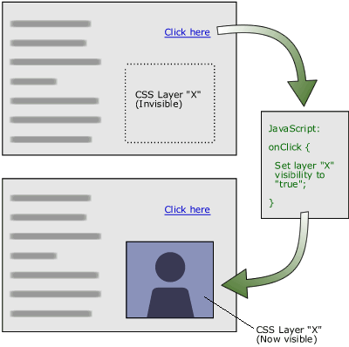
Introduction to JavaScript
Dynamic Behavior at the Client Side

Slide 4
DTHML = HTML + CSS + JavaScript
HTML defines Web sites content and the logical structure of the UI (not the visible layout and style) through semantic tags (headings, paragraphs, lists, …)
CSS defines 'rules' or 'styles' for presenting every aspect of an HTML document
Font (family, size, color, weight, etc.)
Background (color, image, position, repeat)
Position and layout (of any object on the page)
JavaScript defines dynamic behavior
Programming logic for interaction with the user, to handle events, etc.
Notes:
Keep in mind that the HTML represents the logical structure of the UI, not the visible layout and style. The use of data- attributes provides you with a mechanism for annotating the structure and adding metadata without using style class names or element identifiers.

Slide 5
JavaScript
JavaScript is a front-end scripting language developed by Netscape for client side programming
Lightweight but powerful
Can be used as object-oriented language
Embedded in HTML pages
Interpreted by the Web browser
Client-side, mobile and desktop technology
Simple and flexible
Powerful to manipulate the DOM

Slide 6
What Can JavaScript Do?
Handle client side events such as button clicked event
E.g., Changing an image on moving mouse over it
Read and write HTML elements and modify the DOM tree
E.g., Sections of a page appearing and disappearing
Validate form data
Access / modify browser cookies
Detect the user’s browser and OS
Perform computations, sorting and animation
Supports both functional and object-oriented programming style
Perform asynchronous server calls (AJAX)
Notes:
JavaScript allows interactivity such as:
Implementing form validation
React to user actions, e.g. handle keys
Content loading and changing dynamically
Performing complex calculations
Custom HTML controls, e.g. scrollable table

Slide 7
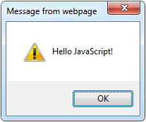
The First Script
<html>
<body>
<script type="text/javascript">
alert('Hello JavaScript!');
</script>
</body>
</html>

Slide 8
Using JavaScript Code
The JavaScript code can be placed in:
<script> tag in the head
<script> tag in the body - not recommended
External files, linked via <script> tag the head
Files usually have .js extension
Highly recommended
The .js files get cached by the browser
<script src="scripts.js" type="text/javscript">
<!– code placed here will not be executed! -->
</script>

Slide 9
JavaScript – When is Executed?
JavaScript code is executed during the page loading or when the browser fires an event
All statements are executed at page loading
Some statements just define functions that can be called later
No compile time checks
Function calls or code can be attached as "event handlers" via tag attributes
Executed when the event is fired by the browser
<img src="logo.gif" onclick="alert('clicked!')" />

Slide 10
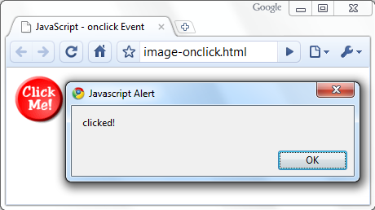
Calling a JavaScript Function from Event Handler – Example
<html>
<head>
<script type="text/javascript">
function test (message) {
alert(message);
}
</script>
</head>
<body>
<img src="logo.gif"
onclick="test('clicked!')" />
</body>
</html>

Slide 11
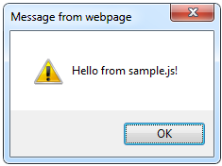
Using External Script Files
Using external script files:
External JavaScript file:
<html>
<head>
<script src="sample.js" type="text/javascript">
</script>
</head>
<body>
<button onclick="sample()" value="Call JavaScript
function from sample.js" />
</body>
</html>
external-JavaScript.html
The <script> tag is always empty.
function sample() {
alert('Hello from sample.js!')
}
sample.js

Slide 12
Standard Popup Boxes
Alert box with text and [OK] button
Just a message shown in a dialog box:
Confirmation box
Contains text, [OK] button and [Cancel] button:
Prompt box
Contains text, input field with default value:
alert("Some text here");
confirm("Are you sure?");
prompt ("enter amount", 10);

Slide 13
JavaScript Syntax
The JavaScript syntax is similar to Java and C#
Variables (typeless)
Operators (+, *, =, !=, &&, ++, …)
Conditional statements (if, else)
Loops (for, while)
Arrays (myArray[]) and associative arrays (myArray['abc'])
Functions (can return value)
Function variables

Slide 14
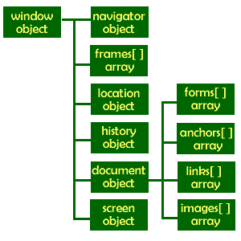
The Built-In Browser Objects

Slide 15
Built-in Browser Objects
The browser provides some read-only data via:
window
The top node of the DOM tree
Represents the browser's window
document
holds information the current loaded document
screen
Holds the user’s display properties
navigator
Holds information about the browser

Slide 16
DOM Hierarchy – Example
window
navigator
screen
document
history
location

Slide 17
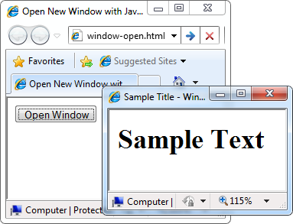
Opening New Window – Example
window.open()
window-open.html
var newWindow = window.open("", "sampleWindow",
"width=300, height=100, menubar=yes,
status=yes, resizable=yes");
newWindow.document.write(
"<html><head><title>
Sample Title</title>
</head><body><h1>Sample
Text</h1></body>");

Slide 18
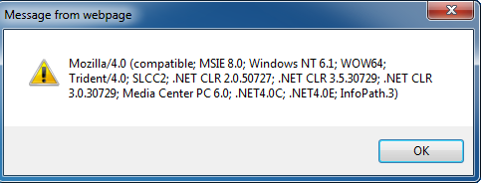
The Navigator Object
alert(window.navigator.userAgent);
The browser window
The navigator in the browser window
The userAgent (browser ID)

Slide 19

The Screen Object
The screen object contains information about the display
window.moveTo(0, 0);
x = screen.availWidth;
y = screen.availHeight;
window.resizeTo(x, y);

Slide 20
Document and Location
document object
Provides some built-in arrays of specific objects on the currently loaded Web page
document.location
Used to access the currently open URL or redirect the browser
document.links[0].href = "yahoo.com";
document.write(
"This is some <b>bold text</b>");
document.location = "http://www.yahoo.com/";

Slide 21
Other JavaScript Objects

Slide 22
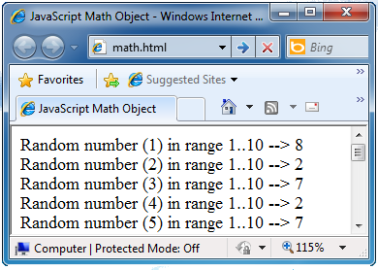
The Math Object
The Math object provides some mathematical functions
math.html
for (var i=1; i<=20; i++) {
var x = Math.random();
x = 10*x + 1;
x = Math.floor(x);
document.write(
"Random number (" +
i + ") in range " +
"1..10 --> " + x +
"<br/>");
}

Slide 23
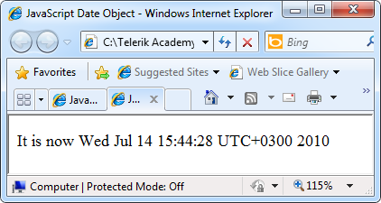
The Date Object
The Date object provides date / calendar functions
dates.html
var now = new Date();
var result = "It is now " + now;
document.getElementById("timeField")
.innerText = result;
...
<p id="timeField"></p>

Slide 24
Timers: setTimeout()
Make something happen (once) after a fixed delay
var timer = setTimeout('bang()', 5000);
5 seconds after this statement executes, this function is called
clearTimeout(timer);
Cancels the timer

Slide 25
Timers: setInterval()
Make something happen repeatedly at fixed intervals
var timer = setInterval('clock()', 1000);
This function is called continuously per 1 second.
clearInterval(timer);
Stop the timer.

Slide 26
Timer – Example
timer-demo.html
<script type="text/javascript">
function timerFunc() {
var now = new Date();
var hour = now.getHours();
var min = now.getMinutes();
var sec = now.getSeconds();
document.getElementById("clock").value =
"" + hour + ":" + min + ":" + sec;
}
setInterval('timerFunc()', 1000);
</script>
<input type="text" id="clock" />

Slide 27

Debugging JavaScript using Browser Development Tools
Modern browsers have Development Tools with built-in JavaScript debugger and console where errors in scripts are reported
Supports breakpoints, watches, JavaScript console editor
Very useful for CSS and HTML too
You can edit all the document real-time: CSS, HTML, etc
Shows how CSS rules apply to element
Shows Ajax requests and responses
Alternative is Firebug – Firefox add-on for debugging JavaScript, CSS, HTML

Slide 28
JavaScript Console Object
The console object exists only if there is a debugging tool that supports it
Used to write log messages at runtime
Methods of the console object:
debug(message)
info(message)
log(message)
warn(message)
error(message)

Slide 29
Data Types in JavaScript

Slide 30
Declaring Variables
When declaring a variable we:
Specify its name (use a descriptive name)
May give it an initial value
The type is identified by the value
Names in JavaScript are case-sensitive
The syntax is the following:
Example:
var <identifier> [= <initialization>];
var height = 200;
Notes:
A variable is a:
Placeholder of information that can usually be changed at run-time
A piece of computer memory holding some value
Variables allow you to:
Store information
Retrieve the stored information
Manipulate the stored information
Identifiers
Should have a descriptive name
It is recommended to use only Latin letters
Should be neither too long nor too short
Names in JavaScript are case-sensitive
Small letters are considered different than the capital letters

Slide 31
Local and Global Variables
Local variables
Declared with the keyword var
Global variables
Declared without the keyword var
Always declare variables with var
Bad practices – never do this!
var a = 5; // a is local in the current scope
a = 5; // the same as window.a = 5;

Slide 32
JavaScript Data Types
JavaScript is a Loosely Typed language
All variables are declared with the keyword var
The type of a variable can be changed at runtime
var count = 5; // variable holds an integer value
count = 'hello'; // the same variable now holds a string
var name = 'Ali Dahak'; // variable holds a string
var grade = 5.25 // grade holds a floating-point number

Slide 33
Primitive types
There are five primitive data types in JavaScript:
number
string
boolean
null
undefined
Everything else is an object

Slide 34
String in JavaScript
A string is a sequence of characters
Text enclosed in single (' ') or double quotes (" ")
var str1 = "Some text saved in a string variable";
var str2 = 'text enclosed in single quotes';
String is a primitive type
It is copied / passed by value
String is also immutable
Every time a string is changed, a new string is created

Slide 35
String Methods
string.length
Returns the number of characters in the string
Indexer (string[index])
Gets a single-character string at location index
If index is outside the range of string characters, the indexer returns undefined
string[-1] or string[string.length]
charAt(index)
Gets a single-character string at location index
Much like the indexer

Slide 36
String Methods (2)
string.concat(string2)
Returns a new string – the concatenation of the two strings or use +
var strConcat1 = str1 + str2;
string.contains(substring)
Determines if a substring in present in the string
Returns True/False
str.startsWith(substr) and str.endsWith(substr)
Determines if str starts/ends with substring
Returns True/False

Slide 37
String Methods (3)
string.indexOf(substring [,position])
Returns the left-most occurrence of substring in string, that is after position
Position is optional and has default value of 0
If string doesn't contain substring, returns -1
string.lastIndexOf(substring [,position])
Returns the right-most occurrence of substring in string, that is before position
Position is optional, default value is string.length
If string doesn't contain substring, returns -1

Slide 38
String Methods (4)
string.split(separator)
Splits the string by separator and returns an array of strings, containing the separated parts
Separator can be a regular expression
string.trim()
Removes whitespace from the beginning and end of the string
str.trimLeft(), str.trimRight()
Remove whitespace from the left/right side of the string

Slide 39
String Methods (5)
string.substr(start, length)
Returns a substring, starting from start and counting length characters
length is optional
string.substring(start, end)
Returns a substring, starting from start and ending at end
string.valueOf()
Returns the primitive value of the object string

Slide 40
Convert a number to a string
Use number’s method (toString)
Use String function
str = num.toString();
str = String(num);
Convert a string to a number
Use the Number function.
Use the + prefix operator.
Use the parseInt function.
num = Number(str);
num = +str;

Slide 41


Undefined and Null Values
Understanding 'undefined' in JavaScript

Slide 42
undefined vs. null
In JavaScript, undefined means a variable has been declared but has not yet been assigned a value, e.g.,:
var testVar; alert(testVar); //shows undefined alert(typeof testVar); //shows undefined
null is an assignment value. It can be assigned to a variable as a representation of no value:
var testVar = null;
alert(testVar); //shows null
alert(typeof testVar); //shows object
From the preceding examples, it is clear that undefined and null are two distinct types: undefined is a type itself (undefined) while null is an object.
Notes:
http://stackoverflow.com/questions/5076944/what-is-the-difference-between-null-and-undefined-in-javascript
var x = 5;
x = undefined;
alert(x); // undefined
x = null;
alert(x); // null

Slide 43
undefined
The default value for variables and parameters.
The value of missing members in objects.
undefined is a data type and null is a value
SO use
undefined to compare the variable data type
Notes:
More info @ http://stackoverflow.com/questions/5076944/what-is-the-difference-between-null-and-undefined-in-javascript
There is one difference between undefined And null in javascript :: undefined is a data type and null is a value
defined empty variable is null of datatype undefined
Both of them are representing a value of a variable with no value
AND null doesn't represent a string that has no value - empty string-
Like
var a = '';
console.log(typeof a); // string
console.log(a == null); //false
console.log(a == undefined); // false
Now if
var a;
console.log(a == null); //true
console.log(a == undefined); //true
BUT
var a;
console.log(a === null); //false
console.log(a === undefined); // true
SO each one has it own way to use
undefined use it to compare the variable data type
null use it to empty a value of a variable
var a = 'javascript';
a = null ; // will change the type of variable "a" from string to undefined

Slide 44
NaN
Special number: Not a Number
Result of undefined or erroneous operations
Toxic: any arithmetic operation with NaN as an input will have NaN as a result
NaN is not equal to anything, including NaN
NaN === NaN is false
NaN !== NaN is true

Slide 45
Checking a Variable Type
The variable type can be checked at runtime:
var x = 5;
console.log(typeof(x)); // number
console.log(x); // 5
x = new Number(5);
console.log(typeof(x)); // object
console.log(x); // Number {}
x = null;
console.log(typeof(x)); // object
x = undefined;
console.log(typeof(x)); // undefined

Slide 46
typeof
The typeof prefix operator returns a string identifying the type of a value.
type | typeof
object | 'object'
function | 'function'
array | 'object'
number | 'number'
string | 'string'
boolean | 'boolean'
null | 'object'
undefined | 'undefined'

Slide 47

Operators in JavaScript
Arithmetic, Logical, Comparison, Assignment, Etc.

Slide 48
Categories of Operators in JS
Category | Operators
Arithmetic | + - * / % ++ --
Logical | && || ^ !
Binary | & | ^ ~ << >>
Comparison | == != < > <= >= === !==
Assignment | = += -= *= /= %= &= |= ^= <<= >>=
String concatenation | +
Other | . [] () ?: new
http://www.w3schools.com/js/js_operators.asp
Notes:
Operators in JavaScript :
Unary – take one operand
Binary – take two operands
Ternary (?:) – takes three operands
Except for the assignment operators, all binary operators are left-associative
The assignment operators and the conditional operator (?:) are right-associative

Slide 49
Arithmetic Operators – Example
var squarePerimeter = 17;
var squareSide = squarePerimeter / 4.25;
var squareArea = squareSide * squareSide;
console.log(squareSide); // 4.25
console.log(squareArea); // 18.0625
var a = 5;
var b = 4;
console.log( a + b ); // 9
console.log( a + b++ ); // 9
console.log( a + b ); // 10
console.log( a + (++b) ); // 11
console.log( a + b ); // 11
console.log(12 / 3); // 4
console.log(11 / 3); // 3.6666666666666665

Slide 50
Arithmetic Operators – Example (2)
console.log(11 % 3); // 2
console.log(11 % -3); // 2
console.log(-11 % 3); // -2
console.log(1.5 / 0.0); // Infinity
console.log(-1.5 / 0.0); // -Infinity
console.log(0.0 / 0.0); // NaN
var x = 0;
console.log(5 / x);

Slide 51
Assignment Operators
Assignment operators are used to assign a value to a variable
=, +=, -=, %=, ...
Assignment operators example:
var x = 6;
var y = 4;
console.log(y *= 2); // 8
var z = y = 3; // y=3 and z=3
console.log(z); // 3
console.log(x += 4); // 10
console.log(x /= 2); // 5
console.log(x %= 2); // 1

Slide 52

Comparison Operators
Comparison operators are used to compare variables
==, <, >, >=, <=, !=, ===, !==
Comparison operators example:
var a = 5;
var b = 4;
console.log(a >= b); // True
console.log(a != b); // True
console.log(a == b); // False
console.log(0 == ""); // True
console.log(0 === ""); //False

Slide 53
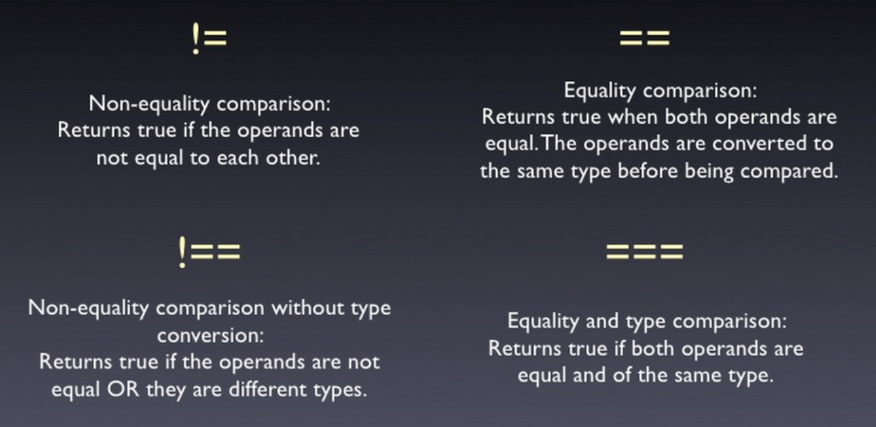
== vs. ===

Slide 54
Evils of type coercion
'' == '0' // false
0 == '' // true
0 == '0' // true
false == 'false' // false
false == '0' // true
false == undefined // false
false == null // false
null == undefined // true
' \t\r\n ' == 0 // true
1 == [1] // true
true == [1] // true
true == [true] // false

Slide 55
Other Operators
Conditional operator ?: has the form
(if b is true then the result is x else the result is y)
The new operator is used to create new objects
The typeof operator returns the type of the object
this operator references the current context
In JavaScript the value this depends on the current scope
b ? x : y

Slide 56
Other Operators – Example
Using some other operators:
var a = 6;
var b = 4;
console.log(a > b ? "a>b" : "b>=a"); // a>b
console.log((long) a); // 6
var c = b = 3; // b=3; followed by c=3;
console.log(c); // 3
console.log(a is int); // True
console.log((a+b)/2); // 4
console.log(typeof(int)); // System.Int32

Slide 57
Expressions
Expressions are sequences of operators, literals and variables that are evaluated to some value
Examples:
var r = (150-20) / 2 + 5; // r=70
// Expression for calculation of circle area
var surface = Math.PI * r * r;
// Expression for calculation of circle perimeter
var perimeter = 2 * Math.PI * r;

Slide 58
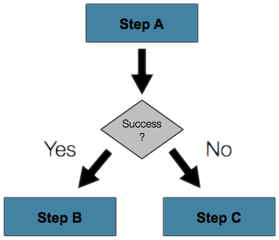
Conditional Statements
Implementing Control Logic in JavaScript

Slide 59

The if Statement – Example
var num1 = parseInt(document.
getElementById('num1').value);
var num2 = parseInt(document.
getElementById(‘num2').value);
var biggest = num1;
if (num2 > biggest)
{
biggest = num2;
}
console.log('The biggest number is: ' + biggest);
}

Slide 60
if-else Statement – Example
Checking a number if it is odd or even
var s = document.getElementById('number-tb').value;
var number = parseInt(s);
if (number % 2 === 0)
{
console.log('This number is even.');
}
else
{
console.log('This number is odd.');
}

Slide 61
The switch-case Statement
Selects for execution a statement from a list depending on the value of the switch expression
switch (day)
{
case 1: console.log('Monday'); break;
case 2: console.log('Tuesday'); break;
case 3: console.log('Wednesday'); break;
case 4: console.log('Thursday'); break;
case 5: console.log('Friday'); break;
case 6: console.log('Saturday'); break;
case 7: console.log('Sunday'); break;
default: console.log('Error!'); break;
}

Slide 62

False-like conditions
These values are always false
false
0 (zero)
"" (empty string)
null
undefined
NaN
All other values are true
Info: http://www.sitepoint.com/javascript-truthy-falsy/

Slide 63

while (…) do { … } Loop
Execute Blocks of Code Multiple Times

Slide 64
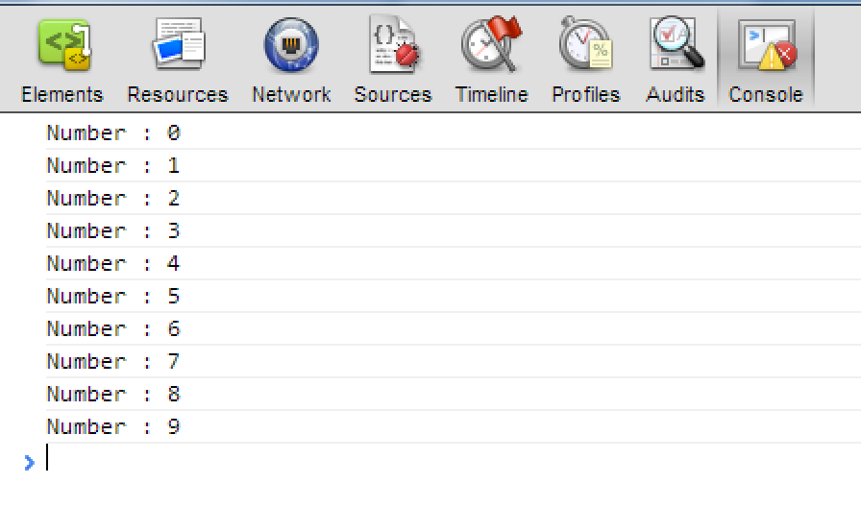
While Loop – Example
var counter = 0;
while (counter < 10){
console.log("Number : "+ counter);
counter++;
}

Slide 65
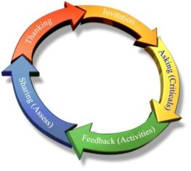
Using Do-While Loop
Another loop structure is:
The block of statements is repeated
While the boolean loop condition holds
The loop is executed at least once
do{
statements;
}
while (condition);

Slide 66
For Loops
The typical for loop syntax is:
Consists of
Initialization statement. Executed once, just before the loop is entered
Test expression that is evaluated to boolean
Update statement
Loop body block
for (initialization; test; update){ statements; }

Slide 67
Simple for Loop – Example
A simple for-loop to print the numbers 0…9:
for (var number = 0; number < 10; number++){
console.log(number + " ");
}
A simple for-loop to calculate n!:
var factorial = 1;
for (var i = 1; i <= n; i++){
factorial *= i;
}

Slide 68
for-in Loop
for-in loop iterates over the properties of an object
When the object is an array, a list for-in iterates over their elements
When the object is not an array, for-in iterates over its properties

Slide 69
for-in Loop (2)
Iterating over the elements of an array
Iterating over the properties of document
var arr = [1,2,3,4,5,6];
for(var i in arr){ console.log(arr[i]); }
//1, 2, 3, 4, 5, 6
for(var prop in document){ console.log(document[prop])}
//http://localhost:64765/xxx%20for-in-loop.html
//function querySelector() { [native code] }
//function querySelectorAll() { [native code] }
//function evaluate() { [native code] }

Slide 70
For in statement
Iterate through all of the members of an object:
for (name in object) {
if (object.hasOwnProperty(name)) {
// within the loop,
// name is the key of current member
// object[name] is the current value
}
}
It is always better to use Object.keys instead.

Slide 71
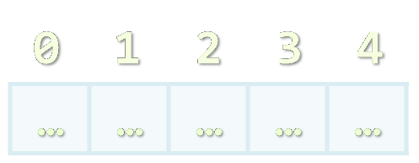
Arrays
Processing Sequences of Elements

Slide 72
What are Arrays?
An array is a sequence of elements
The order of the elements is fixed
Does not have fixed size
Can get the current length (Array.length)
Element of an array
0 1 2 3 4
Element index
Array of 5 elements
… | … | … | … | …

Slide 73
Declaring Arrays
Declaring an array in JavaScript (JS is typeless)
// Array holding integers
var numbers = [1, 2, 3, 4, 5];
// Array holding strings
var weekDays = ["Monday", "Tuesday", "Wednesday",
"Thursday", "Friday", "Saturday", "Sunday"]
// Array of different types
var mixedArr = [1, new Date(), "hello"];
// Array of arrays (matrix)
var matrix = [
["0,0", "0,1", "0,2"],
["1,0", "1,1", "1,2"],
["2,0", "2,1", "2,2"]];

Slide 74

Declare and Initialize Arrays
Initializing an array in JavaScript can be done in three ways:
Using new Array(elements):
Using new Array(initialLength):
Using array literal (recommended):
var arr = new Array(1, 2, 3, 4, 5);
var arr = new Array(10);
var arr = [1, 2, 3, 4, 5];

Slide 75
How to Access Array Element?
Array elements are accessed using the square brackets operator [] (indexer)
Array indexer takes element’s index as parameter in the range 0 … length-1
The first element has index 0
The last element has index length-1
Array elements can be retrieved and changed by the [] operator

Slide 76

Reversing an Array – Example
Reversing the elements of an array
var array = [1, 2, 3, 4, 5];
// Get array size
var length = array.length; // 5
// Declare and create the reversed array
var reversed = new Array(length);
// Initialize the reversed array
for (var index = 0; index < length; index++) {
reversed[length-index-1] = array[index];
}

Slide 77
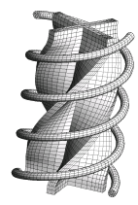
Processing Arrays Using for Loop – Examples
Printing array of integers in reversed order:
Initialize all array elements with their corresponding index number:
var array = [1, 2, 3, 4, 5];
for (var i = array.length-1; i >= 0; i--) {
console.log(array[i]);
}
// Result: 5 4 3 2 1
for (var index = 0; index < array.length; index++) {
array[index] = index;
}

Slide 78
Example: Processing Arrays Using for-in Loop
Print all elements of an array of strings:
var capitals =[
"Sofia",
"Washington",
"London",
"Paris"
];
for (var i in capitals)
{
console.log(capitals[i]);
}

Slide 79
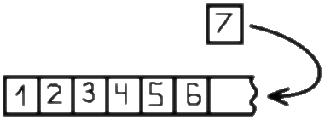
Dynamic Arrays
All arrays in JavaScript are dynamic
Their size can be changed at runtime
New elements can be inserted to the array
Elements can be removed from the array
Methods for array manipulation:
array.push(element)
Inserts a new element at the tail of the array
array.pop()
Removes the element at the tail
Returns the removed element

Slide 80
Dynamic Arrays (2)
Methods for array manipulation (cont.)
array.unshift(element)
Inserts a new element at the head of the array
array.shift()
Removes and returns the element at the head
var numbers = [1, 2, 3, 4, 5];
console.log(numbers.join("|")); // result: 1|2|3|4|5
var tail = number.pop(); // tail = 5;
console.log(numbers.join("|")); // result: 1|2|3|4
number.unshift(0);
console.log(numbers.join("|")); // result: 0|1|2|3|4
var head = number.shift(); // head = 0;
console.log(numbers.join("|")); // result: 1|2|3|4

Slide 81
Deleting Elements
delete array[number]
Removes the element, but leaves a hole in the numbering.
array.splice(number, 1)
Removes the element and renumbers all the following elements.
myArray = ['a', 'b', 'c', 'd'];
delete myArray[1];
// ['a', undefined, 'c', 'd']
myArray.splice(1, 1); // ['a', 'c', 'd']

Slide 82
Sorting Arrays
array.sort()
Sorts the elements of the array ascending
Keep in mind that array.sort uses the string representation of the elements!
i.e. the number 5 is compares as the string "5"
Not quite sorted, right?
var numbers = [5, 4, 2, 3, 1, 4, 5, 6, 7];
numbers.sort();
console.log(numbers.join(", "));
// result: 1, 2, 3, 4, 4, 5, 5, 6, 7
var numbers = [5,4,23,2];
numbers.sort();
console.log(numbers.join(", ")); // result: 2, 23, 4, 5

Slide 83
Other Array Functions
array.reverse()
Returns a new arrays with elements in reversed order
array.splice(index, count, elements)
Adds and / or removes elements from an array
array.concat(elements)
Inserts the elements at the end of the array and returns a new array
array.join(separator)
Concatenates the elements of the array

Slide 84
Other Array Functions (2)
array.filter(condition)
Returns a new array with the elements that satisfy condition
array.forEach(function(item){})
Iterates through the array and executes the function for each item
array.map
See posted examples
array.reduce
See posted examples

Slide 85
Other Array Functions (3)
array.indexOf(element)
Returns the index of the first match in the array
Returns -1 is the element is not found
array.lastIndexOf(element)
Returns the index of the first match in the array
Returns -1 is the element is not found
indexOf() and lastIndexOf() do not work in all browsers
Need to add a predefined functionality

Slide 86
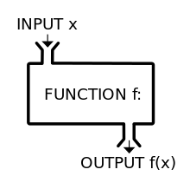
Functions
Reusable parts of Code

Slide 87

Why to Use Functions?
More manageable programming
Split large problems into small pieces
Better organization of the program
Improve code readability and understandability
Enhance abstraction
Avoiding repeating code
Improve code maintainability
Code reusability
Using existing functions several times

Slide 88
Functions
Functions can encapsulate an expression
Functions can be stored in variables
Functions may have parameters
Functions can be invoked
Functions can grow the language
A function can take many parameters, or no parameters
Notes:
If it takes more than one parameter, the parameter names are separated with commas.
A parameter name is like a variable inside the function.
When a function is called, the argument values are assigned to the parameters.

Slide 89
Declaring and Creating Functions
Each function has a name
It is used to call the function
Describes its purpose
Functions in JavaScript does not have return type
Function name
Function body
function printInfo(){
console.log(“Qatar University");
console.log("www.qu.edu.qa");
}

Slide 90
Ways of Defining a Function
Functions can be defined in three ways:
Using the constructor of the Function object
By function declaration
By function expression
var print = new Function("console.log('Hello')");
function print() {console.log('Hello')};
var print = function() {console.log('Hello')};

Slide 91
Defining and Using Function Parameters
function printSign(number) {
if (number > 0)
console.log("Positive");
else if (number < 0)
console.log("Negative");
else
console.log("Zero");
}
Function’s behavior depends on its parameters
Parameters can be of any type
Number, String, Object, Array, etc.
Even Function

Slide 92
function (parameter) { return expression; }
var double = function (number) { return number * 2;}
double(212); // call function
var average = function (a, b)
{ return (a + b) / 2; }
average(10, 20); // call function

Slide 93
arguments Object
Every function have a special object called arguments
It holds information about the function and all the parameters passed to the function
No need to be explicitly declared
It exists in every function
function printArguments(){
for(var i in arguments){
console.log(arguments[i]);
}
}
printArguments(1,2,3,4); //1, 2, 3, 4

Slide 94
Returning Values from Functions
Functions in JavaScript may or may not return a value
The return value can be of any type
Number, String, Object
If no value is returned, the caller gets value "undefined"
var head = arr.shift();
var price = getPrice() * quantity * 1.20;
var noValue = arr.sort();

Slide 95
The return Statement
The return statement:
Immediately terminates function’s execution
Returns specified expression to the caller
Example:
To terminate function execution, use just:
Return can be used several times in a function body
To return a different value in different cases
return -1;
return;

Slide 96
Sum Even Numbers– Example
Calculate the sum of all even numbers in an array
function sum(numbers){
var sum = 0;
for (var i in numbers) {
if(numbers[i]%2 === 0){
sum += numbers[i];
}
}
return sum;
}
if (!numbers[i]%2) is also valid

Slide 97
Function Scope
Every variable has its scope of usage
A scope defines where the variable is accessible
Generally there are local and global scope
<script>
var arr = [1, 2, 3, 4, 5, 6, 7];
function countOccurences (value){
var count = 0;
for (var i=0; i < arr.length; i++){
if (arr[i] == value){
count++;
}
}
return count;
}
</script>
arr is in the global scope (it is accessible from anywhere)
count is declared inside countOccurences and it can be used only inside it
Notes:
Try removing the "var" before count

Slide 98
Scope
Parameters and variables defined inside of a function are not visible outside of the function
There is no block-level scope in JavaScript. E.g., a variable declared inside a block, such as if or loop block, is visible in the whole function
Notes:
Functions can be created inside of other functions
The parameters and variables of an outer function are visible to the inner function

Slide 99
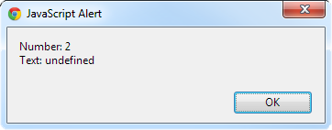
Function Overloading
JavaScript does not support function overloading
i.e. only one function with a specified name can exists in the same scope
The second print overwrites the first one
function print(number){
console.log("Number:" + number);
}
function print(number,text){
console.log("Number:" + number + "\nText: " + text);
}
print(2);

Slide 100
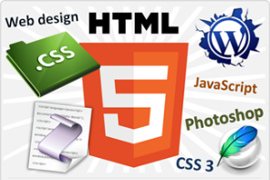
Online JavaScript Rescources
Best JavaScript tutorial:
http://www.w3schools.com/js
Mozilla JavaScript learning links
https://developer.mozilla.org/en-US/learn/javascript
Douglas Crockford – Videos about JavaScript http://www.youtube.com/results?search_query=Douglas+Crockford
Notes:
http://yuiblog.com/crockford/
http://javascript.crockford.com/
"Web Design with HTML 5, CSS 3 and JavaScript" course @ Telerik Academy
html5course.telerik.com
Telerik Software Academy
academy.telerik.com
Web Design with HTML5, CSS3 and JavaScript
All Software Academy courses in one place
HTML, CSS, JavaScript and JS Libraries
http://academy.telerik.com/student-courses/ archive/web-design-html-5-css-3-javascript
Web Client-Side Development
A basic and very similar course
http://academy.telerik.com/student-courses/archive/web-client-side-development

