Slide 1




Generalized Uncertainty-Based Evidential Fusion
with Hybrid Multi-Head Attention for
Weak-Supervised Temporal Action Localization
Yuanpeng He, Lijian Li, Tianxiang Zhan, Wenpin Jiao, Chi-Man Pun
School of Computer Science, Peking University, Beijing, China
Department of Computer and Information Science, University of Macau, Macau, China

Slide 2
Outline
Introduction
Motivations
Contributions
Methods
Experiments
Conclusions
Notes:
In this presentation, we'll discuss five main points: Introduction of weakly-supervised temporal action localization,our research motivation, contributions, method, experiments, and conclusions.
Let's begin.

Slide 3
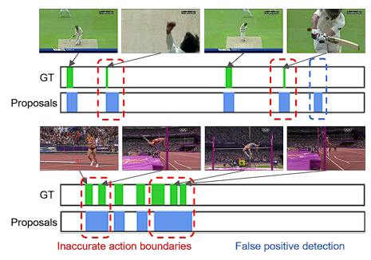
Background
Introduction
Temporal action localization (TAL), which is one of the main tasks of video understanding, aims at localizing the start and end timestamps of action instances in an untrimmed video and classifying them.
Fully-supervised methods require a huge amount of fine-grained frame-level annotations, which need manual labeling and have annotation bias of annotators.
To address above issue, weakly-supervised temporal action localization (WTAL) is proposed, which only require easily collected video-level categorical labels.

Slide 4
Background
Existing Methods and Motivation
Four types of existing methods
MIL-based methods
Attention methods
Uncertainty-based methods
Pseudo-label-based methods
The shortage of previous researches
The primary challenge faced by current WS-TAL methods is action-background ambiguity.
Pre-trained model to extract RGB and optical flow features, which encompass a large quantity of redundant information irrelevant to the task.
Notes:
MIL-based methods: They choose top k instances with the highest classification scores and then average among these selected instances. It should be noted that here we use the original classification score as its value is able to correctly reflect the likelihood of containing certain action instances.
Attention methods: They combine the classification scores of all clip proposals and learn an importance weight to rank different clip proposals. Intuitively, these clip proposals are not all relevant to the action class and we could learn an attention weight to highlight the discriminative clip proposals and suppress the background clip proposals.
The primary challenge faced by current WS-TAL methods is action-background ambiguity. Specifically, during the training process, the classifier tends to pay attention to salient features, leading to the misclassification of background snippets as actions, while disregarding less prominent action snippets. This tendency enables the model to only take a fraction of action snippets rather than an entire action instance into consideration, resulting in inaccurate localization and classification results. Moreover, most existing WS-TAL methods directly employ a pre-trained I3D model to extract RGB and optical flow features, which encompass a large quantity of redundant information irrelevant to the task, consequently impeding performance.

Slide 5
Contributions
We propose a Generalized Uncertainty-Based Evidential Fusion module for the WS-TAL task, which can effectively eliminate action-background ambiguity problem by fusing snippet-level evidences.
A Hybrid Multi-Head Attention module is proposed to enhance the extracted RGB and optical flow features, aligning the feature distribution more appropriately with the requirements of the WS-TAL task.
The results of a large number of experiments conducted on the THUMOS14 dataset demonstrate the excellent performance of our proposed method, surpassing recent state-of-the-art methods.
Notes:
To address the action-background ambiguity problem, we propose a Generalized Uncertainty-Based Evidential fusion (GUEF) module for WS-TAL, inspired by Traditional Evidential Deep Learning (TEDL), which is capable of obtaining the uncertainty of predictions by computing the uncertainty measure of each snippet-level evidence to filter useless background snippets. Within the GUEF module, the disturbance of background information is quantified by video-level uncertainty, which can adaptively eliminate redundant background snippets. Additionally, the snippet-level uncertainty can be spontaneously deduced to be video-level uncertainty. Therefore, the action-background ambiguity problem is alleviated effectively with this module. Besides, a Hybrid Multi-Head Attention (HMHA) is proposed, which effectively strengthens RGB and optical flow features extracted by the pre-trained I3D model by aligning their feature distribution with the WS-TAL task.

Slide 6
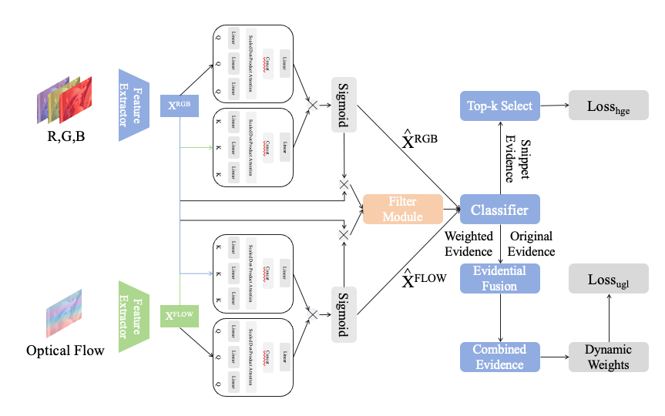
Methods
Two main design of the Methodology
Hybrid Multi-Head Attention
Deep Learning with Generalized Uncertainty-Based Evidential Fusion

Slide 7
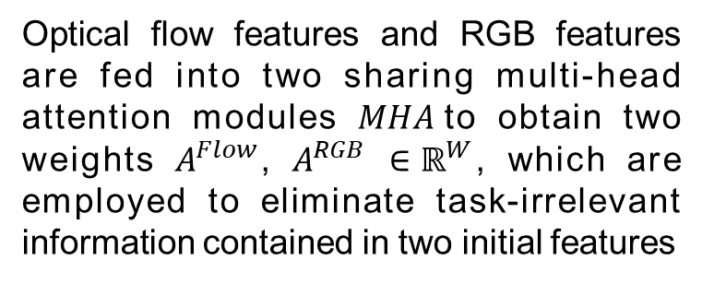
Methods
Hybrid Multi-Head Attention
Optical flow features and RGB features are fed into two sharing multi-head attention modules $MHA$to obtain two weights $A^{Flow}$, $A^{RGB}$ $∈ℝ^{W}$, which are employed to eliminate task-irrelevant information contained in two initial features
$$A^{Flow},A^{RGB}=MHA\left(X^{Flow}\right),MHA\left(X^{RGB}\right)$$
$${\overset{^}{X}}^{Flow}=X^{Flow}⊗σ\left(A^{Flow}⊗A^{RGB}\right)$$
$${\overset{^}{X}}^{RGB}=X^{RGB}⊗σ\left(A^{RGB}⊗A^{Flow}\right)$$

Slide 8

Methods
Hybrid Multi-Head Attention
With optimized optical flow ${\overset{^}{X}}^{Flow}$and RGB features ${\overset{^}{X}}^{RGB}$, we intend to use a filtering module $f_{attn}$ which consists of three 1D convolution layers and a sigmoid function, to extract their temporal attention weights.
$${\overset{^}{A}}^{Flow},{\overset{^}{A}}^{RGB}=f_{attn}\left({\overset{^}{X}}^{Flow}\right),f_{attn}\left({\overset{^}{X}}^{RGB}\right)$$

Slide 9

Methods
Deep Learning with Generalized Uncertainty-Based Evidential Fusion
Evidential deep learning aims to avoid overconfidence of softmax-based classifiers on false predictions. However, according to the original definition of Dempster-Shafer evidence theory, the process of calculation of uncertainty in evidential deep learning is not precise enough to fully represent the level of uncertainty of each complete piece of evidence.
$$m\left(\left\{Θ\right\}\right)=U,Θ=\left\{p_{1} , p_{2} , . , ..p_{N}\right\}=p_{N+1}$$
Notes:
However, according to the original definition of Dempster-Shafer evidence theory, the process of calculation of uncertainty in evidential deep learning is not precise enough to fully represent the level of uncertainty of each complete piece of evidence. Here, we introduce the concept of multiple subsets into the traditional evidential deep learning. The belief values of a multiplet $\Theta$ replace the position of the original uncertainty measure and unify uncertainty measures and belief values into one piece of newly-defined evidence.

Slide 10
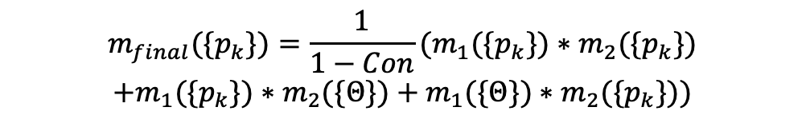
Methods
Deep Learning with Generalized Uncertainty-Based Evidential Fusion
In order to better fuse the classification results from different attention weights, we propose a probability distribution fusion strategy at the snippet level.
$$m_{final}(\{p_{k}\})=\frac{1}{1−Con}(m_{1}(\{p_{k}\})∗m_{2}(\{p_{k}\})$$
$$+m_{1}(\{p_{k}\})∗m_{2}(\{Θ\})+m_{1}(\{Θ\})∗m_{2}(\{p_{k}\}))$$

Slide 11
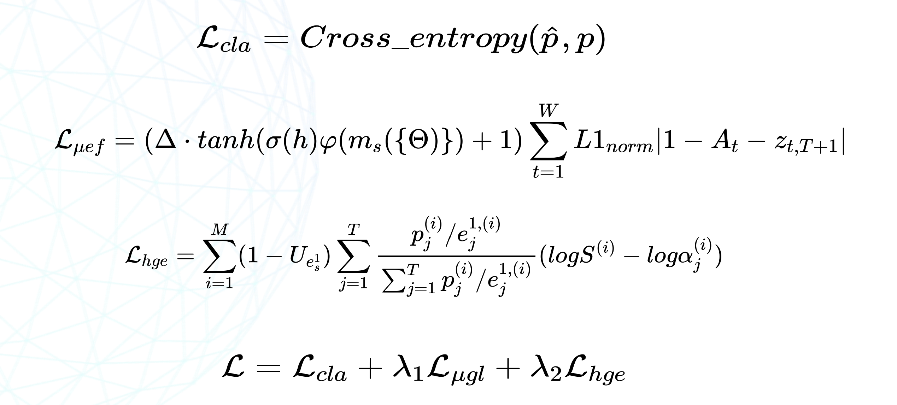


Training
Loss Function
Notes:
L_cla is the cross-entropy loss calculation at the video level after the classifier's results are aggregated. L_uef is the loss that uses attention with weight adjustment based on uncertainty after fusion, and the complementary loss for non-action class probabilities. L_hge is an improvement on the loss for evidence-based deep learning, hoping to further focus on the classification results corresponding to correct labels where the collected evidence is relatively small.

Slide 12
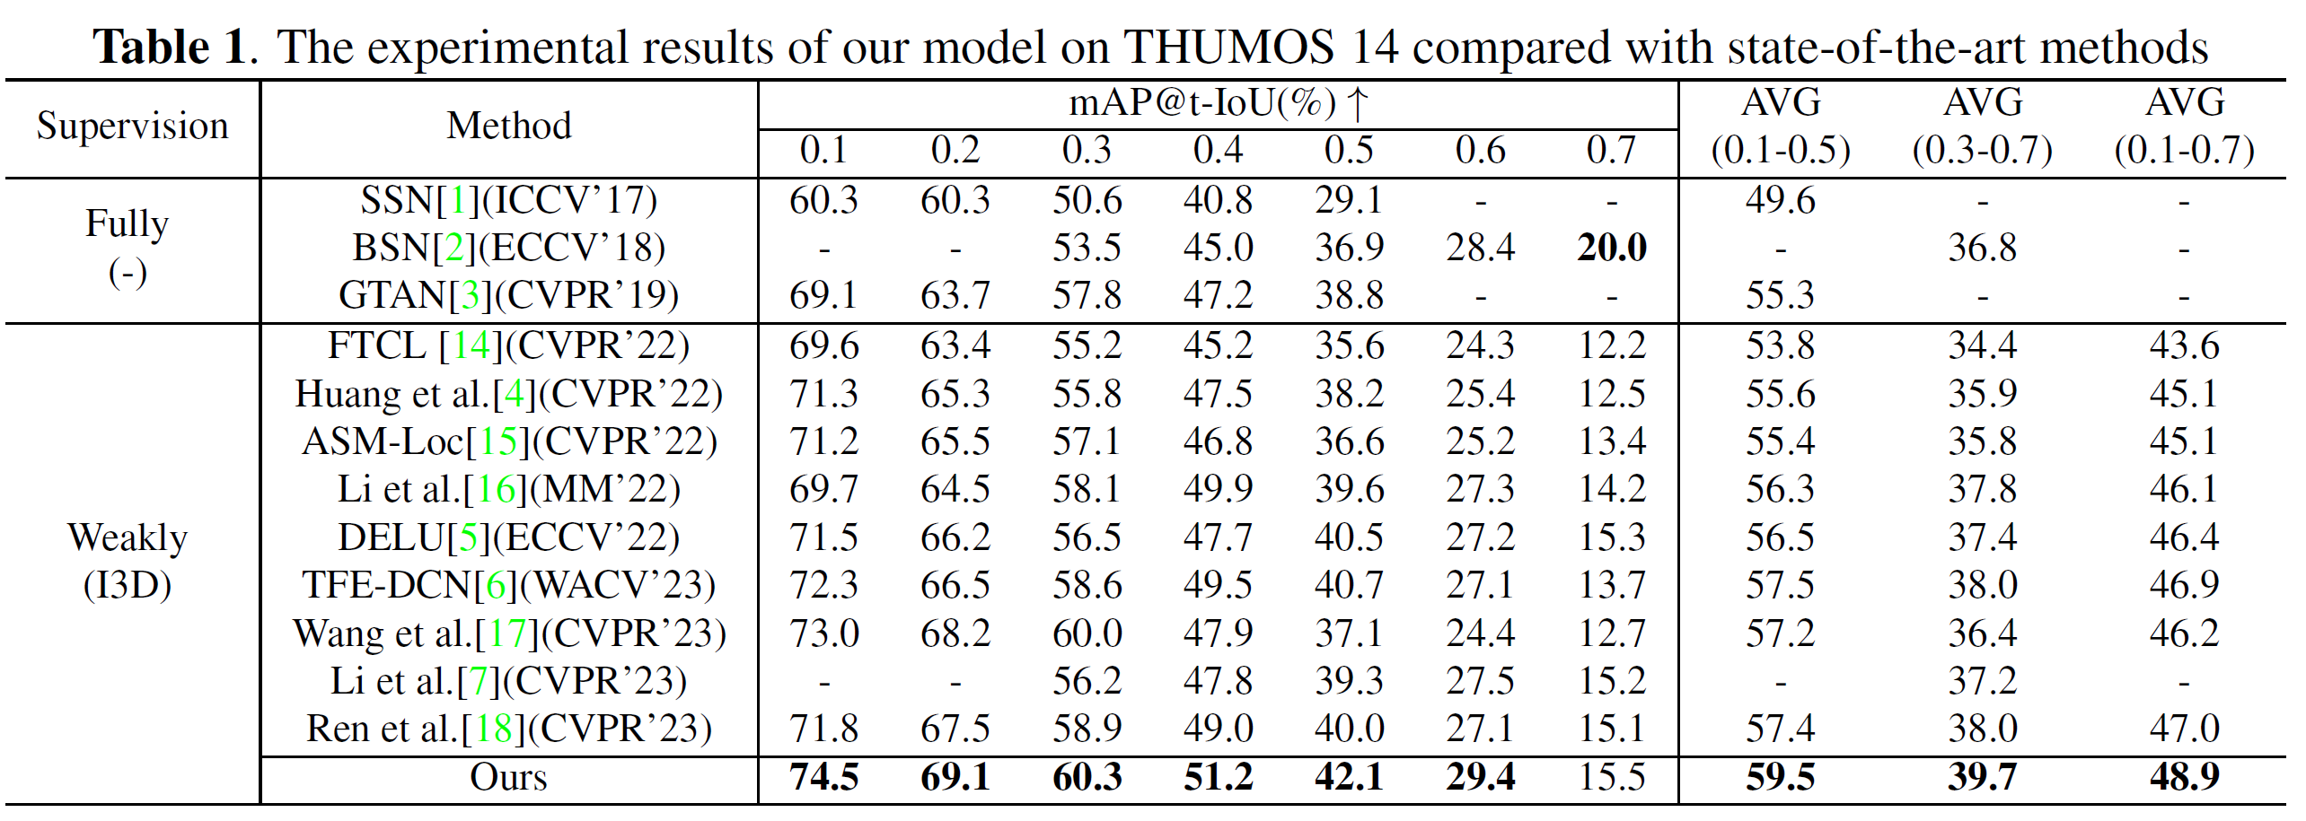
Experiments
We conduct a large amount of experiments to evaluate the proposed method on THUMOS14 dataset. THUMOS14 is composed of 200 validation videos and 213 testing videos with 20 action classes. Besides, The mean Average Precision (mAP) with different Intersection-over-Union (IoU) thresholds, which is regarded as a standard evaluation metric for WS-TAL tasks, is used to evaluate the performance of the proposed model.

Slide 13
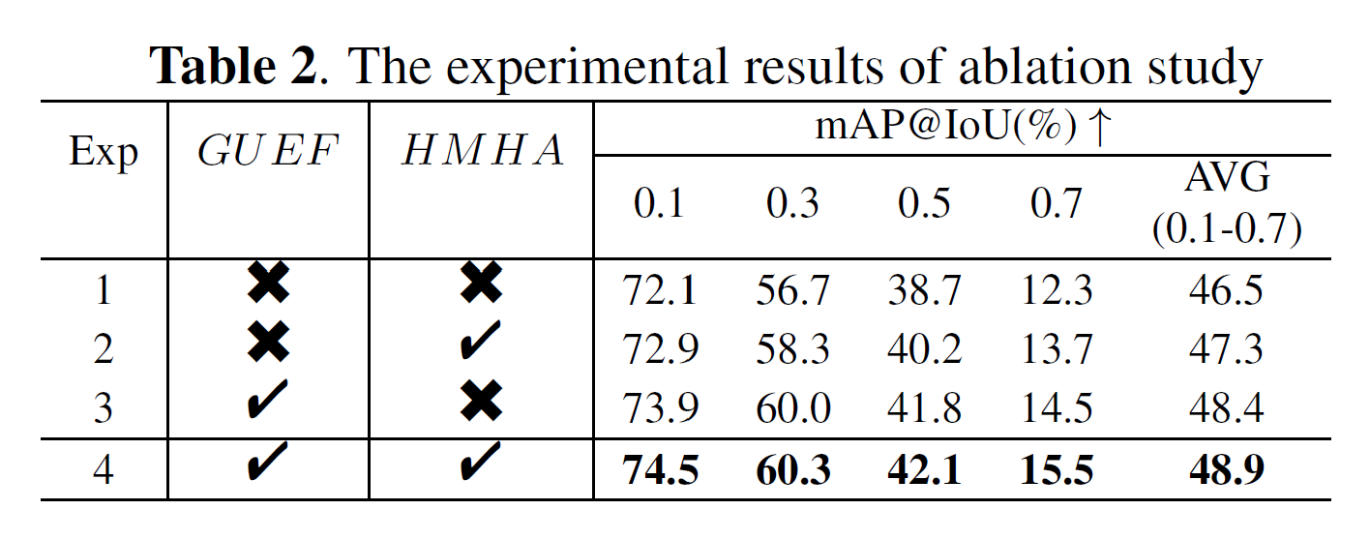
Experiments
Here, we explore the effectiveness of two mentioned modules on the THUMOS14 dataset. Notably, the omission of GUEF results in significant performance degradation, confirming its effectiveness. Besides, only removing HMHA, the performance also shows a moderate degradation within 0.6.

Slide 14
Conclusion
In this paper, we propose a generalized uncertainty-based evidential fusion and hybrid multi-head attention module, which effectively eliminates action-background ambiguity and filters redundant information from pre-trained features to enable the model to focus on foreground snippets, consequently improving performance.
Experimental results on the THUMOS14 dataset compared with the latest state-of-the-art methods demonstrate the effectiveness of our proposed method.
Considering the fact that pseudo-label is also efficacious on WS-TAL tasks, we will conduct further research on this direction.

Slide 15
Thank You!!
Q&A
Our code is available at: https://github.com/heyuanpengpku/GUEF/tree/main

