Slide 1
Introduction to Lab #1
José Nelson Amaral

Slide 2
General Intro to 229 Labs
In 229, a “lab” is a programming assignment:
A lab requires many more hours of work than the time allocated for lab sessions.
Lab sessions are “consulting hours” when TAs are available to answer questions and to help.
Reading/work prior to the lab date/time is essential.
The lab assignments will be progressively more difficult, and will require more time as the term advances.
A CMPUT 229 lab is not a “lab” in the sense of a chemistry lab.

Slide 3
Part #1
Read Appendix titled "Assemblers, Linkers, and the SPIM Simulator" (specially section 9):
In the 4th edition of the book, this is appendix B
In the 5th edition of the book, this is appendix A

Slide 4
Part #2
Self-guided tutorial-style introduction to usage of QTSPIM.
Part #3
Simple exercise to illustrate use of SPIM.

Slide 5
Part #4
Understand data storage in memory.
Question #7: Understand little/big endianess and conversion to/from ASCII.
Question #10: Understand 2-complement integers
Question 11: Assembly directives

Slide 6
Part #5: Find bugs in lab1-broken.s
The program lab1-broken.s was written to
replace characters in a string.
It should convert
“Cmput 229 is the absolute bomb.”
Into
“Cmput-229-is-the-absolute-bomb.”
But lab1-broken.s is not working as it should.
Your job is to read and understand the program and to report what are the errors in this program.

Slide 7
Part #5 submission
You will describe the bugs in a text file called bugs.txt and submit this file.
The solution for parts 1-5 are answers to the questions in the lab assignment.
There is no specified format for these answers. Just use a reasonable formatting and provide clear and concise answers.

Slide 8
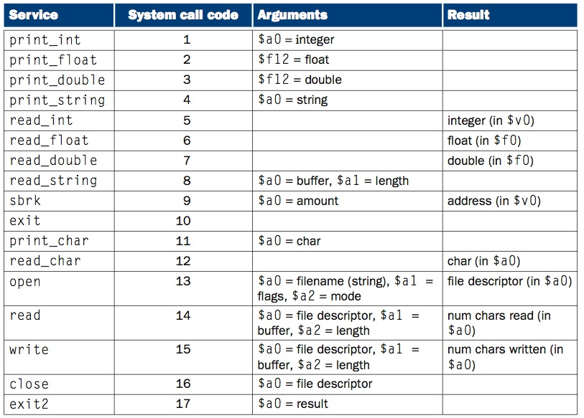
System call table
P-H pp. A-44
Chapter 2 — Instructions: Language of the Computer — 4

Slide 9
Part #6: Write a Simple Program
Write a MIPS assembly language program to:
read an integer from the terminal;
invert the byte order of the integer;
print out the new value of the integer.

Slide 10
Example #2
Integer: 1179907
31
24
23
16
15
8
7
0
0000 0000
0001 0010
0000 0001
0000 0011
Byte 3
Byte 2
Byte 1
Byte 0
Your program has to produce the following value:
31
24
23
16
15
8
7
0
0000 0011
0000 0001
0001 0010
0000 0000

Slide 11
Formatting and Style
Check the grading lab marksheet

Slide 12
Assembler Syntax
comments begin with a sharp sign (#) and run to the end of the line.
identifiers are alphanumeric sequences, underbars (_), and dots (.)
that do not begin with a number.
labels are identifiers placed at the beginning of a line, and followed
by a colon.
.data
item: .word 1
.text
.globl main
main: lw $s3, item
Loop: add $t1, $s3, $s3 # $t1 ← 2 * i
add $t1, $t1, $t1 # $t1 ← 4 * i
add $t1, $t1, $s6 # $t1 ← Addr(save[i])
lw $t0, 0($t1) # $t0 ← MEM[save[i]]
bne $t0, $s5, Exit # if save[I] ≠ k goto Exit
add $s3, $s3, $s4 # i ← i + j
j Loop # goto Loop
Exit:
Chapter 2 — Instructions: Language of the Computer — 4
P-H. p. B-10
Notes:
The University of Adelaide, School of Computer Science
Monday, January 11, 2021
Chapter 2 — Instructions: Language of the Computer
<number>

Slide 13
Assembler Directives
.data identifies the beginning of the data segment
(in this example this segment contains a single word).
.word 1 stores the decimal number 1 in 32-bits (4 bytes)
.text identifies the beginning of the text segment
(where the instructions of the program are stored).
.globl main declares the label main global
(so that it can be accessed from other files).
.data
item: .word 1
.text
.globl main
main: lw $s3, item
Loop: add $t1, $s3, $s3 # $t1 ← 2 * i
add $t1, $t1, $t1 # $t1 ← 4 * i
add $t1, $t1, $s6 # $t1 ← Addr(save[i])
lw $t0, 0($t1) # $t0 ← MEM[save[i]]
bne $t0, $s5, Exit # if save[I] ≠ k goto Exit
add $s3, $s3, $s4 # i ← i + j
j Loop # goto Loop
Exit:
Chapter 2 — Instructions: Language of the Computer — 4
Notes:
The University of Adelaide, School of Computer Science
Monday, January 11, 2021
Chapter 2 — Instructions: Language of the Computer
<number>

Slide 14
File lab1-p1.s
pseudo instruction that
loads the immediate value
in the register
exit: div $t5, $t1, $a1
li $v0, 4
la $a0, outputMsg
syscall
li $v0, 1
add $a0, $0, $t5
syscall
li $v0, 4
la $a0, newln
syscall
jr $ra
.data
val: .word 12, 34, 56, 78, 90
outputMsg:
.asciiz "\n Result = "
newln:
.asciiz "\n\n"
# What's going on here ?
.text
main:
li $a1, 5
la $t0, val
xor $t1, $t1, $t1
xor $t2, $t2, $t2
loop: sub $t3, $a1, $t2
blez $t3, exit
lw $t4, 0($t0)
add $t1, $t1, $t4
add $t2, $t2, 1
addu $t0, $t0, 4
j loop
OS-style call to obtain
services from SPIM:
$a0-$a3: arguments
$v0: system call code
before the call;
return value
after the call.
(see page A-43).
pseudo instruction that
loads the address of
specified label into register
Chapter 2 — Instructions: Language of the Computer — <number>
Notes:
The University of Adelaide, School of Computer Science
Monday, January 11, 2021
Chapter 2 — Instructions: Language of the Computer
<number>

Slide 15
Files to Submit
There are three files to submit:
lab1.txt
lab1.s
bugs.txt

