Slide 1


Slide 2
Lab 2: Hexadecimal and Branching
J. Nelson Amaral

Slide 3
What you need to do
Given a 32-bit word:
bbbb bbbb bbbb bbbb bbbb bbbb bbbb bbbb
if it is the binary code of a MIPS branch instruction
then
print the assembly of the instruction using the
following format (example):
beq $8, $9, 0x00400130
else
Address of the branch
target instruction
do nothing

Slide 4
How do you know if it is the code of a MIPS Instruction?

Slide 5
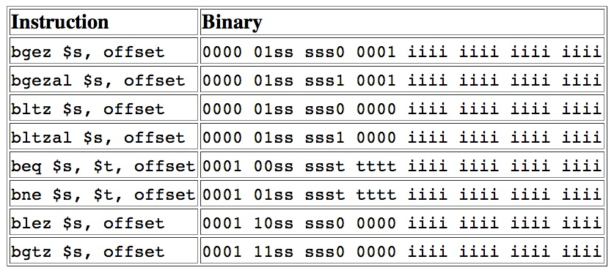
MIPS branch-instruction encodings

Slide 6
Printing Format
Address of the branch
target instruction
beq $8, $9, 0x00400130
How is this 32-bit
value obtained?

Slide 7
The input to disassembleBranch
$a0 contains the address of the assembly instruction.
Address
Content
$a0
0x0040 0100
0x0040 0108
0x0040 0104
0x0040 0100
$t0
0x0040 00fc
0x0040 01f8
Memory

Slide 8
The input to disassembleBranch
$a0 contains the address of the assembly instruction.
Address
Content
$a0
0x0040 0100
0x0040 0108
0x0040 0104
0x0040 0100
0x1109000b
0x1109000b
$t0
0x0040 00fc
0x0040 01f8
Memory

Slide 9
Hexadecimal
Value | Binary | Digit
0 | 0000 | 0
1 | 0001 | 1
2 | 0010 | 2
3 | 0011 | 3
4 | 0100 | 4
5 | 0101 | 5
6 | 0110 | 6
7 | 0111 | 7
Value | Binary | Digit
8 | 1000 | 8
9 | 1001 | 9
10 | 1010 | a
11 | 1011 | b
12 | 1100 | c
13 | 1101 | d
14 | 1110 | e
15 | 1111 | f
Example: eca8 6420
1110 1100 1010 1000 0110 0100 0010 0000

Slide 10
Manipulating the Offset
$a0 contains the address of the assembly instruction.
0000 0000 0000 00
0000 0000 0000 1011
00
sign extension
Address
Content
$a0
0x0040 0100
0x0040 0108
0x0040 0104
0x0040 0100
0x1109000b
0x1109000b
$t0
0x1109
0x0000 002c
000b
0x0040 00fc
0x0040 01f8
Memory

Slide 11
Computing the Target
$a0 contains the address of the assembly instruction.
Address
Content
$a0
0x0040 0100
0x0040 0108
+
0x0000 0004
0x0040 0104
0x0040 0100
0x1109000b
0x1109000b
$t0
0x0000 002c
0x0040 00fc
0x0040 01f8
$t1
0x0040 0130
0
Memory

Slide 12
Computing the Target
beq $8, $9, 0x00400130
Into this sequence
of ASCII characters?
How do we transform
this binary representation?
$t1
0x0040 0130
0

Slide 13
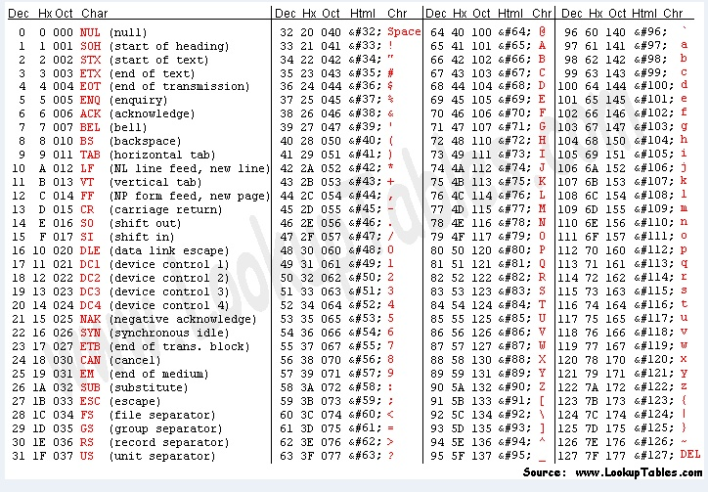
ASCII Table

Slide 14
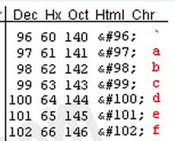
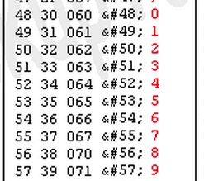
ASCII Table

Slide 15
Printing the Target
beq $8, $9, 0x00400130
Convert into 0x?? (The ASCII code for ‘0’)
0000 0000 0100 0000 0001 0011 0000
$t1
0x0040 0130
0

