Slide 1
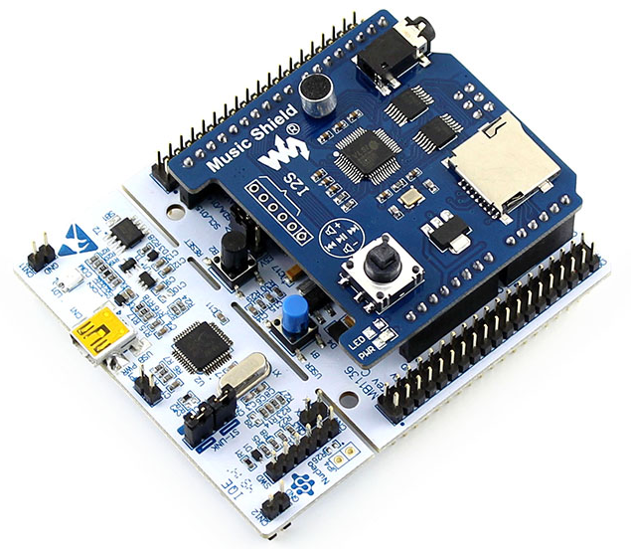
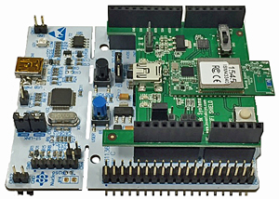
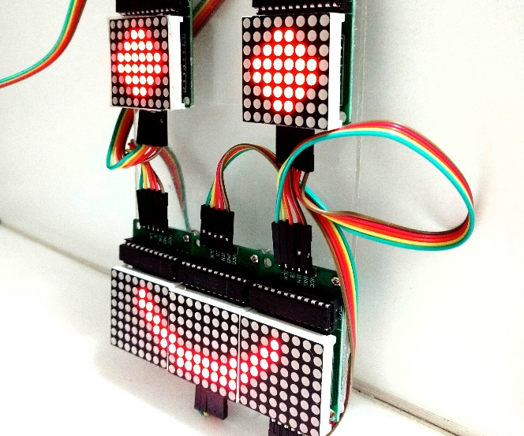
Logic Design Project Expansion Shield for STM Nucleo

Slide 2
Project Overview
In this project, 3 main tasks are proposed:
Schematic design in Altium Designer
PCB Layout and Circuit Assembly
Device driver programming

Slide 3
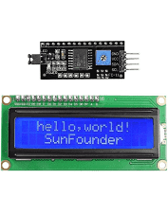
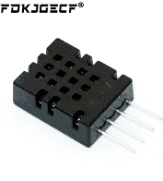
LCD 16x2 and DHT20 (6 points)
I2C connections

Slide 4
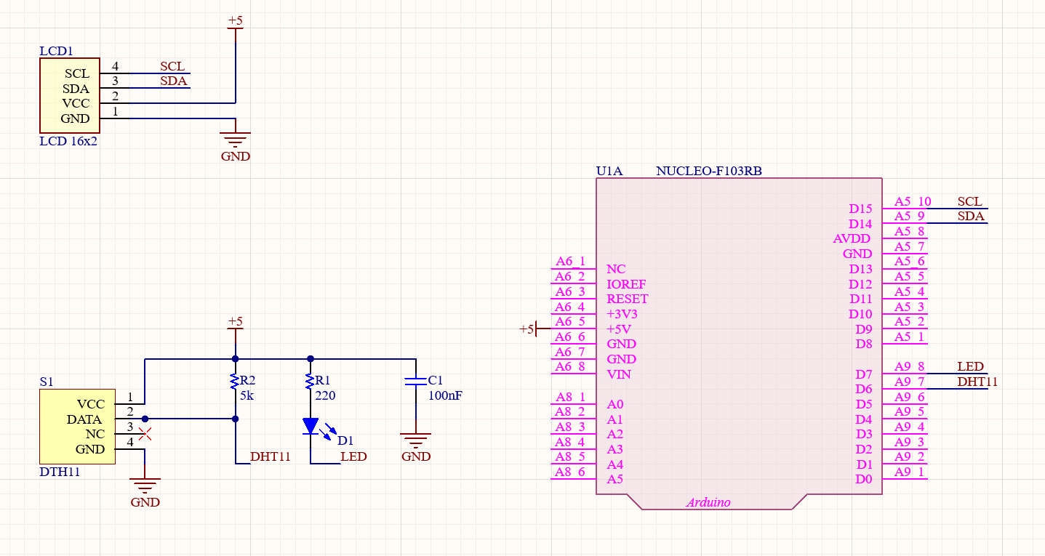
First SCH Design for using DHT11

Slide 5
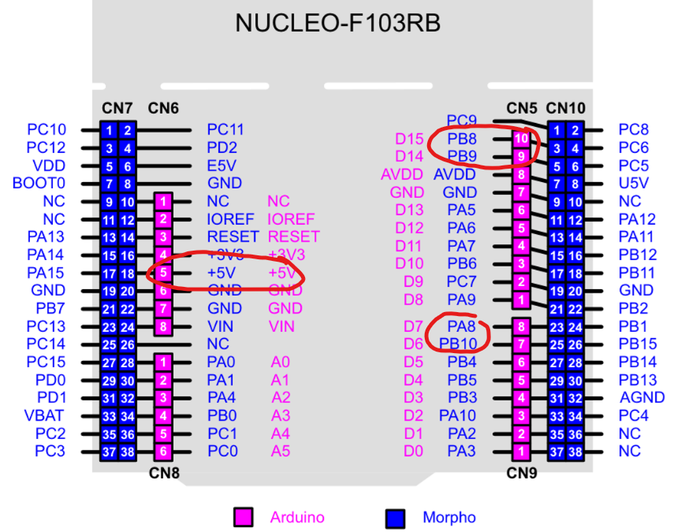
Mapping with STM32 pins

Slide 6
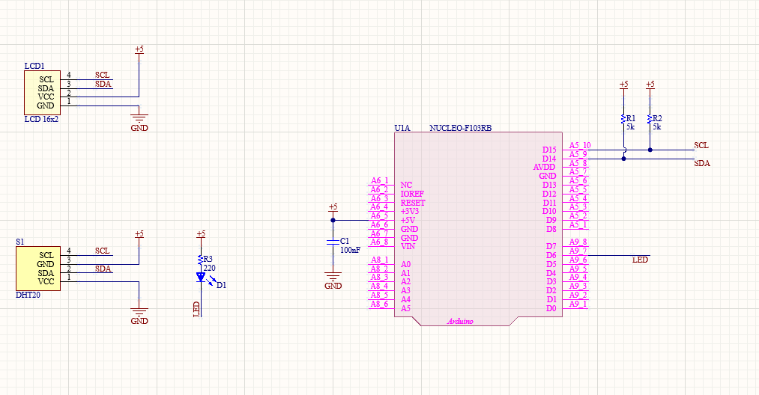
Schematic Design for using DHT20

Slide 7
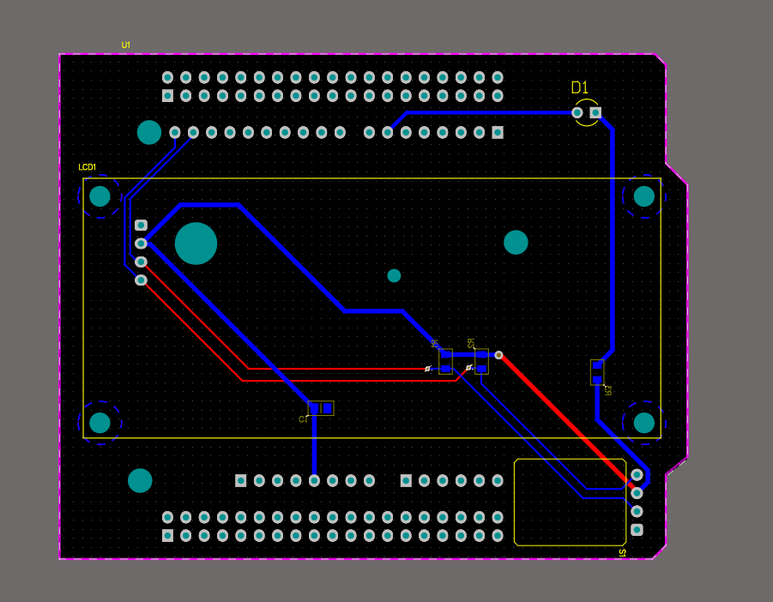
PCB design for using DHT20

