Slide 1
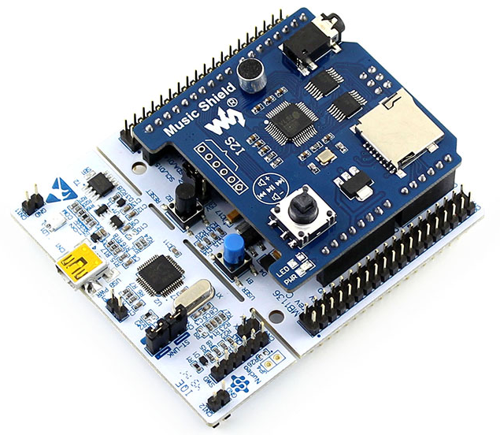
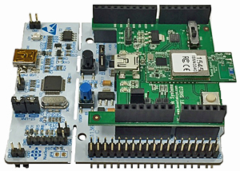
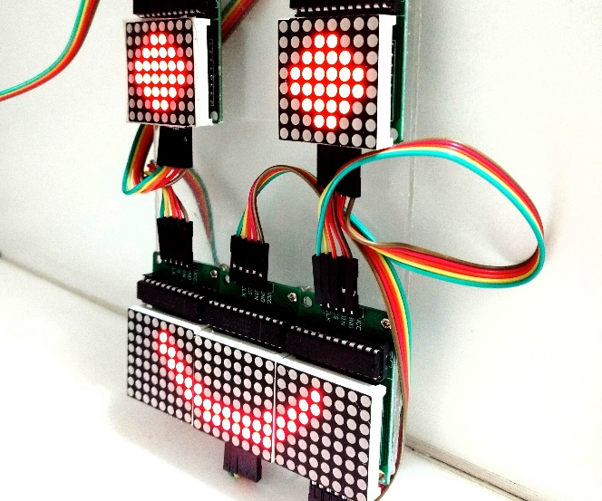
Logic Design Project Expansion Shield for STM Nucleo

Slide 2
Project Overview
In this project, 3 main tasks are proposed:
Schematic design in Altium Designer
PCB Layout and Circuit Assembly
Device driver programming
A template for PCB design is supported for students. This template provides the interface of the shield when it is stacked in the Nucleo board (using STM32F103)
Basically, a shield is composed of LEDs, LED 7s, LED Matrixes and Buttons
A group of 2 – 3 students
Required points = number of student * 2

Slide 3
Digital Clock Shield (2 points)
This shield has 12 single LEDs (3mm or 5mm in size) and 3 buttons.
12 LEDs represent 12 numbers in a digital clock
1 button for mode and 2 others for up and down

Slide 4
Two Ways Traffic Light (2 points)
This shields has 6 LEDs (for 2 way traffic light)
One LED 7 Segment for countdown number
3 buttons for mode, up and down operations

Slide 5
LED Matrix (2 points)
1 LED matrix
2 colors (RED and GREEN)

Slide 6
4 LED 7s and a double dot (3 points)
4 LED 7s (to display minute and hour)
2 Single LEDs for a Dot (blink every second)
3 buttons, 1 one mode, 2 for up and down

Slide 7
LED MATRIX with Serial connection (4 points)
Serial to parallel IC is required (MAX7219 or equivalent Ics)
Many shields can be connected to extend the size of the LED Matrix

Slide 8
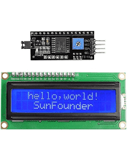
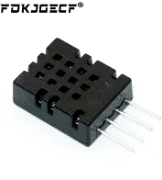
LCD 16x2 and DHT20 (6 points)
I2C connections

