Slide 1
Exercise on BJT
Part 1

Slide 2
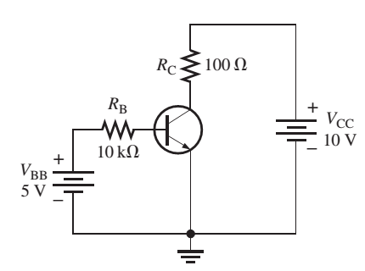
BJT Operation Modes
I_{B} = 0: Cut-off mode
V_{B} is increased (higher than 0.7V), I_{B} is increased:
I_{C} = β_{DC} I_{B}
Amplifier mode (Active mode)
V_{C} is increased
V_{C} = V_{CC} – V_{CE}
Saturation mode
V_{CE} is small (0.2V)
α = β/(β+1) ~ 0.9
α = IC/IE

Slide 3
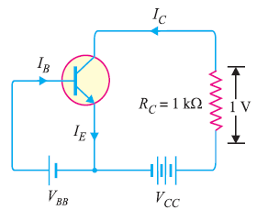
Common Emitter Connection
For a transistor, β = 45 and voltage drop across 1kΩ which is connected in the collector circuit is 1 volt. Find the base current

Slide 4
Answer
IC = 1mA
IB = IC/ 45
VCE = ?

Slide 5
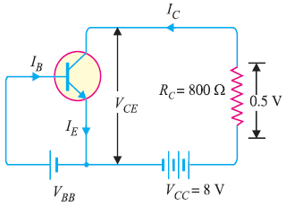
Common Emitter Connection
α = 0.96:
Determine : VCE and IB

Slide 6
Answer
VCE = VCC – 0.5V
IC = 0.5V/RC
beta = alpha ( 1- alpha)
IB = IC/beta = 0.026mA

Slide 7
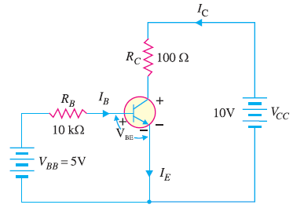
Determine V_{CB}
Beta = 150

Slide 8
Answer
2.85V

Slide 9
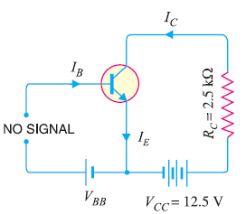
DC Load Line (VCE)
Construct the equation for VCE in the circuit
Draw the DC Load Line (relation between VCE and IC)

Slide 10
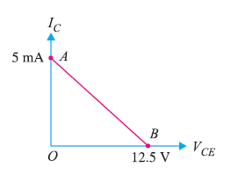
Answer
VCE = VCC – IC * RC:
IC = 0: VCE = 12.5
VCE = 0, IC = VCC/RC
IC is saturated at 5mA

Slide 11
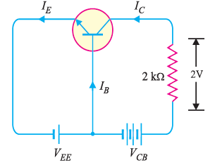
Common Base Connection
α = 0.95
Find IB

Slide 12
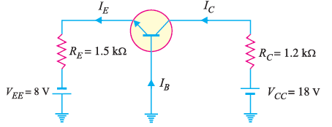
Common Base Connection
Determine VCB
alpha ~ 1

Slide 13
Answer
VEE = VBE + IE * RE
IE = 4.87mA
IC ~ 4.87mA
VCC = IC*RC + VCB
VCB = 12.16V

Slide 14
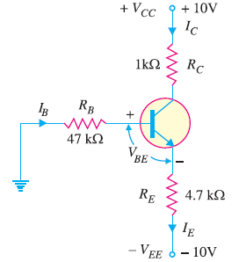
Given β = 100 and V_{BE} = 0.7V.
Find all the current and VCE

Slide 15
IC = 1.8mA
VCE = 9.74V

Slide 16
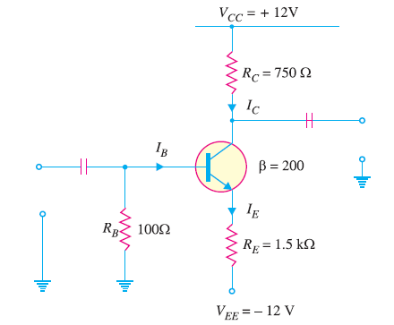
Saturation
Determine the values of V_{CE(off)} and I_{C(sat)}
VCE(Sat) ~ 0V

Slide 17
Answer
VCE(Off) = 12 + 12 = 24V
IC(Sat) = 24 / (RE + RC)

Slide 18
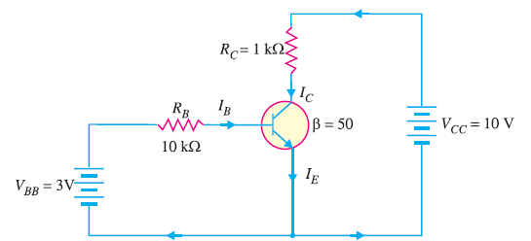
Saturation
Determine whether or not the transistor is in saturation
VCE(Sat) = Vknee = 0.2V

Slide 19
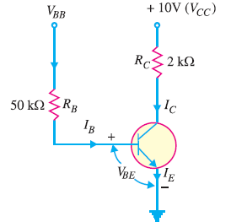
Saturation
Find the base supply voltage ( V_{BB}) that just puts the transistor into saturation.
β = 200.
VCE(Sat) ~ 0V

Slide 20
Answer
VBB > 1.95V

Slide 21
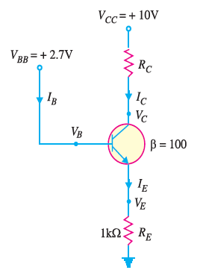
Fix Bias Configuration
Determine the state of the transistor with 3 different values of RC: 2k, 4k and 8k

Slide 22
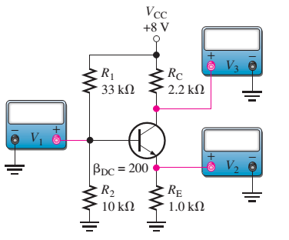
Exercise
Determine values on V1, V2, V3

Slide 23
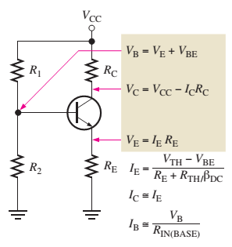
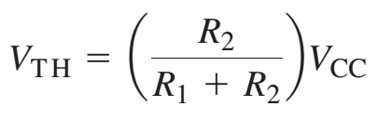
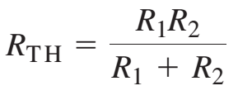

Slide 24
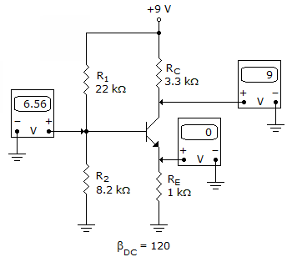
Refer to the given figure. The most probable cause of trouble, if any, from these voltage measurements is
Notes:
Base and Emitter is opened

Slide 25
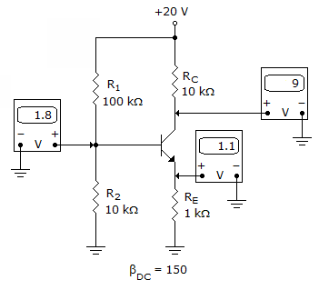
Refer to the given figure. The most probable cause of trouble, if any, from these voltage measurements is
Notes:
No problem

Slide 26
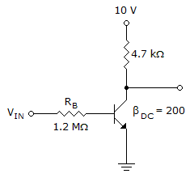
Refer to this figure. If V_{CE} = 0.2 V, I_{C(sat)} is

Slide 27
Refer to this figure. Determine the minimum value of I_{B} that will produce saturation (V_{CE}(sat) = 0.2V).
Notes:
10=4.7*10^3*Ic+0.2
Ic = 2.085 ma.
Ib = 2.085/200 = 10.425 uA .

Slide 28
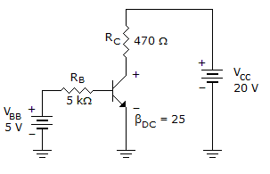
Refer to this figure. The value of V_{BC} is
Notes:
-9.2

Slide 29
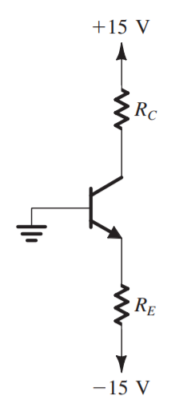
Determine R_{C}, R_{E}
V_{C} = 5V, I_{C} = 2mA
β_{DC} = 100
I_{C} = 2(mA)
V_{C} = 5(V)

Slide 30


Slide 31
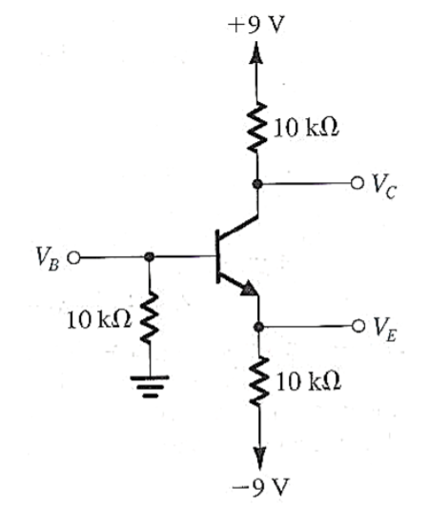
V_{B} = -1.5V
Calculate I_{B}, I_{C}, I_{E}
Notes:
IB = 0 – VB / 10K = 0.15mA
VE = VB – 0.7 = -2.2V
IE = -2.2 + 9/ 10k = 0.68mA

