Slide 1

Algorithm Comparison Based on Input Size Scaling
A Technical Presentation Task
In
CSA0614-Design and Analysis of Algorithms
Presented by:
T.Chandra Mouleswara Rao(192425306)
Guided by:
Dr.A.Sai Ram

Slide 2
Problem Statement
Compare two algorithms:
O(n²)
O(n³)
Analyze how performance changes as input size increases.
Find which algorithm is more efficient for large datasets.

Slide 3
Algorithm Overview
Algorithm A – O(n²)
Uses 2 nested loops
Operations increase as n²
Faster than O(n³)
Algorithm B – O(n³)
Uses 3 nested loops
Operations increase as n³
Slower for large inputs

Slide 4
Algorithm / Pseudocode
O(n²)
for i = 1 to n
for j = 1 to n
process
O(n³)
for i = 1 to n
for j = 1 to n
for k = 1 to n
process

Slide 5
Working Example (Dry Run)
Assume n = 3
Algorithm | Operations
O(n²) | 9
O(n³) | 27
Observation: O(n³) performs more operations than O(n²).

Slide 6
Complexity Analysis
Input (n) | O(n²) | O(n³)
10 | 100 | 1,000
100 | 10,000 | 1,000,000
1000 | 1,000,000 | 1,000,000,000
Observation: O(n³) grows much faster.

Slide 7
Comparative Analysis
Feature | O(n²) | O(n³)
Nested Loops | 2 | 3
Growth Rate | Moderate | Very High
Execution Time | Faster | Slower
Large Data | Better | Poor

Slide 8
Applications
O(n²)
Bubble Sort
Selection Sort
Pairwise Comparison
O(n³)
Matrix Multiplication
Floyd-Warshall Algorithm
Graph Processing

Slide 9
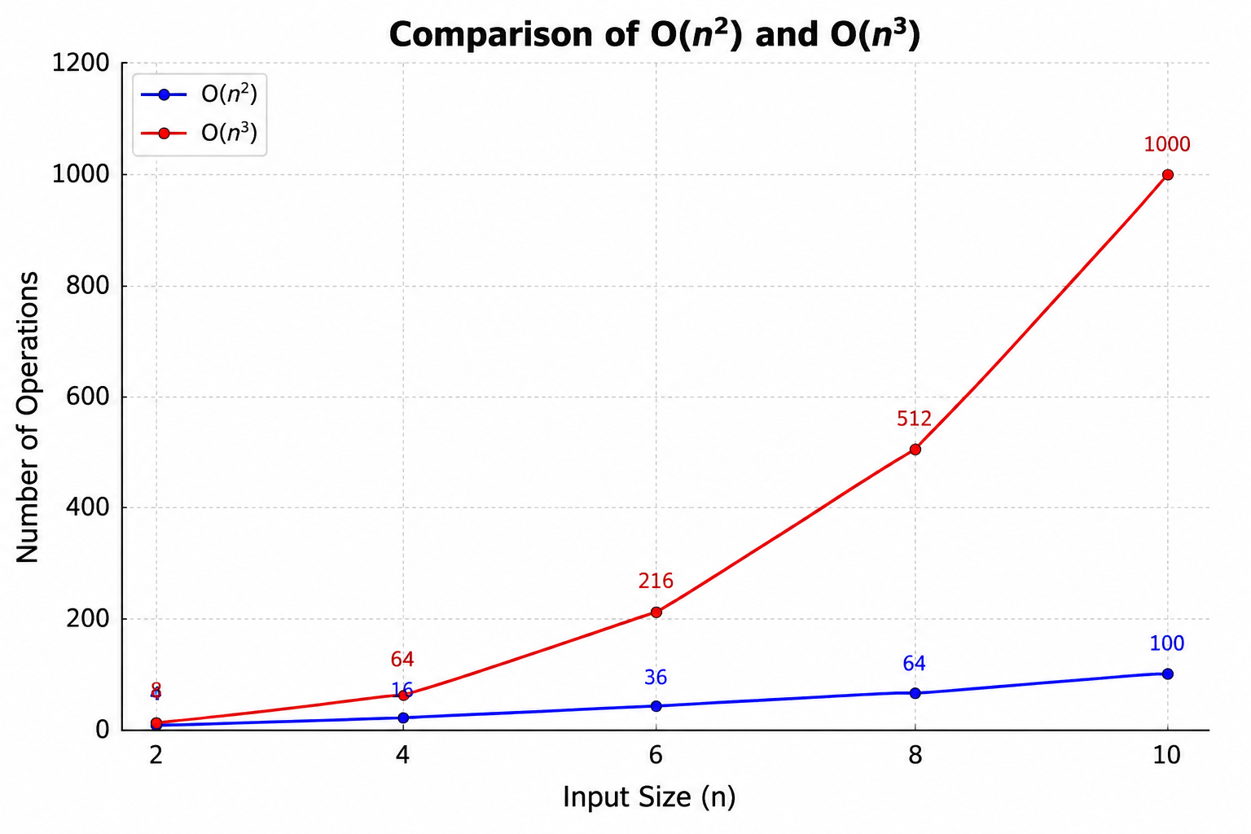
Results & Discussion
Small inputs: Both algorithms perform well.
Large inputs: O(n³) becomes much slower.
O(n²) scales better.
Graph: Plot Input Size (X-axis) vs Operations (Y-axis) with two lines for O(n²) and O(n³).

Slide 10
Conclusion
Time complexity affects algorithm performance.
O(n²) grows slower than O(n³).
O(n²) is more suitable for large datasets.
Choosing an efficient algorithm improves speed and scalability.
References
Introduction to Algorithms – Cormen et al.
Algorithms – Robert Sedgewick
The Art of Computer Programming – Donald Knuth

Slide 11
THANK YOU

