Slide 1
IOT AND CLOUD COMPUTING LAB
By,
Asst. Prof. S.Asra
M.E(Computer science & Engineering)
B.E(Computer Science & Engineering)
Diploma(Computer Science & Engineering)

Slide 2
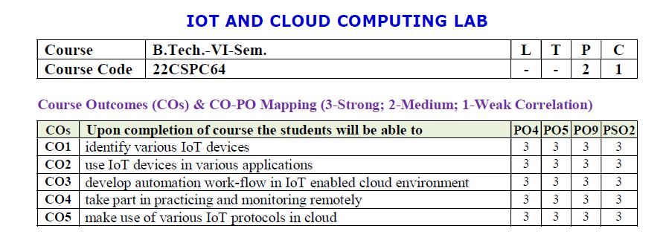

Slide 3
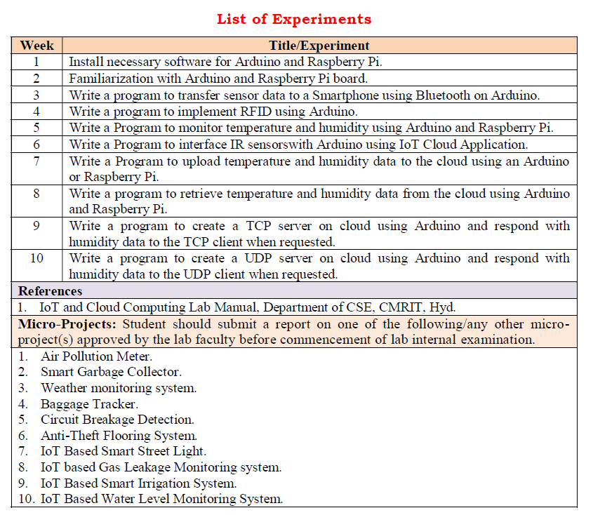

Slide 4
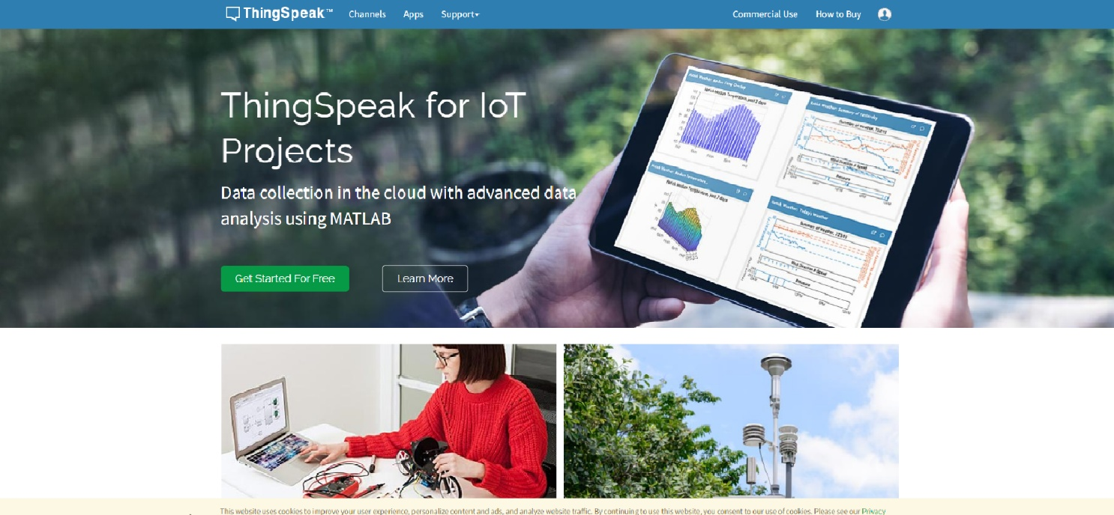
WEEK-6
Aim: Write a program to interface IR Sensor with Arduino using IoT Cloud application.
IOT-Cloud Application:
THINGSPEAK
Asst. Prof. S.Asra
CSE Department, CMRIT

Slide 5
THINGSPEAK
ThingSpeak is a Web Service (REST API) that lets you collect and store sensor data in the cloud and develop Internet of Things applications.
It works with Arduino, Raspberry Pi and MATLAB (premade libraries and APIs exists).
But it should work with all kind of Programming Languages, since it uses a REST API and HTTP.
ADD YOUR TEXT
ADD YOUR TEXT
Asst. Prof. S.Asra
CSE Department, CMRIT

Slide 6
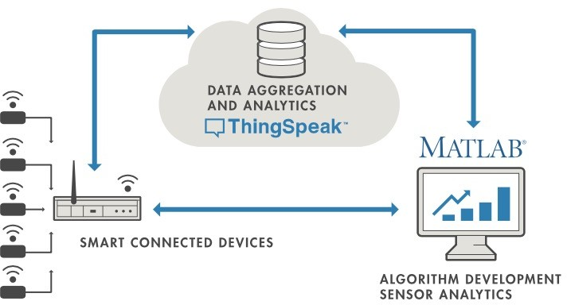
ADD YOUR TEXT
ADD YOUR TEXT
Asst. Prof. S.Asra
CSE Department, CMRIT

Slide 7

What is ThingSpeak?
ADD YOUR TEXT
ADD YOUR TEXT
Asst. Prof. S.Asra
CSE Department, CMRIT

Slide 8
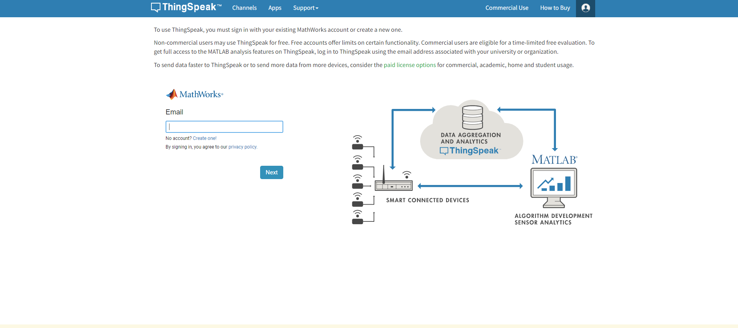
Asst. Prof. S.Asra
CSE Department, CMRIT

Slide 9
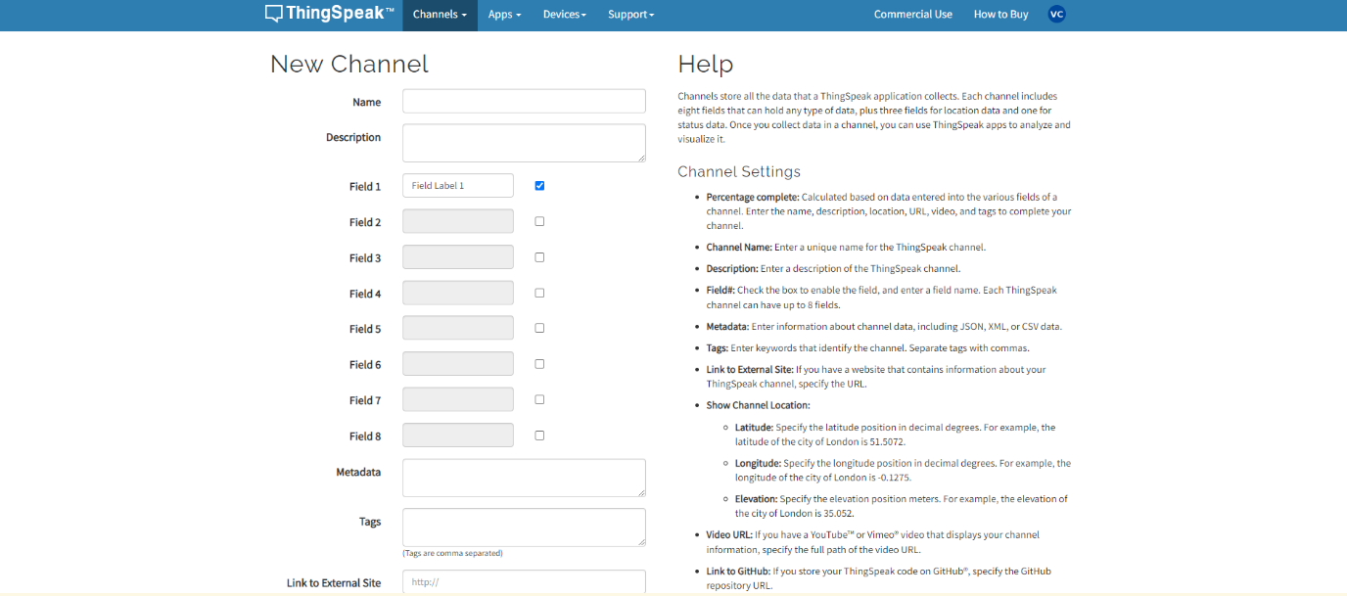
Asst. Prof. S.Asra
CSE Department, CMRIT

Slide 10
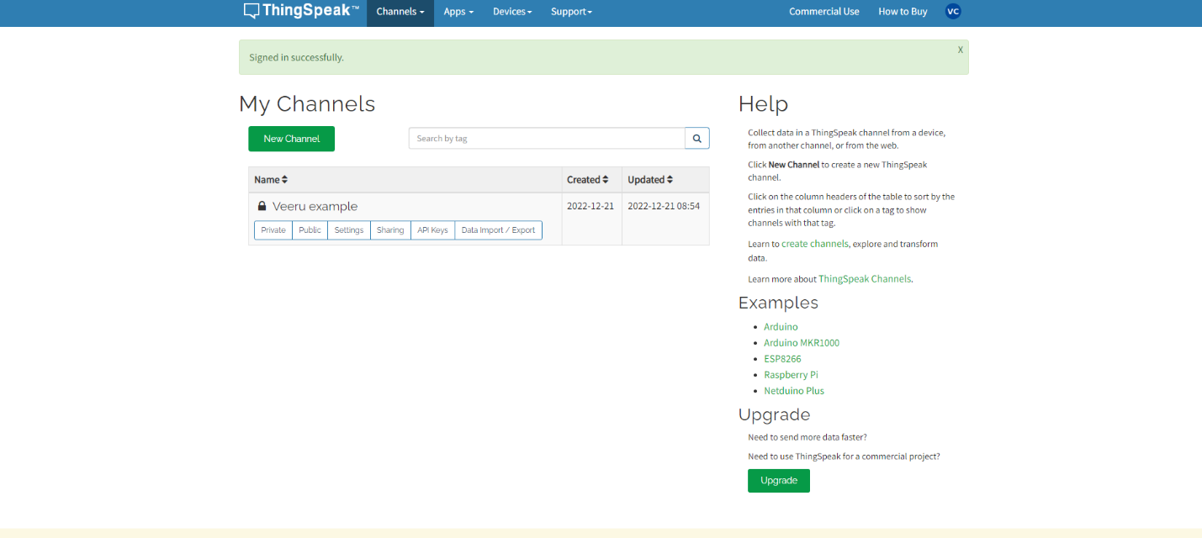
Asst. Prof. S.Asra
CSE Department, CMRIT

Slide 11
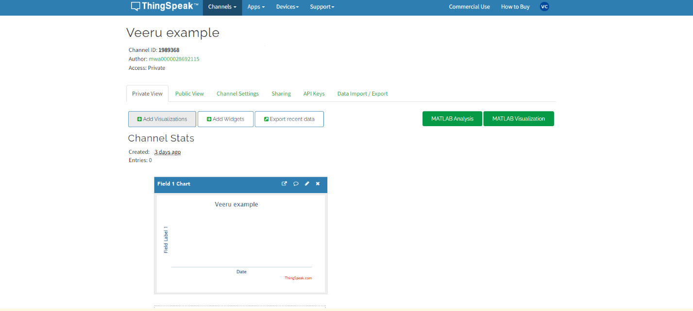
Asst. Prof. S.Asra
CSE Department, CMRIT

Slide 12
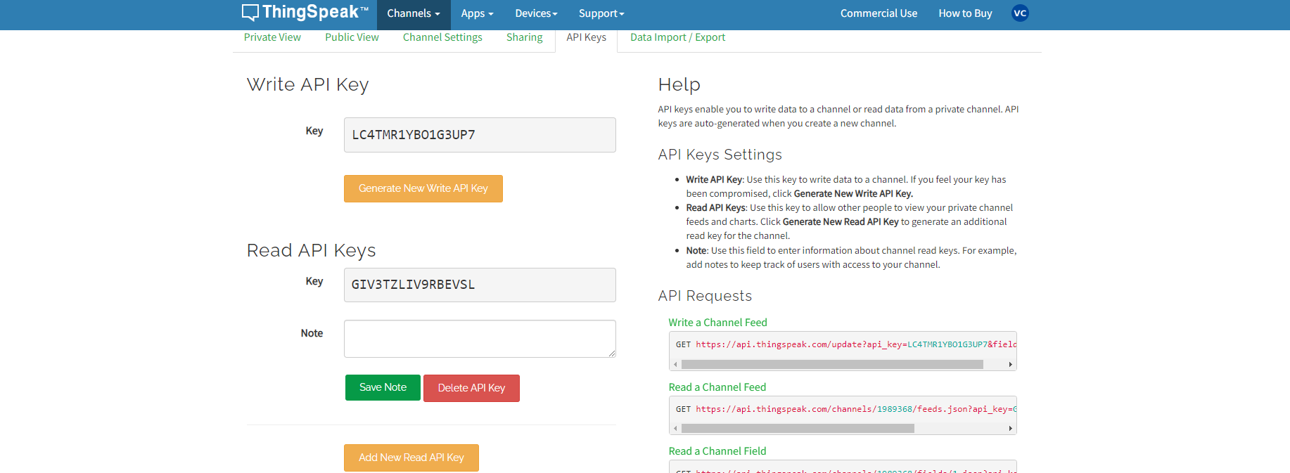
Asst. Prof. S.Asra
CSE Department, CMRIT

Slide 13
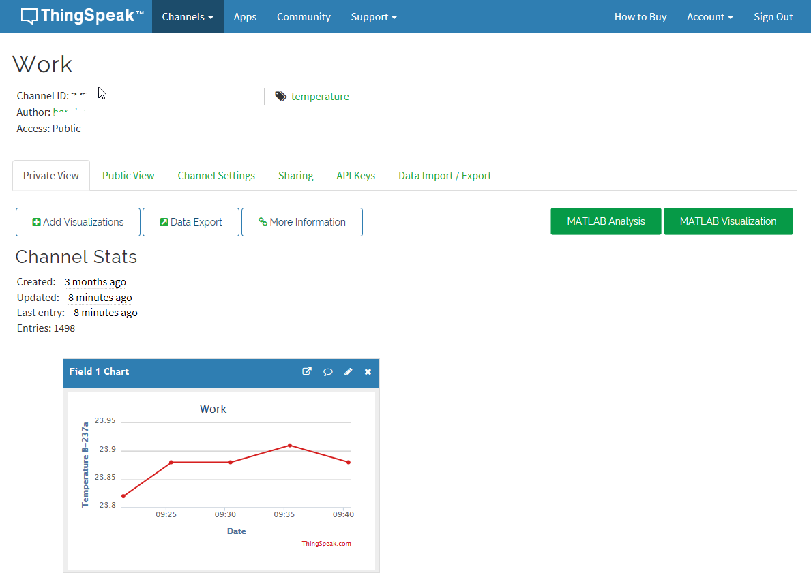
ADD YOUR TEXT
ADD YOUR TEXT
Asst. Prof. S.Asra
CSE Department, CMRIT

Slide 14
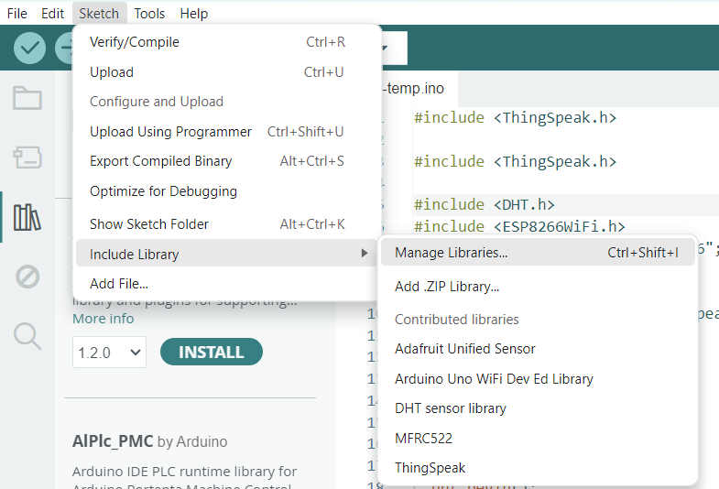
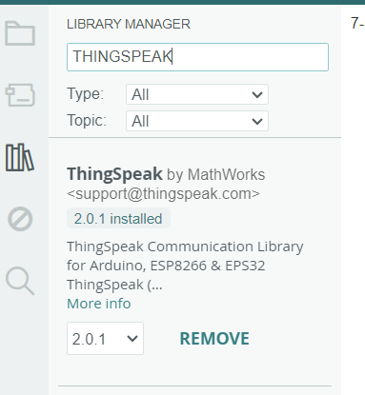
ADD YOUR TEXT
ADD YOUR TEXT
Asst. Prof. S.Asra
CSE Department, CMRIT

Slide 15
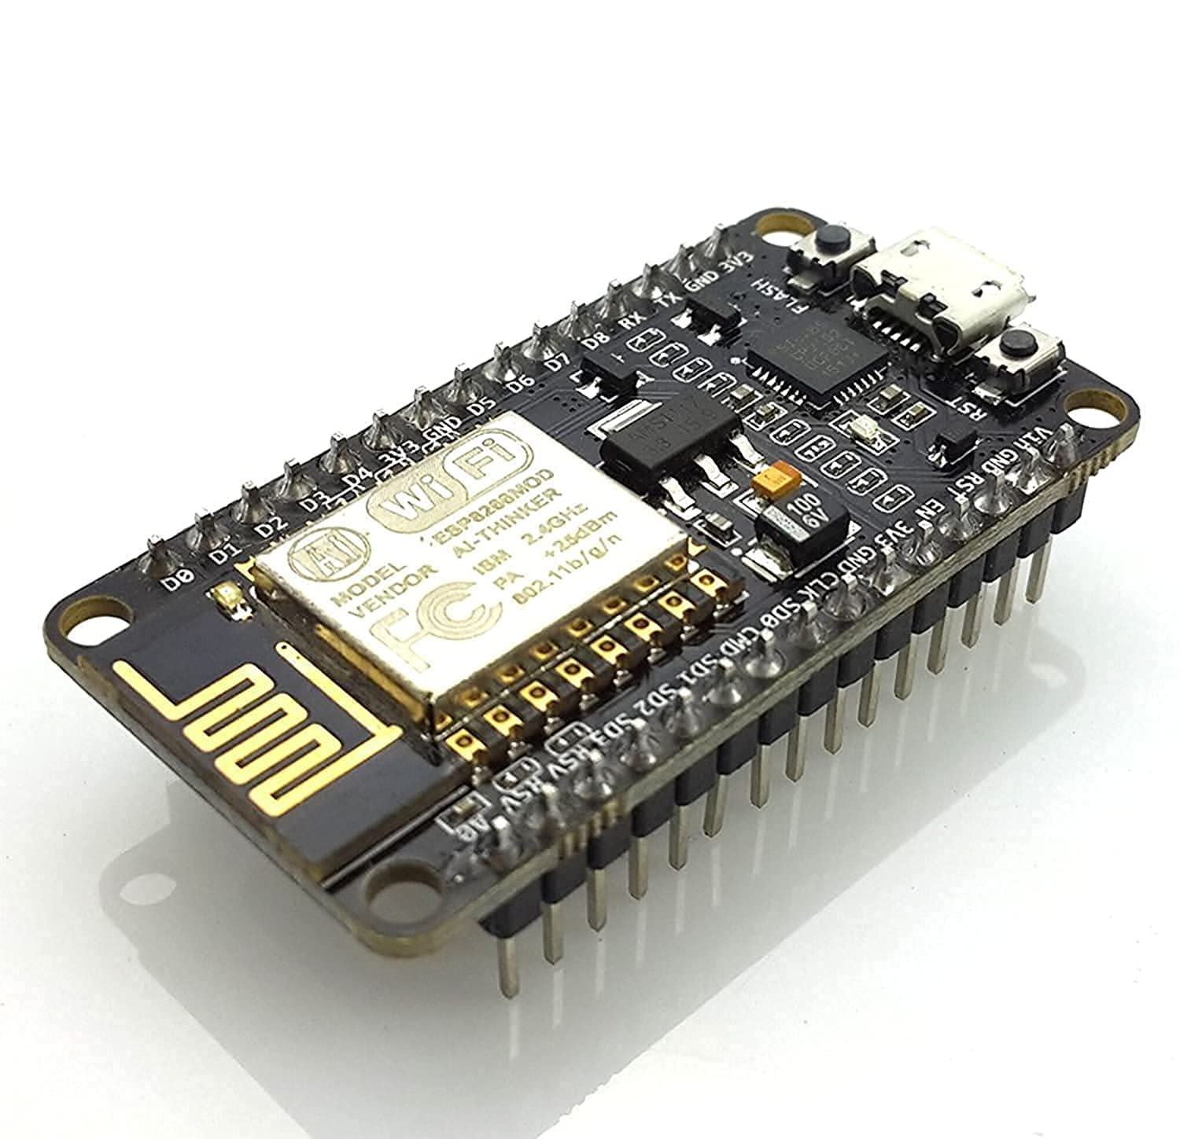

Asst. Prof. S.Asra
CSE Department, CMRIT

Slide 16
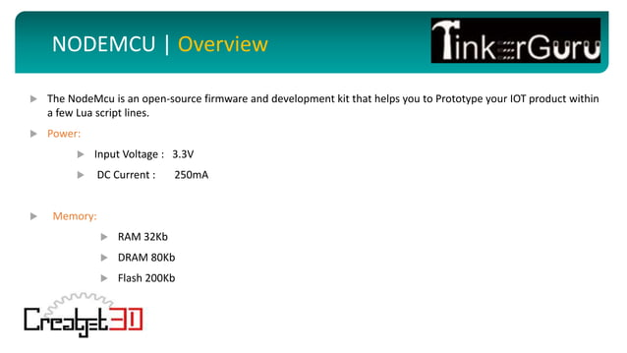
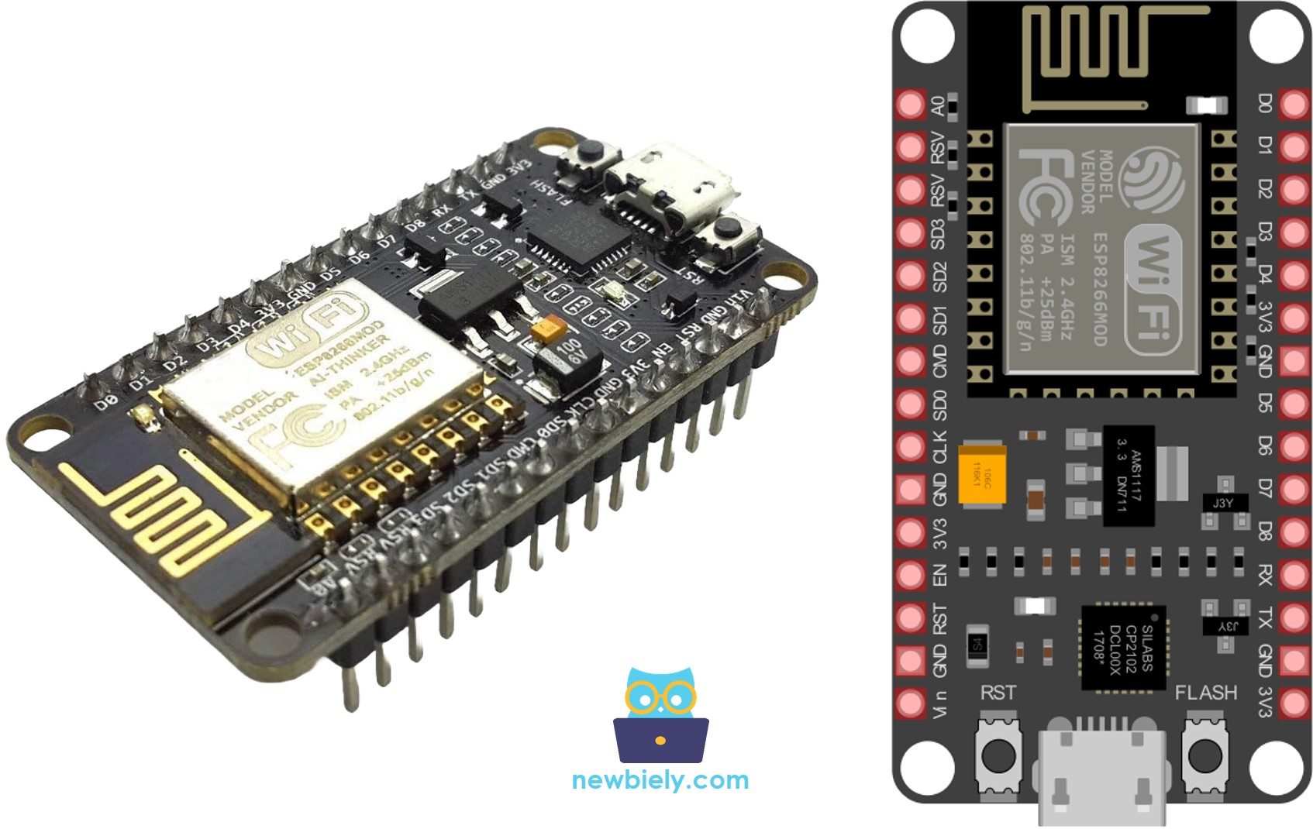
Asst. Prof. S.Asra
CSE Department, CMRIT

Slide 17
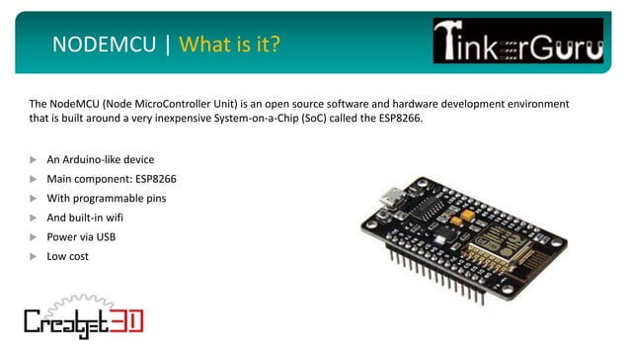

Asst. Prof. S.Asra
CSE Department, CMRIT

Slide 18
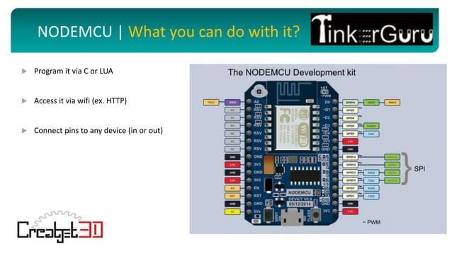
Asst. Prof. S.Asra
CSE Department, CMRIT

Slide 19
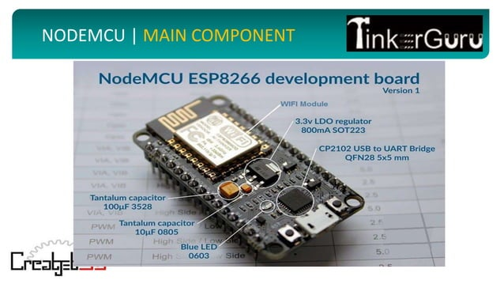
Asst. Prof. S.Asra
CSE Department, CMRIT

Slide 20
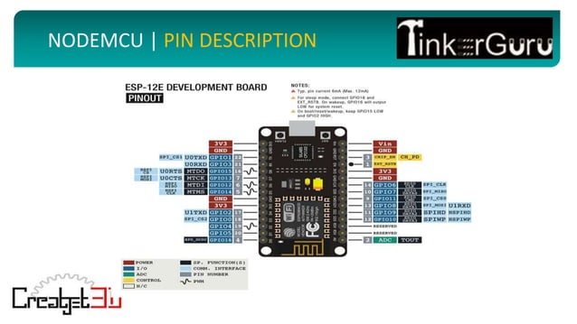
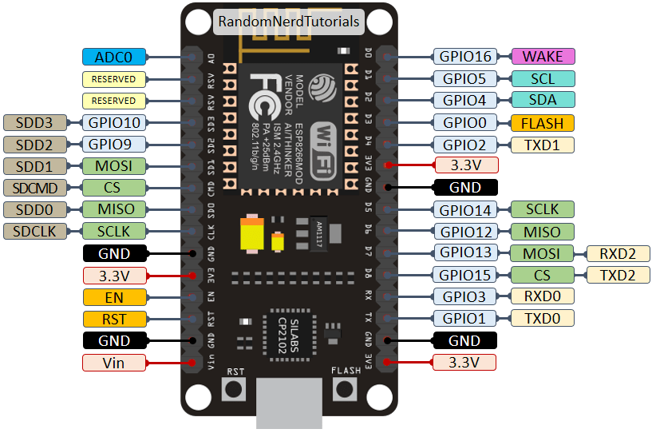
ADD YOUR TEXT
ADD YOUR TEXT
Asst. Prof. S.Asra
CSE Department, CMRIT

Slide 21
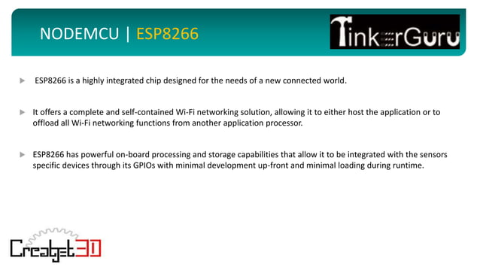
ADD YOUR TEXT
ADD YOUR TEXT
Asst. Prof. S.Asra
CSE Department, CMRIT

Slide 22

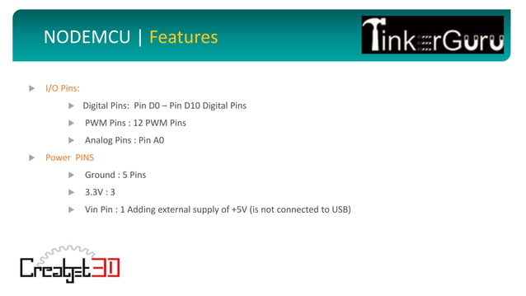
Pulse width modulation
ADD YOUR TEXT
ADD YOUR TEXT
Asst. Prof. S.Asra
CSE Department, CMRIT

Slide 23
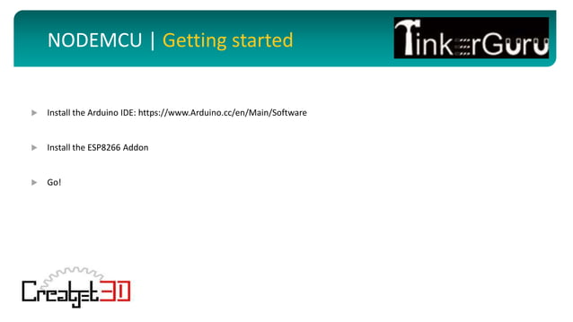
ADD YOUR TEXT
ADD YOUR TEXT
Asst. Prof. S.Asra
CSE Department, CMRIT

Slide 24
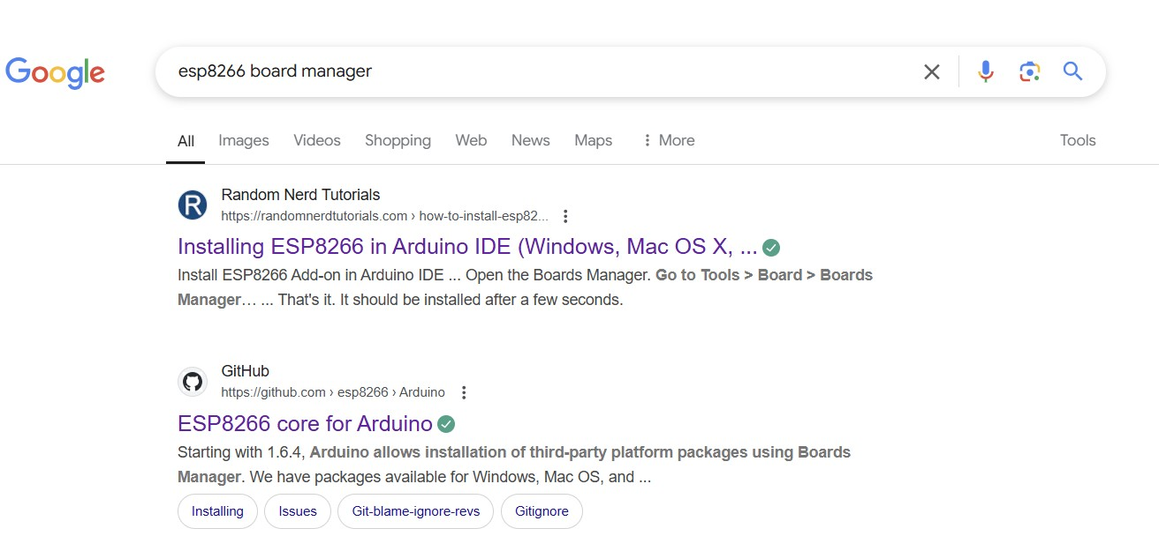
ADD YOUR TEXT
ADD YOUR TEXT
Asst. Prof. S.Asra
CSE Department, CMRIT

Slide 25
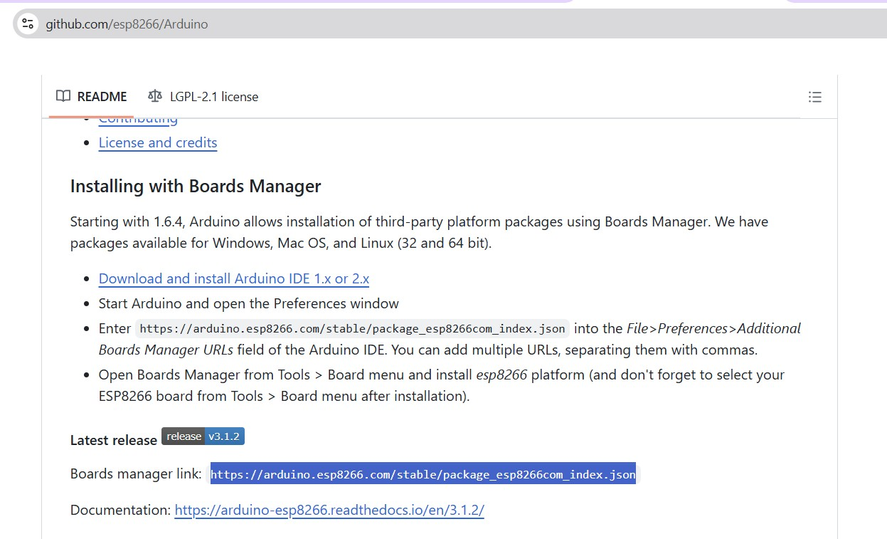
ADD YOUR TEXT
ADD YOUR TEXT
Asst. Prof. S.Asra
CSE Department, CMRIT

Slide 26
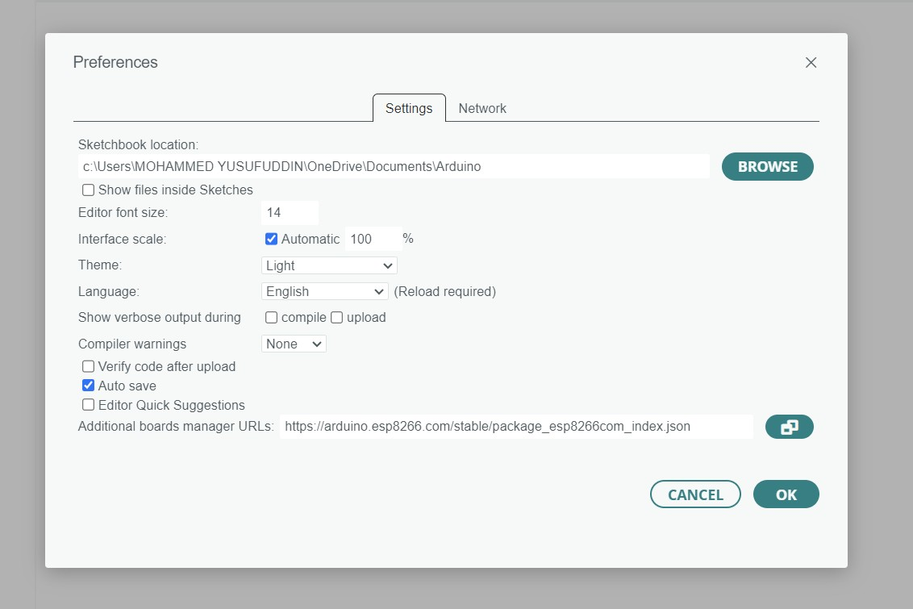
ADD YOUR TEXT
ADD YOUR TEXT
Asst. Prof. S.Asra
CSE Department, CMRIT

Slide 27
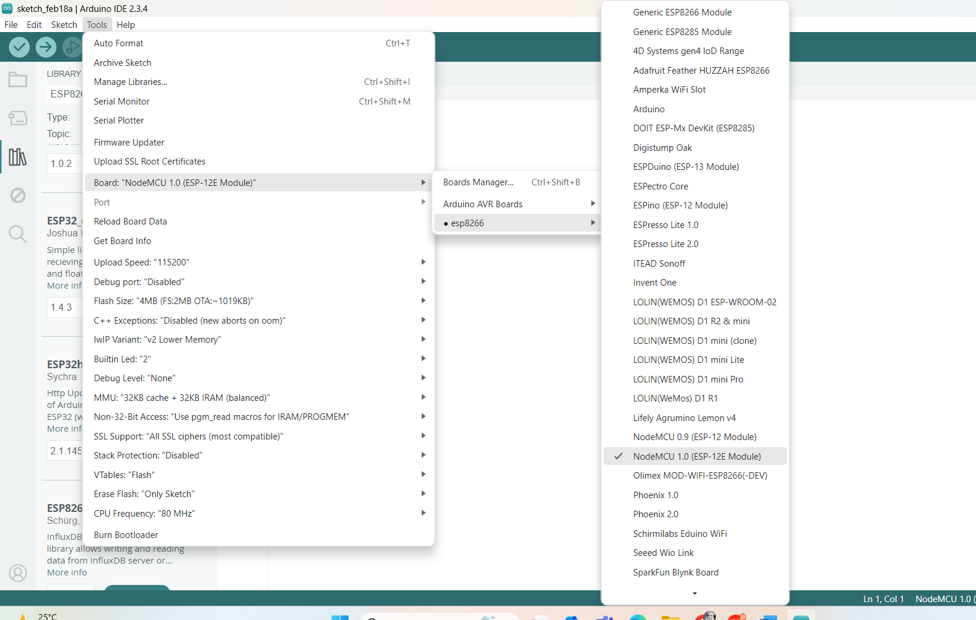
ADD YOUR TEXT
ADD YOUR TEXT
Asst. Prof. S.Asra
CSE Department, CMRIT

Slide 28
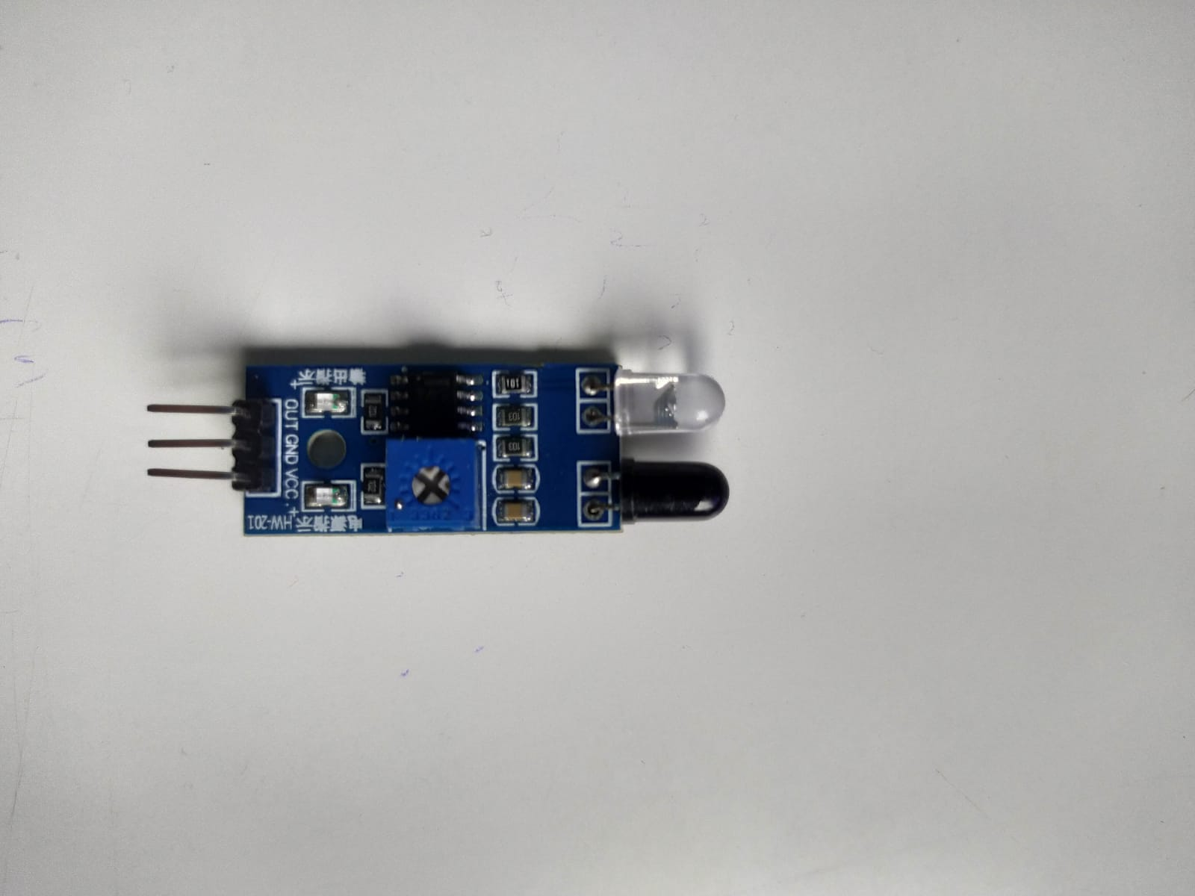
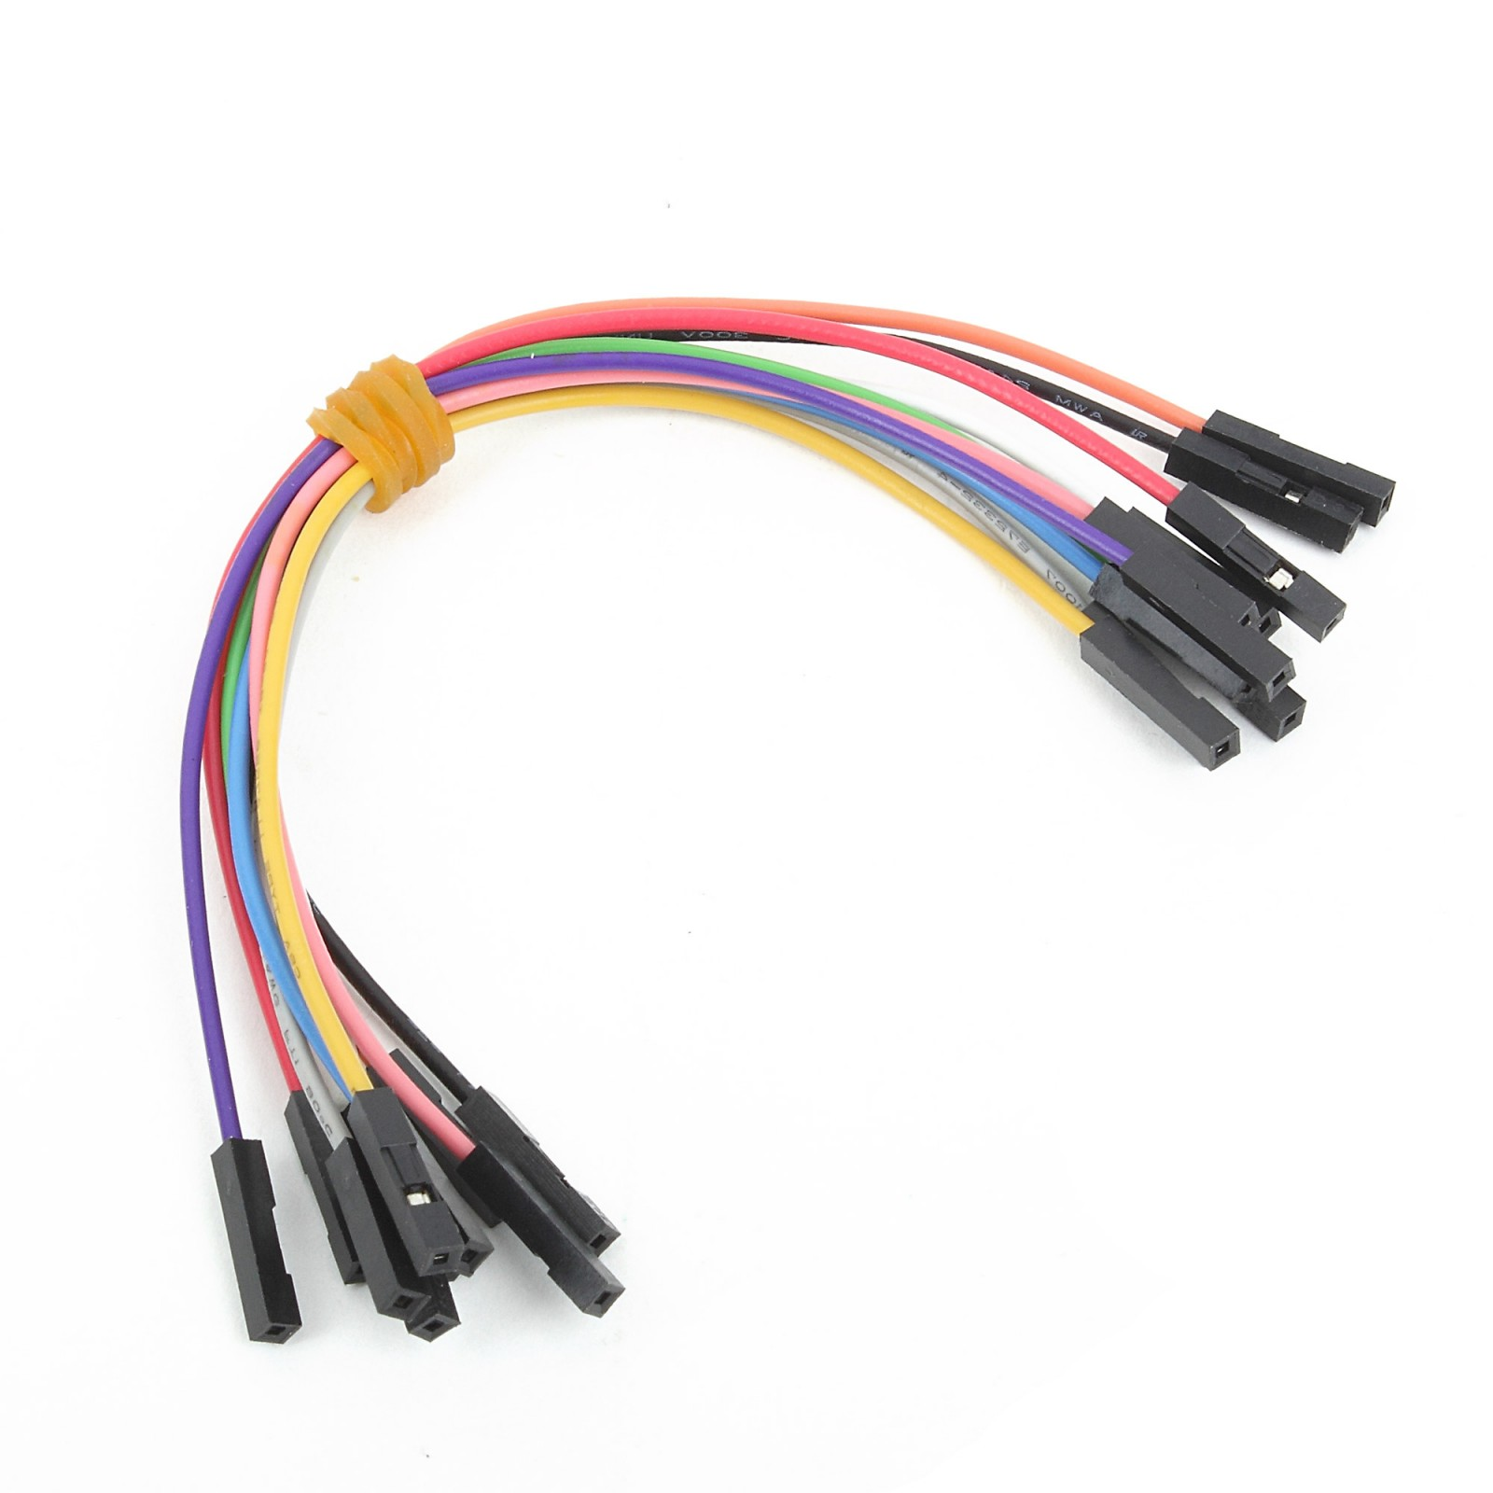
HARDWARE REQUIREMETS:
OUT- D3
GND- GND
VCC- 3.3V
ADD YOUR TEXT
ADD YOUR TEXT
Asst. Prof. S.Asra
CSE Department, CMRIT

Slide 29
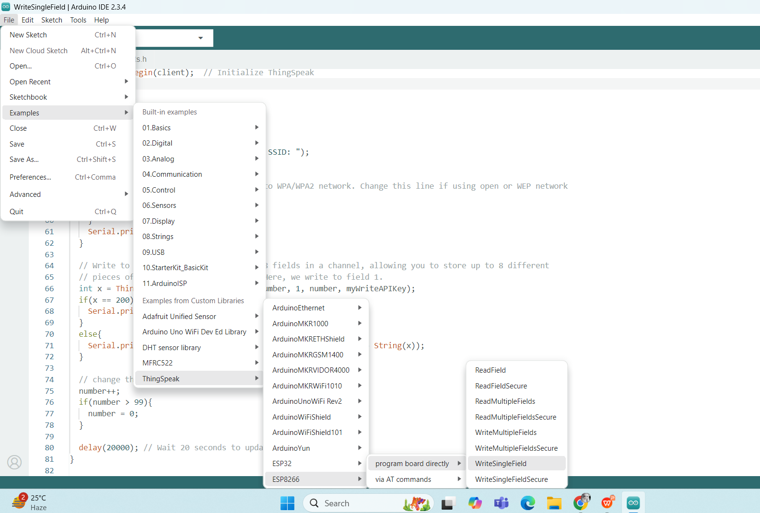
ADD YOUR TEXT
ADD YOUR TEXT
Asst. Prof. S.Asra
CSE Department, CMRIT

Slide 30
#include<ESP8266WiFi.h>
#include"secrets.h"
#include"ThingSpeak.h"// always include thingspeak header file after other header files and custom macros
char ssid[] = SECRET_SSID; // your network SSID (name)
char pass[] = SECRET_PASS; // your network password
int keyIndex = 0; // your network key Index number (needed only for WEP)
WiFiClient client;
unsignedlong myChannelNumber = SECRET_CH_ID;
constchar * myWriteAPIKey = SECRET_WRITE_APIKEY;
int number = 0;
int IRPIN = D3;
voidsetup(){
Serial.begin(115200); // Initialize serial
while(!Serial){
; // wait for serial port to connect. Needed for Leonardo native USB port only
}
WiFi.mode(WIFI_STA);
ThingSpeak.begin(client); // Initialize ThingSpeak
}
ADD YOUR TEXT
ADD YOUR TEXT
Asst. Prof. S.Asra
CSE Department, CMRIT

Slide 31
voidloop(){
// Connect or reconnect to WiFi
if(WiFi.status() != WL_CONNECTED){
Serial.print("Attempting to connect to SSID: ");
Serial.println(SECRET_SSID);
while(WiFi.status() != WL_CONNECTED){
WiFi.begin(ssid, pass); // Connect to WPA/WPA2 network. Change this line if using open or WEP network
Serial.print(".");
delay(5000);
}
Serial.println("\nConnected.");
}
// Write to ThingSpeak. There are up to 8 fields in a channel, allowing you to store up to 8 different
// pieces of information in a channel. Here, we write to field 1.
int x = ThingSpeak.writeField(myChannelNumber, 1, number, myWriteAPIKey);
if(x == 200){
Serial.println("Channel update successful.");
}
else{
Serial.println("Problem updating channel. HTTP error code " + String(x));
}
ADD YOUR TEXT
ADD YOUR TEXT
Asst. Prof. S.Asra
CSE Department, CMRIT

Slide 32
// change the value
number++;
if(number > 99){
number = 0;
}
delay(20000); // Wait 20 seconds to update the channel again
}
Secrets.h
#define SECRET_SSID "ACENAARTECHNOLOGY”
#define SECRET_PASS "987654321"
#define SECRET_CH_ID 1748773
#define SECRET_WRITE_APIKEY "IT8VWXOS2XKSYFR9"
Asst. Prof. S.Asra
CSE Department, CMRIT

Slide 33
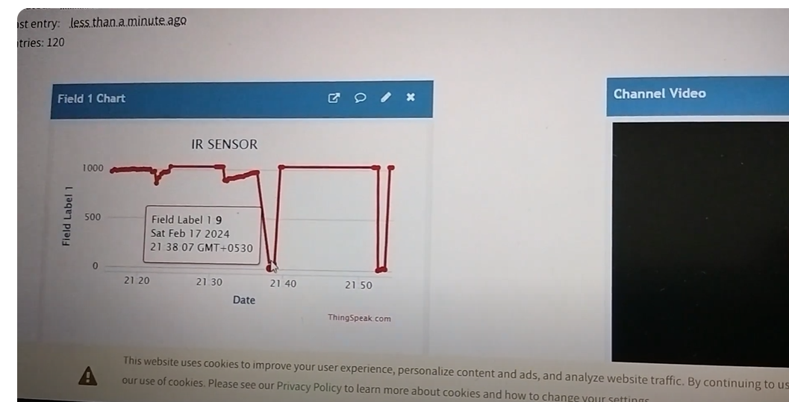
OUTPUT
ADD YOUR TEXT
ADD YOUR TEXT
Asst. Prof. S.Asra
CSE Department, CMRIT

Slide 34
THANK YOU

