Slide 1
IOT AND CLOUD COMPUTING LAB
By,
Asst. Prof. S.Asra
M.E(Computer science & Engineering)
B.E(Computer Science & Engineering)
Diploma(Computer Science & Engineering)

Slide 2
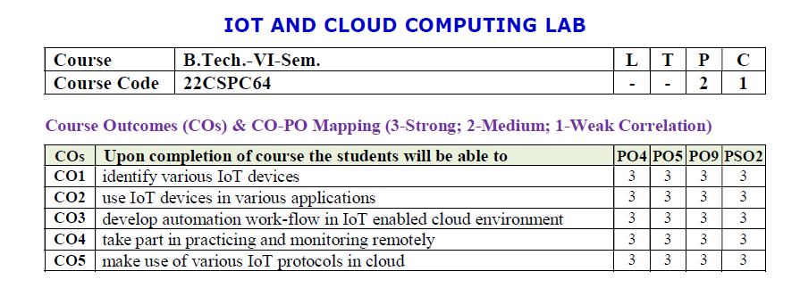
01
Add your title
02
Add your title
03
Add your title
04
Add your title
05
Add your title

Slide 3
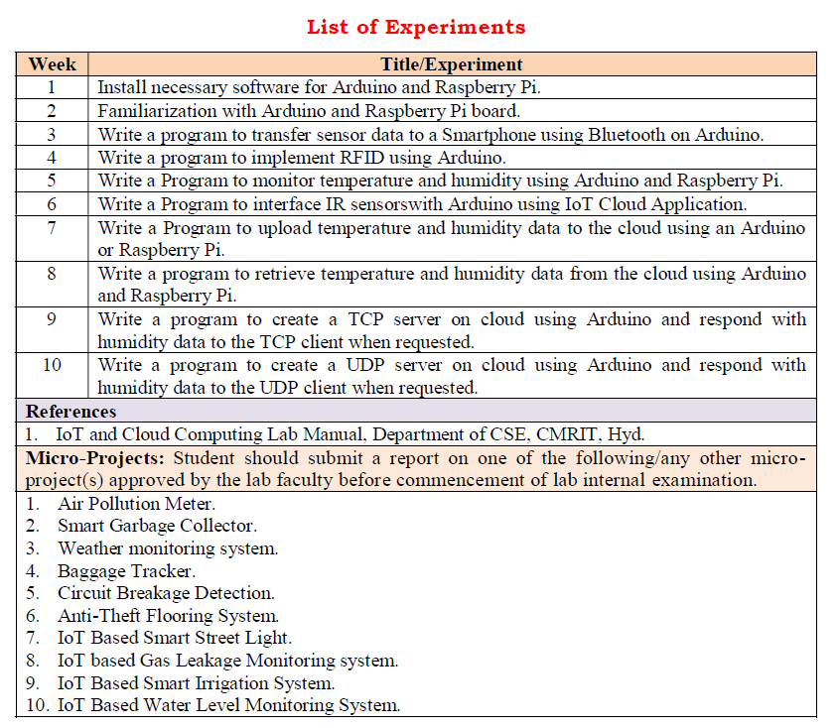

Slide 4
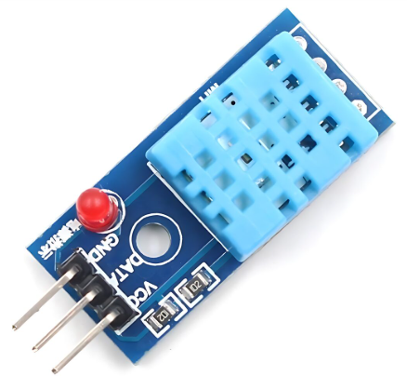
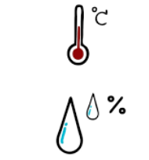
WEEK-7
Aim: Write a program on Arduino/Raspberry Pi to upload temperature and humidity data to cloud.
Hardware Requirements:
1. Arduino UNO board
2. NodeMCU ESP8266 Breakout Board
3. DHT-11 temperature and humidity sensor
4. Jumper wires
5. Bread board
6. WIFI Network
Procedure:
1. Download esp8266 Zip file->go to libraries->add Zip file
2. Connect Node MCU, Go to tools->change board to Node MCU esp8266 and port number
3. Connect DHT-11 temperature and Humidity sensor to Node MCU
4. Sign up to cloud->create channels->copy API key to the source code
5. SSID and password of your WIFI connection should be given in source code
6. Compile and upload the program and verify the temperature and humidity readings in serial monitor
7. Go to cloud and verify the temperature and humidity values in graph.
07
Asst. Prof. S.Asra
CSE Department, CMRIT

Slide 5

The DHT11 is a digital temperature and humidity sensor that provides calibrated output via a single-wire communication protocol.
It is commonly used in
weather monitoring systems,
home automation, and
IoT applications.
1. Weather Monitoring Systems
🌤️ Used in DIY and professional weather stations to measure temperature and humidity levels.
2. Home Automation & Smart Homes
🏡 Integrated into IoT-based smart home systems for automatic climate control, triggering fans, air purifiers, or dehumidifiers.
Asst. Prof. S.Asra
CSE Department, CMRIT

Slide 6
3. Greenhouse Monitoring
🌱 Helps maintain optimal temperature and humidity levels for plant
growth in agricultural environments.
4. Industrial Environmental Monitoring
🏭 Used in factories and warehouses to monitor environmental
conditions that affect machinery and stored goods.
5. HVAC (Heating, Ventilation, and Air Conditioning) Systems
❄️ Helps in climate control systems by providing real-time temperature and humidity data for automated adjustments.
Asst. Prof. S.Asra
CSE Department, CMRIT

Slide 7
Specifications:
Temperature Range: 0°C to 50°C (±2°C accuracy)
Humidity Range: 20% to 90% RH (±5% accuracy)
Operating Voltage: 3.3V - 5V
Output Signal: Digital (single-wire)
Sampling Rate: 1 Hz (one reading per second)
Response Time: ~2 seconds
Dimensions: 15mm x 12mm x 5mm
Pinout:
VCC - Power supply (3.3V or 5V)
Data - Digital output (connect to a pull-up resistor, typically 4.7kΩ)
GND - Ground
Asst. Prof. S.Asra
CSE Department, CMRIT

Slide 8
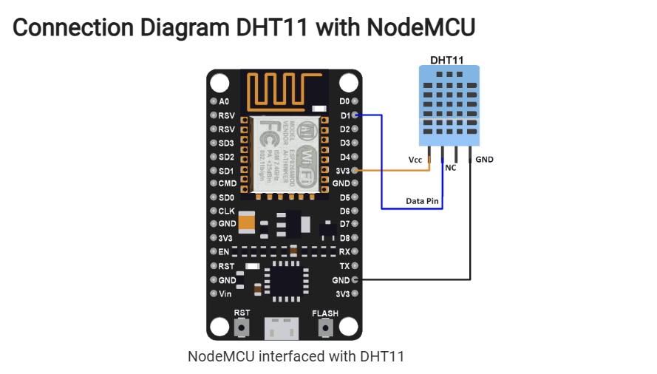
OUTPUT:
Asst. Prof. S.Asra
CSE Department, CMRIT

Slide 9
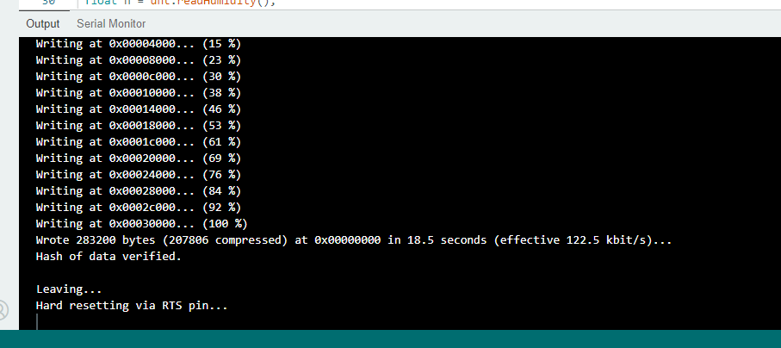
OUTPUT:1
Asst. Prof. S.Asra
CSE Department, CMRIT

Slide 10
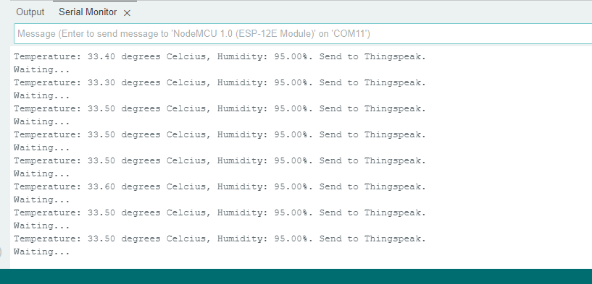
OUTPUT:2
Asst. Prof. S.Asra
CSE Department, CMRIT

Slide 11
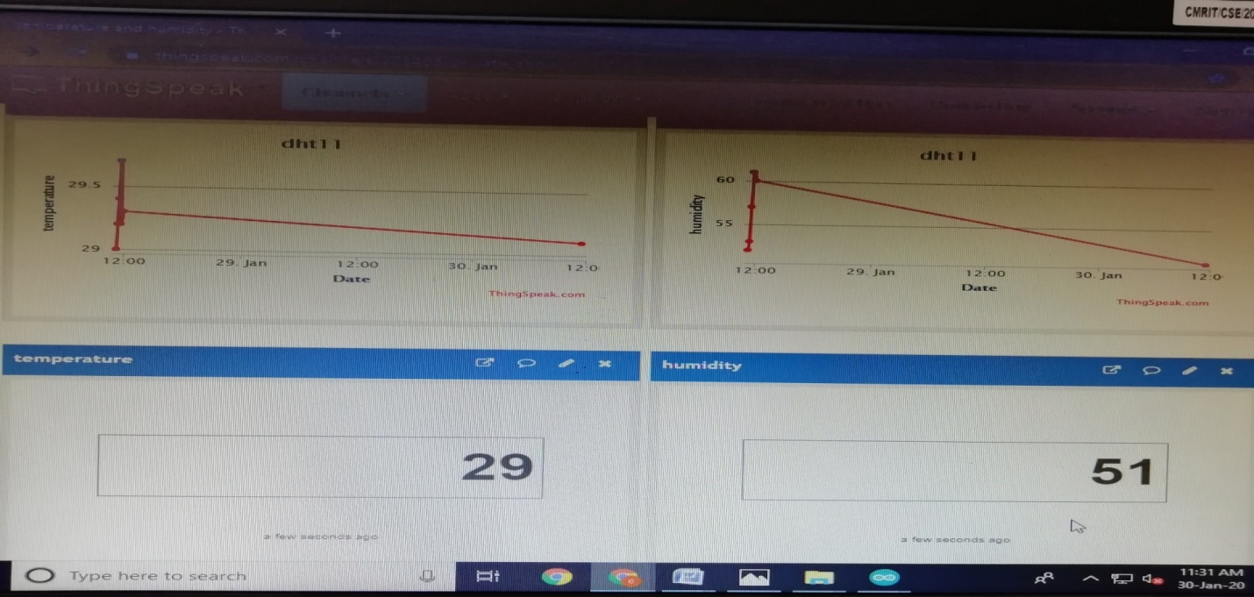
Uploading the data in CLOUD:
Asst. Prof. S.Asra
CSE Department, CMRIT

Slide 12
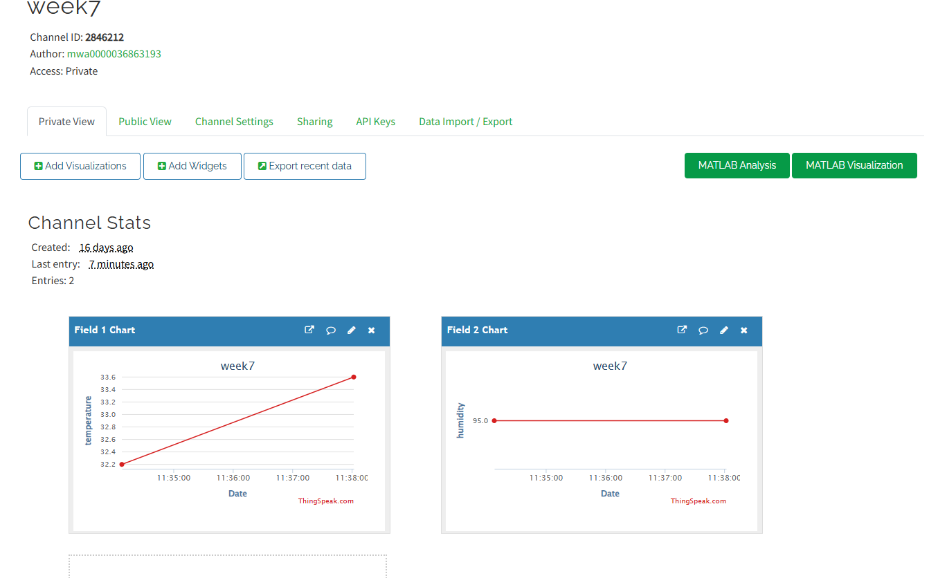
Output:3
Asst. Prof. S.Asra
CSE Department, CMRIT

Slide 13
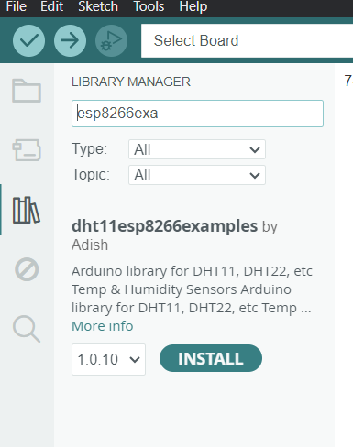
Asst. Prof. S.Asra
CSE Department, CMRIT

Slide 14
THANK YOU!
THANK YOU FOR WATCHING

