Slide 1
IOT AND CLOUD COMPUTING LAB
By,
Asst. Prof. S.Asra
M.E(Computer science & Engineering)
B.E(Computer Science & Engineering)
Diploma(Computer Science & Engineering)

Slide 2
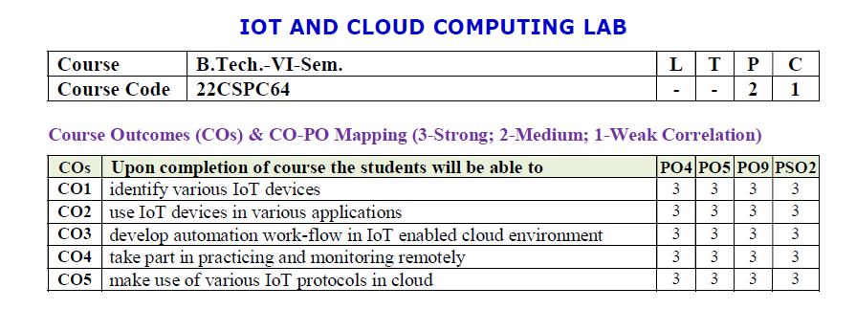
IOT AND CLOUD COMPUTING LAB

Slide 3
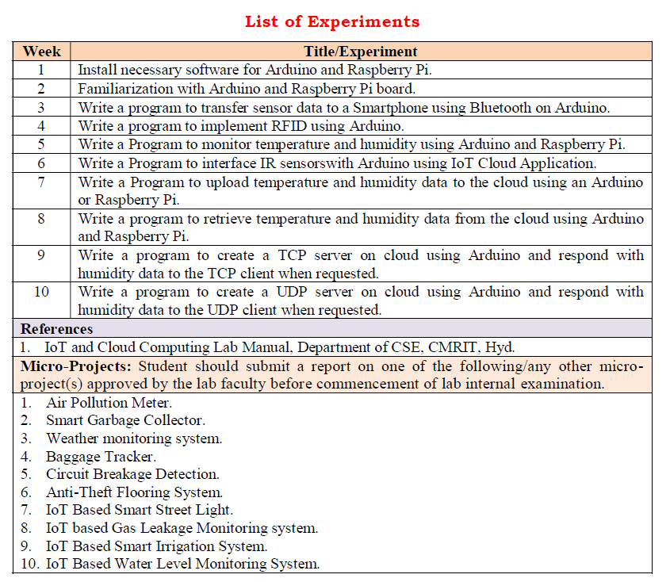
Analysis of teaching
Teaching strategy
CONTENTS
The teaching process
Teaching reflection

Slide 4
WEEK-8
Aim: Write a program to retrieve temperature and humidity data to the cloud using Arduino or Raspberry Pi.
Hardware Requirements:
1.Arduino UNO board
2.NodeMCU ESP8266 Breakout Board
3.DHT-11 temperature and humidity sensor
4.Jumper wires
5.Bread board
Procedure:
1. Open up the Arduino IDE and head over to the library manager.
2. Install the DHT library (You can also install it by going to Sketch > Include Library > Manage Libraries, and search for adafruit dht library).
DHT sensor with 3 pins:
1. Power supply 3.5V to 5.5V.
2. Data, Outputs both Temperature and Humidity through serial Data.
3. Ground, Connected to the ground of the circuit.
Set up in source code:
1. Set your Wi-Fi SSID and password.
2. Set the API Key
3. Save->Compile->upload->now us can visualize our data in cloud
Asst. Prof. S.Asra
CSE Department, CMRIT

Slide 5
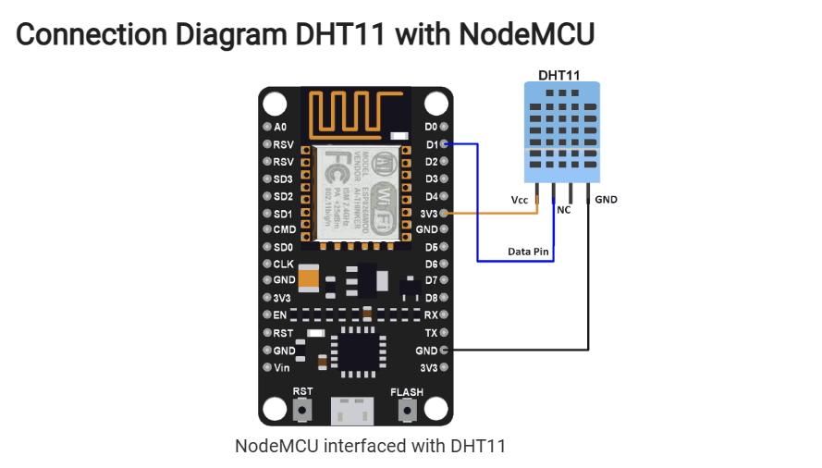
Asst. Prof. S.Asra
CSE Department, CMRIT

Slide 6
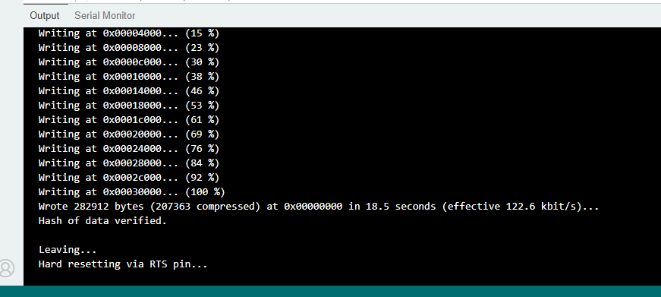
OUTPUT 1 :
Asst. Prof. S.Asra
CSE Department, CMRIT

Slide 7
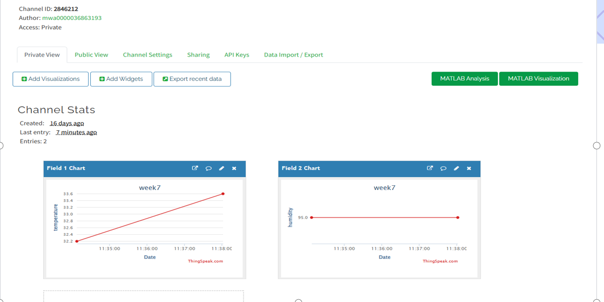
OUTPUT 2:
Asst. Prof. S.Asra
CSE Department, CMRIT

Slide 8
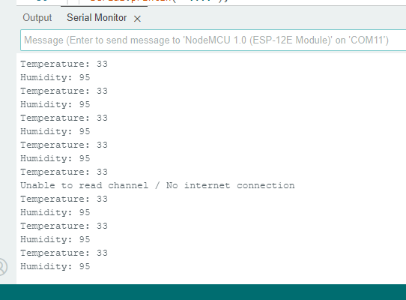
OUTPUT 3:
Asst. Prof. S.Asra
CSE Department, CMRIT

Slide 9
Thank you for listening to

