Slide 1
FIXERS
CAPSTONE PROJECT
K.JASMINE
M.AMULYA
M.DIVYA
P.BABITHA

Slide 2
Problem Statement:
In Pharmaceutical companies, they maintain the temperatures of the capsules in the range of threshold values. If these threshold values crosses their limits, then there will be a huge loss to the companies.
So, to minimize this loss, we come up with a solution by using IOT.

Slide 3
Solution:
By discussing with all our team members ,we come up with a solution in such a way that, whenever the temperature crosses the range of threshold values, the company owner will receive an alert of warning message either through SMS or through Email. So that He/ She can immediately set the temperature back to its threshold limits. By this, the loss will be decreases.

Slide 4
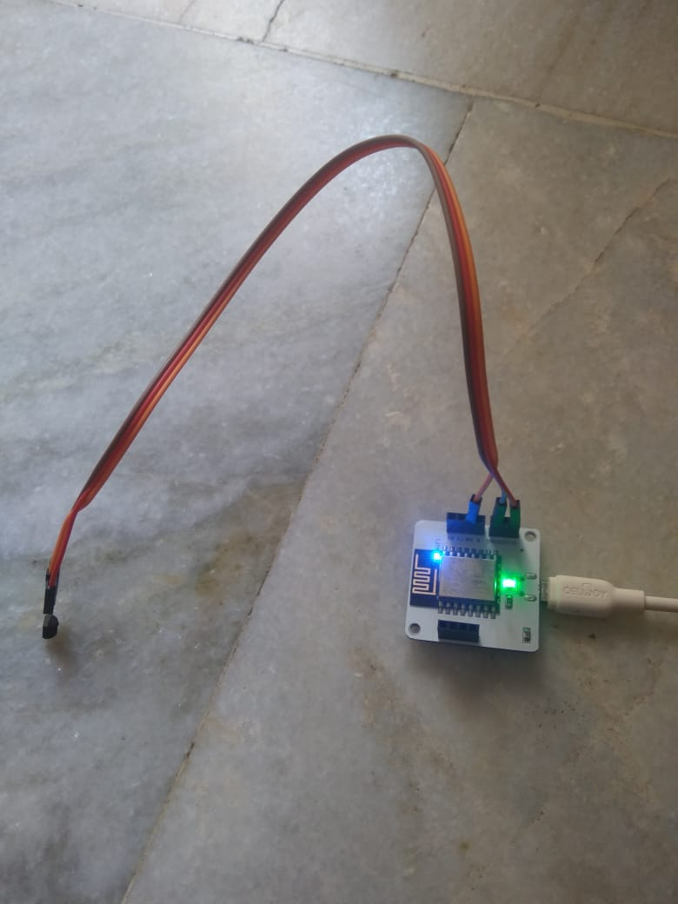
Here are some of the shots that taken while doing the project
CIRCUIT CONNECTIONS

Slide 5
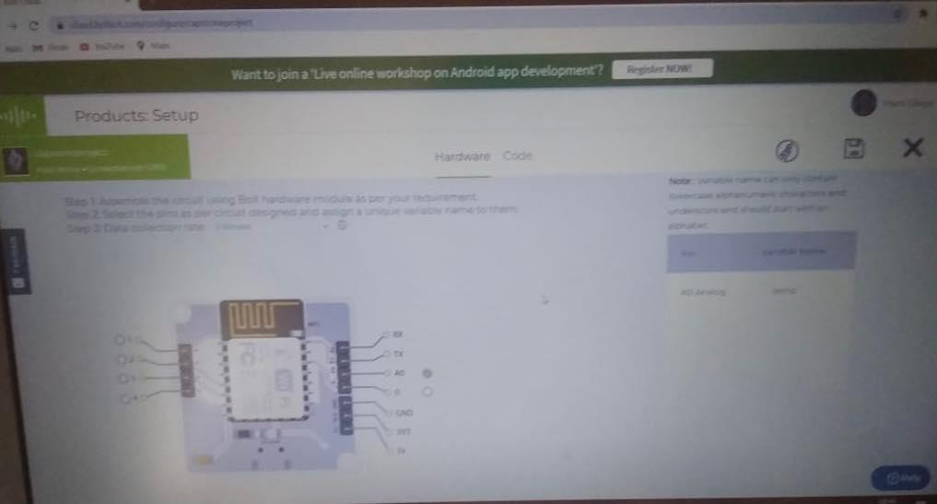
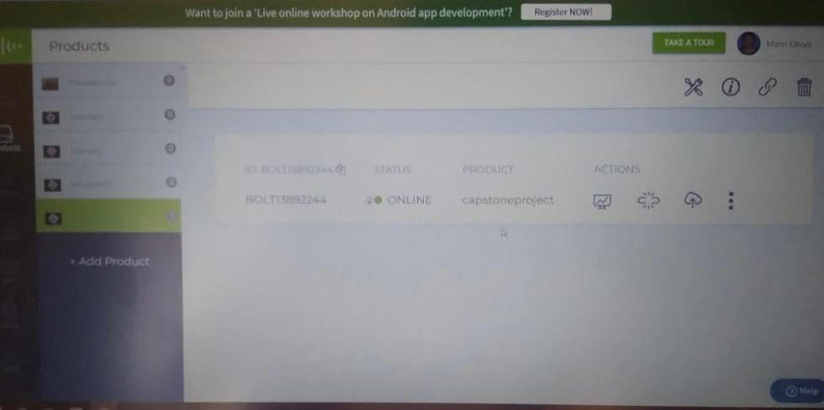
Creation of Product on BOLT Cloud

Slide 6
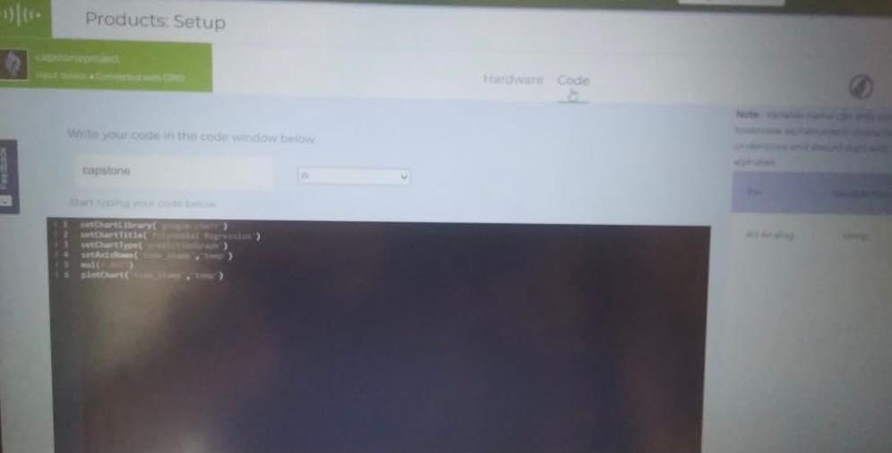
Code for Polynomial Regression

Slide 7
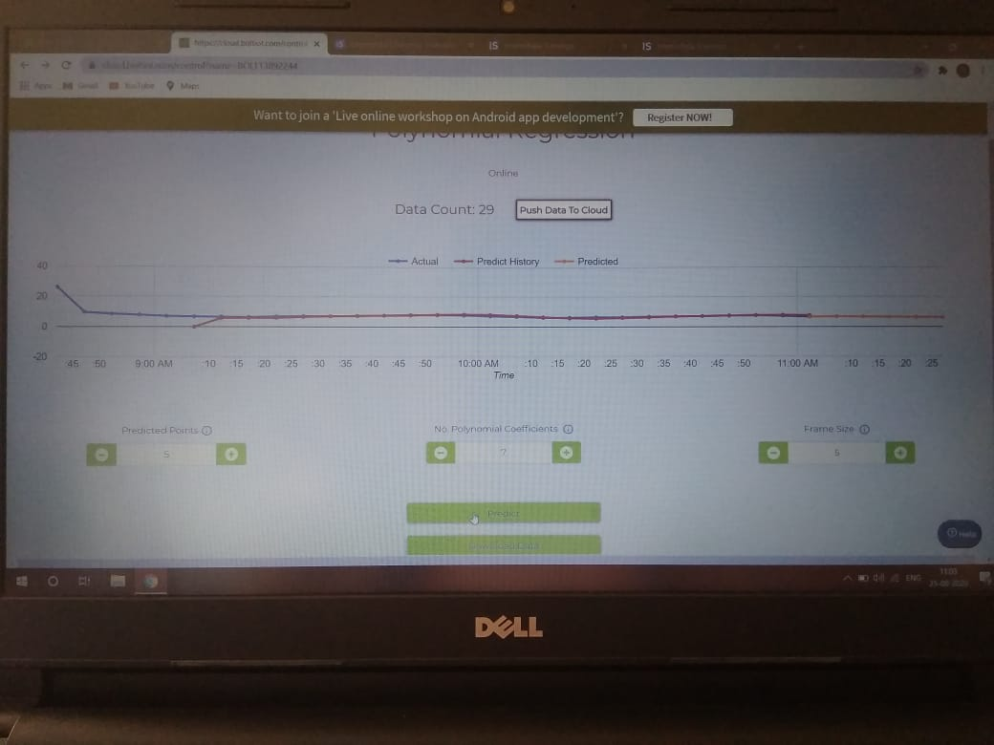
GRAPH

Slide 8
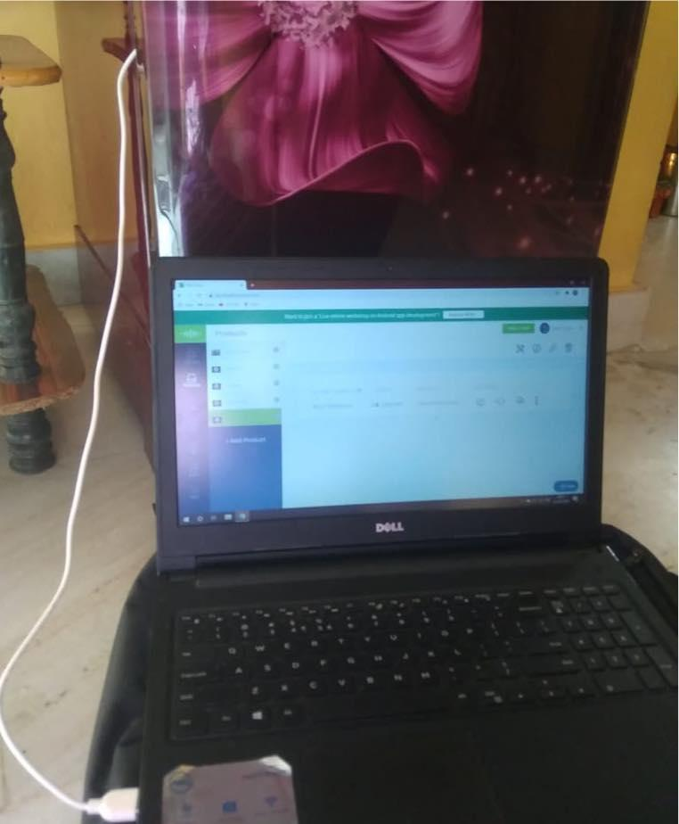
Setting up the Circuit inside the Refrigerator

Slide 9
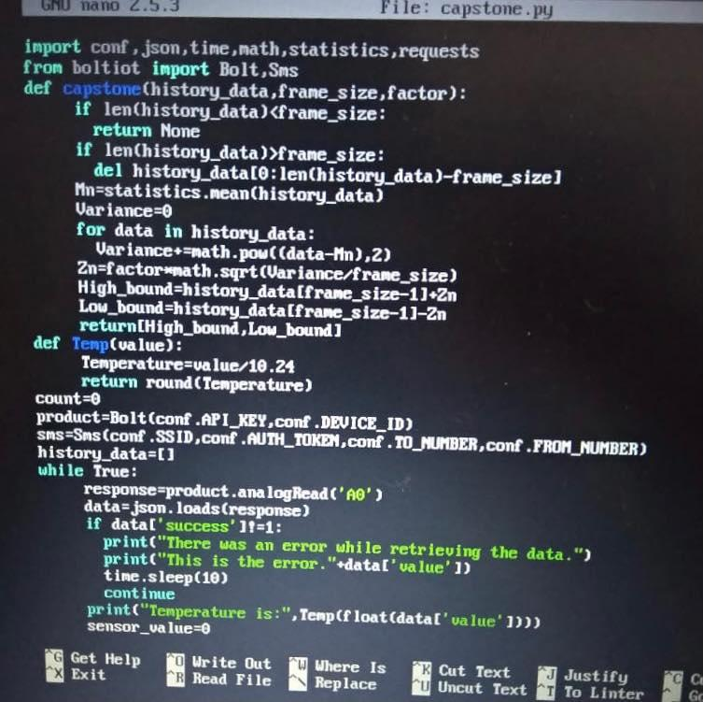
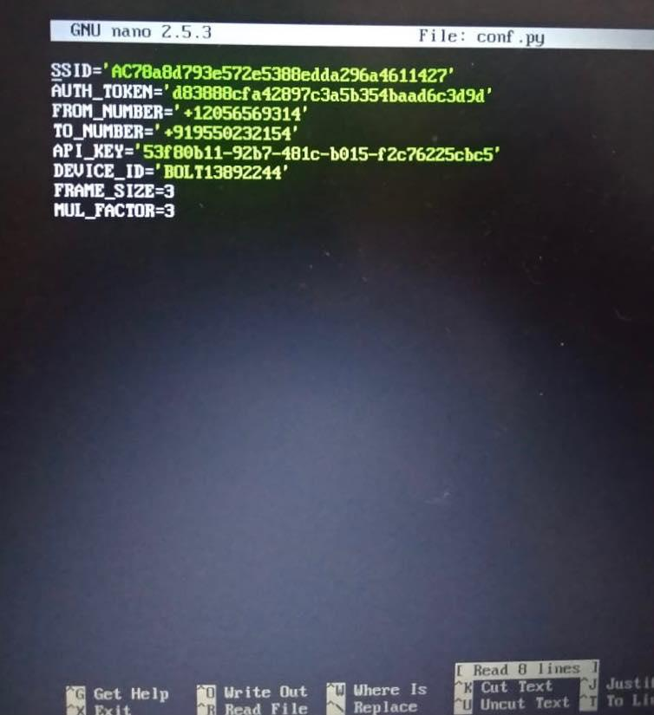
PYTHON CODE

Slide 10
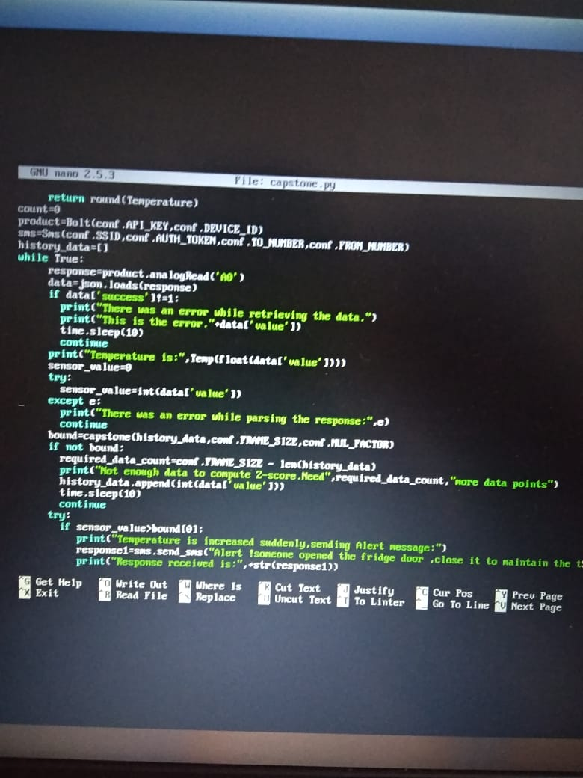
PYTHON CODE

Slide 11
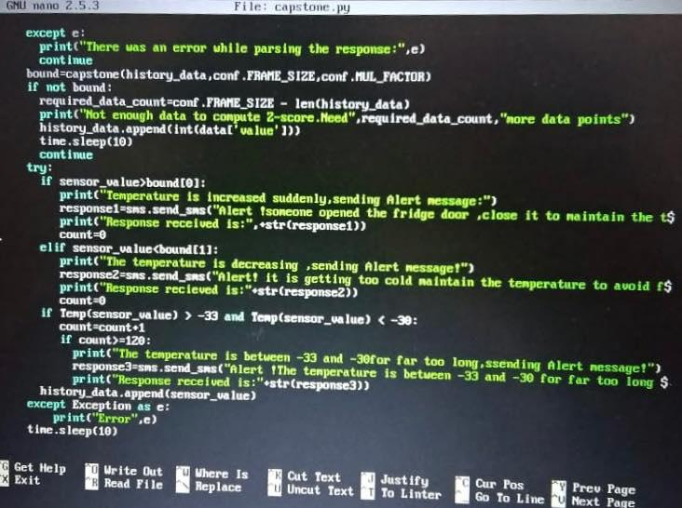
PYTHON CODE

Slide 12
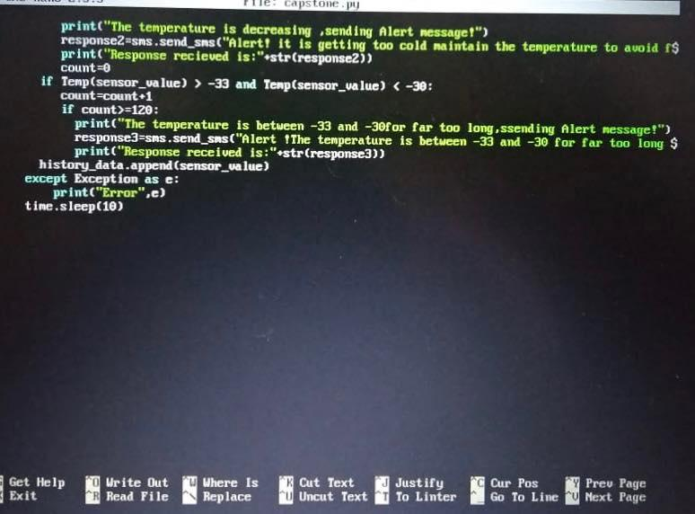
PYTHON CODE

Slide 13
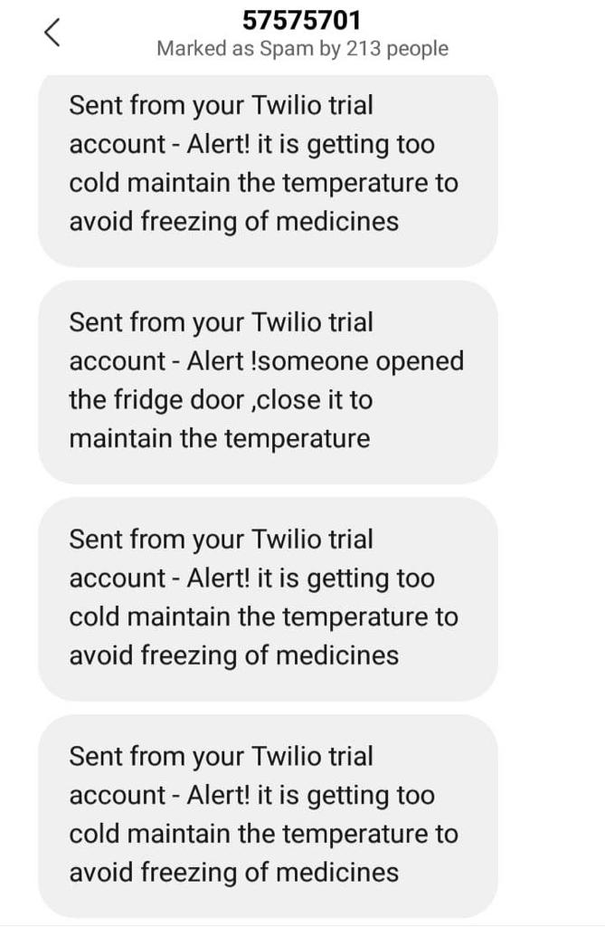
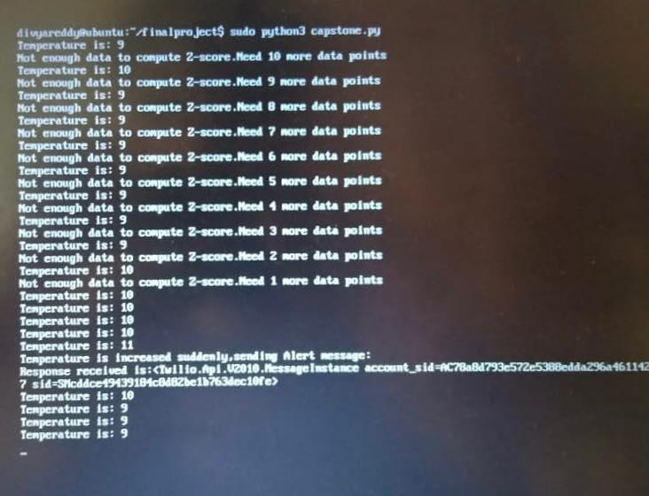
OUTPUT

Slide 14
THANK YOU

