Slide 1

AgrObot
Team Turing
Taking agriculture a step forward

Slide 2
Team members:
P.Dinesh
Md Ameer
K. Vijay Raghav
D.Dineshwar

Slide 3
What’s new with our idea…..?

Slide 4
IS IT EVEN USEFUL…?

Slide 5
Every
question
is
answered…..

Slide 6
Did you know that only in the span of last decade nearly 8.6 millions of farmers dipped

Slide 7
If these Numbers are real….

Slide 8
Who will be the next farmer…

Slide 9
So we came up with a solution ………..

Slide 10
It’s

Slide 11
Robot

Slide 12
Is this going to work…………..??

Slide 13
Yes countries like:
Japan
Netherlands
China

Slide 14
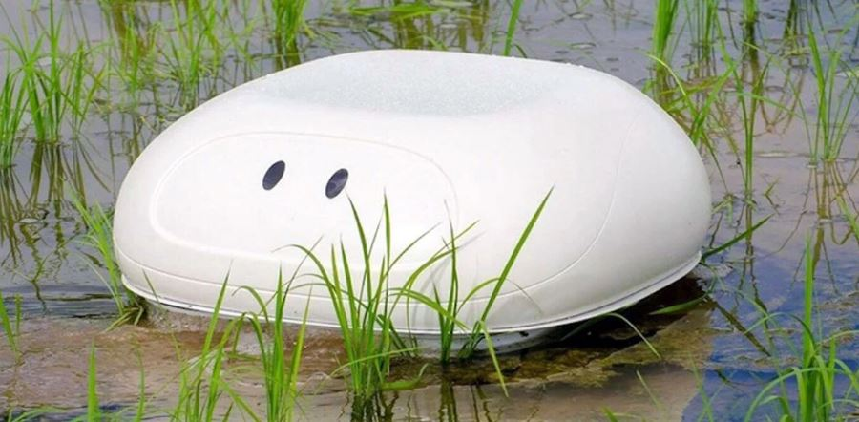

Slide 15
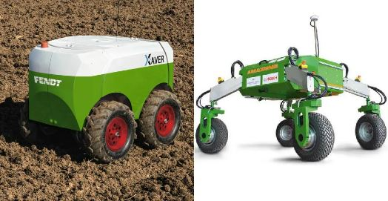

Slide 16
So what’s new with our project

Slide 17
The way we imply…..

Slide 18
What makes our project better over theirs….

Slide 19
Complete autonomous Vehicle

Slide 20
Daily monitoring of crop

Slide 21
Robot’s Main functions:
Plant health tracking
Soil moisture tracking
Weed plant detection
Autonomously watering crop
Integrated to Rainfall predictor
Autonomous Herbicide/Pesticide sprinkling

Slide 22
Is your prototype ready…?

Slide 23
No, not yet we are currently working on rainfall predictor using telangana rainfall dataset
We assure that we will do it by 2021

