Slide 1
Stud-FEED
BANDARI MEGHANA(17R01A0504)
RAVULA MANISHA(17R01A05G2)
KAMPELLI VINEESHA(18R05A0504)

Slide 2



Contents
Introduction
Existing System
Proposed System
Hardware and Software Requirements
Implementation
Conclusion
Future scope

Slide 3
introduction
Stud-Feed Project helps the administration of the college in collecting the feedback from students.

Slide 4
Proposed system
An app is created to collect the feedback from students about the teachers, on which the system performs sentiment analysis and produces an overall rating.
An admin site is crested to monitor all the ratings of teachers.

Slide 5
Software requirements
Operating system: Windows 7 or later, macOS, Linux.
Development Tools: Python 3.7 or above, Django 3.0,Bootstrap, MySQL, Android Studio, Visual Studio Code or PyCharm.

Slide 6
Hardware requirements
Processors: Intel Atom® processor or Intel® Core™: i3 processor.
Disk space: 1 GB.
Input device (mouse / trackpad) to select options
32 – 64 bit processor
Sufficient RAM to run the program (Minimum 2GB)
Android Mobile version 5.0 or above.

Slide 7
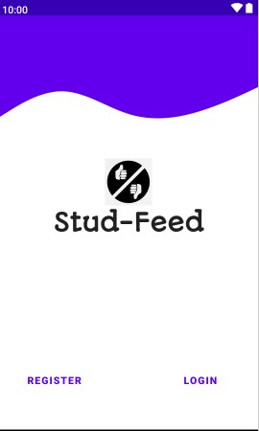
implementation
Main Page

Slide 8
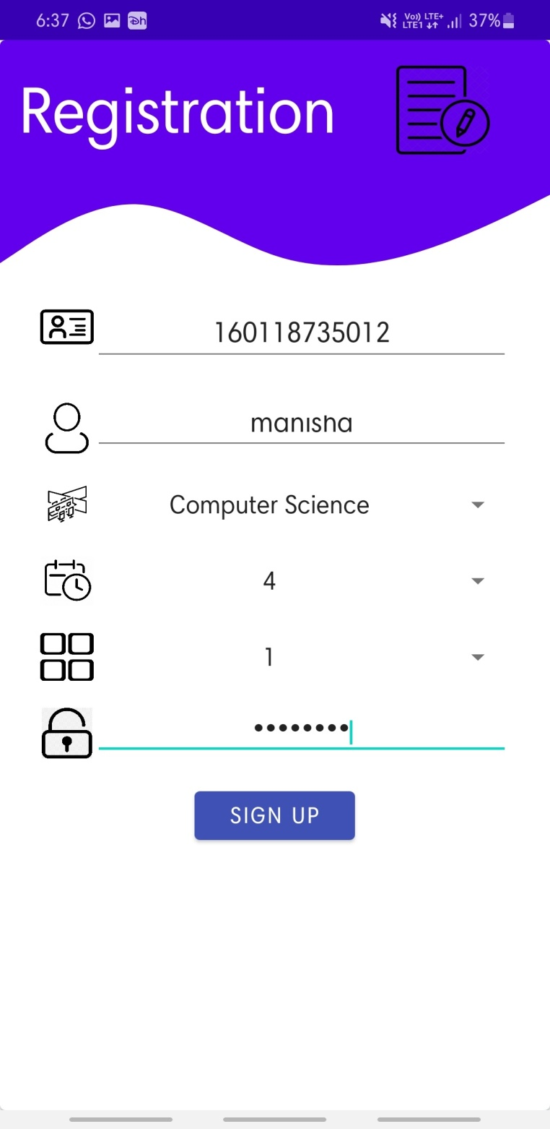
implementation
Registration Page

Slide 9
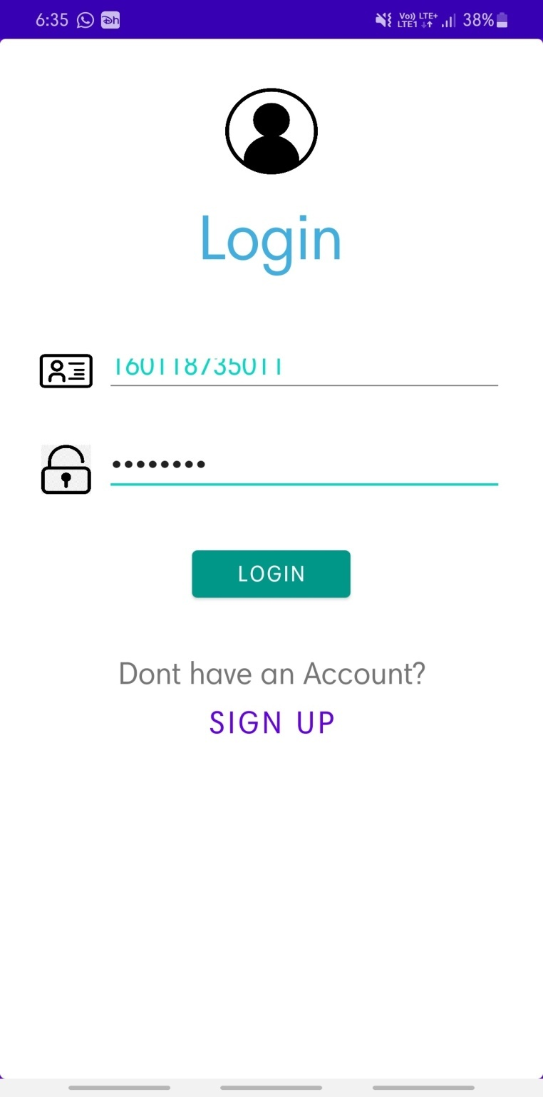
implementation
Login Page

Slide 10
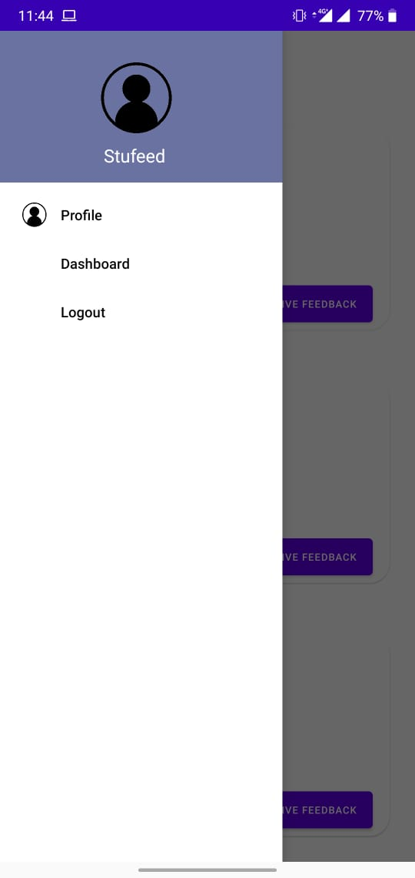
implementation
Dashboard

Slide 11
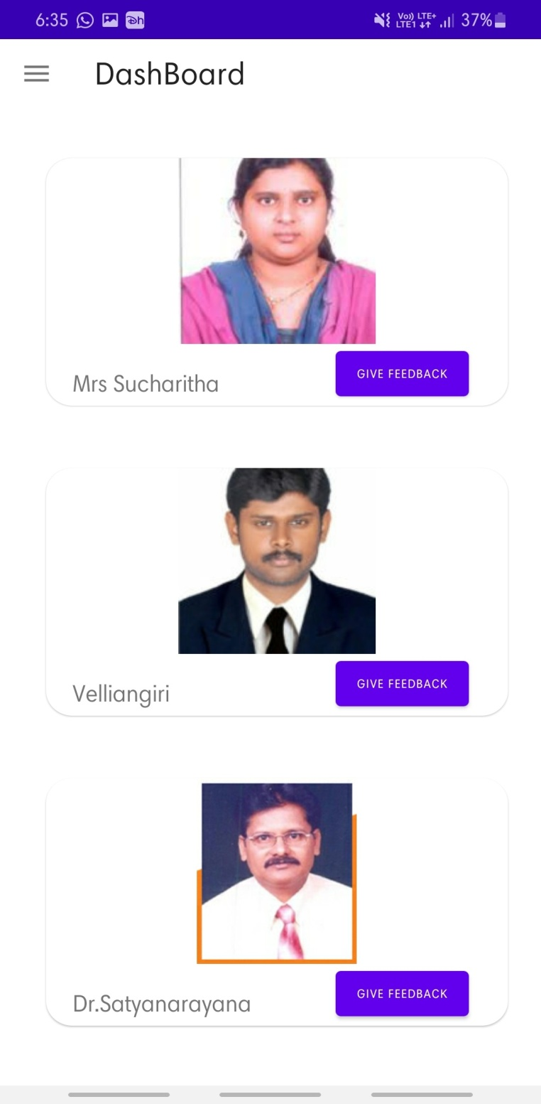
implementation
Home Page

Slide 12
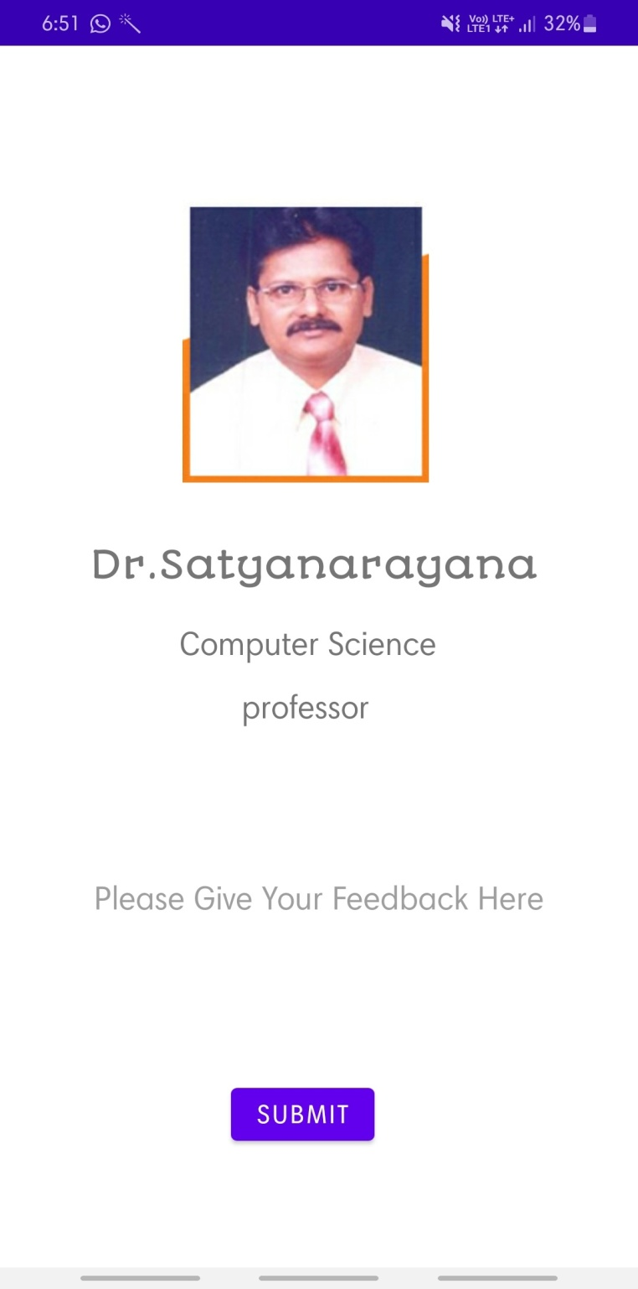
implementation
Feedback Page

Slide 13
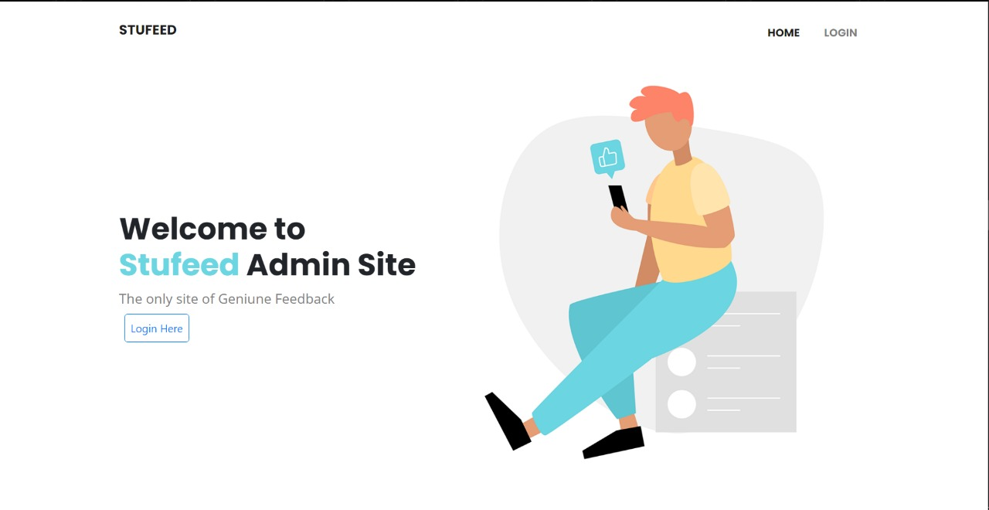
implementation
Admin Main Page

Slide 14
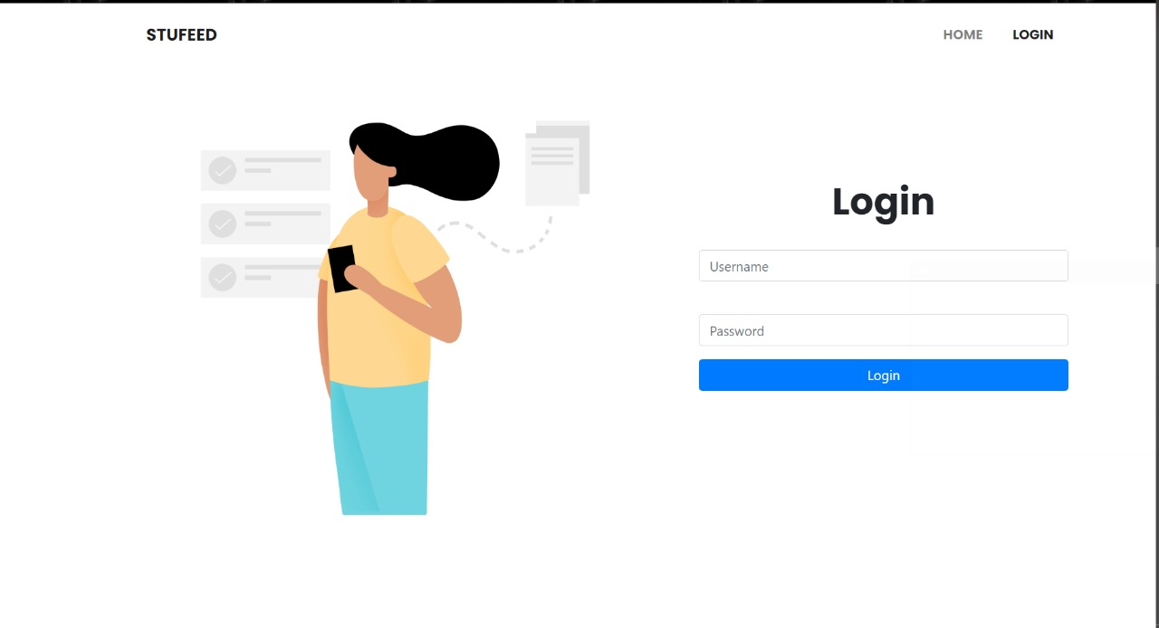
implementation
Admin Login Page

Slide 15
conclusion
The Stud-Feed project intends to resolve all the problems faced by administration in getting feedback from the students.

Slide 16
future scope
There will always be areas for potential improvement, UI of the application can be improved.
We can add various features such provide feedback for each period according to the timetable.

Slide 17

Thank you!

