Slide 1
Case Study 2 – Attrition & Salary
DDSAnalytics presents an analysis of attrition and monthly salary for your company
Chris Roche
MSDS 6306: Doing Data Science
February 20, 2021

Slide 2
Agenda
Overview of data
Attrition and 3 leading contributors
Predicting attrition
Linear Regression and monthly salary
Helpful insights to make data driven decisions

Slide 3

Overview of the data
Employee data set used for exploratory data analysis had 870 observations
There were 36 variables per observations:
Satisfaction: job, environment, relationship with manager, work life balance
Years: with company, in current position, total working years
Income rates: daily, weekly, monthly
The data set was complete and contained no missing values

Slide 4
Attrition overview
Three leading contributors to attrition:
Job level (levels from 1 – 5)
Number of companies worked for
Years at the company
Utilized K-Nearest Neighbor model
K = 5
Accuracy contained in the table to the right
P-value of less than 0.05 shows the results are statistically significant
Metric | Value
Accuracy | 87.4%
Sensitivity | 87.6%
Specificity | 66.7%
Accuracy 95% CI | [82.7, 91.1]
P-value | < 0.05

Slide 5
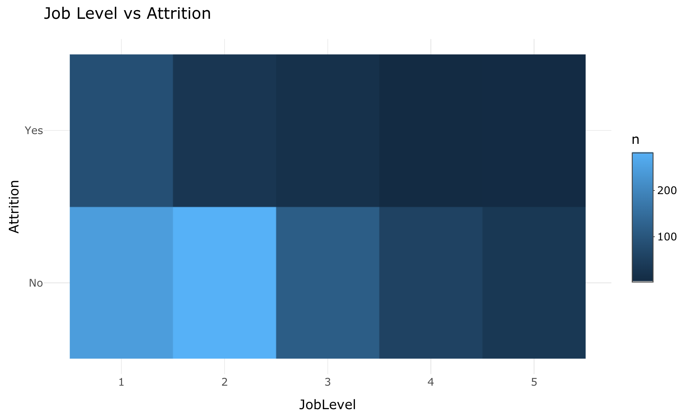
Attrition contributors – one
Employee Job Level:
As the Job Level increases from 1 to 5, the number of employees who have voluntarily left decreases
This suggests that senior level employees are more likely to stay with the company than entry level or junior hires

Slide 6
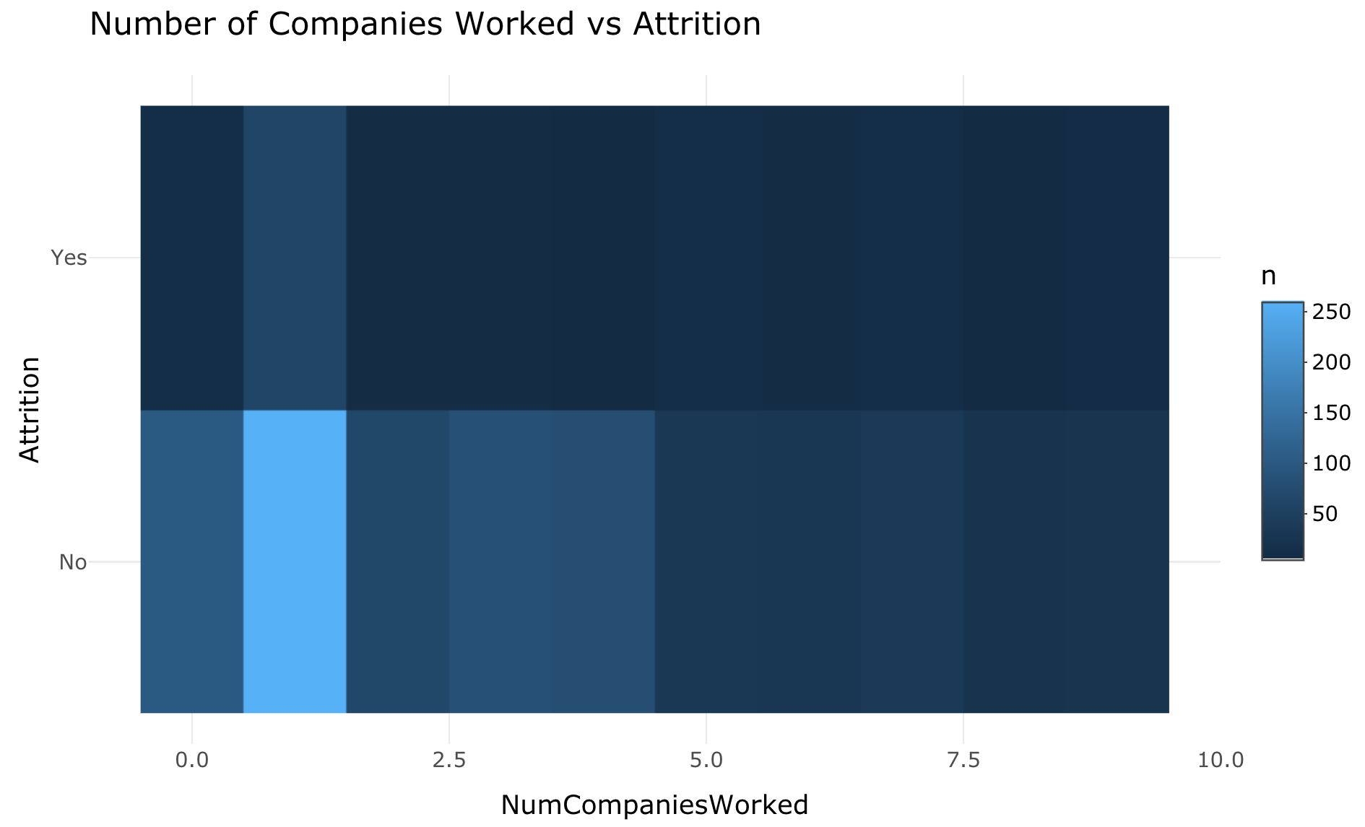
Attrition contributors – two
Number of companies the employee has worked for:
The tile graph suggests the less companies a person has worked for in their career, the less likely they are to voluntarily leave

Slide 7
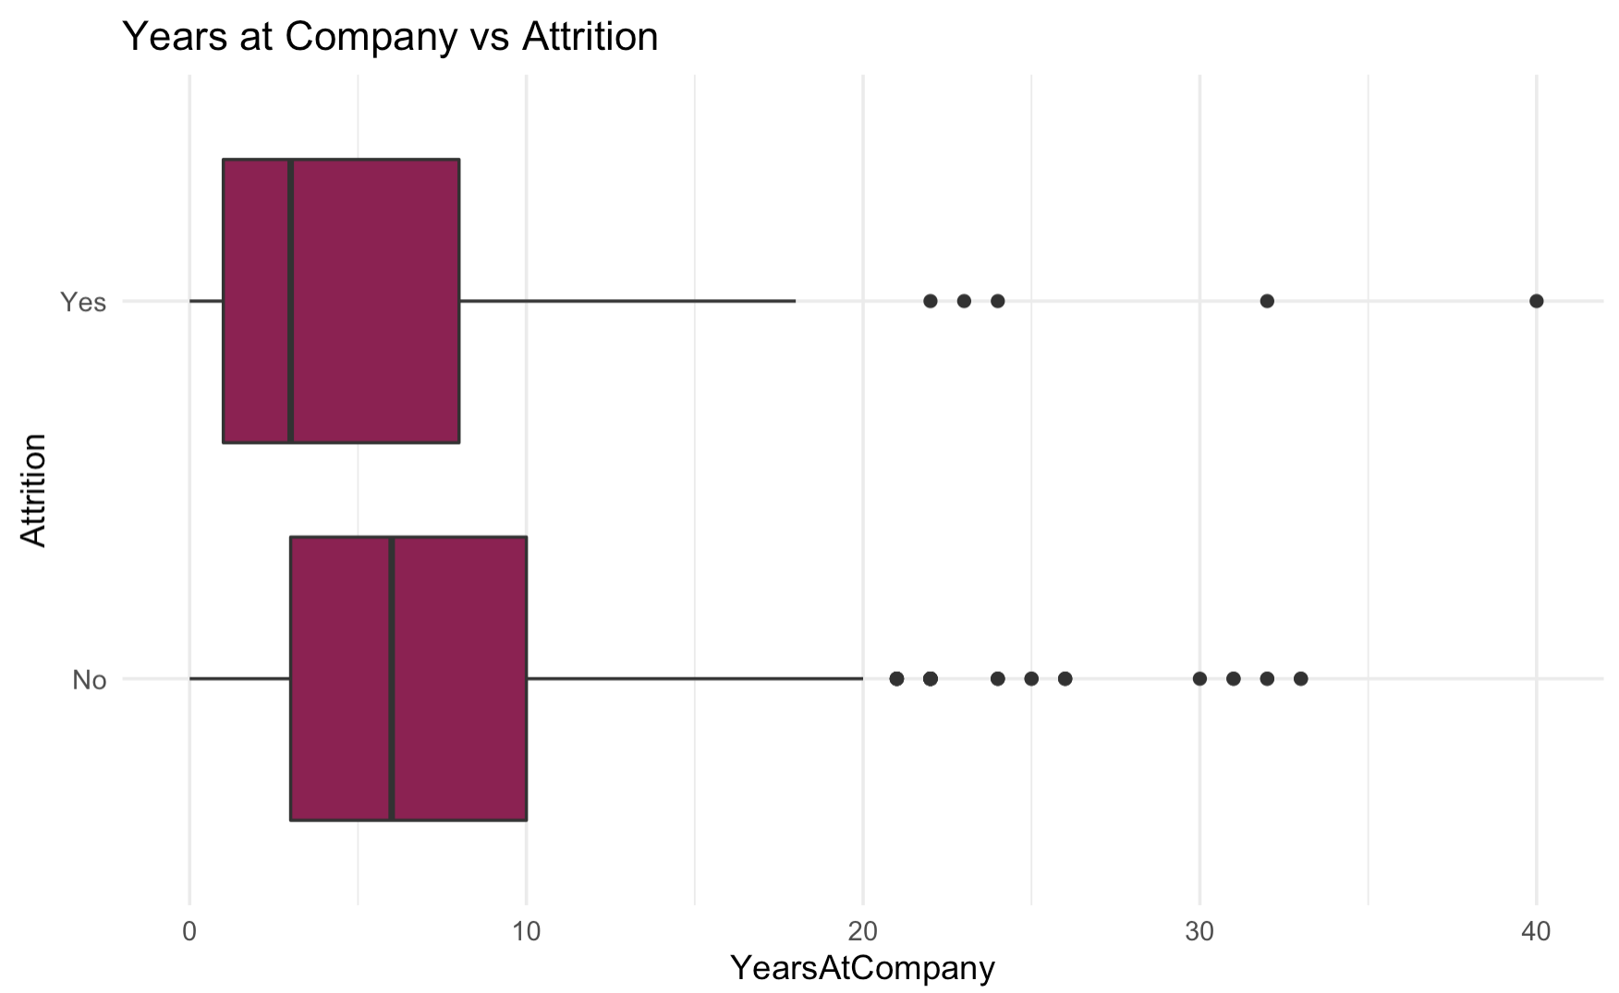
Attrition Contributors – three
Years at the company:
On average, the longer a person is employed by the company the less likely they are to leave
Median – Attrition ‘Yes’: 3 years
Median – Attrition ‘No’: 6 years
This suggests years ~2 – 6 are key for employees to determine whether they stay on

Slide 8
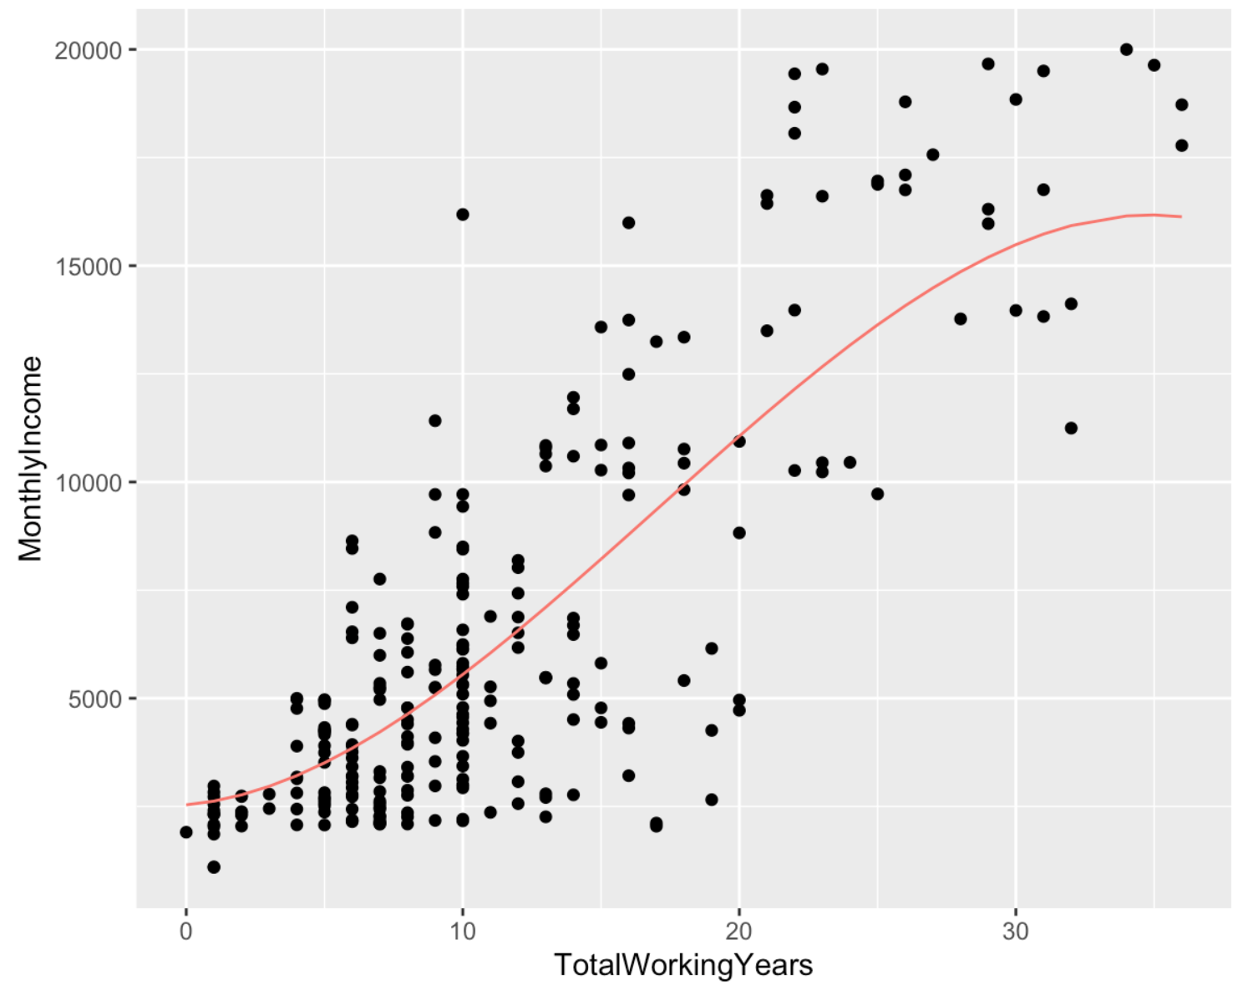
Monthly salary
Predicted Monthly Salary:
2535.4563 + 57.3128 * (Total Working Years)
Generating new terms for Total Working Years Squared and Total Working Years Cubed reduced RSME marginally
Achieved RSME of < $2716
Adjusted R-Squared of 0.5873
About 59% of predicted monthly income can be attributed to total working years of the employee

Slide 9
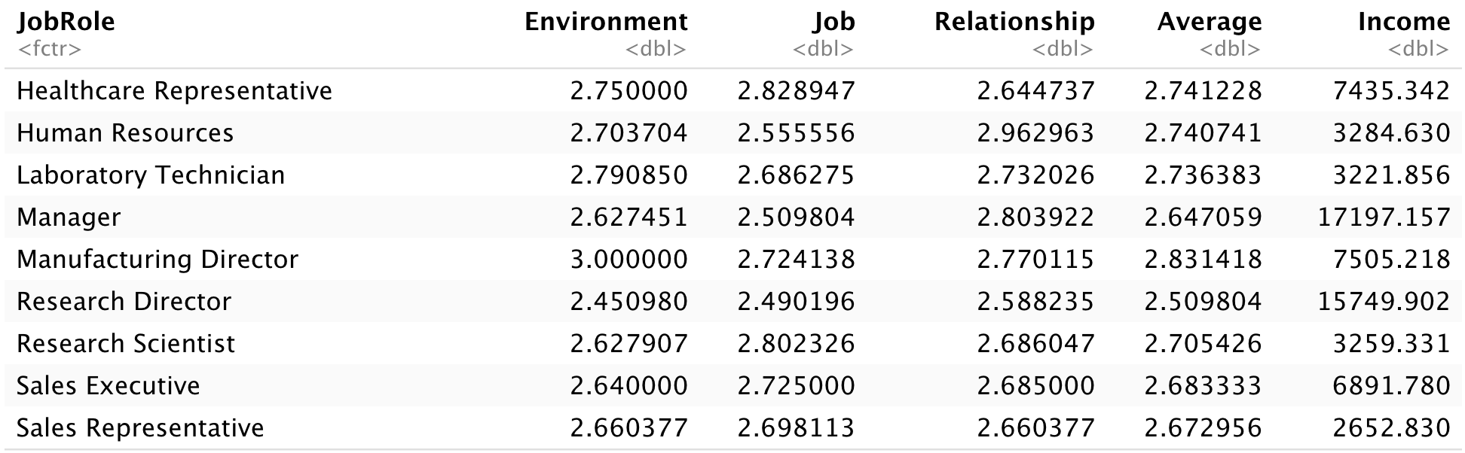
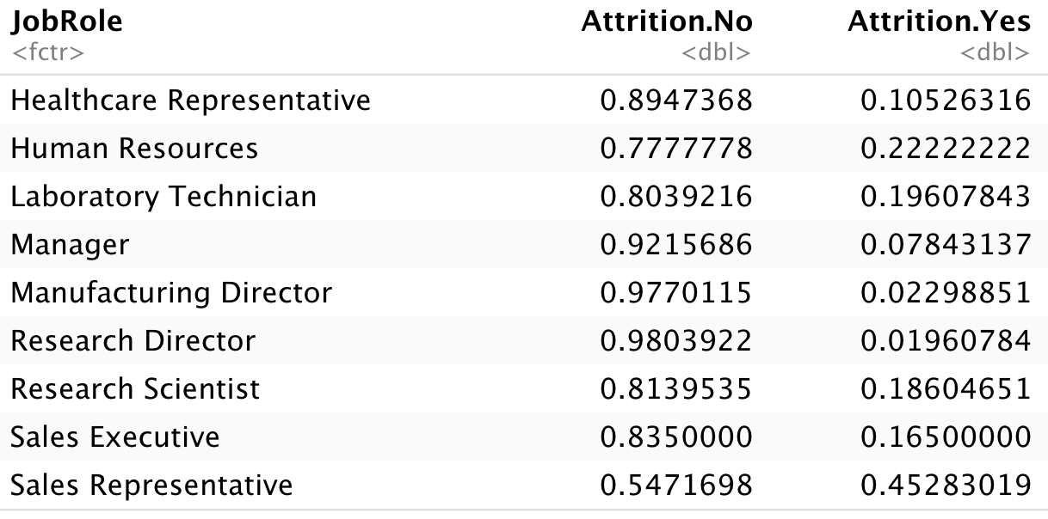
Insights by job role
Mean satisfaction by Job Role
Measuring Job, Environment, and Relationship with manager. Levels from 1 – 4, higher is better
On average, Manufacturing Directors have highest satisfaction and Research Directors have lowest
Attrition by Job Role, highest and lowest
Research Director: 98% / 2% (No / Yes)
Human Resources: 78% / 22% (No / Yes)

Slide 10
summary
Overview of data
Attrition and 3 leading contributors
Predicting attrition
Linear Regression and monthly salary
Helpful insights to make data driven decisions

