Slide 1
Pioneer AWS Linux Training

Slide 2
Housekeeping
THERE ARE NO BAD QUESTIONS
Intros
Name
Experience
Attitude towards training (this is a safe place!)
Non-scientific poll

Slide 3
Prerequisites
An installation of Mint/Ubuntu/Debian (MacOS will work as well)
Access to a UNIX bash shell

Slide 4
Some basics
Most commands take –h, --help, or help as parameters to display usage examples e.g. ls --help
For even more detail, most commands support man pages. You can simply prefix the command with the word man. e.g. man ls
Use Ctrl+C to kill the current running command or to terminate the current line
The file system starts at /
Use ; to put multiple commands in a single line e.g. mkdir a; cd a

Slide 5
Navigating basics
ls [directory or file]
List files in a directory
ls –lah [directory or file]
Common alias and shortcut to see details of files
cd [directory]
Change directory
pwd
Prints the current working directory
The shortcut . references the current directory
The shortcut .. references the parent directory
The shortcut ~ references your home directory

Slide 6
Navigating knowledge check
What command(s) would you use to
move to the directory one level up and list the contents?
list the contents of your home directory?

Slide 7
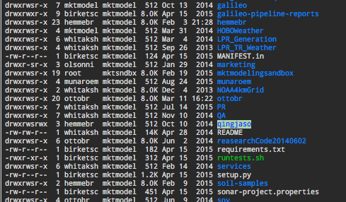
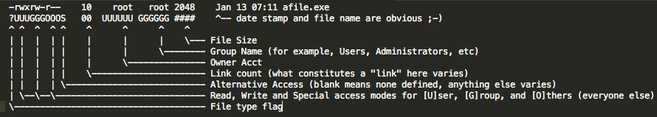
File permissions

Slide 8
Changing permissions
chmod mode path
Changes the permissions of the target file or directory
The mode parameter can use symbolic or absolute permissions. We will focus on absolute permissions
chown user:group path
Changes the owner of the file provided

Slide 9
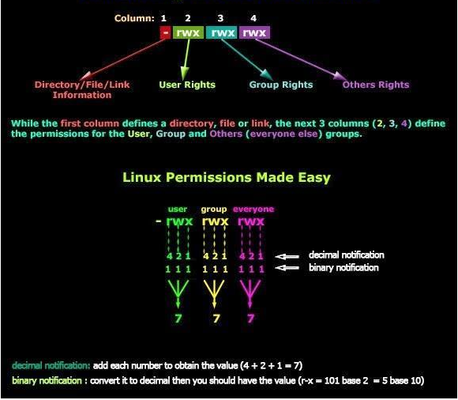
chmod example

Slide 10
Permissions knowledge check
How would you
make a file read only by the current user?
make a file readable by all users and writeable by only the owner?
make a file readable, writable, and executable by everyone?

Slide 11
File system manipulation
cp <source> <destination>
Copies a file from one location to another. The source file remains unaltered. More than one source can be listed. Works with wild cards (*)
Use –r for moving directories
mv <source> <destination>
Similar to copy but moves the source file. Think of it as a Cut operation in windows. More than one source can be listed. Works with wild cards (*)
rm <some-file>
Removes the file listed as the target. More than one target can be listed. Works with wild cards (*)
-r for directories. –f for read only files (BE CAREFUL!)
mkdir <new-directory>
Makes a new directory at the target path
mkdir -p <directory-tree> makes a stack of directories e.g. mkdir -p a/b/c

Slide 12
Viewing file contents
cat <some-file>
Outputs the contents of a file to the current shell
less <some-file>
Views file contents in current shell and supports paging. More is old but still used heavily, less is an updated version of more
tail <some-file>
Used to view the last 10 lines of a file.
tail -n 23 <some-file>
See the last 23 lines of the file
head <some-file>
See the first 10 lines of a file
head -n 23 <some-file>
See the first 23 lines of a file

Slide 13
File knowledge check
How would you:
Copy a file from directory a to directory b and then delete the file in directory a?
View the last 50 lines of a file?
Move all files from directory /a that have a .txt extension to directory /b?
Print all lines of a file to the console?

Slide 14
Files and input
echo “some text”
Prints the provided text back to the screen
Can also print variables when executed in a script or from environment
touch <some-file>
Creates an empty file at the target path or updates the modification time of an existing file
Command > somefile
The > operator writes the output of the command to the file listed overwriting the current file contents
Command >> somefile
The >> operator appends the output of the command to the file listed

Slide 15
Files and input knowledge check
How would you:
Write the text “this is my sample text” to a new file?
Write the text “this is my appended sample text” so that it is appended to an existing file?
View the contents of the appended text file?

Slide 16
Other utilities
command | command
The | (pipe) operator sends the output of the first command as input to the second command
sort
Sorts lines of input file or input sent via pipe
wc
Prints number of lines, number of words, and characters
env
Prints all environment variables for the current shell
ps
Displays a list of all running processes for current user. Add aux to see all processes
wget a “simple” file downloader
wget http://www.google.com
curl used to make HTTP request from the shell
curl http://www.google.com > google.html

Slide 17
Other utilities continued
top
See running processes and server resource utilization
tar
Used to extract or create tar files.
Extract .gz file: tar xzvf filepath
Extract .bz2 file: tar xjvf filepath
Create .gz file: tar cvzf compressedfilepath pathtofiles
grep
Used to search for text in files or input text

Slide 18
Utilities knowledge check
How would you:
Get the count of the number of processes running on the system?
Get the HTTP response from google.com?
List the current environment variables, sort them in alphabetical order, and then write to a local file?
Download a file from a remote server and then find a specific string in the file contents? How would you do this in one line?

Slide 19
Package Managers
Used to install software from remote repositories and make software installs easier
Ubuntu, Debian, Mint
apt-get
Language specific
Python - pip

Slide 20
Environment file
In your home directory .bashrc contains all the environment variables for your shell
Run on new shell/terminal
/etc/profile has a bunch of stuff set for all users

Slide 21
Profile and rc files – example settings
alias simple_cmd=‘complex_cmd’
Used to create command shortcuts
export name=‘value’
Used to set environment variables accessible by child processes
Environment variables can be referenced by prepending a $ character
Example - appending and prepending to existing variables
export PATH=/my/addtion:$PATH
export PATH=$PATH:/my/addition

Slide 22
Profile and rc Knowledge Check
How would you:
Create an alias to monitor the file /var/log/system.log as a new lines are written to the log file?
Append the path /usr/bin to the environment variable named my_env?

Slide 23
SSH, SSH Config, SCP
ssh remote_user@remote_server
Usually a SSH key is required. The –i option facilitates this
Private SSH keys typically stored under ~/.ssh/
Keys must only be accessible to user (chmod 600)
SSH Agent for passing keys through to remote servers
-L used for local forwarding
-D used for dynamic forwarding
Make it simple with SSH config…
~/.ssh/config
Preconfigure connections into simple alias

Slide 24

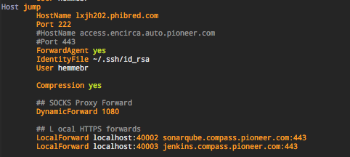

SSH Config Example

Slide 25
SCP
scp source_server:source_path remote_server:remote_path
Used to copy files between systems
if source_server or remote_server are not provided, localhost is used by default
Again, simple with SSH config

Slide 26
SSH, SSH Config, SCP Knowledge Check
How would you:
Copy a file named test.txt from your home directory locally to your home directory on a remote server configured with the name jump in your SSH config?
Connect to a remote server named remote.pioneer.com
using a SSH key named remote_key that is stored in ~/.ssh
Username of cloud_user
Forward local port 5035 to a remote database at db.pioneer.com port 6100

Slide 27
Keeping sessions alive
Nohup asdfasdfasdfasdfasdf
Job control

