Slide 1
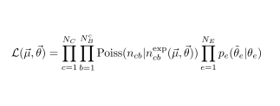





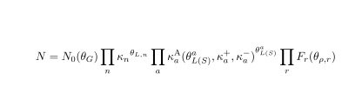
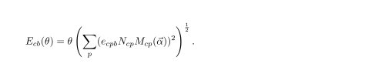
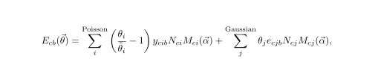
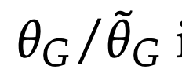

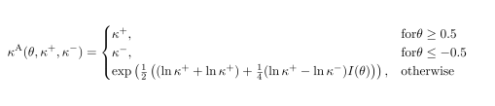
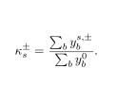
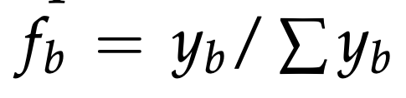


Exp. events per bin
NP constraints
Physics model scaling
Process norm.
Process templates
MC stats
Barlow-Beeston
Log-normal
Asymmetric log-normal
rateParams
"lite"
Gamma
full
Vertical morphing
Interpolation between up and down variations (norm)
Shape uncert. norm. change factored out
Interpolation between up and down variations (shape)

