Slide 1




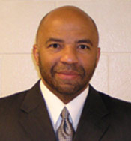
Seminar supported by NMHU Sigma Xi Chapter and NMHU-NSF-PREM CHEM 255/455/555(Chemistry Seminar) Special Lecture, November 10, 2010(Wednesday) Dr. Keith L. Oden (Georgia Institute of Technology, Atlanta, GA) Career Development and Graduate Fellowships Opportunities in Science and Engineering (including graduate fellowship opportunities for minorities students) Time: 12-2 pm (lecture: 12-1 pm, Q&A \ individual consultations: 1-2 pm) Location: 100 Sininger Hall NSF supported PREM program at NMHU About Dr. Keith L. Oden Bachelors of Arts in Psychology, University of New York(SUNY), Albany Master of Science in Counseling Education, State University College, Brockport Ph.D. in Educational Policy Studies, Georgia State University, Atlanta Food will be provided…

