Slide 1



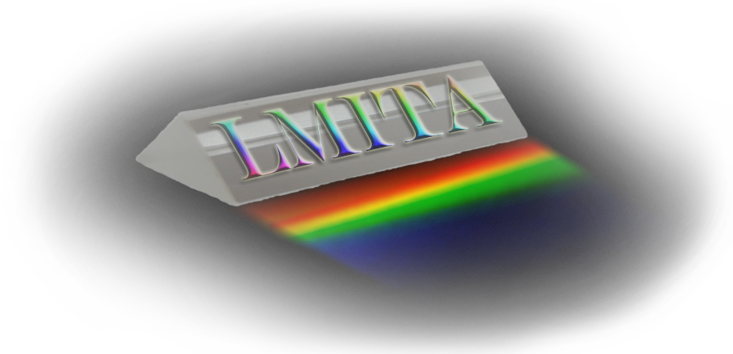

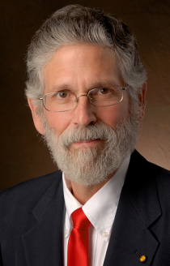
Seminar supported by
NSF funded PREM program at NMHU
& NMHU Sigma Xi Chapter
Chemistry and Biology students are invited to
Special Lecture – March 27, 2013 (Wednesday)
Dr. Luis Echegoyen
(University of Texas at El Paso, El Paso, TX)
"Buckyball Maracas:
The Inside (and Outside) Story of Endohedral Fullerenes"
Place: Kennedy Lounge, 12pm – 1pm
Light Refreshments will be served
After presentation there will be discussion about graduate school
opportunities at UTEP and other PREM programs

