Slide 1
CIS 505
Team Project
Group A2
Chaithanya Muninagappa
Jinghuan Li
Nathaniel Englert
Suparva Paruthy

Slide 2
Agenda
Objective
Background of Data
Approach
Entity Relationship Diagram
Normalized Relational Schema
Implementation:
Questions
Business Value
Recommendations

Slide 3

Objective
Our client : NIKE, inc.
Client requirement
Understand customer profiles
Increase sales/ profits
Decrease production cost
Make business decisions based on real data
Goal : perform advanced analytics to provide useful insights

Slide 4
Data Background
Store/Transaction Data
By utilizing store data, we can analyze transactions that occur in the company’s online store, as well as transactions that occur in retail stores. More specifically, we can utilize retail stores to separate transactions into regions, states, or cities without the need of consumer data.
Customer/Census/Weather Info
If the data is present, we can utilize customer info to go deeper in our data analysis. We can take into account transactions, more importantly the items purchased, from customers and filter them by age, location (state, region, city, zip), gender, etc.. We can combine this with census and weather info to also take into consideration factors like average winter temperature and median salary when we run our analysis.
Reviews Data
Analyzing this data can provide a new unique perspective to our client. If we have data on the customer along with their reviews made on their products, we can filter reviews by age, location, gender, etc. And if we can grab data from the census and gather weather data, we have more filters. This will allow the company to evaluate ratings and reviews written directly from their intended audience. An example would be providing common themes amongst reviews from higher salary zip codes when evaluating a higher priced product.

Slide 5
Approach
Maximize sales & Minimize costs
Accommodate strategy adjustments
Make Recommendations
Analyze outcomes, Perform predictions
Understand Customer’s Profiles

Slide 6
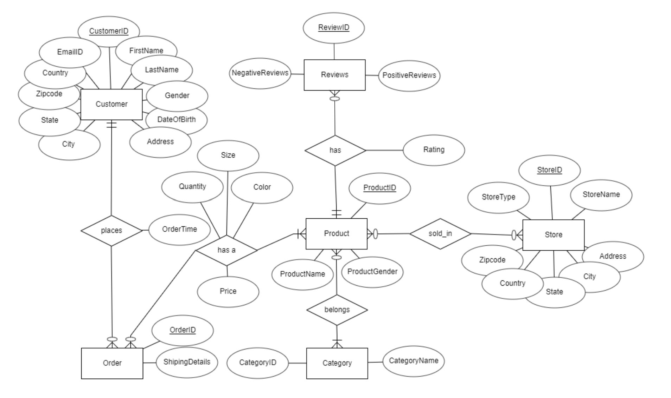
Entity Relationship Diagram

Slide 7
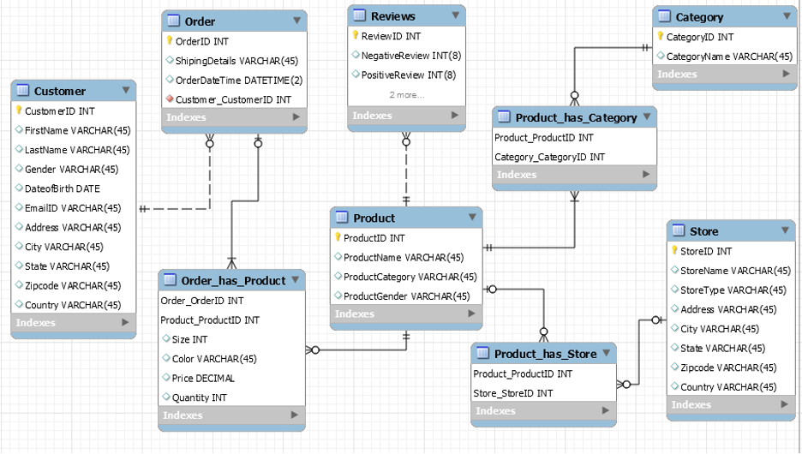
Normalized Relational Schema

Slide 8
Core Question
How does supply chain management affect sales and production?
What are the recommended changes that can be made in supply chain management to obtain positive increase in sales/ profit?

Slide 9
Relevant Questions
Question | Business value:
Which is the least bought product and product category across different regions among store types? | The company could eliminate manufacturing and supply of such products region wise reducing manufacturing costs
List the product and product types with respect to demand, gender across regions and seasons. | Enables clients to understand the demand of the products they produce along with the preference of their customers in varied conditions.
Which is the most happening product among product types and brands ? | It is important to understand the current and future trend in the market and change our strategies in production; thereby knowing where we stand amongst the competitors. We can use the data available with our subscription stores for aggregation on weekly sales in comparison with brand and product categories.

Slide 10
Relevant Questions
Question | Business value:
Which store type has the most and least revenue generation? | Clients can make informed decisions about where they must increase or adapt newer marketing strategies to improve their turnover.
What is the recommended future increase in production with respect to size and gender of the product? | Learning what to expect next and focusing production on those terms increases the sales and profitably, hence analysis on the publicly available census data in combination with the available client data will help predict the age groups and gender spread across different regions and accordingly the sizes and material type could be decided for production.
Which products have the highest and lowest accumulated rating, highest positive reviews, and highest negative reviews? | It is important to understand the current and future trend in the market and change our strategies in production; We can use the data available with our subscription stores for aggregation on weekly sales in comparison with brand and product categories.

Slide 11
Further insights
Zip code-based Census data
Salary
Median age
Number of kids per household
Weather information
Style trends

