Slide 1

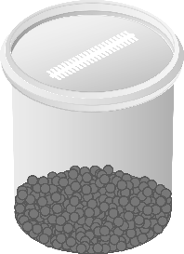
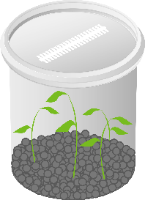
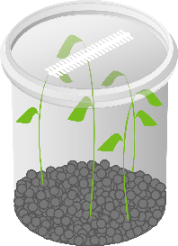
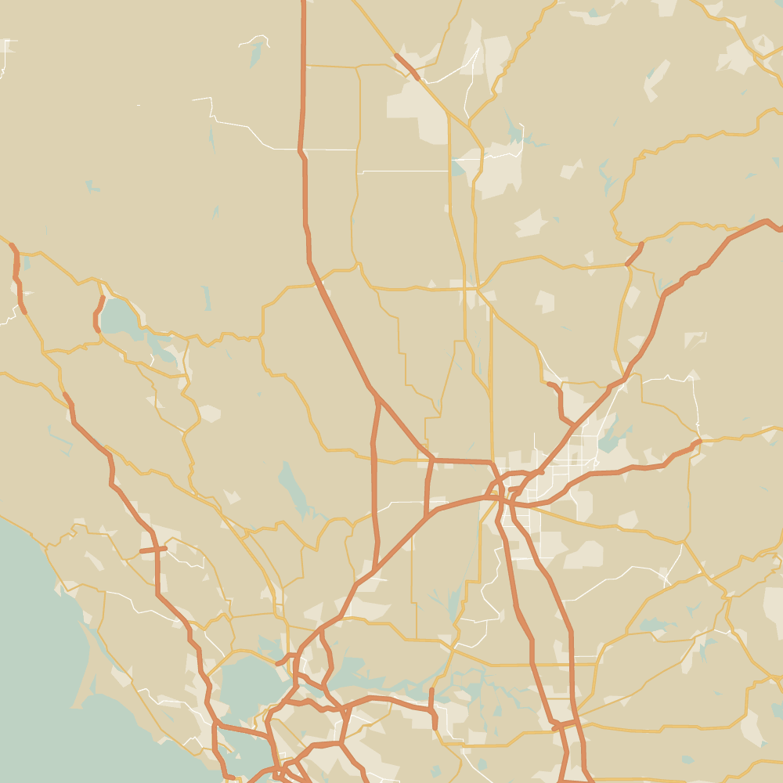
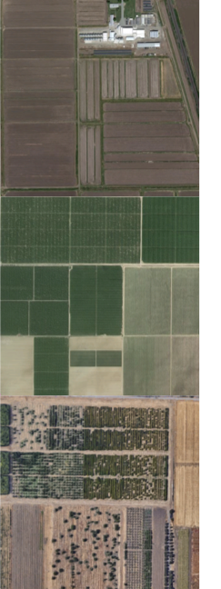
(a)
Assembling
Inoculating
Harvesting
Roots:
- 16S rRNA gene profiling
- mRNA-Seq
Leaves:
- mRNA-Seq
- Calcined clay
- Plant growing medium
- Rice seeds
7 days
14 days
Germination
Microbiome
assembly
(b)
Soil-inoculated
(SI)
Biggs
Arbuckle
Davis
Mock-inoculated
(MI)

