Slide 1
Image Motion

Slide 2
The Information from Image Motion
3D motion between observer and scene + structure of the scene
  Wallach O’Connell (1953): Kinetic depth effect
  http://www.biols.susx.ac.uk/home/George_Mather/Motion/KDE.HTML
  Motion parallax: two static points close by in the image with different image motion; the larger translational motion corresponds to the point closer by (smaller depth)
Recognition
  Johansson (1975): Light bulbs on joints
  http://www.biols.susx.ac.uk/home/George_Mather/Motion/index.html

Slide 3
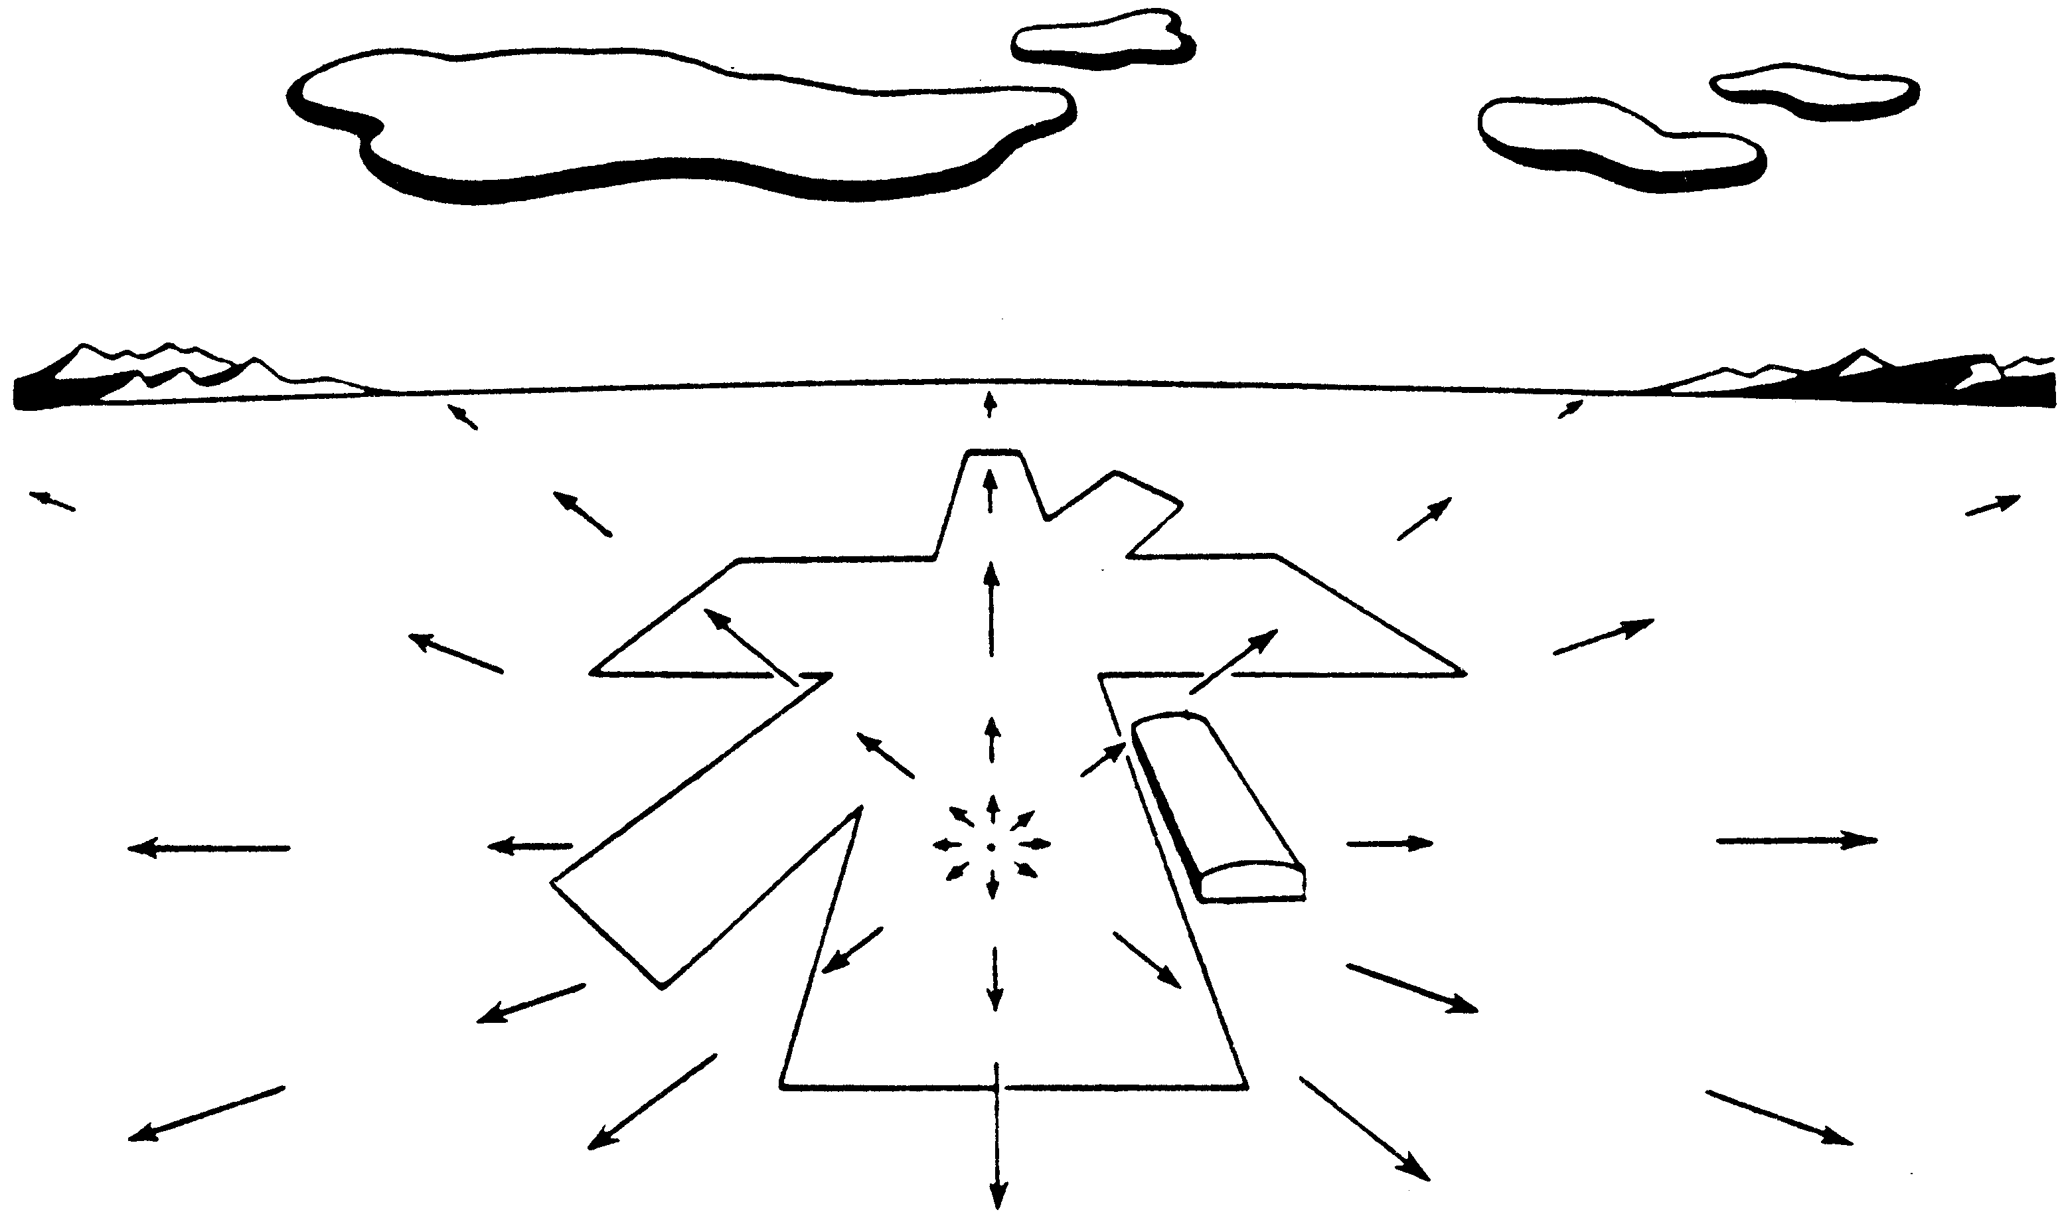
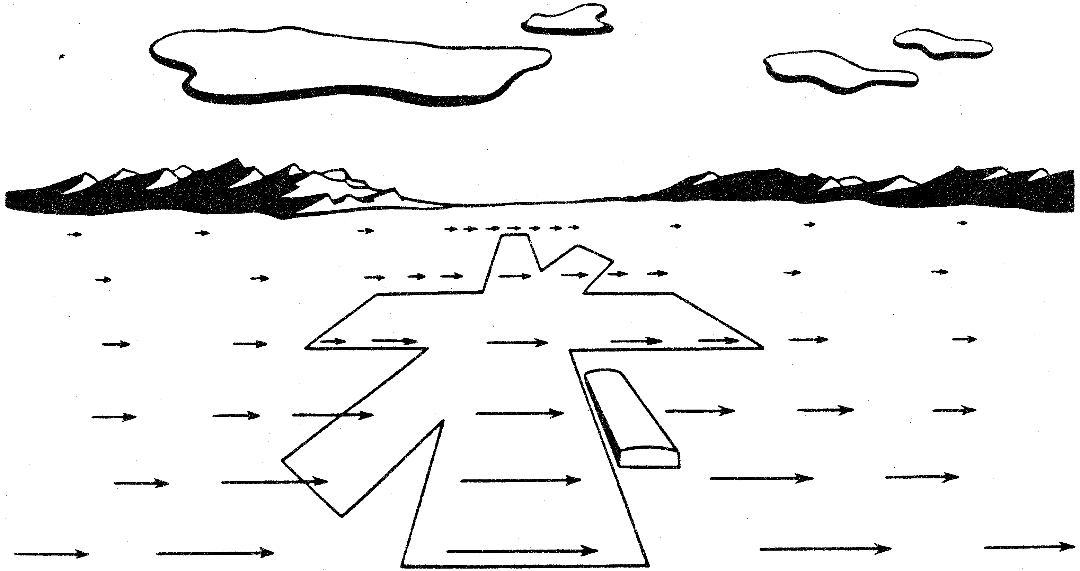
Examples of Motion Fields I
(a) (b)
(a) Motion field of a pilot looking straight ahead while approaching a fixed point on a landing strip. (b) Pilot is looking to the right in level flight.

Slide 4
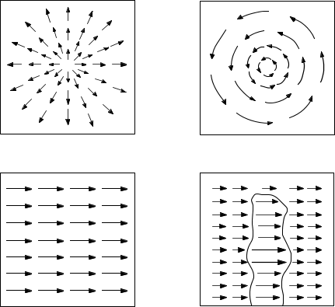
Examples of Motion Fields II
(a) (b)
(c) (d)
(a) Translation perpendicular to a surface. (b) Rotation about axis perpendicular to image plane. (c) Translation parallel to a surface at a constant distance. (d) Translation parallel to an obstacle in front of a more distant background.

Slide 5
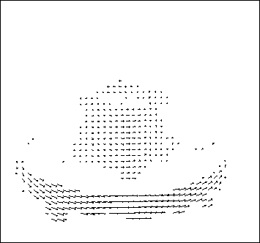
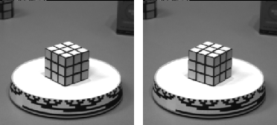
Optical flow

Slide 6
Assuming that illumination does not change:
Image changes are due to the RELATIVE MOTION between the scene and the camera.
There are 3 possibilities:
  Camera still, moving scene
  Moving camera, still scene
  Moving camera, moving scene

Slide 7
Motion Analysis Problems
Correspondence Problem
  Track corresponding elements across frames
Reconstruction Problem
  Given a number of corresponding elements, and camera parameters, what can we say about the 3D motion and structure of the observed scene?
Segmentation Problem
  What are the regions of the image plane which correspond to different moving objects?

Slide 8
Motion Field (MF)
The MF assigns a velocity vector to each pixel in the image.
These velocities are INDUCED by the RELATIVE MOTION btw the camera and the 3D scene
The MF can be thought as the projection of the 3D velocities on the image plane.

Slide 9
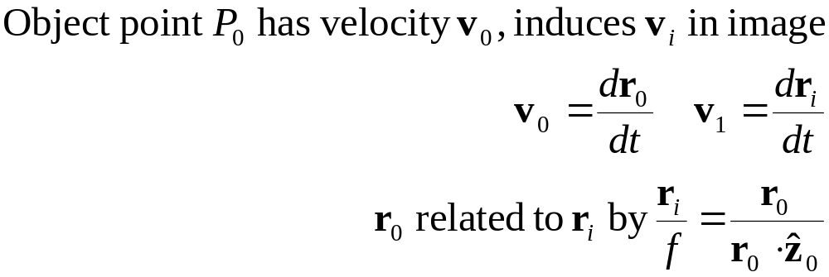
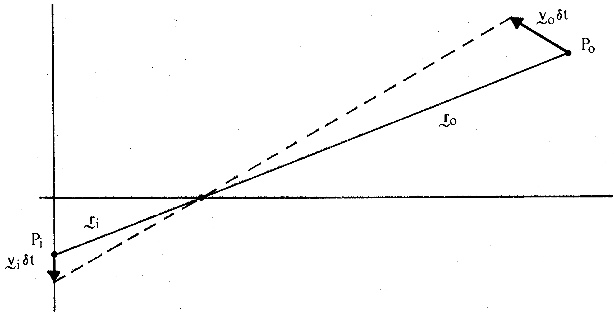
Motion Field and Optical Flow Field
Motion field: projection of 3D motion vectors on image plane
Optical flow field: apparent motion of brightness patterns
We equate motion field with optical flow field

Slide 10
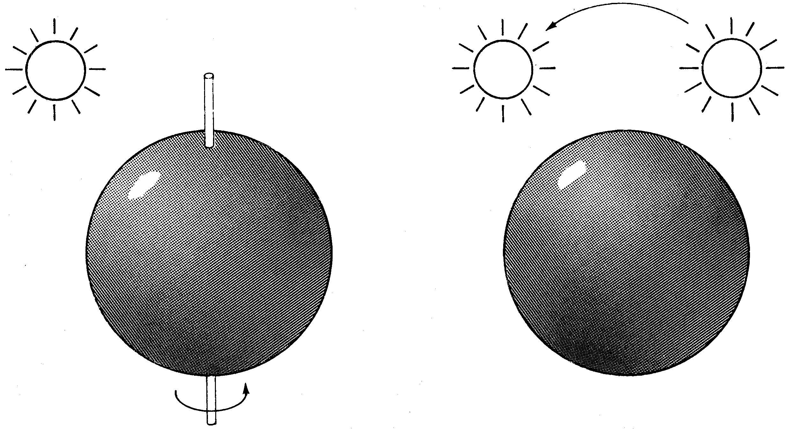
2 Cases Where this Assumption Clearly is not Valid
(a) A smooth sphere is rotating under constant illumination. Thus the optical flow field is zero, but the motion field is not.
(b) A fixed sphere is illuminated by a moving source—the shading of the image changes. Thus the motion field is zero, but the optical flow field is not.
(a) (b)

Slide 11
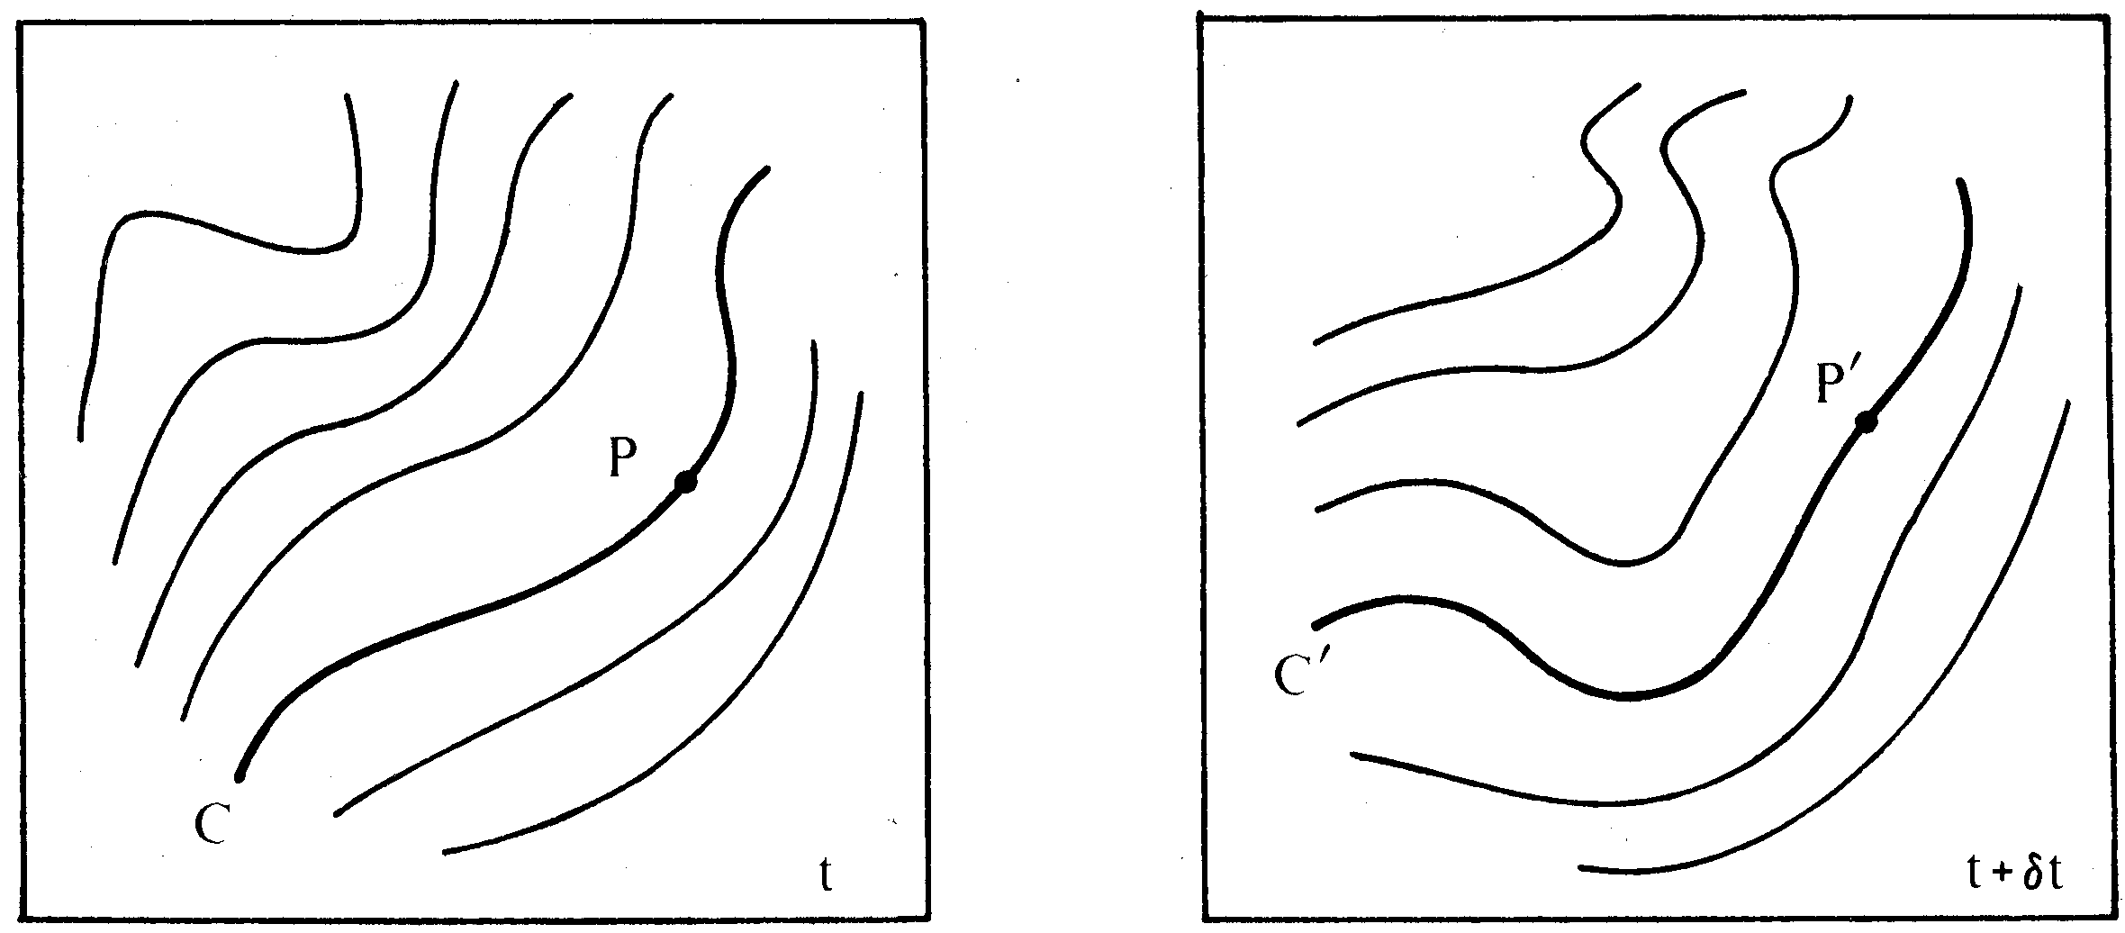
What is Meant by Apparent Motion of Brightness Pattern?
The apparent motion of brightness patterns is an awkward concept. It is not easy to decide which point P' on a contour C' of constant brightness in the second image corresponds to a particular point P on the corresponding contour C in the first image.

Slide 12
The aperture problem

Slide 13
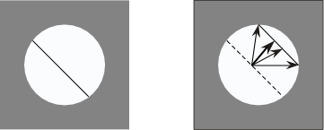
Aperture Problem
(a) (b)
(a) Line feature observed through a small aperture at time t.
(b) At time t+δt the feature has moved to a new position. It is not possible to determine exactly where each point has moved. From local image measurements only the flow component perpendicular to the line feature can be computed.
Normal flow: Component of flow perpendicular to line feature.

Slide 14
Brightness Constancy Equation
Let P be a moving point in 3D:
  At time t, P has coords (X(t),Y(t),Z(t))
  Let p=(x(t),y(t)) be the coords. of its image at time t.
  Let E(x(t),y(t),t) be the brightness at p at time t.
Brightness Constancy Assumption:
  As P moves over time, E(x(t),y(t),t) remains constant.

Slide 15
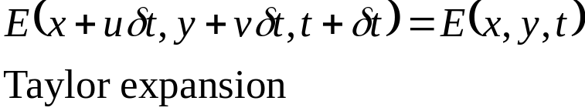
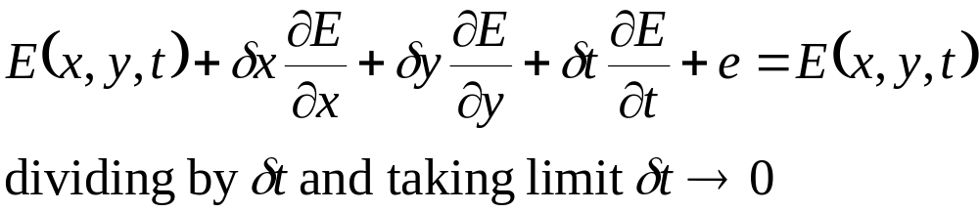
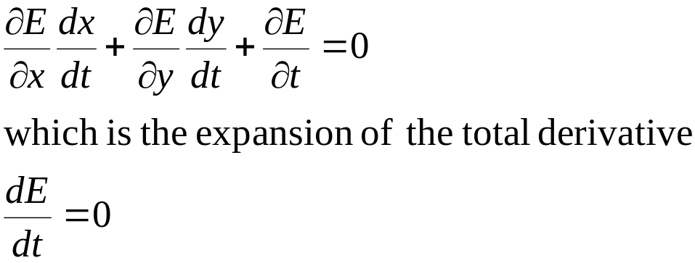

Brightness Constraint Equation
short:

Slide 16
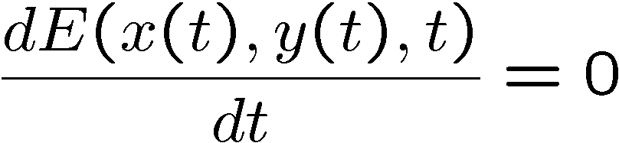
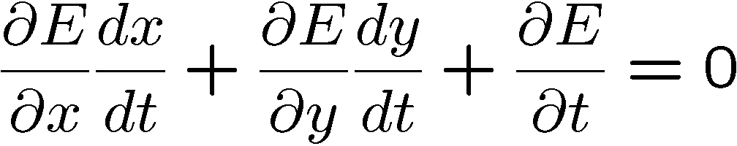
Brightness Constancy Equation
Taking derivative wrt time:

Slide 17
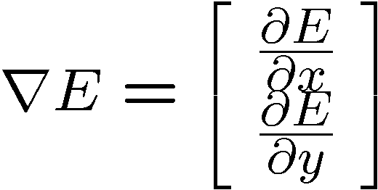
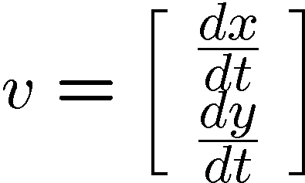
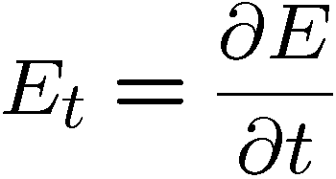
Brightness Constancy Equation
Let
(Frame spatial gradient)
(optical flow)
(derivative across frames)
and

Slide 18
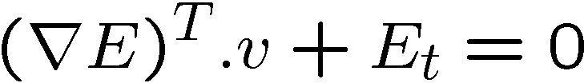
Brightness Constancy Equation
Becomes:
v_{y}
r E
-E_{t}/|r E|
v_{x}
The OF is CONSTRAINED to be on a line !

Slide 19
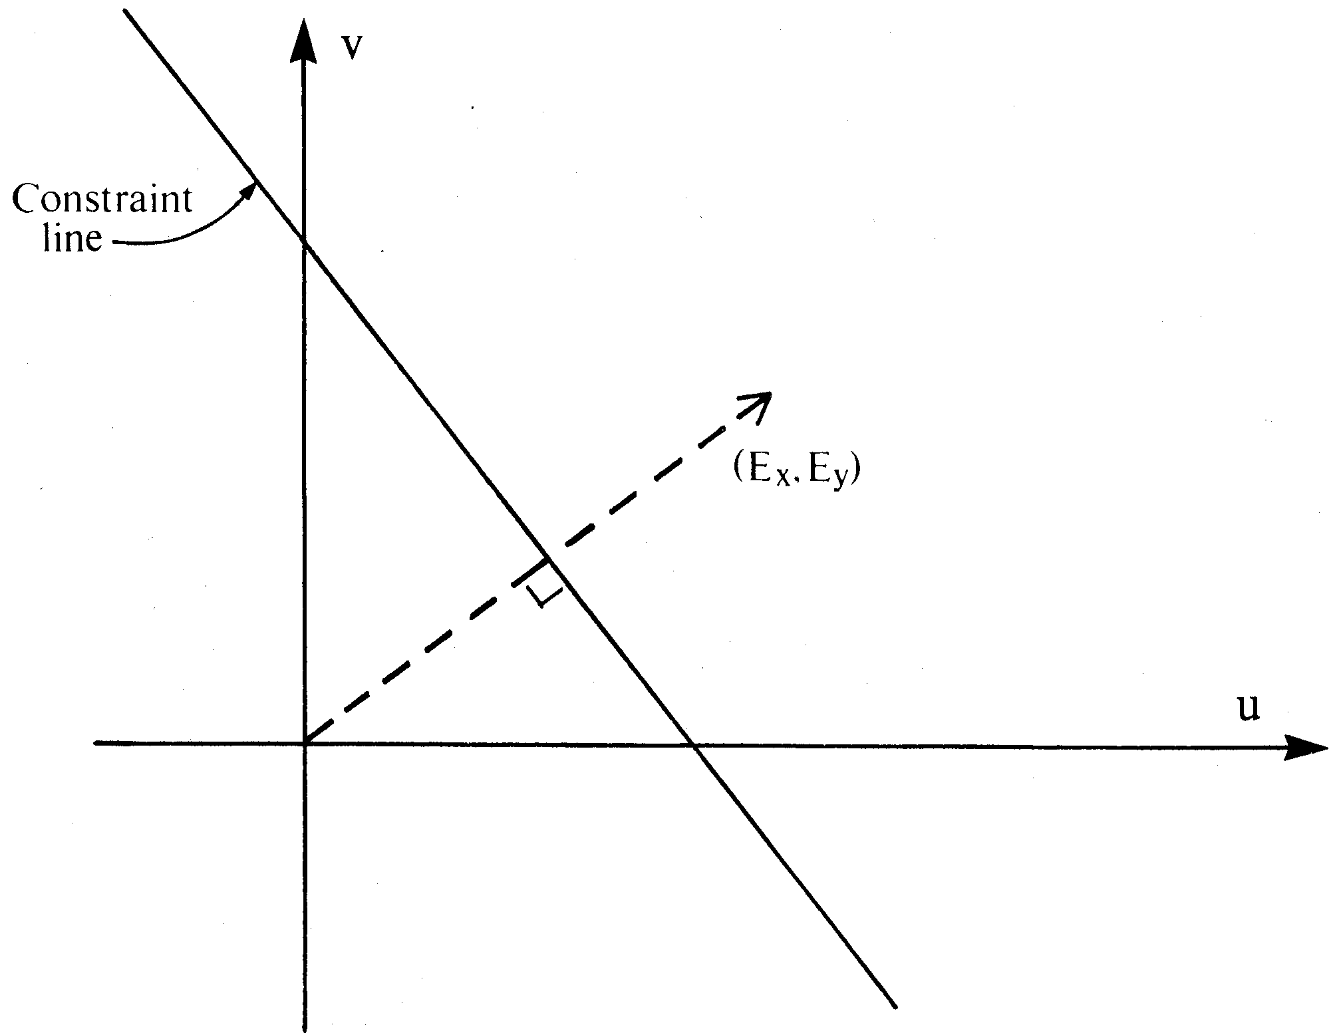
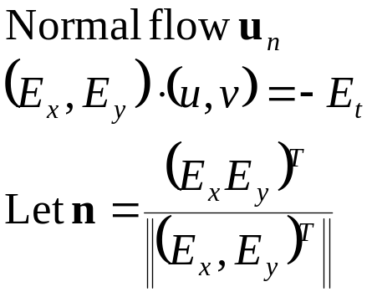
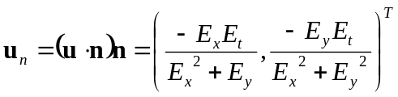
Interpretation
Values of (u, v) satisfying the constraint equation lie on a straight line in velocity space. A local measurement only provides this constraint line (aperture problem).

Slide 20

Optical flow equation
Barber Pole illusion
  http://www.sandlotscience.com/Ambiguous/barberpole.htm
Notes:
A: u and v are unknown, 1 equation

Slide 21
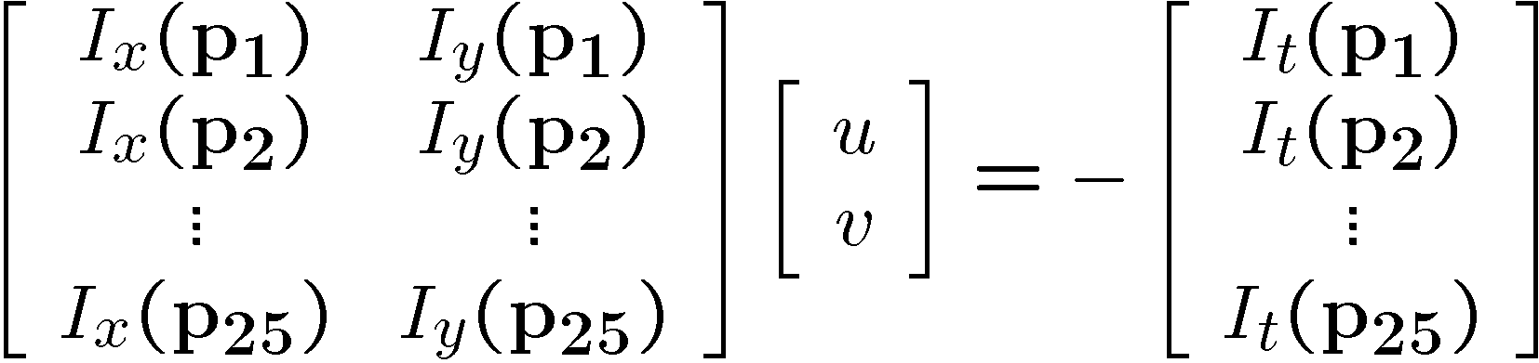






Solving the aperture problem
How to get more equations for a pixel?
  Basic idea: impose additional constraints
    most common is to assume that the flow field is smooth locally
    one method: pretend the pixel’s neighbors have the same (u,v)
      If we use a 5x5 window, that gives us 25 equations per pixel!

Slide 22






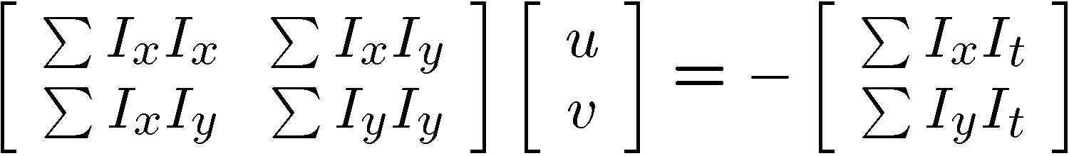


Constant flow
Prob: we have more equations than unknowns
Solution: solve least squares problem
  minimum least squares solution given by solution (in d) of:
  The summations are over all pixels in the K x K window

Slide 23
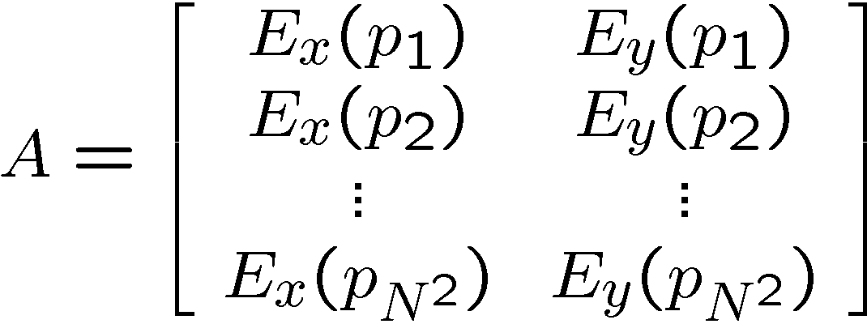
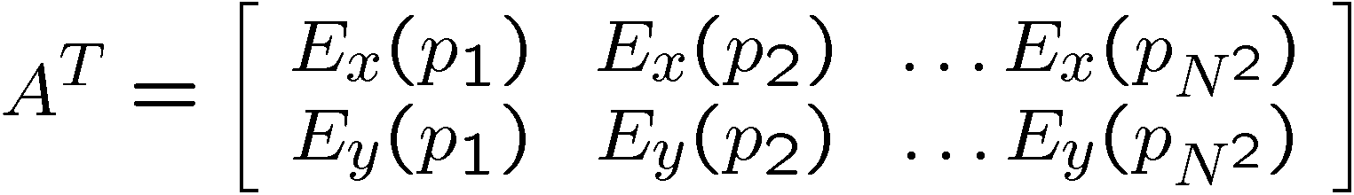
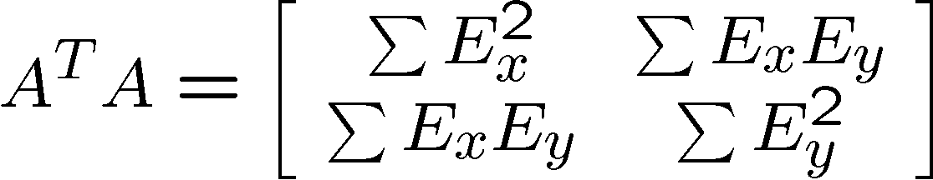
Taking a closer look at (A^{T}A)
This is the same matrix we used for corner detection!

Slide 24
Taking a closer look at (A^{T}A)
The matrix for corner detection:
is singular (not invertible) when det(A^{T}A) = 0
But det(A^{T}A) = ∏ λ_{i} = 0 -> one or both e.v. are 0
One e.v. = 0 -> no corner, just an edge
Two e.v. = 0 -> no corner, homogeneous region
Aperture Problem !

Slide 25
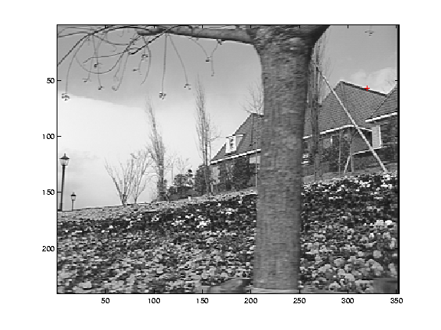
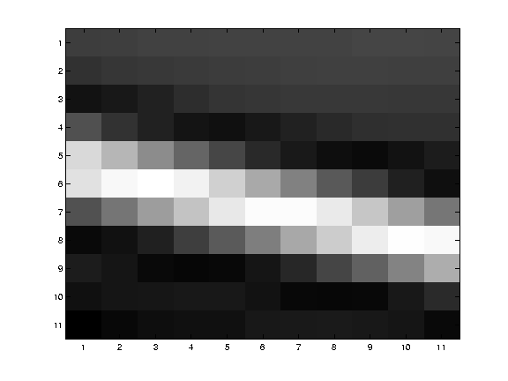
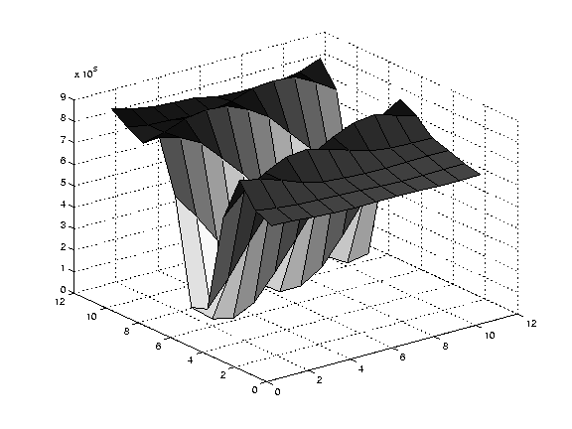
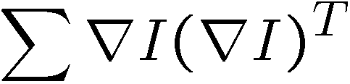
Edge
large gradients, all the same
large λ₁, small λ₂

Slide 26
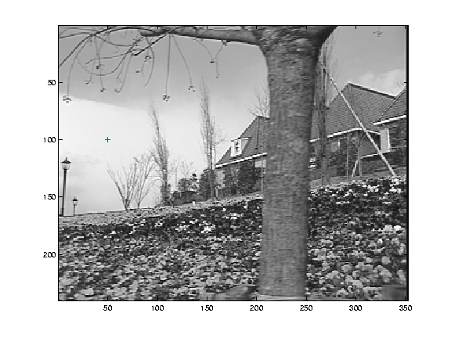
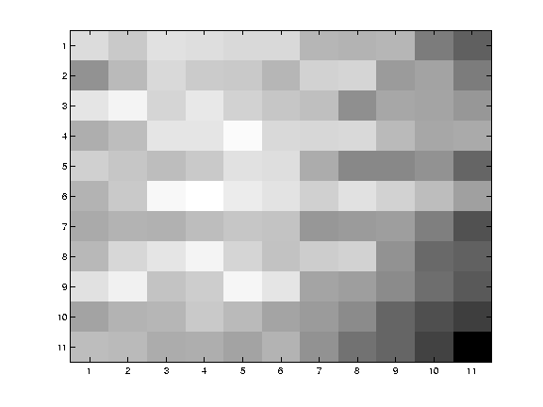
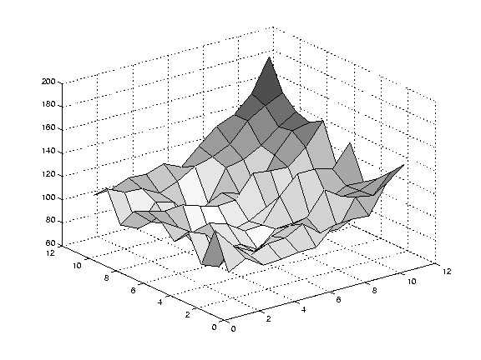
Low texture region
gradients have small magnitude
small λ₁, small λ₂

Slide 27
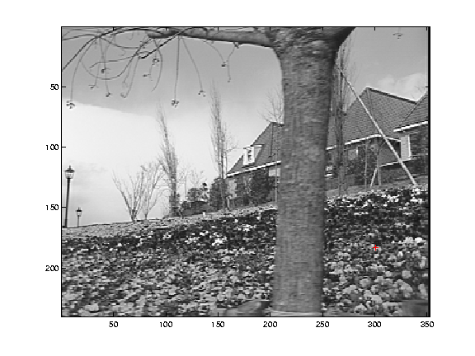
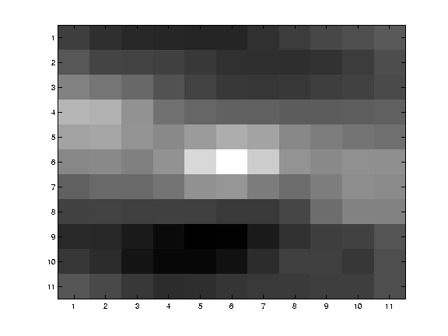
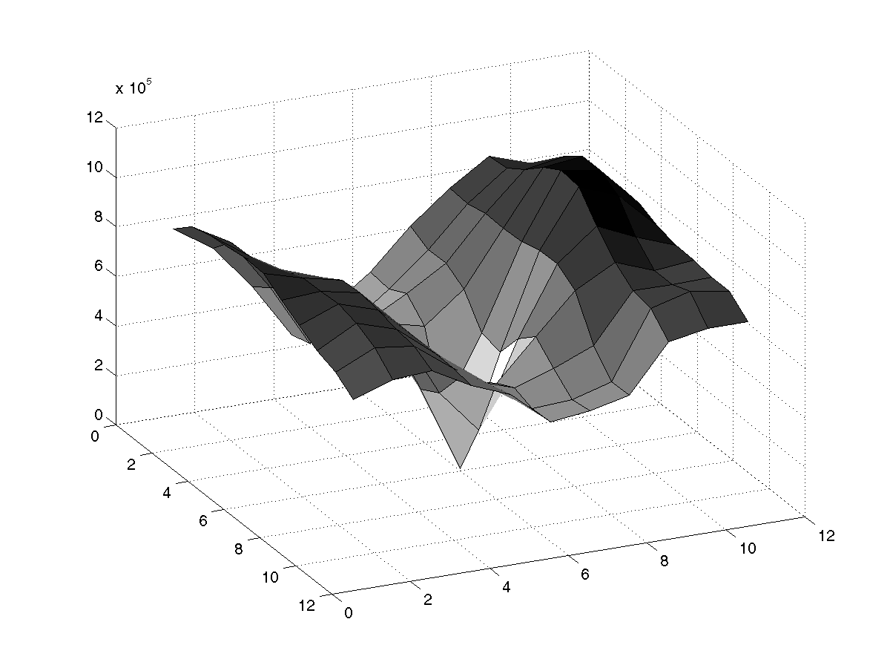
High textured region
gradients are different, large magnitudes
large λ₁, large λ₂

Slide 28
An improvement …
NOTE:
  The assumption of constant OF is more likely to be wrong as we move away from the point of interest (the center point of Q)
Use weights to control the influence of the points: the farther from p, the less weight

Slide 29
Solving for v with weights:
Let W be a diagonal matrix with weights
Multiply both sides of Av = b by W:
  W A v = W b
Multiply both sides of WAv = Wb by (WA)^{T}:
  A^{T} WWA v = A^{T} WWb
A^{T} W²A is square (2x2):
    (A^{T}W²A)⁻¹ exists if det(A^{T}W²A) ≠ 0
Assuming that (A^{T}W²A)⁻¹ does exists:
  (A^{T} W²A)⁻¹ (A^{T} W²A) v = (A^{T} W²A)⁻¹ A^{T} W²b
  v = (A^{T} W²A)⁻¹ A^{T} W²b

Slide 30
Observation
This is a two image problem BUT
  Can measure sensitivity by just looking at one of the images!
  This tells us which pixels are easy to track, which are hard
    very useful later on when we do feature tracking...

Slide 31
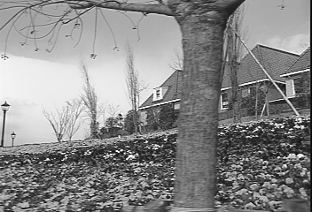
Revisiting the small motion assumption
Is this motion small enough?
  Probably not—it’s much larger than one pixel (2nd order terms dominate)
  How might we solve this problem?

Slide 32
Iterative Refinement
Iterative Lukas-Kanade Algorithm
  Estimate velocity at each pixel by solving Lucas-Kanade equations
  Warp H towards I using the estimated flow field
    - use image warping techniques
  Repeat until convergence

Slide 33
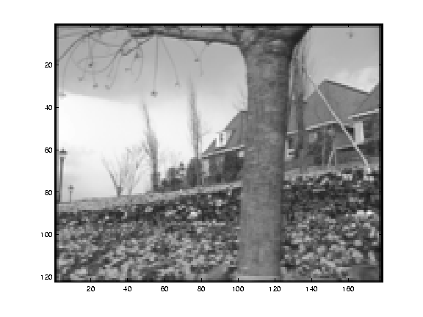
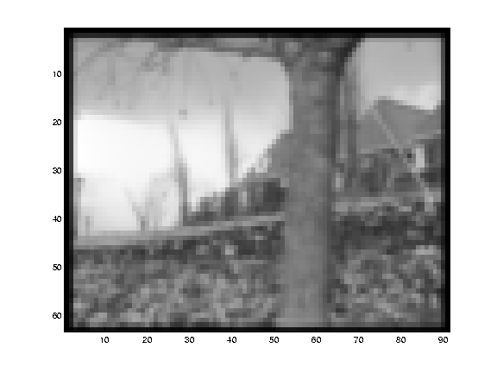
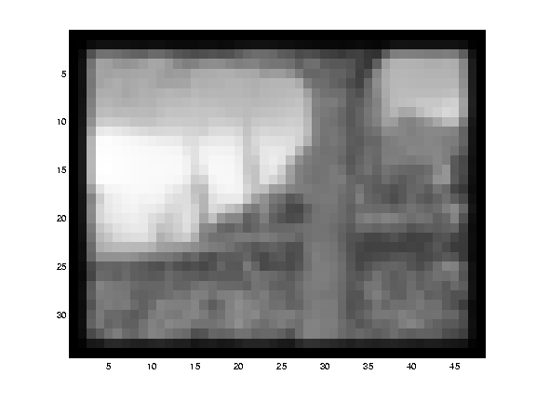
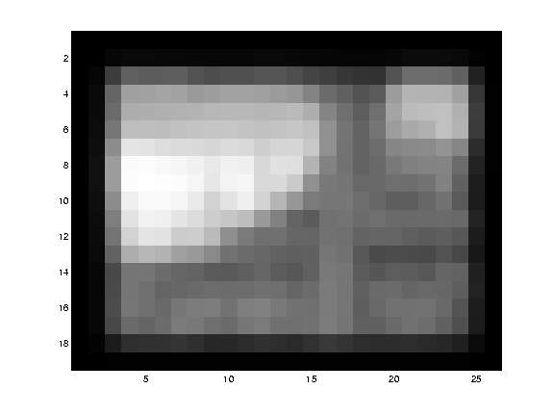
Reduce the resolution!

Slide 34
Coarse-to-fine optical flow estimation
u=1.25 pixels
u=2.5 pixels
u=5 pixels
image H
u=10 pixels
image H
image I
image I
Gaussian pyramid of image H
Gaussian pyramid of image I

Slide 35
Coarse-to-fine optical flow estimation
run iterative L-K
warp & upsample
run iterative L-K
.
.
.
image J
image H
image I
image I
Gaussian pyramid of image H
Gaussian pyramid of image I

Slide 36
Optical flow result

Slide 37
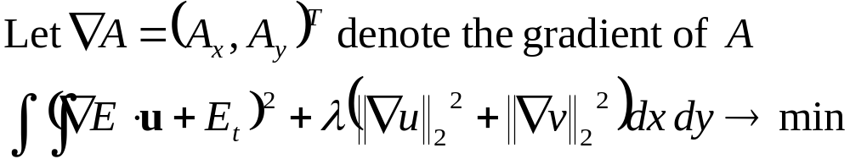
Additional Constraints
Additional constraints are necessary to estimate optical flow, for example, constraints on size of derivatives, or parametric models of the velocity field.
Horn and Schunck (1981): global smoothness term
This approach is called regularization.
Solve by means of calculus of variation.

Slide 38
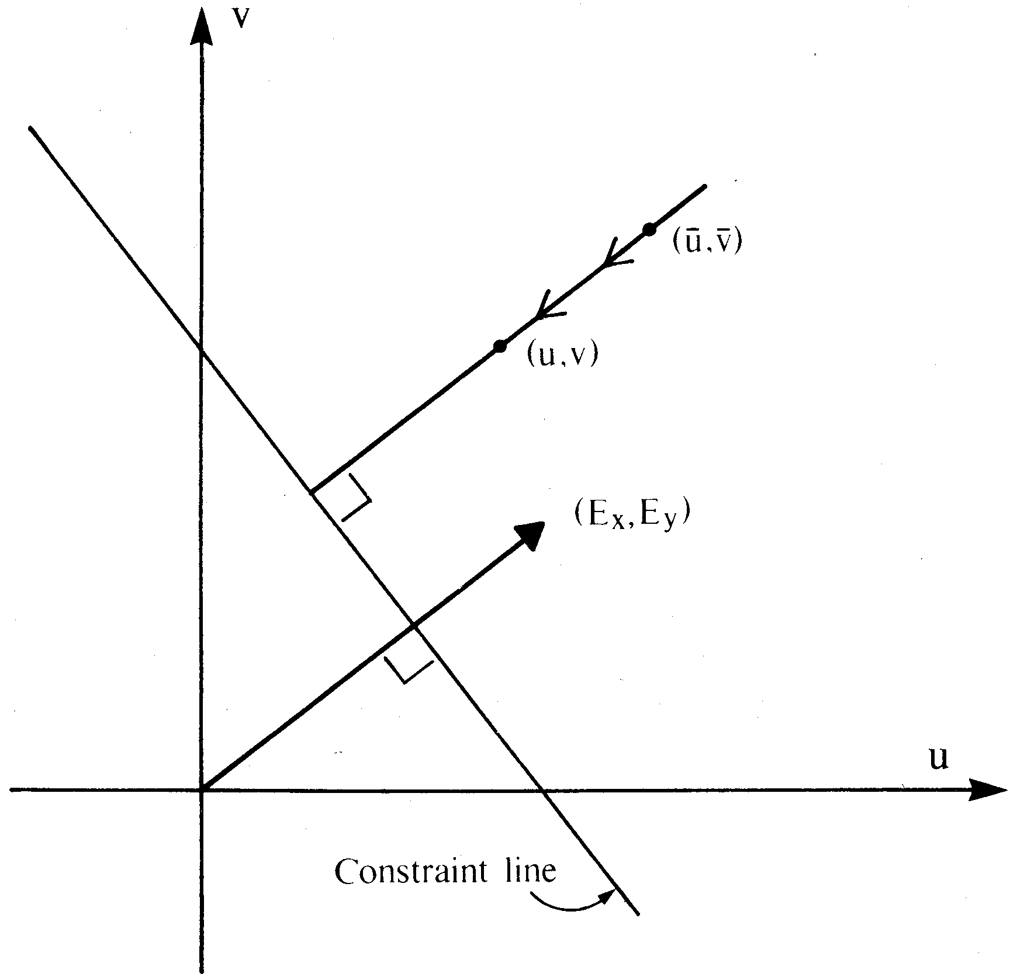
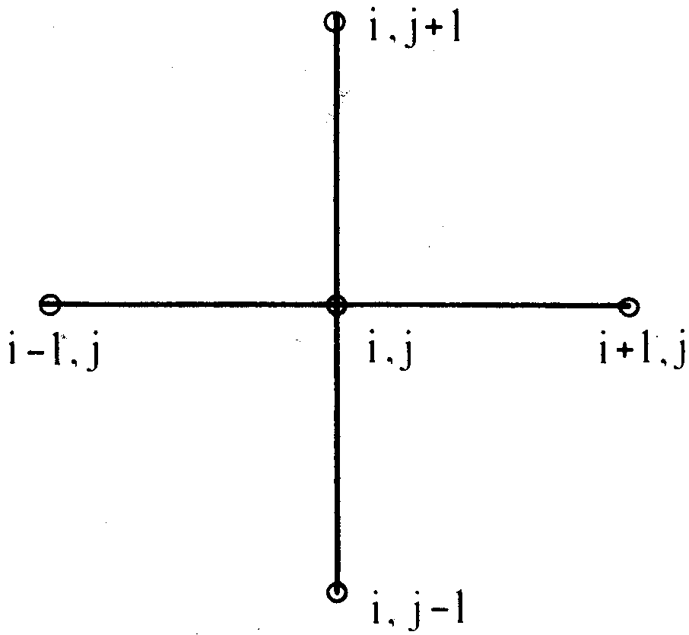
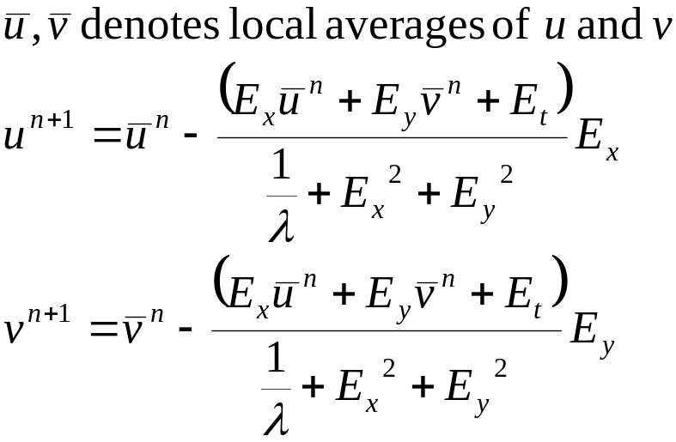
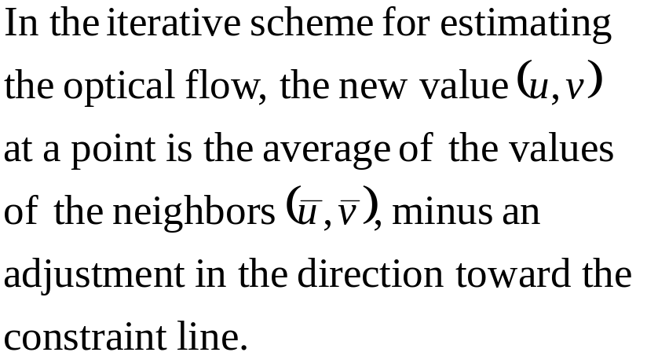
Discrete implementation leads to iterative equations
Geometric interpretation

Slide 39
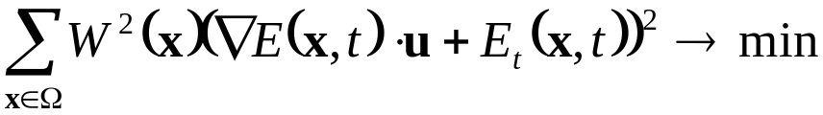
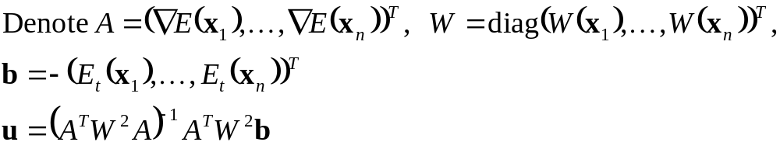
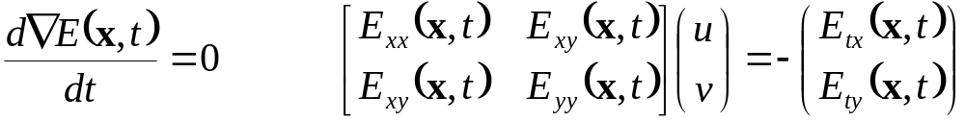
Other Differential Techniques
Lucas Kanade (1984): Weighted least-squares (LS) fit to a constant model of u in a small neighborhood Ω;
Nagel (1983,87): Oriented smoothness constraint; smoothness is not imposed across edges
Uras et al. (1988): Use constraints on second-order derivatives

Slide 40
Classification of Optical Flow Techniques
Gradient-based methods
Frequency-domain methods
Correlation methods

Slide 41
3 Computational Stages
1. Prefiltering or smoothing with
low-pass/band-pass filters to enhance signal-to-noise ratio
2. Extraction of basic measurements (e.g., spatiotemporal derivatives, spatiotemporal frequencies, local correlation surfaces)
3. Integration of these measurements, to produce 2D image flow using smoothness assumptions

Slide 42


Energy-based Methods
Adelson Berger (1985), Watson Ahumada (1985), Heeger (1988): Fourier transform of a translating 2D pattern:
All the energy lies on a plane through the origin in frequency space
Local energy is extracted using velocity-tuned filters (for example, Gabor-energy filters)
Motion is found by fitting the best plane in frequency space
Fleet Jepson (1990): Phase-based Technique
  Assumption that phase is preserved (as opposed to amplitude)
  Velocity tuned band pass filters have complex-valued outputs

Slide 43


Correlation-based Methods
Anandan (1987), Singh (1990)
1. Find displacement (dx, dy) which maximizes cross correlation
or minimizes sum of squared differences (SSD)
2. Smooth the correlation outputs

Slide 44

A Pattern of Hajime Ouchi

Slide 45

Bias in Flow Estimation
Symmetric noise in spatial and temporal derivatives
Notation: δA=A-A', where A is the estimate, A' the actual value and δA the error
Underestimation in length
Bias in direction: more underestimation in direction of fewer measurements

Slide 46




Epipolar Constraint for Discrete Motions

Slide 47




points lie on their corresponding epipolar lines.
The epipole lies on all epipolar lines

Slide 48
Sources:
Horn (1986)
J. L. Barron, D. J. Fleet, S. S. Beauchemin (1994). Systems and Experiment. Performance of Optical Flow Techniques. IJCV 12(1):43–77. Available at http://www.cs.queesu.ca/home/fleet/
research/Projects/flowCompare.html
http://www.cfar.umd.edu/~fer/postscript/ouchipapernew.ps.gz (paper on Ouchi illusion)
http://www.cfar.umd.edu./ftp/TRs/CVL-Reports-1999/TR4080-fermueller.ps.gz (paper on statistical bias)
http://www.cis.upenn.edu/~beau/home.html
http://www.isi.uu.nl/people/michael/of.html (code for optical flow estimation techniques)

