Slide 1
Humans and animals have a number of senses
Sight
Hearing
Touch
Smell
Taste
Balance
Echolocation: bats, electric fields: sharks, compass: birds

Slide 2
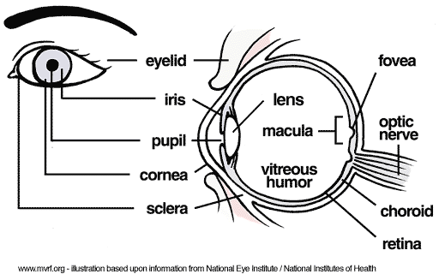
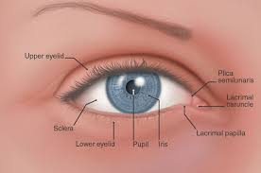
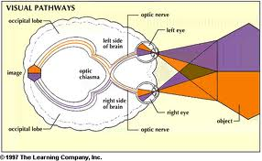
Vision

Slide 3
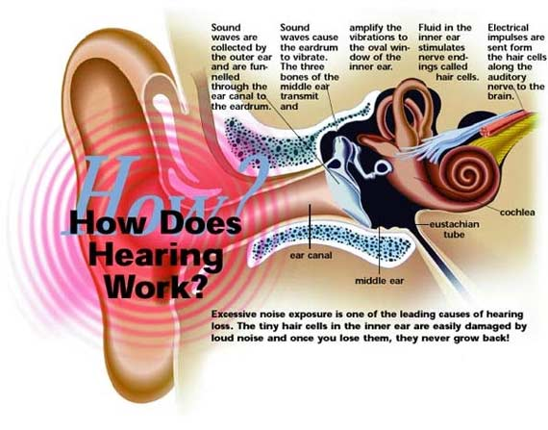
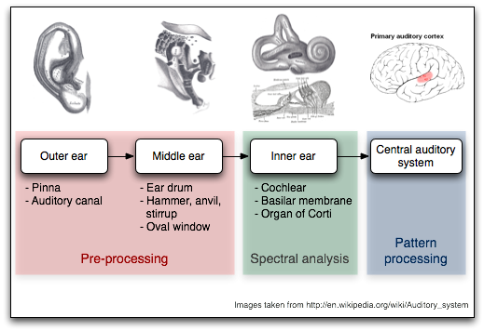
Hearing

Slide 4
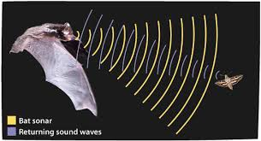
Echolocation of bats

Slide 5
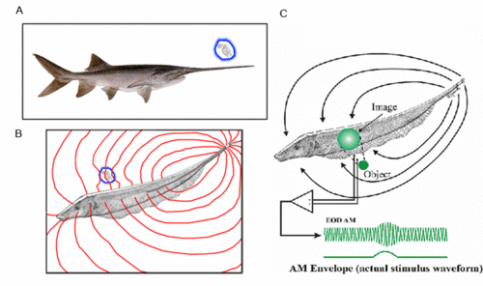
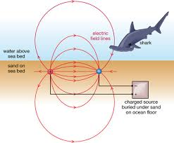
Electric field sensing

Slide 6
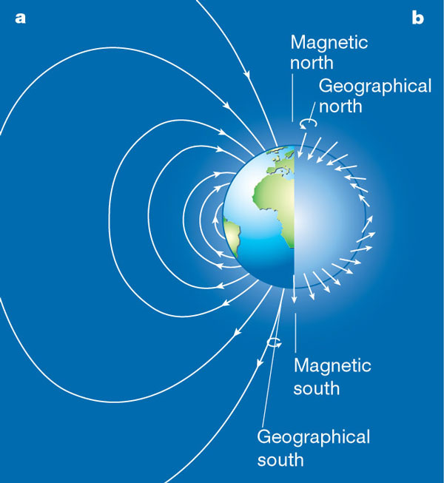
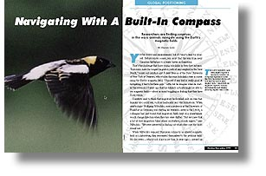
Magnetic field sensing

Slide 7


Vision: most powerful sense
Essential for survival: finding food, avoiding being food, finding mates
Long range sensing: beyond our fingertip (vision is our way to touch the world)

Slide 8
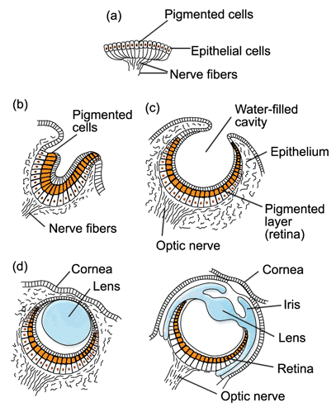
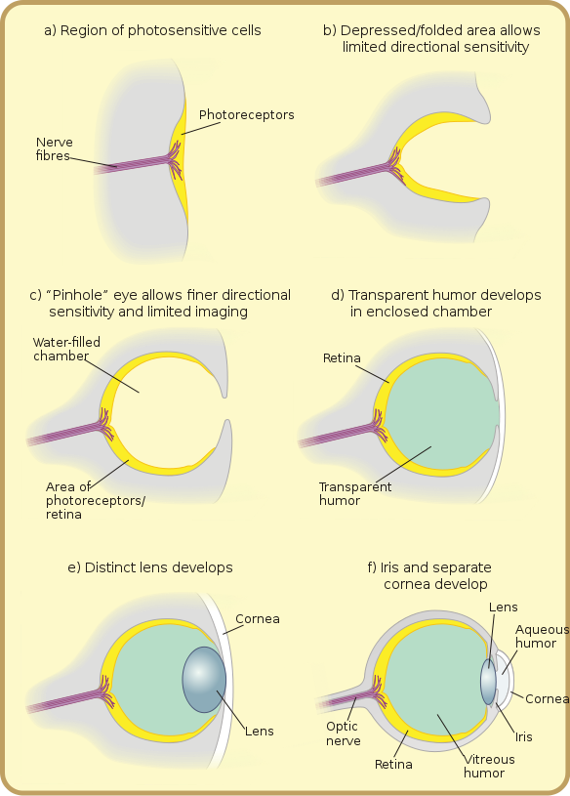
Evolution of the eye ½ billion years

Slide 9
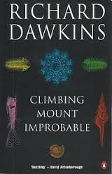
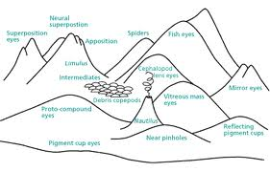
Climbing mount improbable 10 different designs

Slide 10
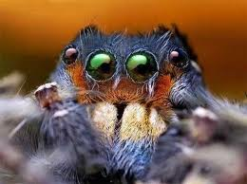
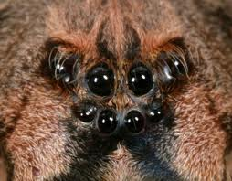
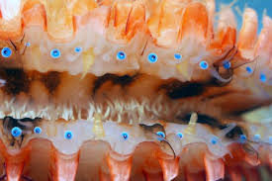
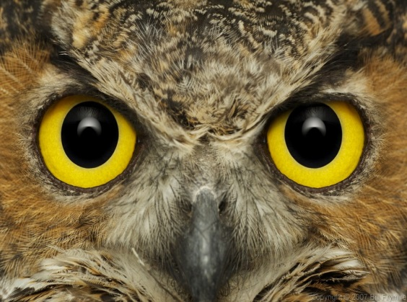
A plethora of eyes

Slide 11
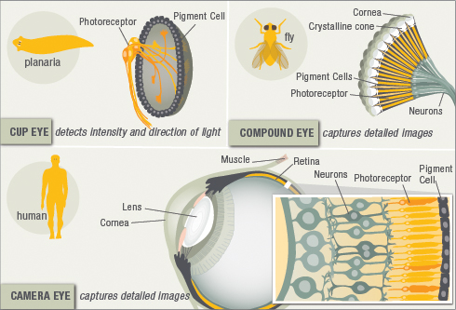
Complex Eyes

Slide 12
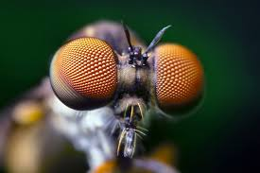
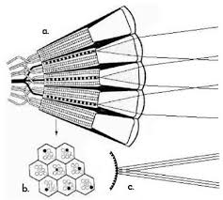
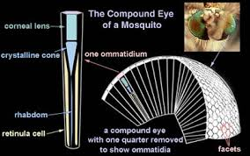
Compound eyes

Slide 13
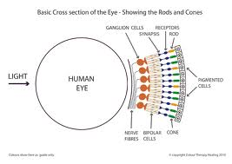
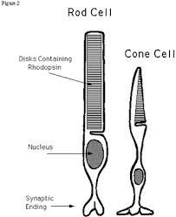
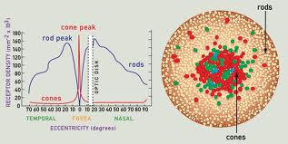
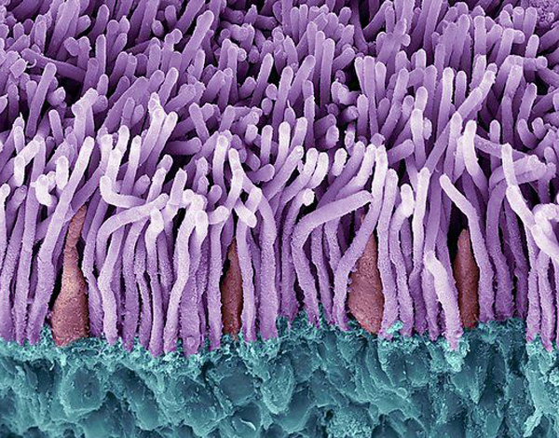
Human Eyes

Slide 14
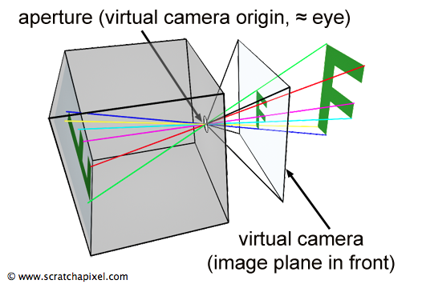
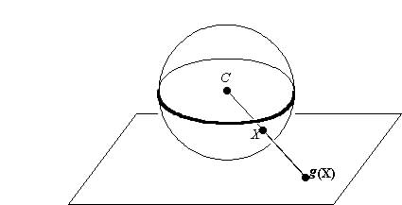
Two kinds of eyes at the top: Camera type or planar Spherical

Slide 15



Many cameras in the market

Slide 16
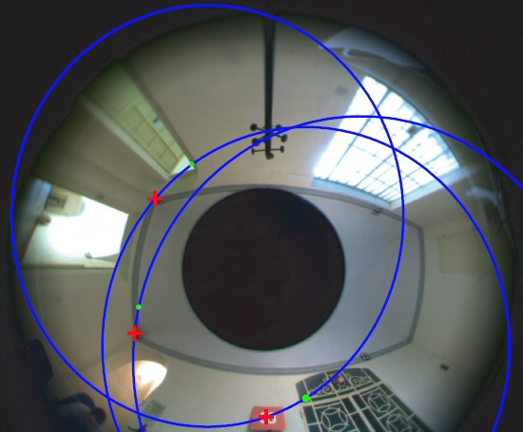
Catadioptric – panoramic images

Slide 17
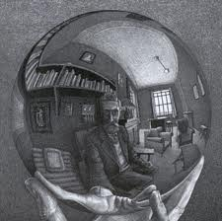

Slide 18
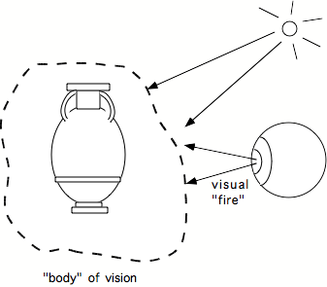

How does Vision work?
Ancient Greeks: Extramission Theory

Slide 19
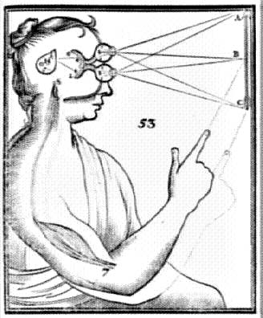
Descartes got it right

Slide 20
Many theories over the centuries
The Gestaltists
Von Helmholz: Unconscious inference
David Marr: A reconstruction process that tells us where is what.

Slide 21
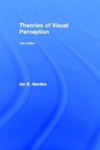
Theories influenced by the zeitgeist

Slide 22
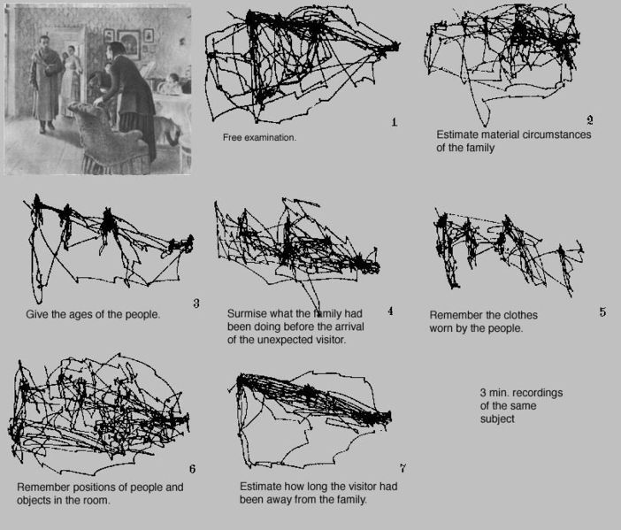
Animal perception is active

Slide 23
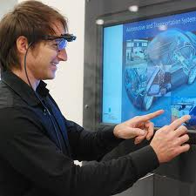
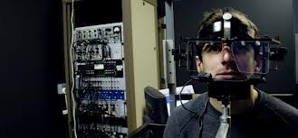
Measuring eye movements

Slide 24
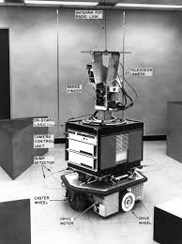
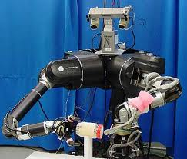
Robots with Vision

Slide 25

PR2 Humanoid

Slide 26
Perception for Robots 3 major problems
Reconstruction
Reorganization
Recognition

Slide 27
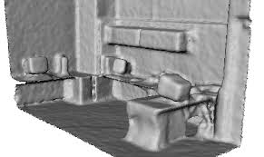
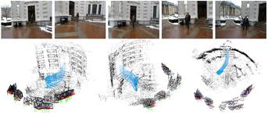
Reconstruction

Slide 28
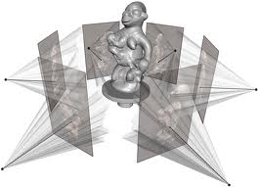

Slide 29
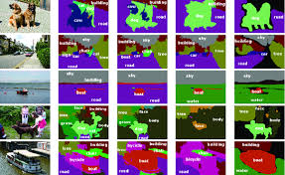
Reorganization: segmentation

Slide 30
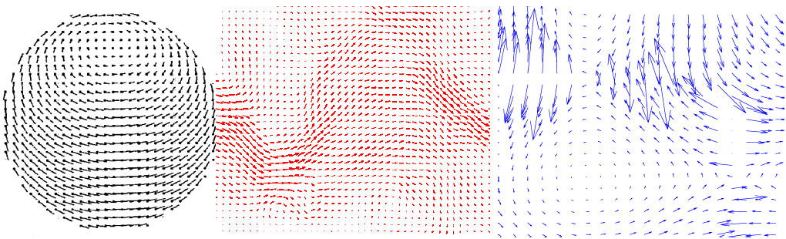
Reorganization: flow

Slide 31
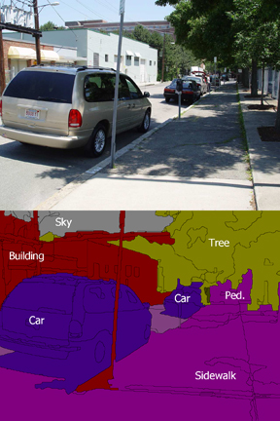
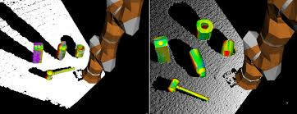
Recognition

Slide 32
Images and Videos Contain
Lines (contours, edges)
Intensity and Color
Texture
movement

Slide 33

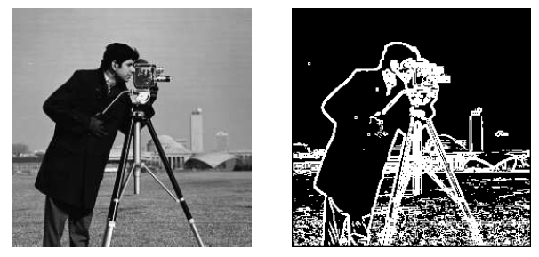
Lines

Slide 34
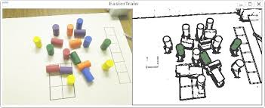

Color, Texture

Slide 35
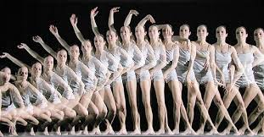
Motion

Slide 36
A theoretical model of an eye
Pick a point in space and the light rays passing through
O

Slide 37
Then cut the rays with a plane
This gives an image
O

Slide 38
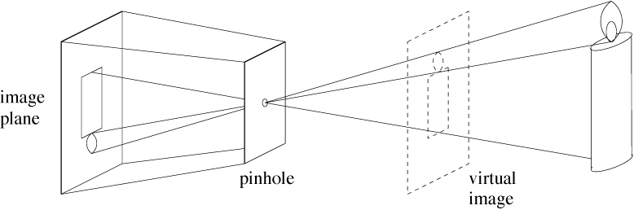
Pinhole cameras
Abstract camera model - box with a small hole in it
Pinhole cameras work in practice
(Forsyth & Ponce)

Slide 39
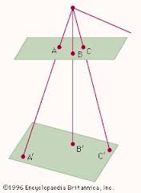
If we change the plane, we get an new image

Slide 40


How are these images related? (what remains invariant?)

Slide 41


Conics

Slide 42

Projection of circle

Slide 43
Vanishing points
image plane
vanishing point
camera
center
ground plane
Vanishing point
projection of a point at infinity

Slide 44
Vanishing points (2D)
image plane
vanishing point
camera
center
line on ground plane

Slide 45
Vanishing points
image plane
vanishing point V
camera
center
C
line on ground plane
line on ground plane
Properties
Any two parallel lines have the same vanishing point v
The ray from C through v is parallel to the lines
An image may have more than one vanishing point

Slide 46

Parallelism (angles) not invariant

Slide 47

Cross ratio = only invariant

Slide 48


Slide 49


Slide 50
Back to our question: how are the 2 images related to each other
Can we find a map, a function mapping x’ to x?

Slide 51

Fundamental Theorem: If we know how 4 points map to each other in the two planes, then we know how all points map. (if a→A, b→B, c→C,d→D, then we can map any point)

Slide 52
Proof
B
b
a
p
A
P
c
C
s
S
d
D

Slide 53
The projective plane
Why do we need homogeneous coordinates?
represent points at infinity, homographies, perspective projection, multi-view relationships
What is the geometric intuition?
a point in the image is a ray in projective space
y
(sx,sy,s)
(x,y,1)
(0,0,0)
z
x
image plane
Each point (x,y) on the plane is represented by a ray (sx,sy,s)
all points on the ray are equivalent: (x, y, 1) ≅ (sx, sy, s)

Slide 54
Projective lines
What does a line in the image correspond to in projective space?
A line is a plane of rays through origin
all rays (x,y,z) satisfying: ax + by + cz = 0
l
p
A line is also represented as a homogeneous 3-vector l

Slide 55
Point and line duality
A line l is a homogeneous 3-vector
It is ⊥ to every point (ray) p on the line: l p=0
p₁
p₂
l₁
p
l
l₂
What is the line l spanned by rays p₁ and p₂ ?
l is ⊥ to p₁ and p₂ ⇒ l = p₁ × p₂
l is the plane normal
What is the intersection of two lines l₁ and l₂ ?
p is ⊥ to l₁ and l₂ ⇒ p = l₁ × l₂
Points and lines are dual in projective space
given any formula, can switch the meanings of points and lines to get another formula

Slide 56
Ideal points and lines
(a,b,0)
y
(sx,sy,0)
y
z
image plane
z
image plane
x
x
Ideal point (“point at infinity”)
p ≅ (x, y, 0) – parallel to image plane
It has infinite image coordinates
Ideal line
l ≅ (a, b, 0) – parallel to image plane
Corresponds to a line in the image (finite coordinates)

Slide 57

Fundamental Theorem (homography or collineation)

Slide 58


Slide 59


Slide 60

Projective vs Affine

Slide 61

Rectification

