Slide 1
EM Algorithm and its Applications
slides adapted from Yi Li, WU

Slide 2
Outline
Introduction of EM
K-Means → EM
EM Applications
  Image Segmentation using EM in Clustering Algorithms
  Object Class Recognition in CBIR

Slide 3
Color Clustering by K-means Algorithm
Form K-means clusters from a set of n-dimensional vectors
1. Set ic (iteration count) to 1
2. Choose randomly a set of K means m₁(1), …, m_{K}(1).
  3. For each vector x_{i}, compute distance D(x_{i},m_{k}(ic)), k=1,…K
  and assign x_{i} to the cluster C_{j} with nearest mean.
  4. Update the means to get m₁(ic),…,m_{K}(ic); increment ic by 1
5. Repeat steps 3 and 4 until C_{k}(ic) = C_{k}(ic+1) for all k.

Slide 4
K-Means Classifier
Classification Results
x₁→C(x₁)
x₂→C(x₂)
…
x_{i}→C(x_{i})
…
x₁={r₁, g₁, b₁}
x₂={r₂, g₂, b₂}
…
x_{i}={r_{i}, g_{i}, b_{i}}
…
Classifier
(K-Means)
Cluster Parameters
m₁ for C₁
m₂ for C₂
…
m_{k} for C_{k}

Slide 5
K-Means Classifier (Cont.)
Input (Known)
Output (Unknown)
x₁={r₁, g₁, b₁}
x₂={r₂, g₂, b₂}
…
x_{i}={r_{i}, g_{i}, b_{i}}
…
Classification Results
x₁→C(x₁)
x₂→C(x₂)
…
x_{i}→C(x_{i})
…
Cluster Parameters
m₁ for C₁
m₂ for C₂
…
m_{k} for C_{k}

Slide 6
Input (Known)
Output (Unknown)
Initial Guess of
Cluster Parameters
m₁ , m₂ , …, m_{k}
x₁={r₁, g₁, b₁}
x₂={r₂, g₂, b₂}
…
x_{i}={r_{i}, g_{i}, b_{i}}
…
Classification Results ⁽¹⁾
C(x₁), C(x₂), …, C(x_{i})
Cluster Parameters⁽¹⁾
m₁ , m₂ , …, m_{k}
Classification Results ⁽²⁾
C(x₁), C(x₂), …, C(x_{i})
Cluster Parameters⁽²⁾
m₁ , m₂ , …, m_{k}
•••
•••
Classification Results ^{(ic)}
C(x₁), C(x₂), …, C(x_{i})
Cluster Parameters^{(ic)}
m₁ , m₂ , …, m_{k}
•••
•••

Slide 7

K-Means (Cont.)
Boot Step:
  Initialize K clusters: C₁, …, C_{K}
  Each Cluster is represented by its mean m_{j}
Iteration Step:
  Estimate the cluster of each data
  Re-estimate the cluster parameters
x_{i}
C(x_{i})

Slide 8
K-Means Example

Slide 9
K-Means Example

Slide 10
K means: Challenges
Will converge
But not to the global minimum of objective function
Variations: search for appropriate number of clusters by applying k-means with different k and comparing the results

Slide 11
Image Segmentation by K-Means
Select a value of K
Select a feature vector for every pixel (color, texture, position, or combination of these etc.)
Define a similarity measure between feature vectors (Usually Euclidean Distance).
Apply K-Means Algorithm.
Apply Connected Components Algorithm.
Merge any components of size less than some threshold to an adjacent component that is most similar to it.
* From Marc Pollefeys COMP 256 2003

Slide 12
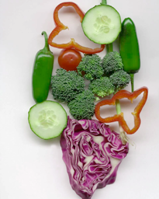
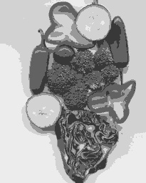
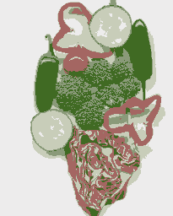
Results of K-Means Clustering:
Image
Clusters on intensity
Clusters on color
K-means clustering using intensity alone and color alone
* From Marc Pollefeys COMP 256 2003
Notes:
I gave each pixel the mean intensity or mean color of its cluster --- this is basically just vector quantizing the image intensities/colors. Notice that there is no requirement that clusters be spatially localized and they’re not.

Slide 13
Refinement
Use mixture of Gaussians; augment cluster centers with covariance matrix, which are re-estimated each step; amounts to Mahalanobis distance instead of nearest neighbors
The approach corresponds to iteratively estimating the parameters of a mixture of Gaussian density function and the assignment of pixels to the Gaussians.
with x_{i} data, μ_{i} cluster centers, Σ_{i} covariances
Probability distribution for x
We need to estimate the p_{k,} (the distribution k): μ_{k} ,Σ_{k} and assignment value π_{k}

Slide 14
E M algorithm
Like K-means with soft assignment.
(vs hard assignment)
Assign point partly to all clusters based on probability it belongs to each.
Compute weighted averages (centers, and covariances)

Slide 15
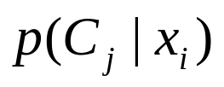
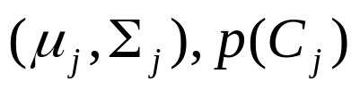
K-Means → EM with Gaussian Mixture Models (GMM)
Boot Step:
  Initialize K clusters: C₁, …, C_{K}
Iteration Step:
  Estimate the (soft) cluster assignment
  of each data
  Re-estimate the cluster parameters
(μ_{j,} Σ_{j}) and P(C_{j}) for each cluster j.
Expectation
Maximization
For each cluster j

Slide 16
EM Classifier
Classification Results
p(C₁|x₁)
p(C_{j}|x₂)
…
p(C_{j}|x_{i})
…
x₁={r₁, g₁, b₁}
x₂={r₂, g₂, b₂}
…
x_{i}={r_{i}, g_{i}, b_{i}}
…
Classifier
(EM)
Cluster Parameters
(μ₁,Σ₁),p(C₁) for C₁
(μ₂,Σ₂),p(C₂) for C₂
…
(μ_{k},Σ_{k}),p(C_{k}) for C_{k}

Slide 17
EM Classifier (Cont.)
Input (Known)
Output (Unknown)
x₁={r₁, g₁, b₁}
x₂={r₂, g₂, b₂}
…
x_{i}={r_{i}, g_{i}, b_{i}}
…
Cluster Parameters
(μ₁,Σ₁), p(C₁) for C₁
(μ₂,Σ₂), p(C₂) for C₂
…
(μ_{k},Σ_{k}), p(C_{k}) for C_{k}
Classification Results
p(C₁|x₁)
p(C_{j}|x₂)
…
p(C_{j}|x_{i})
…

Slide 18
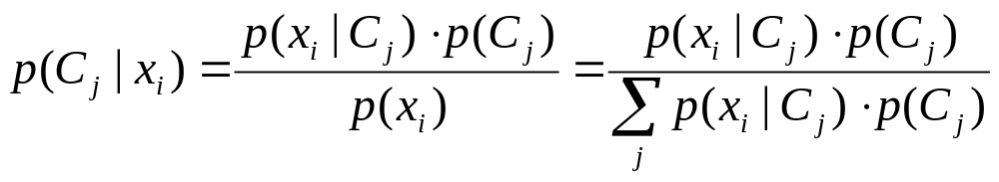
Expectation Step
Input (Known)
Input (Estimation)
Output
x₁={r₁, g₁, b₁}
x₂={r₂, g₂, b₂}
…
x_{i}={r_{i}, g_{i}, b_{i}}
…
Cluster Parameters
(μ₁,Σ₁), p(C₁) for C₁
(μ₂,Σ₂), p(C₂) for C₂
…
(μ_{k},Σ_{k}), p(C_{k}) for C_{k}
Classification Results
p(C₁|x₁)
p(C_{j}|x₂)
…
p(C_{j}|x_{i})
…
+

Slide 19
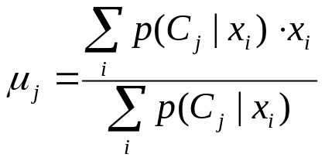
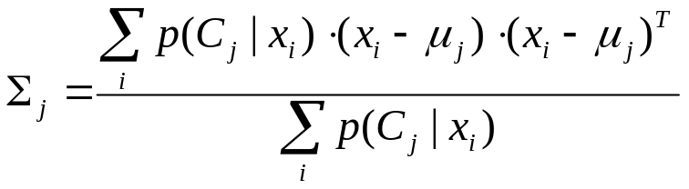
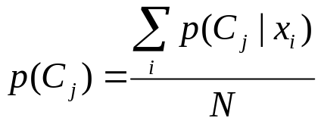
Maximization Step
Input (Known)
Input (Estimation)
Output
x₁={r₁, g₁, b₁}
x₂={r₂, g₂, b₂}
…
x_{i}={r_{i}, g_{i}, b_{i}}
…
Classification Results
p(C₁|x₁)
p(C_{j}|x₂)
…
p(C_{j}|x_{i})
…
Cluster Parameters
(μ₁,Σ₁), p(C₁) for C₁
(μ₂,Σ₂), p(C₂) for C₂
…
(μ_{k},Σ_{k}), p(C_{k}) for C_{k}
+

Slide 20

EM Algorithm
Boot Step:
  Initialize K clusters: C₁, …, C_{K}
Iteration Step:
  Expectation Step
  Maximization Step
(μ_{j,} Σ_{j}) and P(C_{j}) for each cluster j.

Slide 21
EM Demo
Video of Image Classification with EM
Online Tutorial

Slide 22
EM Applications
Blobworld: Image Segmentation Using Expectation-Maximization and its Application to Image Querying

Slide 23
Image Segmentation using EM
Step 1: Feature Extraction
Step 2: Image Segmentation using EM

Slide 24
Symbols
The feature vector for pixel i is called x_{i}.
There are going to be K segments; K is given.
The j-th segment has a Gaussian distribution with parameters θ_{j}=(μ_{j},Σ_{j}).
α_{j}'s are the weights (which sum to 1) of Gaussians. Θ is the collection of parameters:
Θ =(α₁, …, α_{k}, θ₁, …, θ_{k})

Slide 25
Initialization
Each of the K Gaussians will have parameters θ_{j}=(μ_{j},Σ_{j}), where
  μ_{j} is the mean of the j-th Gaussian.
  Σ_{j} is the covariance matrix of the j-th Gaussian.
The covariance matrices are initialized to be the identity matrix.
The means can be initialized by finding the average feature vectors in each of K windows in the image; this is data-driven initialization.

Slide 26
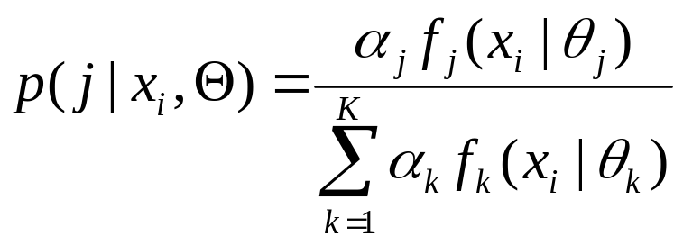
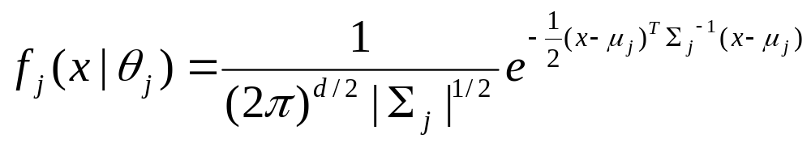
E-Step
(referred to as responsibilities)

Slide 27
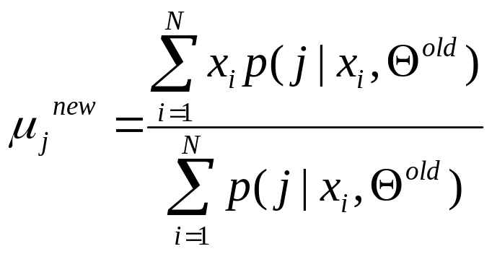
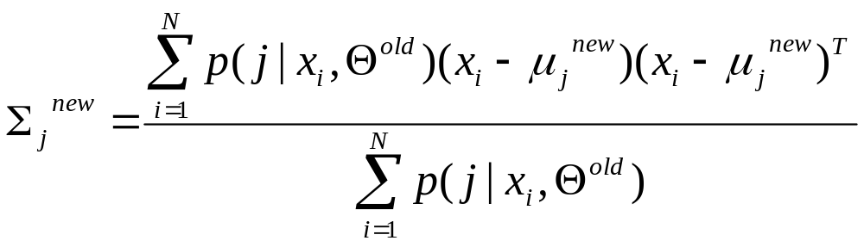
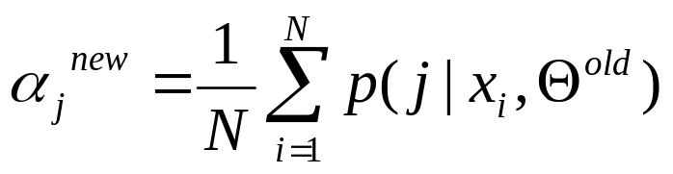
M-Step

Slide 28

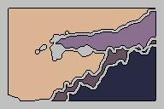
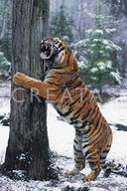


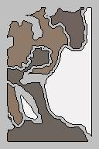

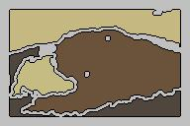
Sample Results

