Slide 1
Edge Detection

Slide 2
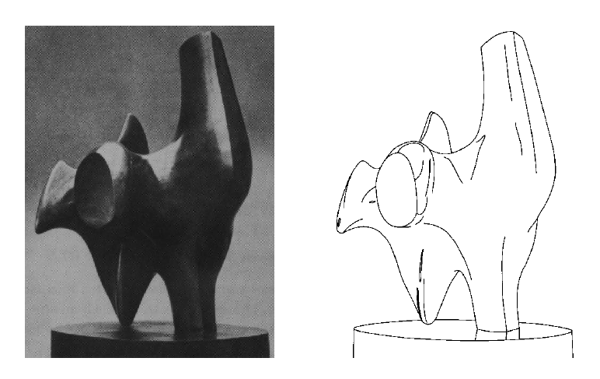
Edge detection
Convert a 2D image into a set of curves
  Extracts salient features of the scene
  More compact than pixels

Slide 3
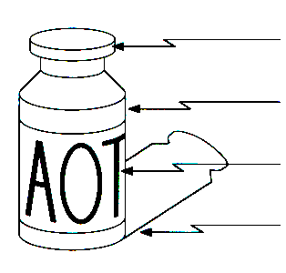
Origin of Edges
surface normal discontinuity
depth discontinuity
surface color discontinuity
illumination discontinuity
Edges are caused by a variety of factors

Slide 4
Edge detection
How can you tell that a pixel is on an edge?

Slide 5
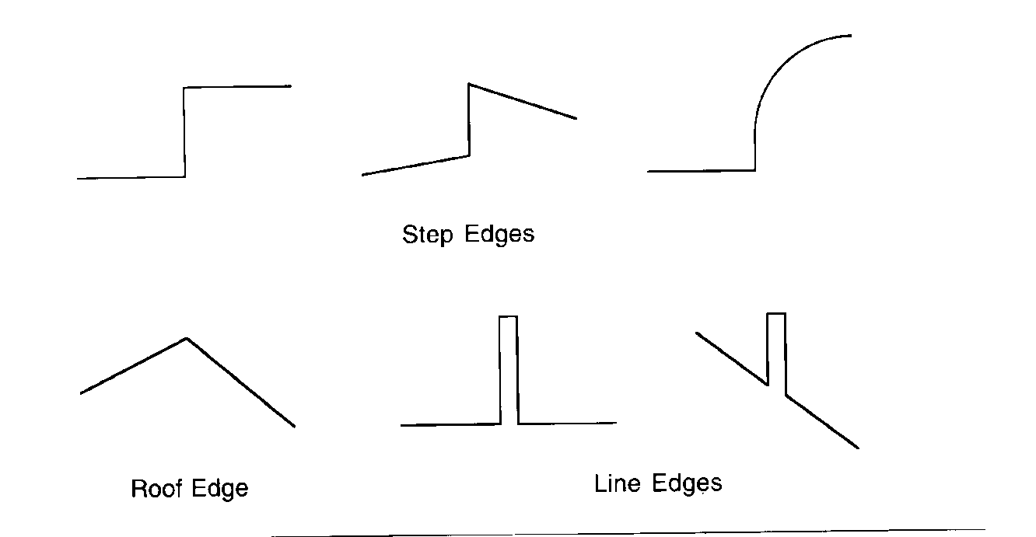
Profiles of image intensity edges

Slide 6
Edge detection
Detection of short linear edge segments (edgels)
Aggregation of edgels into extended edges
(maybe parametric description)

Slide 7
Edgel detection
Difference operators
Parametric-model matchers

Slide 8
Edge is Where Change Occurs
Change is measured by derivative in 1D
Biggest change, derivative has maximum magnitude
Or 2nd derivative is zero.

Slide 9
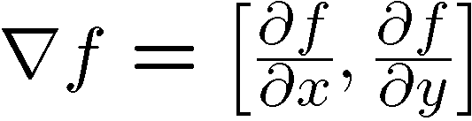
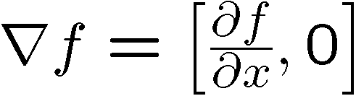

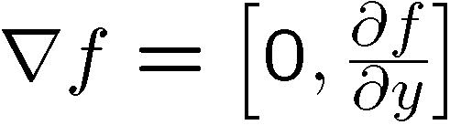
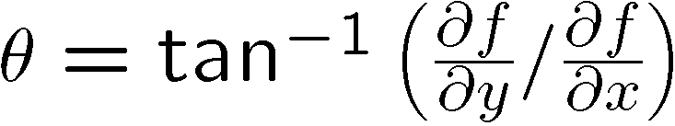
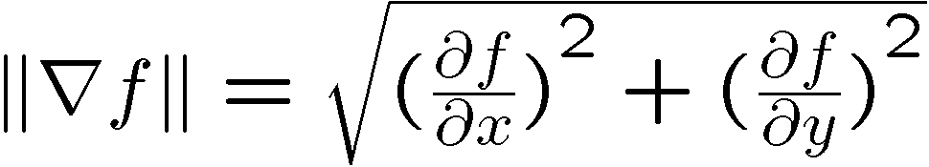
Image gradient
The gradient of an image:
The gradient points in the direction of most rapid change in intensity
The gradient direction is given by:
  how does this relate to the direction of the edge?
The edge strength is given by the gradient magnitude

Slide 10
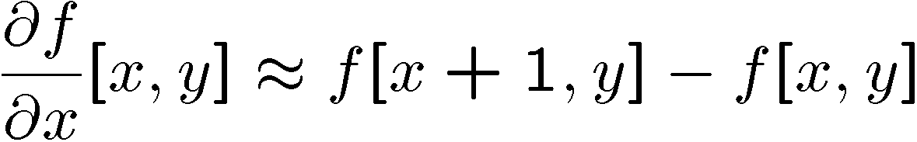

The discrete gradient
How can we differentiate a digital image f[x,y]?
  Option 1: reconstruct a continuous image, then take gradient
  Option 2: take discrete derivative (finite difference)
How would you implement this as a cross-correlation?

Slide 11



The Sobel operator
Better approximations of the derivatives exist
  The Sobel operators below are very commonly used
-1 | 0 | 1
-2 | 0 | 2
-1 | 0 | 1
1 | 2 | 1
0 | 0 | 0
-1 | -2 | -1
  The standard defn. of the Sobel operator omits the 1/8 term
    doesn’t make a difference for edge detection
    the 1/8 term is needed to get the right gradient value, however

Slide 12
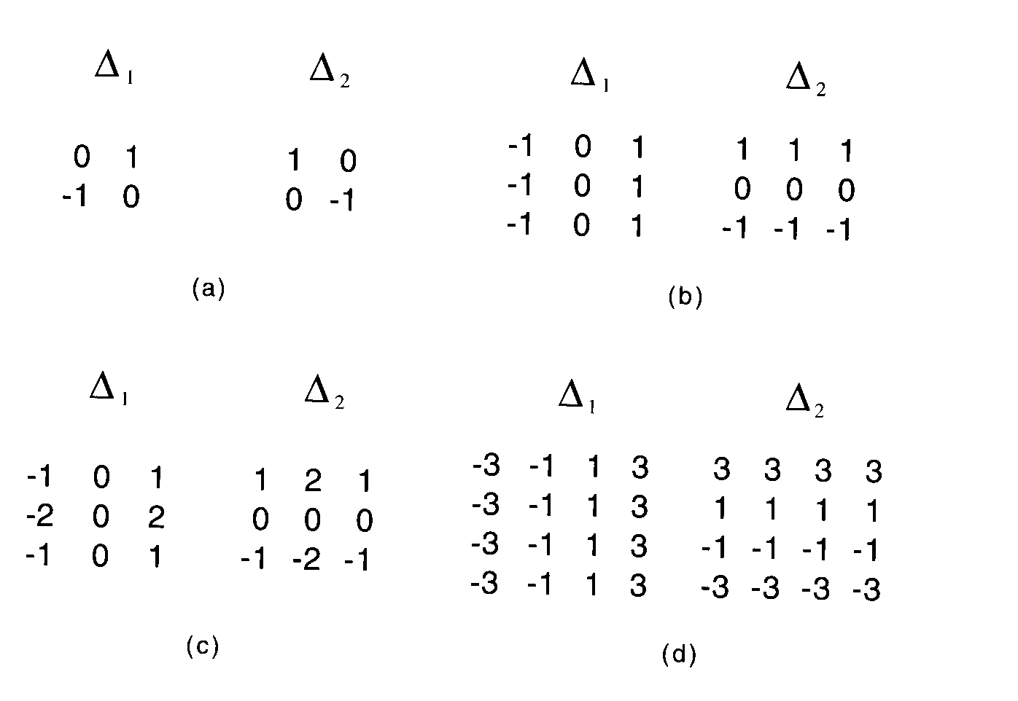
Gradient operators
(a): Roberts’ cross operator (b): 3x3 Prewitt operator
(c): Sobel operator (d) 4x4 Prewitt operator

Slide 13
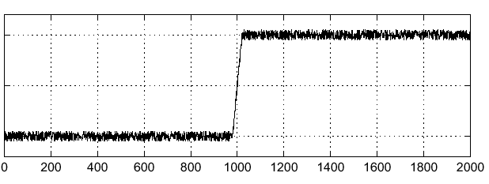

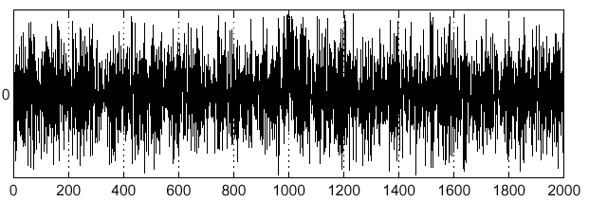
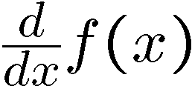
Effects of noise
Consider a single row or column of the image
  Plotting intensity as a function of position gives a signal
Where is the edge?

Slide 14
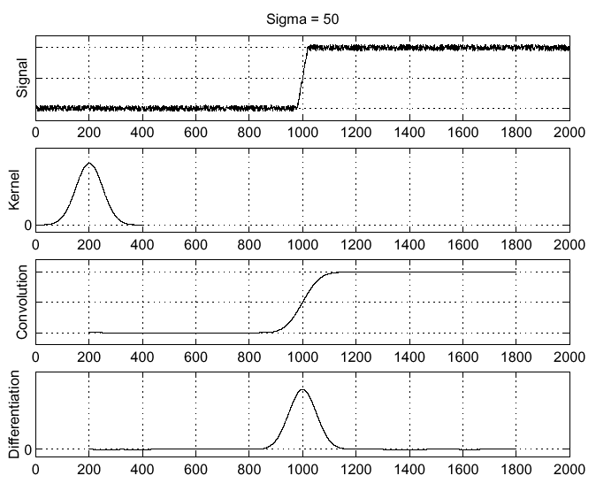



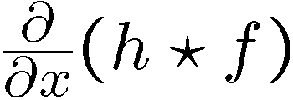
Solution: smooth first
Where is the edge?
Look for peaks in

Slide 15
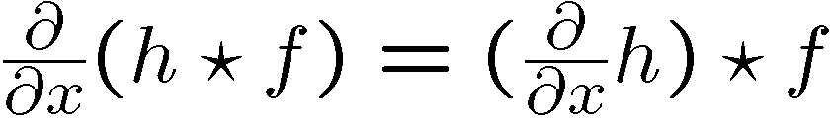
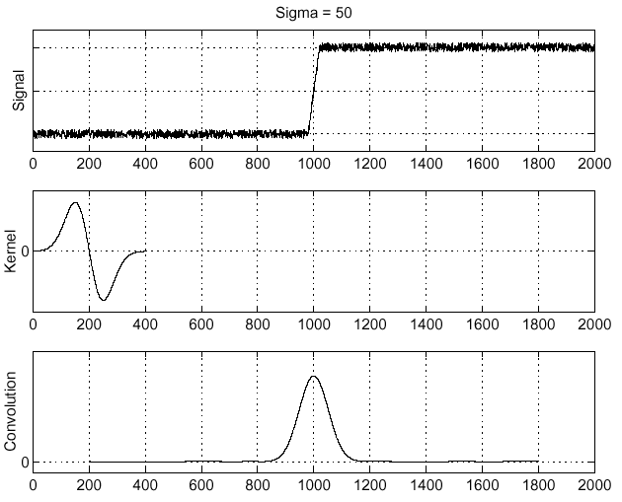
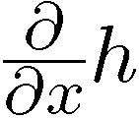
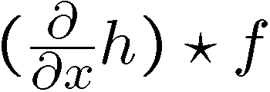
Derivative theorem of convolution
This saves us one operation:

Slide 16
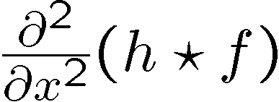
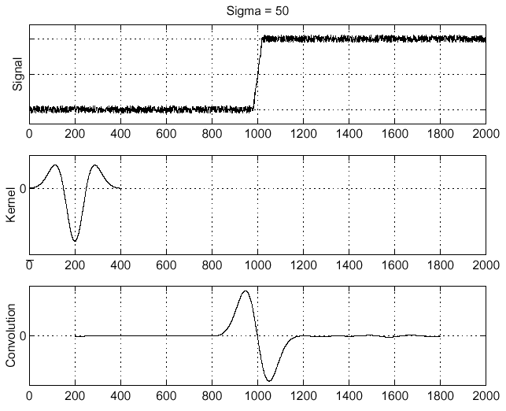
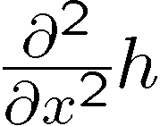
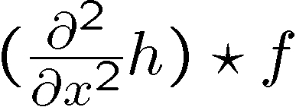
Laplacian of Gaussian
Consider
Laplacian of Gaussian
operator
Where is the edge?
Zero-crossings of bottom graph

Slide 17
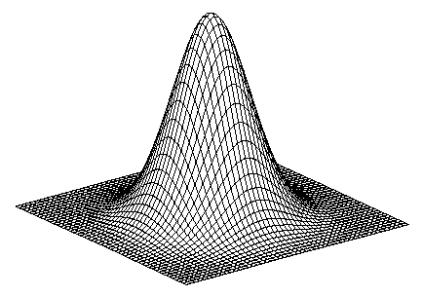
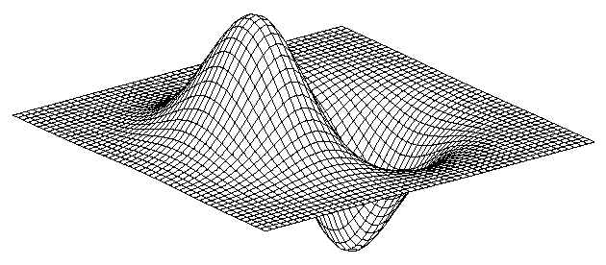
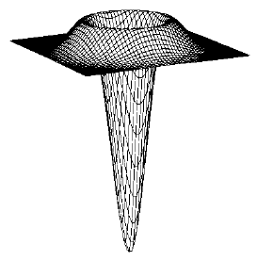
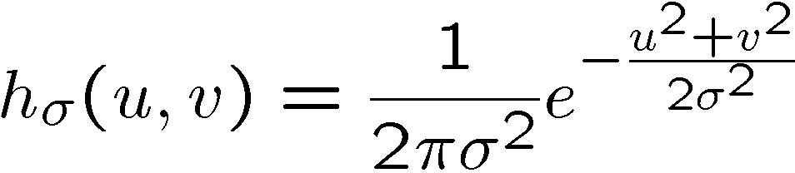
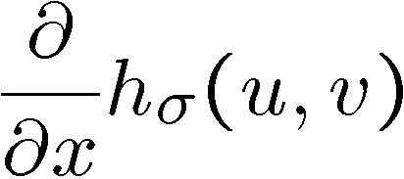
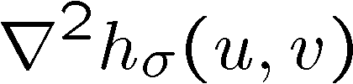

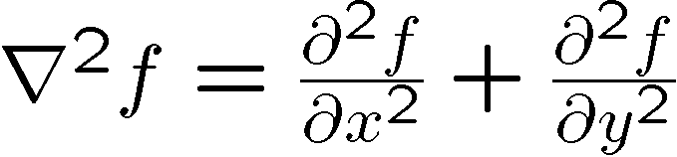
2D edge detection filters
Laplacian of Gaussian
Gaussian
derivative of Gaussian
is the Laplacian operator:

Slide 18
Optimal Edge Detection: Canny
Assume:
  Linear filtering
  Additive iid Gaussian noise
Edge detector should have:
  Good Detection. Filter responds to edge, not noise.
  Good Localization: detected edge near true edge.
  Single Response: one per edge.

Slide 19
Optimal Edge Detection: Canny (continued)
Optimal Detector is approximately Derivative of Gaussian.
Detection/Localization trade-off
  More smoothing improves detection
  And hurts localization.
This is what you might guess from (detect change) + (remove noise)

Slide 20

The Canny edge detector
original image (Lena)

Slide 21
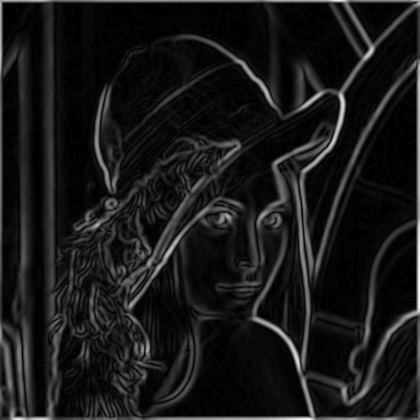
The Canny edge detector
norm of the gradient

Slide 22
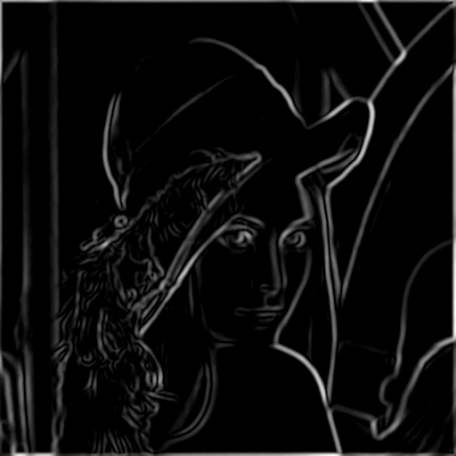
The Canny edge detector
thresholding

Slide 23

The Canny edge detector
thinning
(non-maximum suppression)

Slide 24

Non-maximum suppression
Check if pixel is local maximum along gradient direction
  requires checking interpolated pixels p and r

Slide 25

Predicting
the next
edge point
Assume the marked point is an edge point. Then we construct the tangent to the edge curve (which is normal to the gradient at that point) and use this to predict the next points (here either r or s).
(Forsyth & Ponce)

Slide 26
Hysteresis
Check that maximum value of gradient value is sufficiently large
  drop-outs? use hysteresis
    use a high threshold to start edge curves and a low threshold to continue them.

Slide 27






Effect of σ (Gaussian kernel size)
original
Canny with
Canny with
The choice of depends on desired behavior
  large detects large scale edges
  small detects fine features

Slide 28
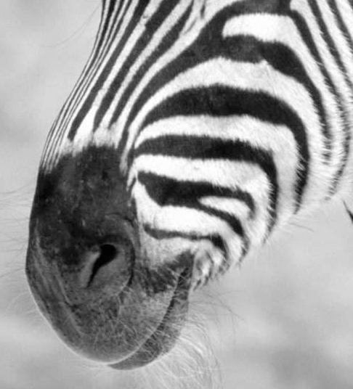
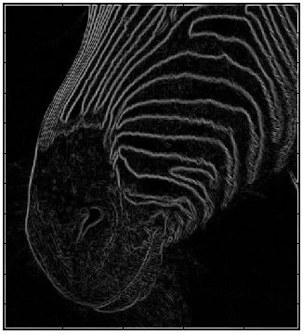
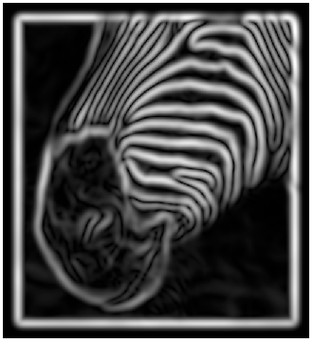
Scale
Smoothing
Eliminates noise edges.
Makes edges smoother.
Removes fine detail.
(Forsyth & Ponce)
Notes:
Figures show gradient magnitude of zebra at two different scales

Slide 29
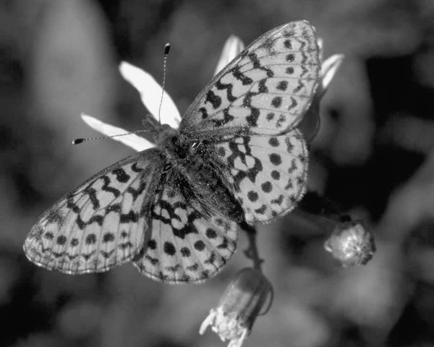

Slide 30
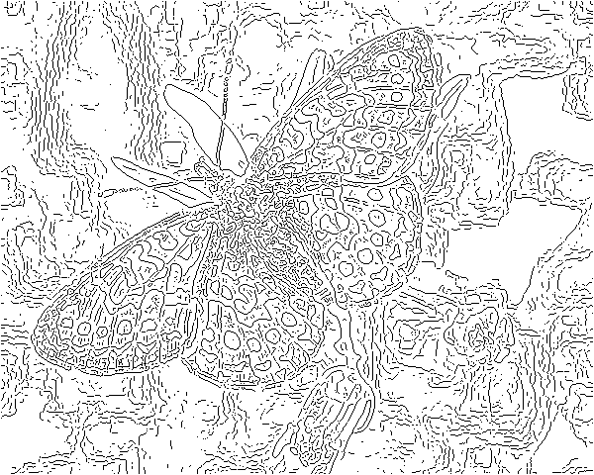
fine scale
high
threshold

Slide 31
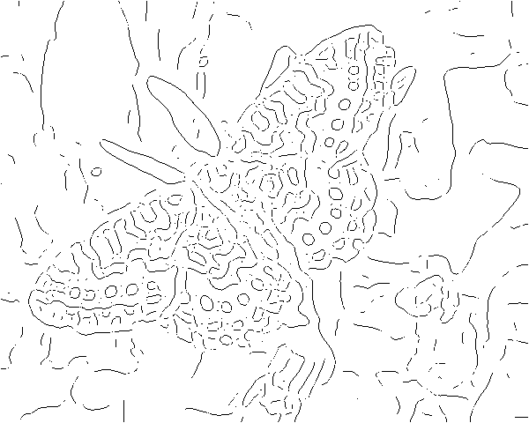
coarse
scale,
high
threshold

Slide 32
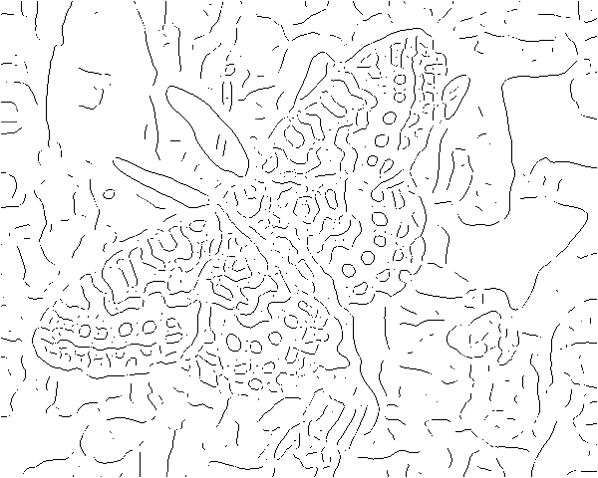
coarse
scale
low
threshold

Slide 33
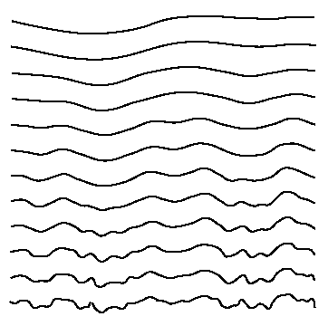
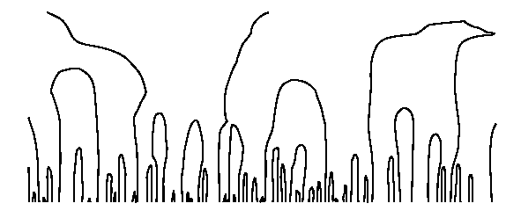

Scale space (Witkin 83)
first derivative peaks
larger
Gaussian filtered signal
Properties of scale space (w/ Gaussian smoothing)
  edge position may shift with increasing scale (σ)
  two edges may merge with increasing scale
  an edge may not split into two with increasing scale

Slide 34

Edge detection by subtraction
original

Slide 35
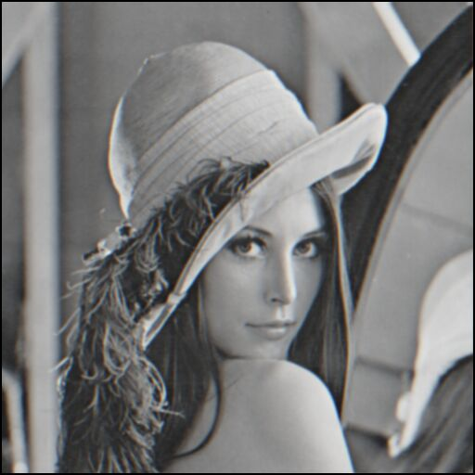
Edge detection by subtraction
smoothed (5x5 Gaussian)

Slide 36

Edge detection by subtraction
Why does
this work?
smoothed – original
(scaled by 4, offset +128)
filter demo

Slide 37

Gaussian - image filter
Gaussian
delta function
Laplacian of Gaussian

Slide 38
An edge is not a line...
How can we detect lines ?

Slide 39
Finding lines in an image
Option 1:
  Search for the line at every possible position/orientation
  What is the cost of this operation?
Option 2:
  Use a voting scheme: Hough transform

Slide 40

Finding lines in an image
y
b
b₀
x
m₀
m
image space
Hough space
Connection between image (x,y) and Hough (m,b) spaces
  A line in the image corresponds to a point in Hough space
  To go from image space to Hough space:
    given a set of points (x,y), find all (m,b) such that y = mx + b

Slide 41

Finding lines in an image
y
b
y₀
x₀
x
m
image space
Hough space
Connection between image (x,y) and Hough (m,b) spaces
  A line in the image corresponds to a point in Hough space
  To go from image space to Hough space:
    given a set of points (x,y), find all (m,b) such that y = mx + b
  What does a point (x₀, y₀) in the image space map to?
    A: the solutions of b = -x₀m + y₀
    this is a line in Hough space

Slide 42

Hough transform algorithm
Typically use a different parameterization
  d is the perpendicular distance from the line to the origin
  θ is the angle this perpendicular makes with the x axis
  Why?

Slide 43
Hough transform algorithm
Typically use a different parameterization
  d is the perpendicular distance from the line to the origin
  θ is the angle this perpendicular makes with the x axis
  Why?
Basic Hough transform algorithm
  Initialize H[d, θ]=0
  for each edge point I[x,y] in the image
    for θ = 0 to 180
      H[d, θ] += 1
  Find the value(s) of (d, θ) where H[d, θ] is maximum
  The detected line in the image is given by
What’s the running time (measured in # votes)?

Slide 44
Extensions
Extension 1: Use the image gradient
  same
  for each edge point I[x,y] in the image
    compute unique (d, θ) based on image gradient at (x,y)
      H[d, θ] += 1
  same
  same
What’s the running time measured in votes?
Extension 2
  give more votes for stronger edges
Extension 3
  change the sampling of (d, θ) to give more/less resolution
Extension 4
  The same procedure can be used with circles, squares, or any other shape

Slide 45
Extensions
Extension 1: Use the image gradient
  same
  for each edge point I[x,y] in the image
    compute unique (d, θ) based on image gradient at (x,y)
      H[d, θ] += 1
  same
  same
What’s the running time measured in votes?
Extension 2
  give more votes for stronger edges
Extension 3
  change the sampling of (d, θ) to give more/less resolution
Extension 4
  The same procedure can be used with circles, squares, or any other shape

Slide 46
Hough demos
Line : http://www/dai.ed.ac.uk/HIPR2/houghdemo.html
http://www.dis.uniroma1.it/~iocchi/slides/icra2001/java/hough.html
Circle : http://www.markschulze.net/java/hough/

Slide 47
Hough Transform for Curves
The H.T. can be generalized to detect any curve that can be expressed in parametric form:
  Y = f(x, a1,a2,…ap)
  a1, a2, … ap are the parameters
  The parameter space is p-dimensional
  The accumulating array is LARGE!

Slide 48
Generalizing the H.T.
The H.T. can be used even if the curve has not a simple analytic form!
Pick a reference point (x_{c},y_{c})
For i = 1,…,n :
  Draw segment to P_{i} on the boundary.
  Measure its length r_{i}, and its orientation α_{i}.
  Write the coordinates of (x_{c},y_{c}) as a function of r_{i} and α_{i}
  Record the gradient orientation φ_{i} at P_{i.}
Build a table with the data, indexed by φ_{i} .
(x_{c},y_{c})
r_{i}
φ_{i}
α_{i}
P_{i}
x_{c} = x_{i} + r_{i}cos(α_{i})
y_{c} = y_{i} + r_{i}sin(α_{i})

Slide 49
Generalizing the H.T.
Suppose, there were m different gradient orientations:
(m <= n)
φ₁
φ₂
.
.
.
φ_{m}
(r¹₁,α¹₁),(r¹₂,α¹₂),…,(r¹_{n1},α¹_{n1})
(r²₁,α²₁),(r²₂,α¹₂),…,(r²_{n2},α¹_{n2})
.
.
.
(r^{m}₁,α^{m}₁),(r^{m}₂,α^{m}₂),…,(r^{m}_{nm},α^{m}_{nm})
φ_{j}
α_{j}
r_{j}
(x_{c},y_{c})
φ_{i}
r_{i}
α_{i}
P_{i}
x_{c} = x_{i} + r_{i}cos(α_{i})
y_{c} = y_{i} + r_{i}sin(α_{i})
H.T. table

Slide 50
Generalized H.T. Algorithm:
Finds a rotated, scaled, and translated version of the curve:
Form an A accumulator array of possible reference points (x_{c},y_{c}), scaling factor S and Rotation angle θ.
For each edge (x,y) in the image:
  Compute φ(x,y)
  For each (r,α) corresponding to φ(x,y) do:
    For each S and θ:
      x_{c} = x_{i} + r(φ) S cos[α(φ) + θ]
      y_{c} = y_{i} + r(φ) S sin[α(φ) + θ]
      A(x_{c},y_{c},S,θ) ++
  Find maxima of A.
α_{j}
φ_{j}
Sr_{j}
θ
P_{j}
φ_{i}
Sr_{i}
α_{i}
θ
(x_{c},y_{c})
P_{i}
φ_{i}
Sr_{k}
α_{k}
θ
P_{k}
x_{c} = x_{i} + r_{i}cos(α_{i})
y_{c} = y_{i} + r_{i}sin(α_{i})

Slide 51
H.T. Summary
H.T. is a “voting” scheme
  points vote for a set of parameters describing a line or curve.
The more votes for a particular set
  the more evidence that the corresponding curve is present in the image.
Can detect MULTIPLE curves in one shot.
Computational cost increases with the number of parameters describing the curve.

Slide 52
Corners contain more edges than lines.
Corner detection
A point on a line is hard to match.

Slide 53
Corners contain more edges than lines.
A corner is easier

Slide 54
Edge Detectors Tend to Fail at Corners

Slide 55
Finding Corners
Intuition:
  Right at corner, gradient is ill defined.
  Near corner, gradient has two different values.

Slide 56
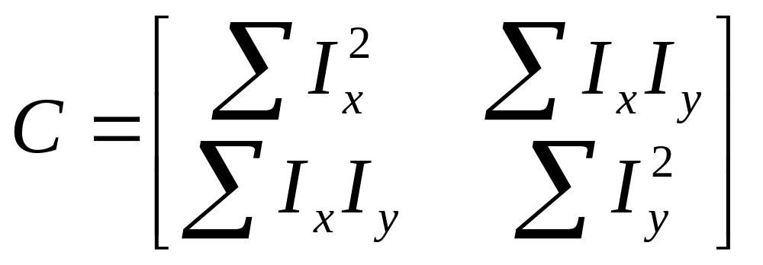
Formula for Finding Corners
We look at matrix:
Gradient with respect to x, times gradient with respect to y
Sum over a small region, the hypothetical corner
WHY THIS?
Matrix is symmetric

Slide 57
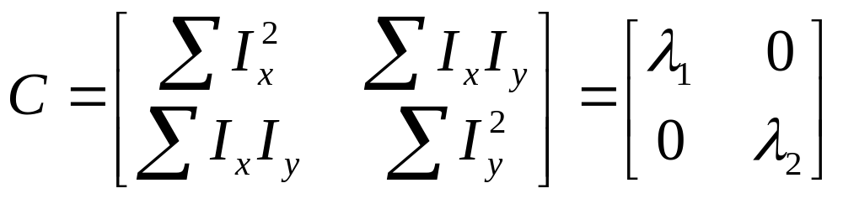
First, consider case where:
This means all gradients in neighborhood are:
(k,0) or (0, c) or (0, 0) (or off-diagonals cancel).
What is region like if:
λ1 = 0?
λ2 = 0?
λ1 = 0 and λ2 = 0?
λ1 > 0 and λ2 > 0?

Slide 58
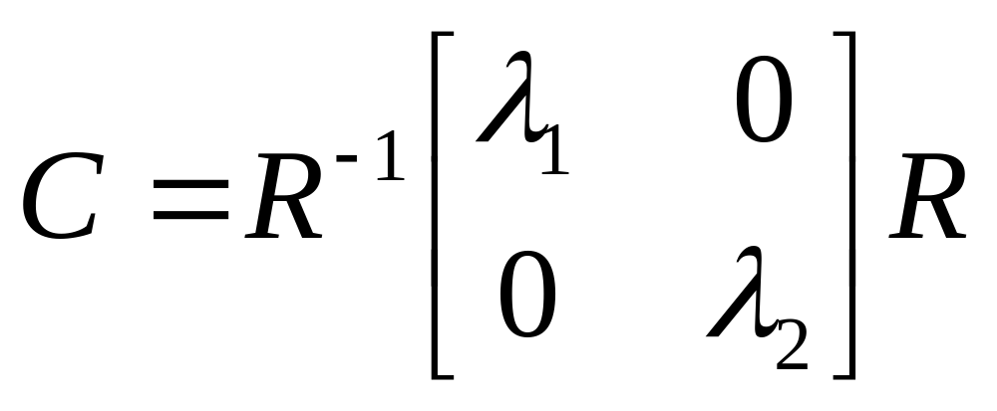
General Case:
From Linear Algebra, it follows that because C is symmetric:
With R a rotation matrix.
So every case is like one on last slide.

Slide 59
So, to detect corners
Filter image.
Compute magnitude of the gradient everywhere.
We construct C in a window.
Use Linear Algebra to find λ1 and λ2.
If they are both big, we have a corner.

