Slide 2
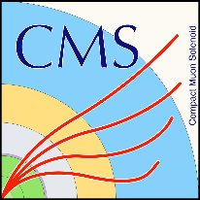

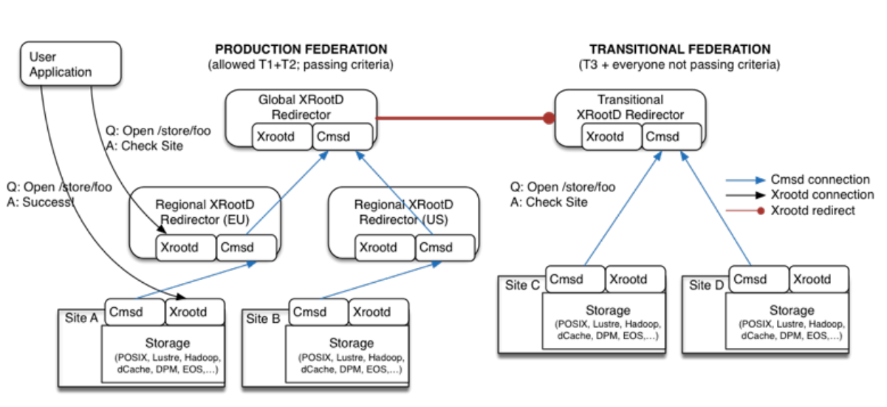
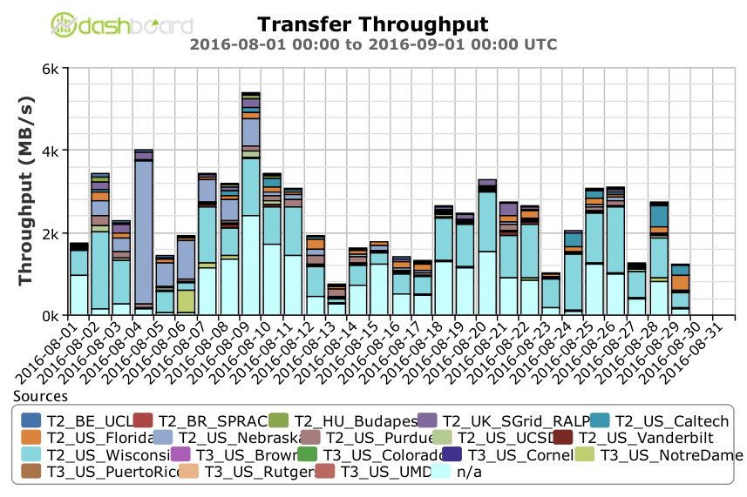
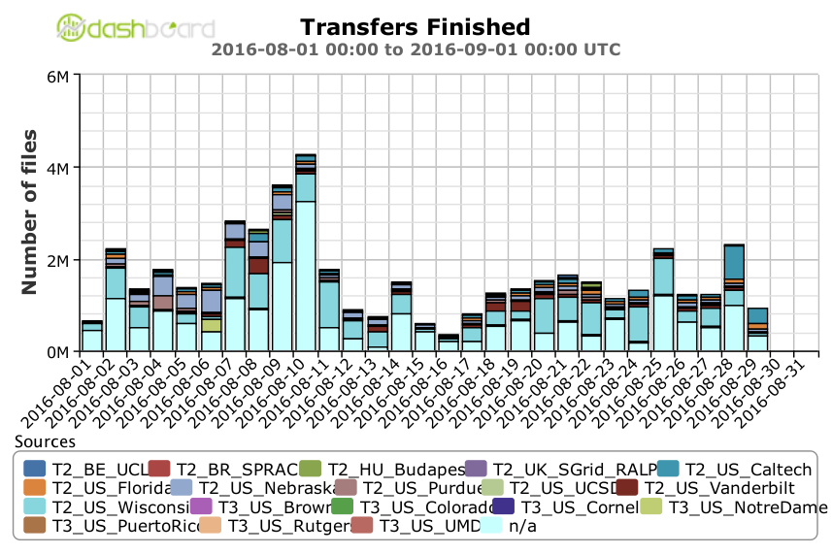
Any Data, Any Time, Anywhere
AAA data federation based on XRootD, this system provides uniform remote data access to all of CMS’s on-disk data.
Workflow management software: HTCondor and glideinWMS provides computing resource provisioning.
Global file systems: To distribute CMS software, we utilize CernVM File System (CVMFS) and have integrated it with Parrot to emulate it on hosts where it is otherwise unavailable.

Slide 3
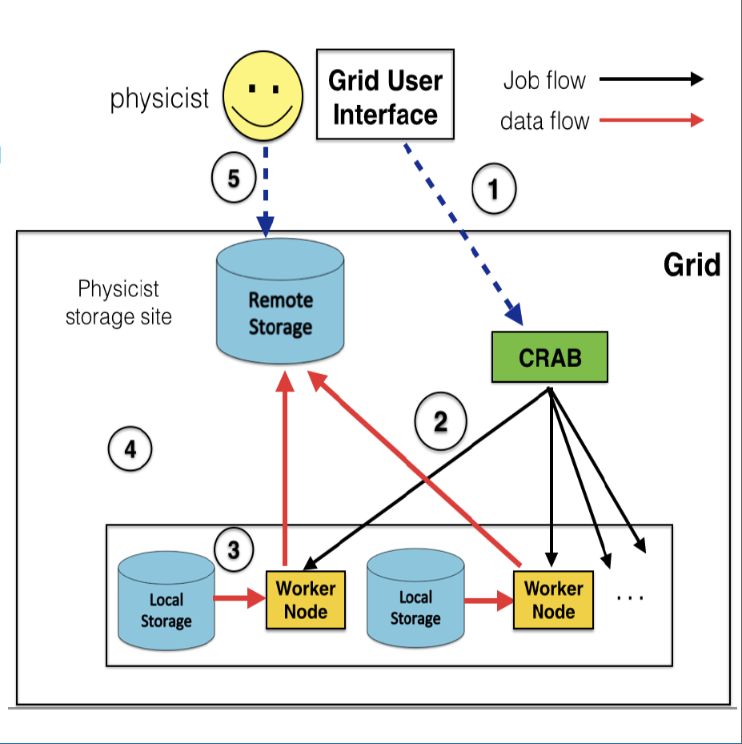
Distributed Data Analysis in CMS (CRAB2)
Use Case:
+1000 individual user/month
+100 sites
+20k concurrent jobs
Typically 1 output/job
  Files vary in size
+200k completed jobs/day
Chaotic environment
Minimal latencies
Problems of CRAB2:
25-30% the jobs fail and about 30-50% of the failures are due to the remote stage-out
Between 10-15% of analysis jobs fail in the remote copy of outputs
the overall CPU loss is even higher than 10-15% since those jobs fail at the end of the processing after multiple retries
often it results in DDoS to CMS Tier-2 storage systems
This Summer (2016) CRAB2 was fully turned off. CRAB3 & ASO overtook all work.

Slide 4
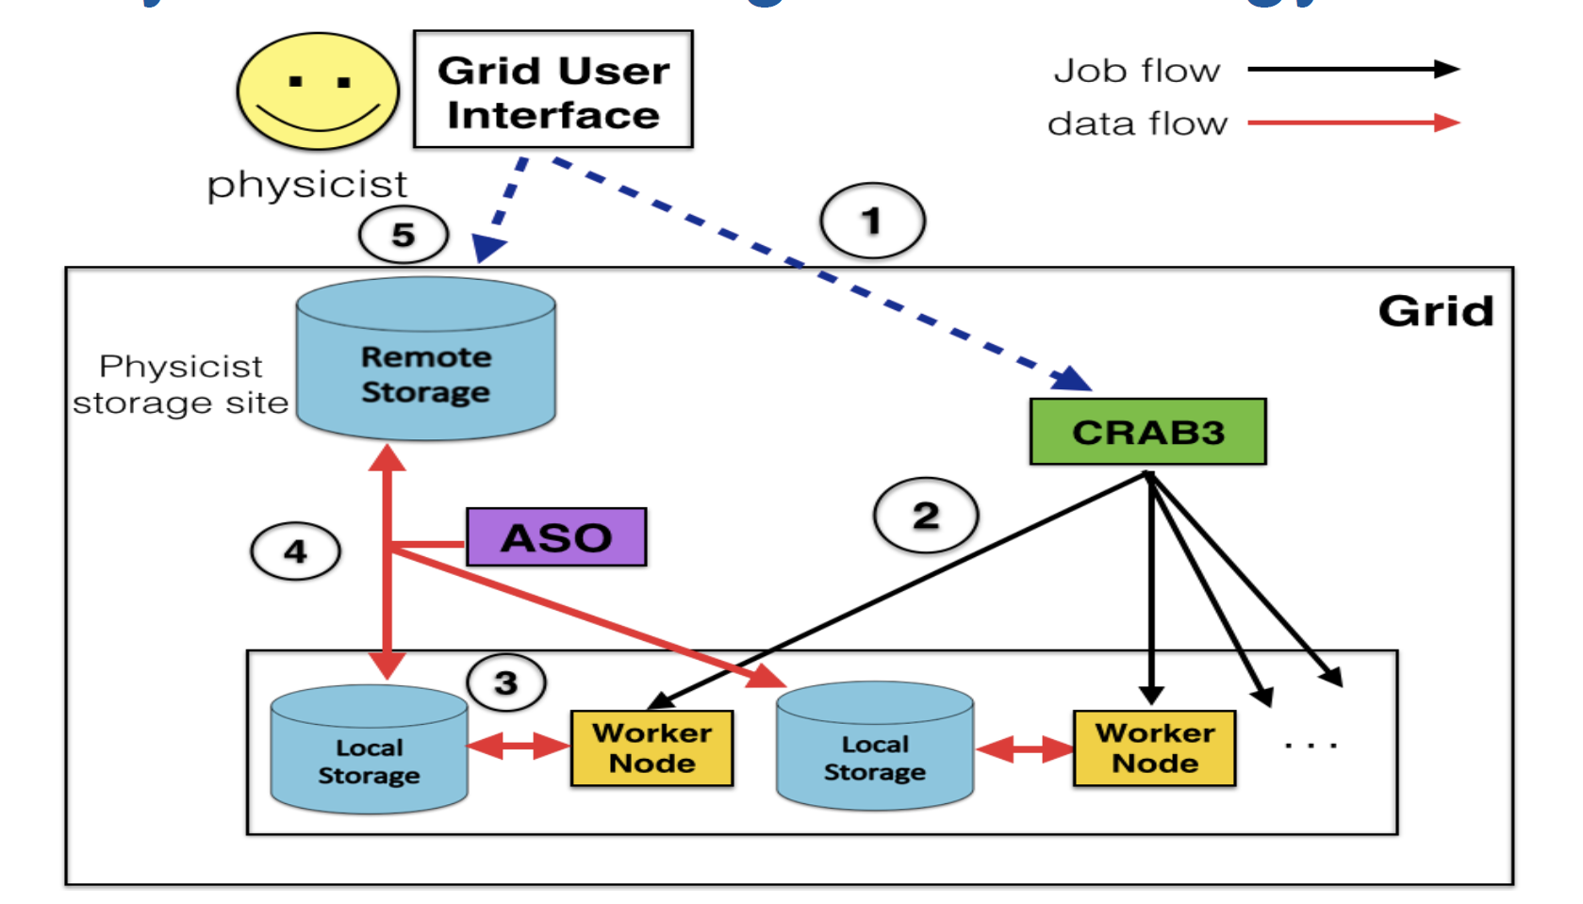
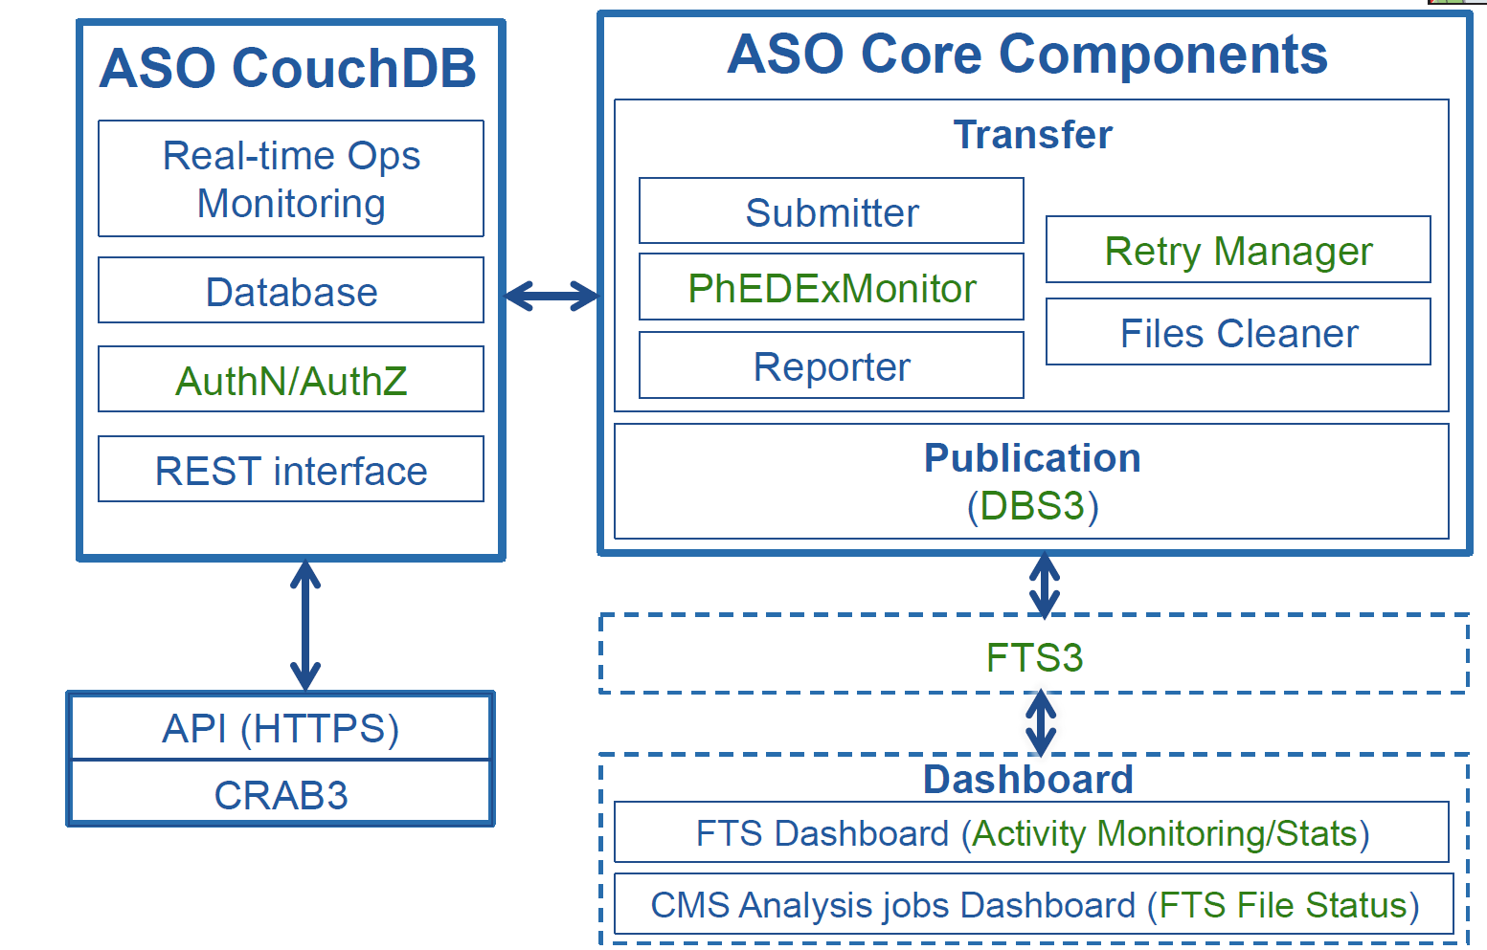
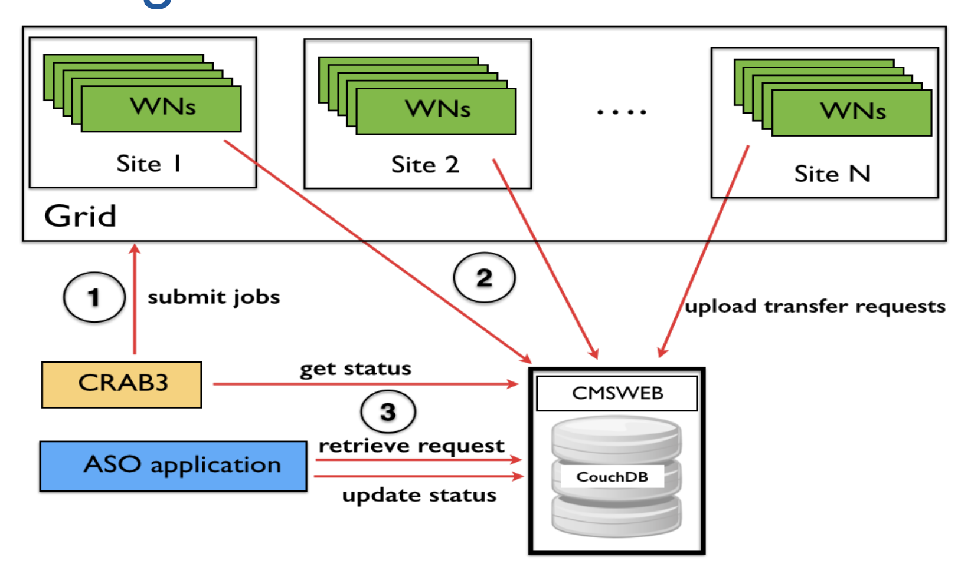
Distributed Data Analysis in CMS (CRAB3)
Overall Architecture
ASO Components Schema
Detailed communication

Slide 5
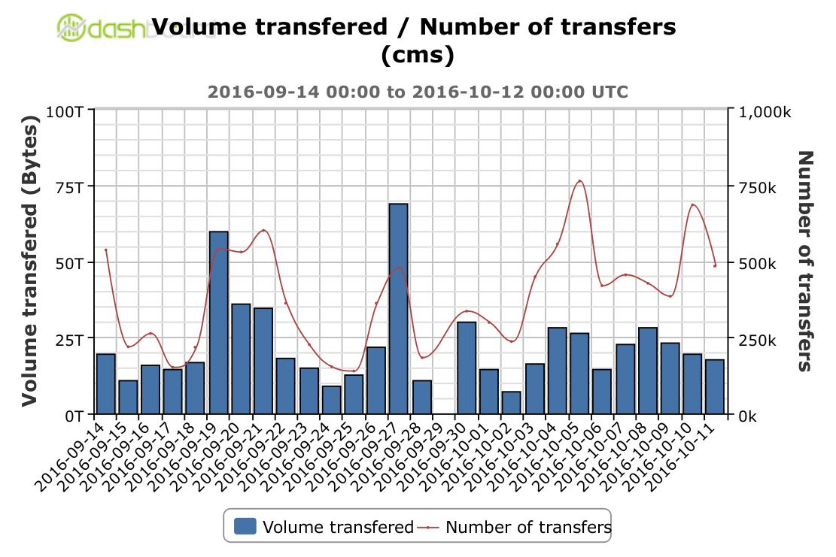
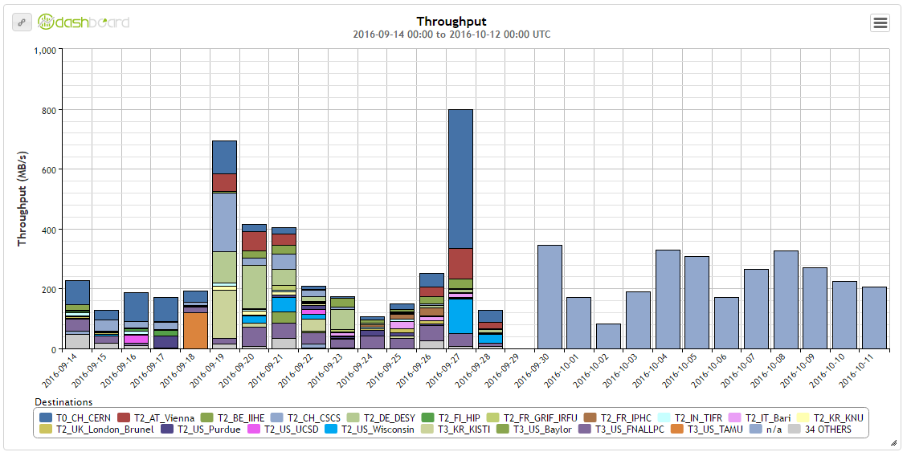
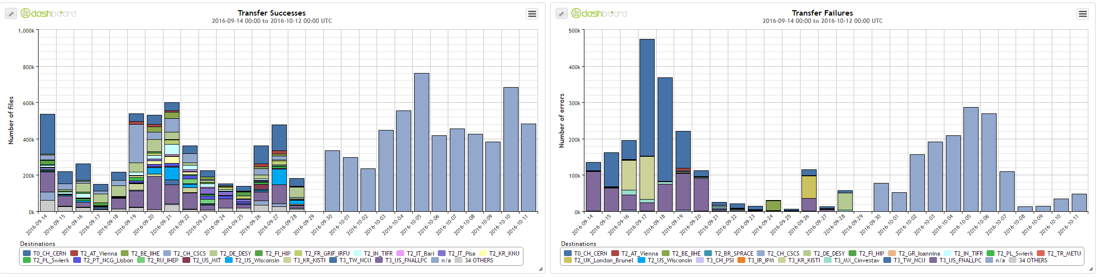
Distributed Data Analysis in CMS (CRAB3)

Slide 6
Physics Experiment Data Export (PhEDEx)
Central component of CMS Data Management System, responsible for data location and placement
created in 2004, undergone significant evolution over time
uses grid tools (FDT, FTS, SRM, GRIDFTP, etc.) to transfer files according to the CMS data placement policy
manages CMS data at CMS grid sites: currently 149 nodes are registered in CMS production instance
uses debug instance for load test transfers between the sites to ensure “links” quality
provides tools for verifying data consistency, statistics and monitoring
uses clever routing algorithm, adjustable workload, and more
PhEDEx components
Transfer Management Database at CERN (oracle)
Site agents – set of perl daemons running at every site, each performing a particular local data management task:
  file download, delete, stage from MSS, export for outbound transfer, verify
Central agents managing PhEDEx workflows and infrastructure
  transfer requests, data routing, bookkeeping, monitoring and other central activities
PhEDEx web site – set of interactive web applications to control and monitor the PhEDEx system
  new implementation uses combination of perl + javascript for more interactive features

Slide 7
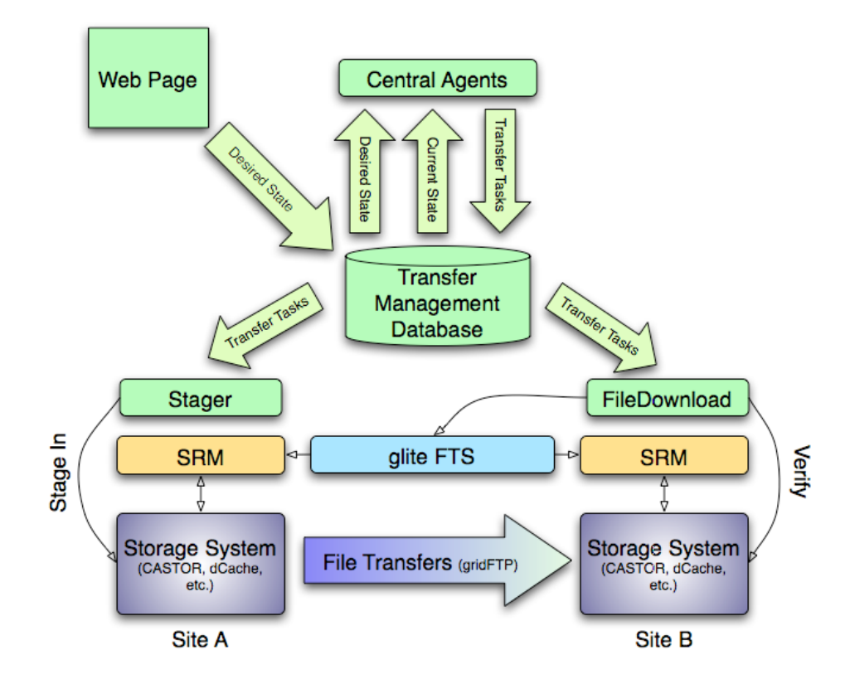
Physics Experiment Data Export (PhEDEx)

Slide 8
PhEDEx workflow (Step By Step)
Request dataset or block transfer.
0s
T_req_xfer
T_req_dataset
Dataset/Block tables
Web Pages / API
T_req_node
T_req_decision
Node level tables
File level tables
Central Agent
Site Agent

Slide 9
PhEDEx workflow (Step By Step)
Request dataset or block transfer.
0s
T_req_xfer
T_req_dataset
Dataset/Block tables
Web Pages / API
15*60s
T_req_node
T_req_decision
Node level tables
Expand approved requests into subscriptions.
RequestAllocator
File level tables
T_dps_subscription
Central Agent
Site Agent

Slide 10
PhEDEx workflow (Step By Step)
Request dataset or block transfer.
0s
T_req_xfer
T_req_dataset
Dataset/Block tables
Web Pages / API
15*60s
T_req_node
T_req_decision
Node level tables
Expand approved requests into subscriptions.
RequestAllocator
File level tables
300s
T_dps_subscription
Central Agent
Expand subscriptions into block destinations.
BlockAllocator
T_dps_block_dest
Site Agent

Slide 11
PhEDEx workflow (Step By Step)
Request dataset or block transfer.
0s
T_req_xfer
T_req_dataset
Dataset/Block tables
Web Pages / API
15*60s
T_req_node
T_req_decision
Node level tables
Expand approved requests into subscriptions.
RequestAllocator
File level tables
300s
T_dps_subscription
Central Agent
Expand subscriptions into block destinations.
BlockAllocator
T_dps_block_dest
Site Agent
60s+r(10)
Expand block destinations into file requests. Compute the path of least cost from available replicas.
FileRouter
t_xfer_request
T_xfer_path

Slide 12
PhEDEx workflow (Step By Step)
Request dataset or block transfer.
0s
T_req_xfer
T_req_dataset
Dataset/Block tables
Web Pages / API
15*60s
T_req_node
T_req_decision
Node level tables
Expand approved requests into subscriptions.
RequestAllocator
File level tables
300s
T_dps_subscription
Central Agent
Expand subscriptions into block destinations.
BlockAllocator
T_dps_block_dest
Site Agent
60s+r(10)
Expand block destinations into file requests. Compute the path of least cost from available replicas.
FileRouter
t_xfer_request
T_xfer_path
60s+r(10)
Create transfer tasks from path segments.
FileIssue
t_xfer_task

Slide 13
PhEDEx workflow (Step By Step)
Request dataset or block transfer.
0s
T_req_xfer
T_req_dataset
Dataset/Block tables
Web Pages / API
15*60s
T_req_node
T_req_decision
Node level tables
Expand approved requests into subscriptions.
RequestAllocator
File level tables
300s
T_dps_subscription
Central Agent
Expand subscriptions into block destinations.
BlockAllocator
T_dps_block_dest
Site Agent
60s+r(10)
Expand block destinations into file requests. Compute the path of least cost from available replicas.
FileRouter
t_xfer_request
T_xfer_path
60s+r(10)
Create transfer tasks from path segments.
FileIssue
t_xfer_task
15*60s
Execute staging, transfer, migrations.
FileDownload
File Stager
File Migrate
Task_export
Task_inxfer
Task_done
Task_error

Slide 14
PhEDEx workflow (Step By Step)
Request dataset or block transfer.
0s
T_req_xfer
T_req_dataset
Dataset/Block tables
Web Pages / API
15*60s
T_req_node
T_req_decision
Node level tables
Expand approved requests into subscriptions.
RequestAllocator
File level tables
300s
T_dps_subscription
Central Agent
Expand subscriptions into block destinations.
BlockAllocator
T_dps_block_dest
Site Agent
60s+r(10)
Expand block destinations into file requests. Compute the path of least cost from available replicas.
FileRouter
t_xfer_request
T_xfer_path
60s+r(10)
Create transfer tasks from path segments.
FileIssue
t_xfer_task
15*60s
Execute staging, transfer, migrations.
FileDownload
File Stager
File Migrate
Task_export
Task_inxfer
60s
Task_done
Task_error
Collect completed tasks. Create replica if success.
FilePump
Task_harvest
Xfer_replica

Slide 15
PhEDEx workflow (Step By Step)
Request dataset or block transfer.
0s
T_req_xfer
T_req_dataset
Dataset/Block tables
Web Pages / API
15*60s
T_req_node
T_req_decision
Node level tables
Expand approved requests into subscriptions.
RequestAllocator
File level tables
300s
T_dps_subscription
Central Agent
Expand subscriptions into block destinations.
BlockAllocator
T_dps_block_dest
Site Agent
60s+r(10)
Expand block destinations into file requests. Compute the path of least cost from available replicas.
FileRouter
t_xfer_request
T_xfer_path
60s+r(10)
Create transfer tasks from path segments.
FileIssue
t_xfer_task
15*60s
Execute staging, transfer, migrations.
FileDownload
File Stager
File Migrate
Task_export
Task_inxfer
60s
Task_done
Task_error
Collect completed tasks. Create replica if success.
FilePump
Task_harvest
Xfer_replica
60s
Observe file replicas and update block replica statistics.
BlockMonitor
Dps_block_replica

Slide 16
PhEDEx workflow (Step By Step)
Request dataset or block transfer.
0s
T_req_xfer
T_req_dataset
Dataset/Block tables
Web Pages / API
15*60s
T_req_node
T_req_decision
Node level tables
Expand approved requests into subscriptions.
RequestAllocator
File level tables
300s
T_dps_subscription
Central Agent
Expand subscriptions into block destinations.
BlockAllocator
T_dps_block_dest
Site Agent
60s+r(10)
Expand block destinations into file requests. Compute the path of least cost from available replicas.
FileRouter
t_xfer_request
T_xfer_path
60s+r(10)
Create transfer tasks from path segments.
FileIssue
t_xfer_task
15*60s
Execute staging, transfer, migrations.
FileDownload
File Stager
File Migrate
Task_export
Task_inxfer
60s
Task_done
Task_error
Collect completed tasks. Create replica if success.
FilePump
Task_harvest
Xfer_replica
60s
Observe file replicas and update block replica statistics.
BlockMonitor
Dps_block_replica
Observe states and fill summary table.
60s
PerfMonitor
History_link_ev
Status_task

Slide 17
PhEDEx workflow (Step By Step)
Request dataset or block transfer.
0s
T_req_xfer
T_req_dataset
Dataset/Block tables
Web Pages / API
15*60s
T_req_node
T_req_decision
Node level tables
Expand approved requests into subscriptions.
RequestAllocator
File level tables
300s
T_dps_subscription
Central Agent
Expand subscriptions into block destinations.
BlockAllocator
T_dps_block_dest
Site Agent
60s+r(10)
Expand block destinations into file requests. Compute the path of least cost from available replicas.
FileRouter
t_xfer_request
T_xfer_path
60s+r(10)
Create transfer tasks from path segments.
FileIssue
t_xfer_task
15*60s
Execute staging, transfer, migrations.
FileDownload
File Stager
File Migrate
Task_export
Task_inxfer
60s
Task_done
Task_error
Collect completed tasks. Create replica if success.
FilePump
Task_harvest
Xfer_replica
60s
Observe file replicas and update block replica statistics.
BlockMonitor
Dps_block_replica
Observe states and fill summary table.
60s
PerfMonitor
History_link_ev
Status_task
Display recent state and history.
Web Pages/ API
60s + 3600s (compact)

Slide 18
What else we don`t know...
Request dataset or block transfer.
0s
T_req_xfer
T_req_dataset
Dataset/Block tables
Web Pages / API
15*60s
T_req_node
T_req_decision
Node level tables
Expand approved requests into subscriptions.
RequestAllocator
File level tables
300s
T_dps_subscription
Central Agent
Expand subscriptions into block destinations.
BlockAllocator
T_dps_block_dest
Site Agent
60s+r(10)
Expand block destinations into file requests. Compute the path of least cost from available replicas.
FileRouter
t_xfer_request
T_xfer_path
60s+r(10)
Create transfer tasks from path segments.
FileIssue
t_xfer_task
15*60s
Execute staging, transfer, migrations.
FileDownload
File Stager
File Migrate
Task_export
Task_inxfer
60s
Task_done
Task_error
Collect completed tasks. Create replica if success.
FilePump
Task_harvest
Xfer_replica
60s
Observe file replicas and update block replica statistics.
BlockMonitor
Dps_block_replica
Observe states and fill summary table.
60s
PerfMonitor
History_link_ev
Status_task
Display recent state and history.
Web Pages/ API
60s + 3600s (compact)

Slide 19
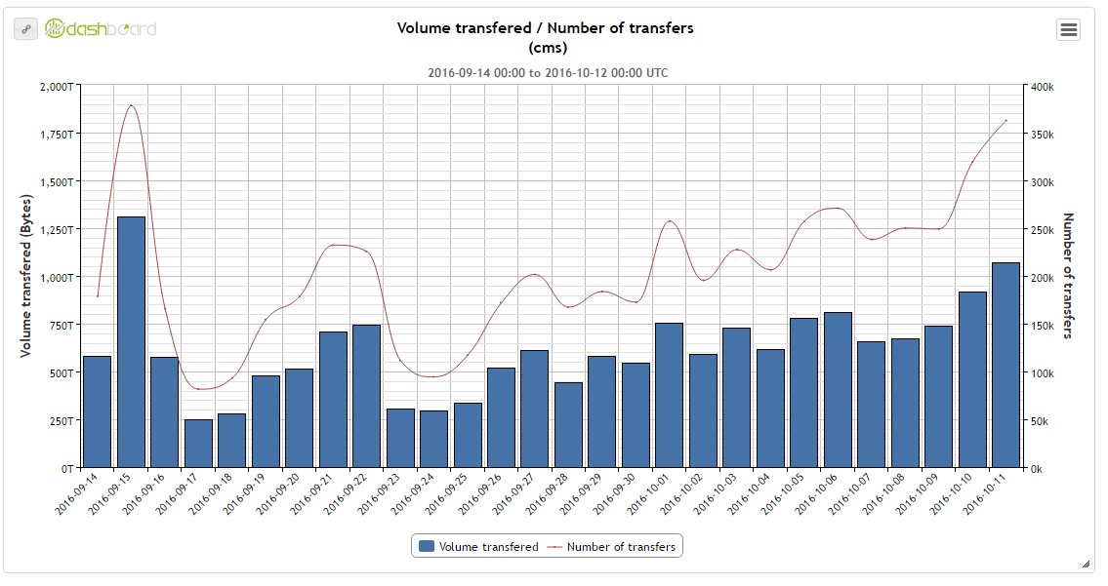
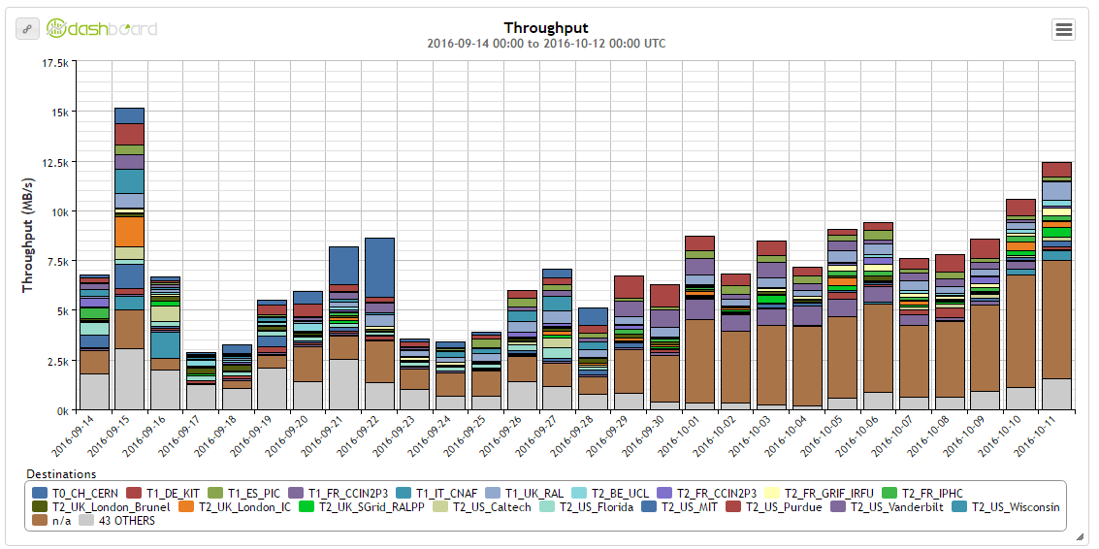
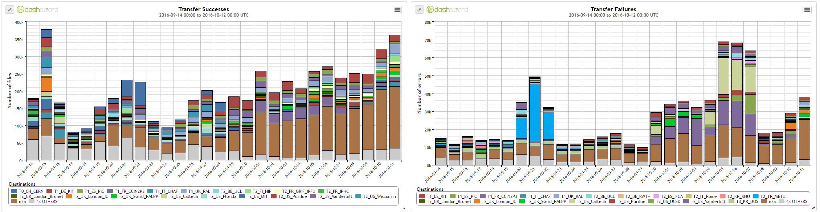
Physics Experiment Data Export (PhEDEx)

