Slide 1


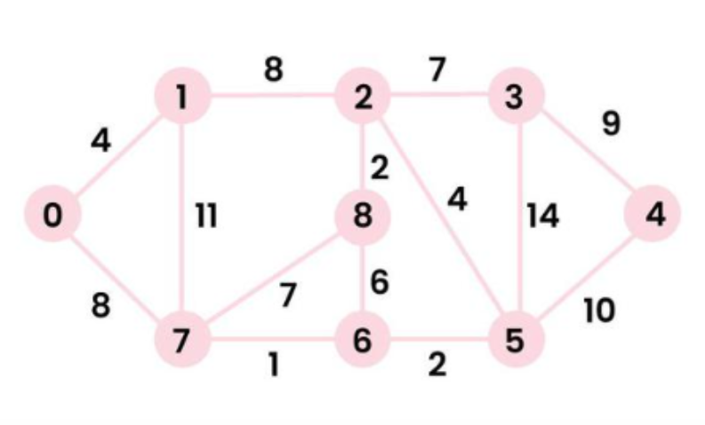
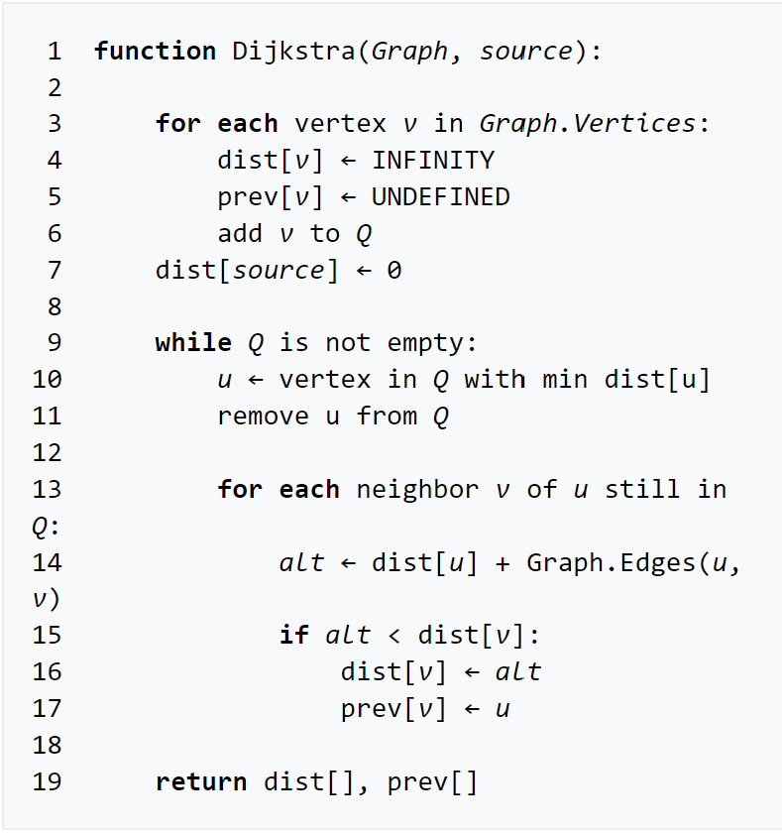
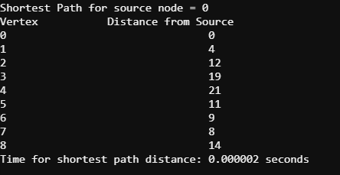
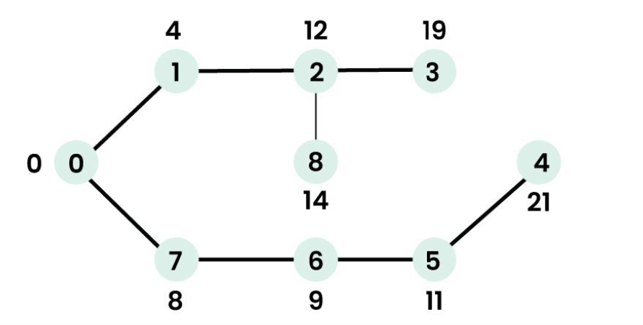
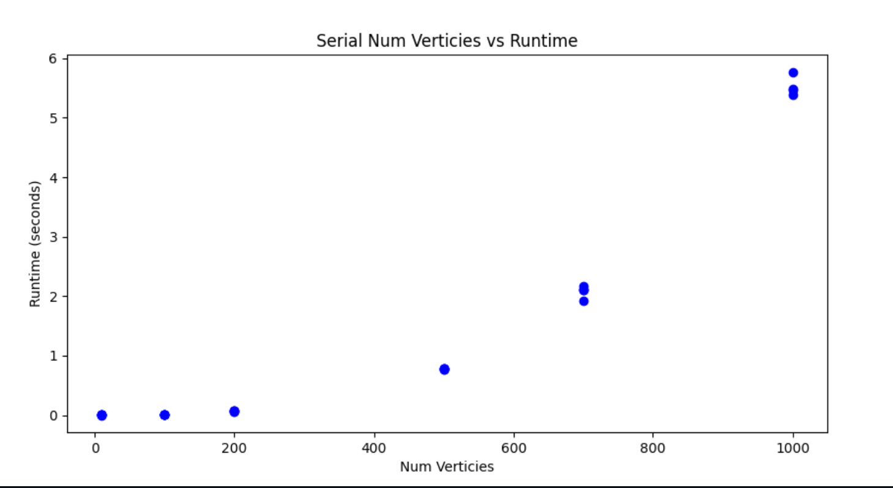
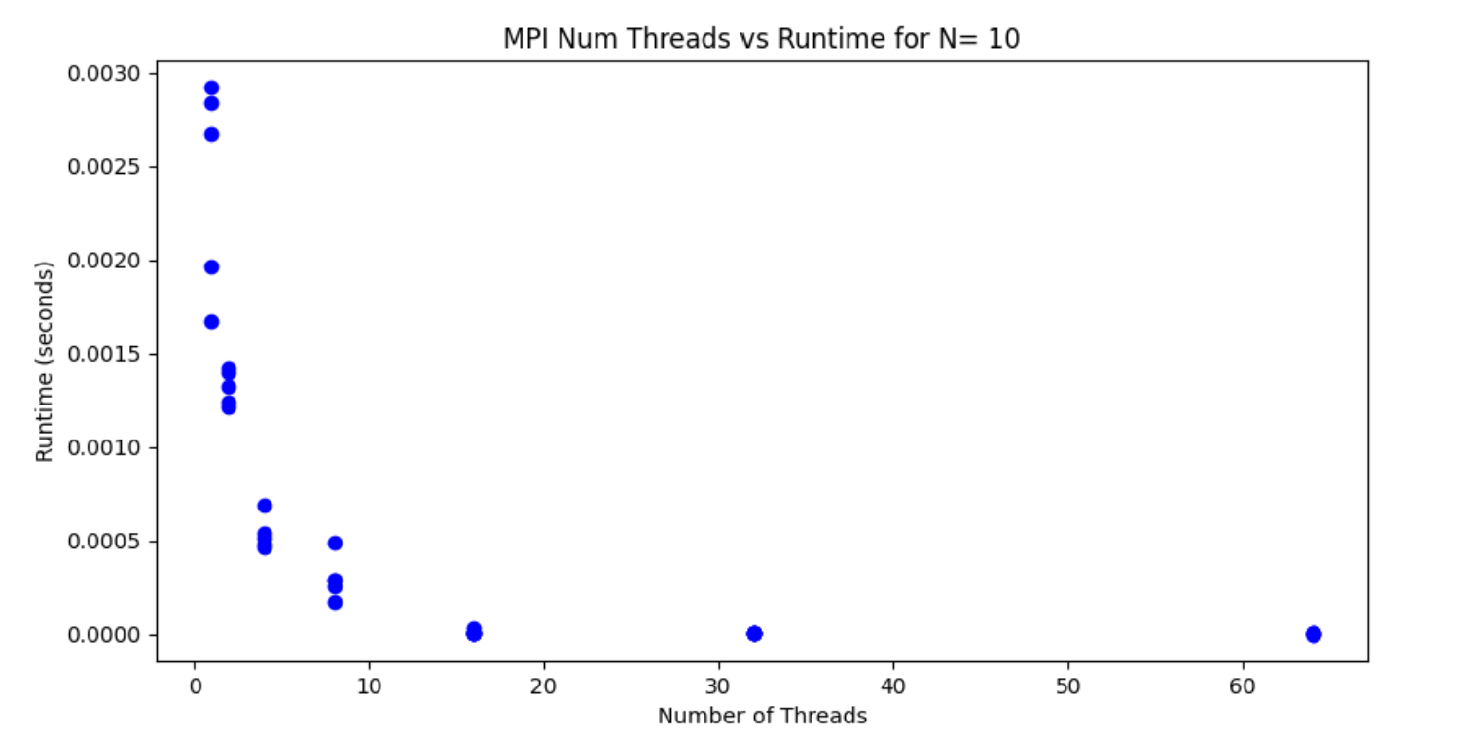
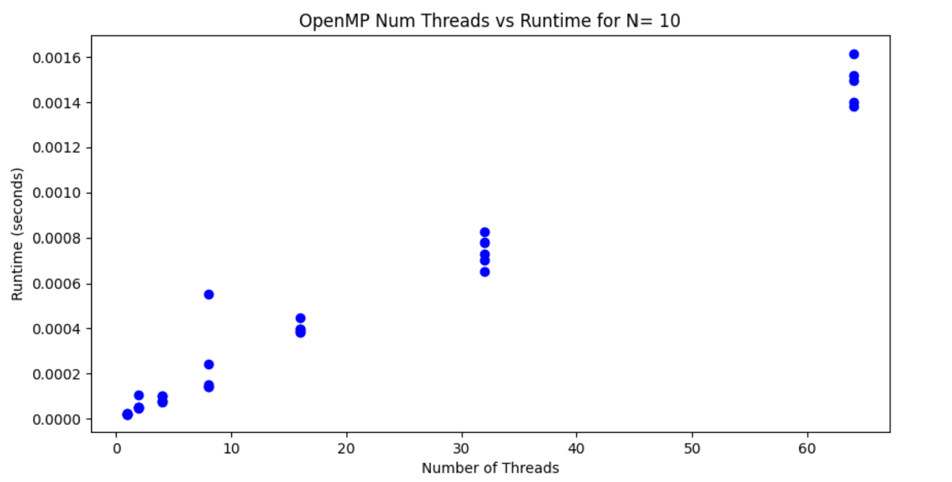
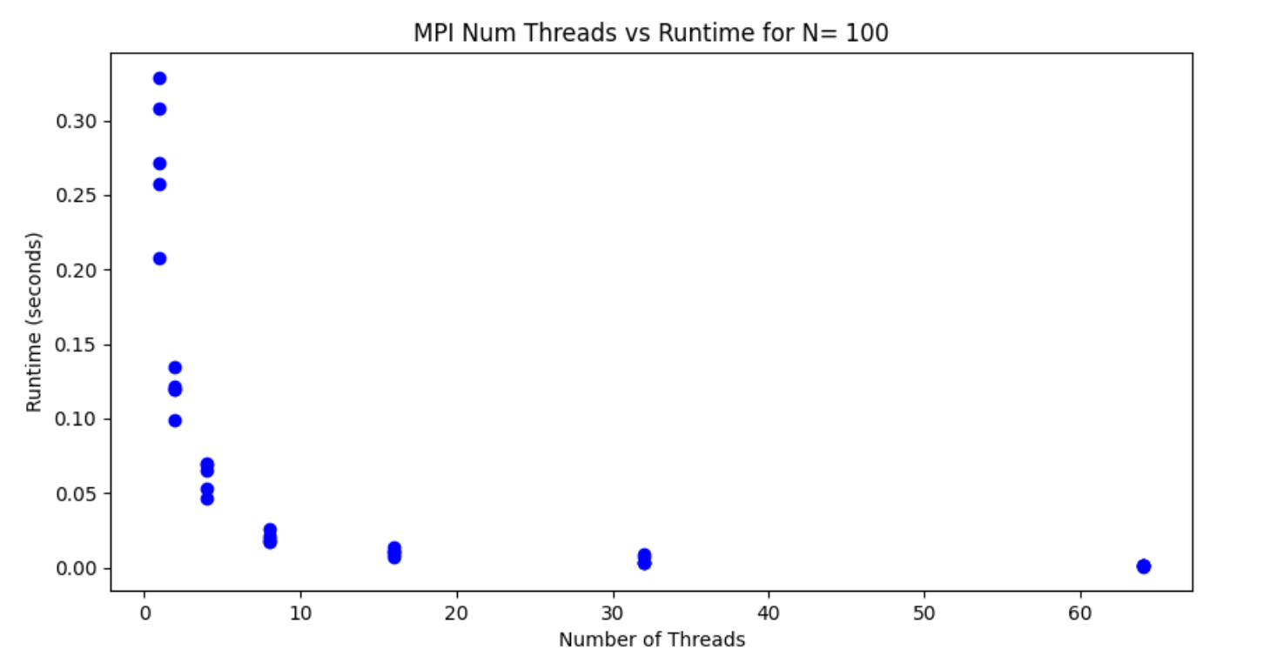
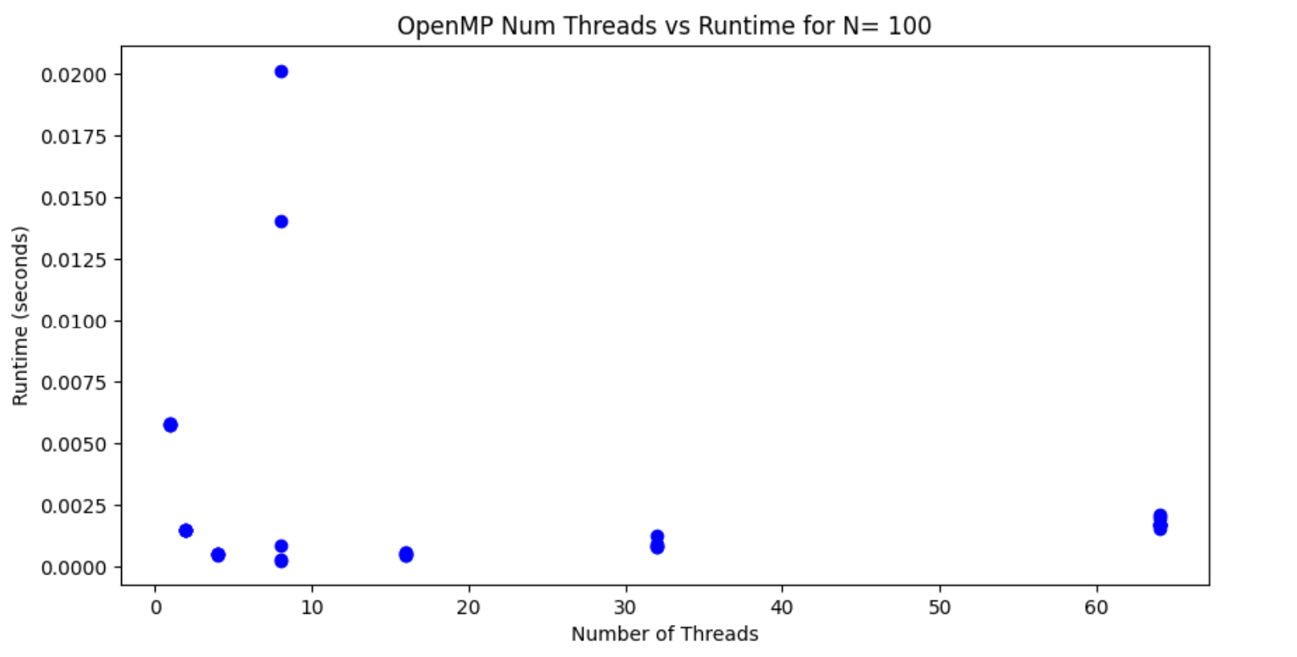
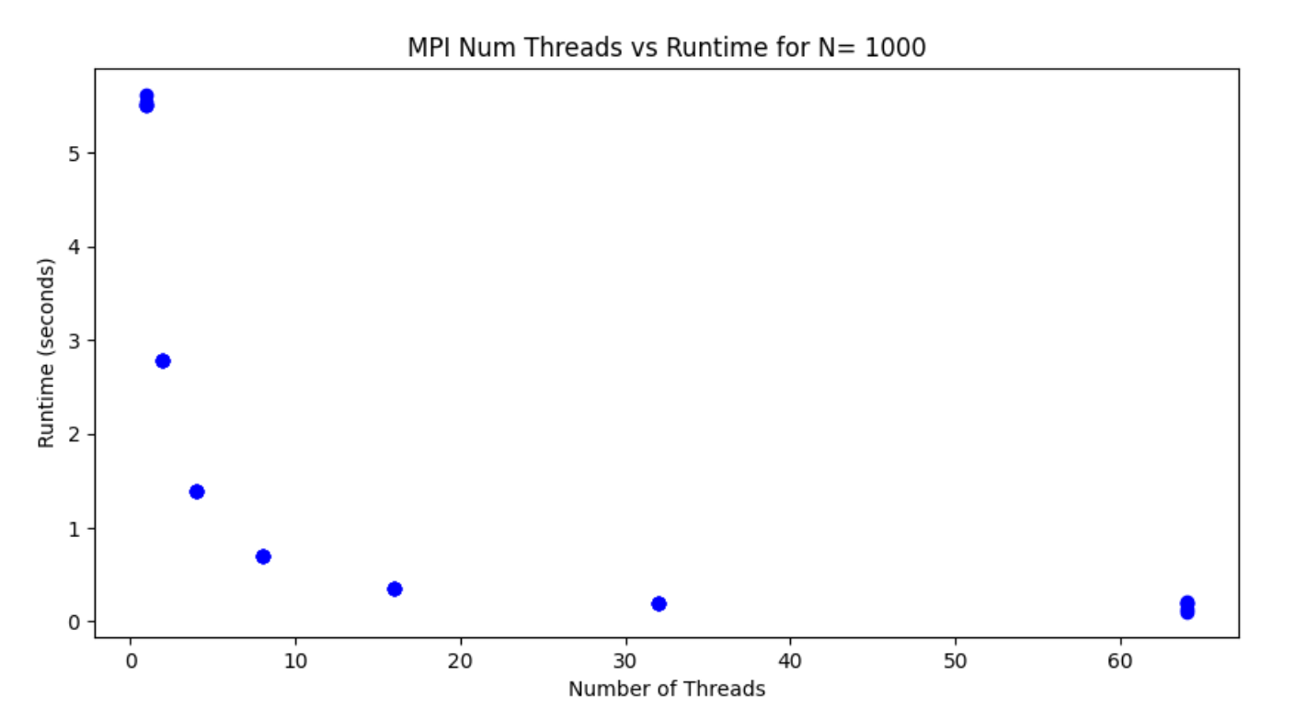
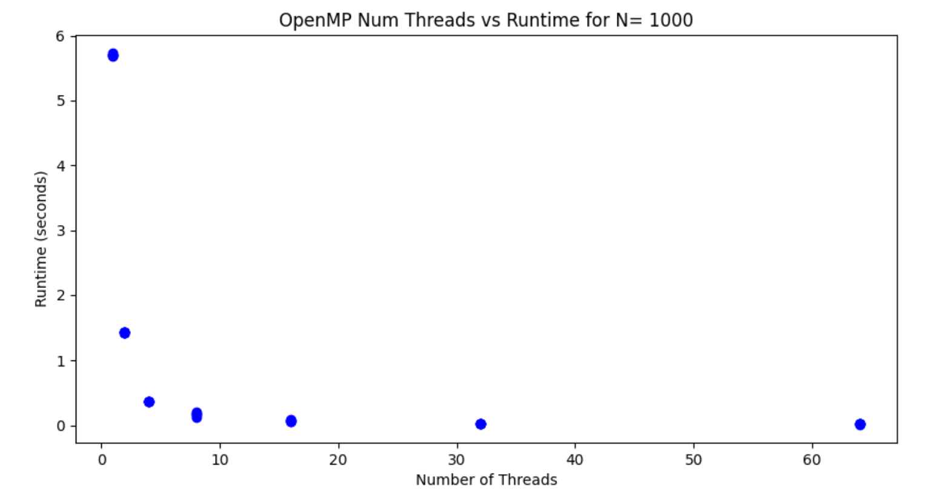

Parallelization of Dijkstra’s Shortest Path Algorithm using OpenMP and MPI with Performance Analysis
Jared Reiling
CMSE 822: Parallel Computing
Department of Computational Mathematics, Science, and Engineering, Michigan State University
Introduction
Finding the shortest path in a graph is a necessary algorithm implemented in computational sciences
Applications include computational neuroscience, topological data analysis, and supply-chain management [1]
Algorithm works by calculating shortest path from source node to all other nodes in the graph. Returns the distances between all nodes from source and shortest path [2]
Calculated Dijkstra’s algorithm for every node as a source point
Implementation of Dijkstra’s Algorithm
Serial
Parallel (OpenMP)
Parallel (MPI)
Common graph between serial and parallel algorithms [3]
Verify correct shortest path calculation for serial and parallel implementation with changing ranks/threads
Implementation of Dijkstra’s algorithm [2]
Calculate shortest path
Key Points
Significant speedup occurred upon implementation of OpenMP and MPI
Implemented balanced workload in threads/ranks through domain decomposition
All MPI implementations have exponential decrease in run time
Graphs using OpenMP with size 100 and 1000, number of threads exponentially decrease runtime
Graphs of size 10 with OpenMP did not experience speedup with parallelization
Parallelization produced significant speedup with larger graphs
Serial Implementation
Parallel Implementations
Serial:
Time complexity of algorithm is $O(V^{2})$ where $V$ is the number of nodes. Performance is as expected.
MPI:
Discretized domain where each thread has a balanced workload
For larger node graphs, exponential decrease in run time as number of threads increase
OpenMP:
For graph size = 10, linear relationship between run time and number of threads
Graph sizes = 100 and graph sizes = 1000, exponential decrease in run time as number of threads increases
Outliers due to jitter when “fighting” for resources in HPCC
References
Mengsen Zhang, Samir Chowdhury, Manish Saggar; Temporal Mapper: Transition networks in simulated and real neural dynamics. Network Neuroscience 2023; 7 (2): 431–460. doi: https://doi.org/10.1162/netn_a_00301
"Dijkstra's algorithm." wikipedia. Wikimedia Foundation, 20 April 2024, https://en.wikipedia.org/wiki/Dijkstra's_algorithm
"How to find Shortest Paths from Source to all Vertices using Dijkstra’s Algorithm." geeksforgeeks, 20 April 2024, https://www.geeksforgeeks.org/dijkstras-shortest-path-algorithm-greedy-algo-7/

