Slide 1

Università
di Pisa
Custom Gaussian Blur
Controlled by a Blur Map
Università di Pisa
Carlo Mazzanti | Andrea Migliore

Slide 2


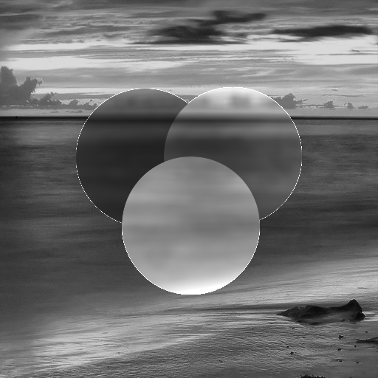
Project Idea
Blur an image based on a control map
Blur only selected areas of the image and modulate brightness depending on pixel values in the map:
0
leave pixel unchanged
1
apply blur, increase brightness
127
apply blur, keep brightness
255
apply blur, reduce brightness
Università di Pisa
Carlo Mazzanti | Andrea Migliore

Slide 3
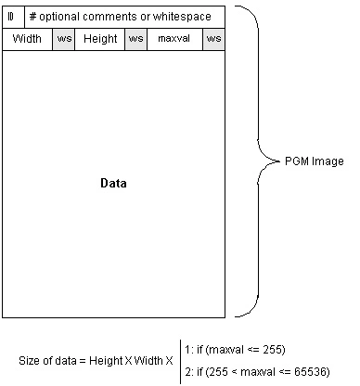
Input Format: PGM Images
Input images are in PGM ASCII format (Portable Gray Map)
Two inputs:
The main image to be blurred
A Blur Control Map that determines how each pixel is processed
Grayscale format: easy to parse and process pixel values directly.
Università di Pisa
Carlo Mazzanti | Andrea Migliore

Slide 4
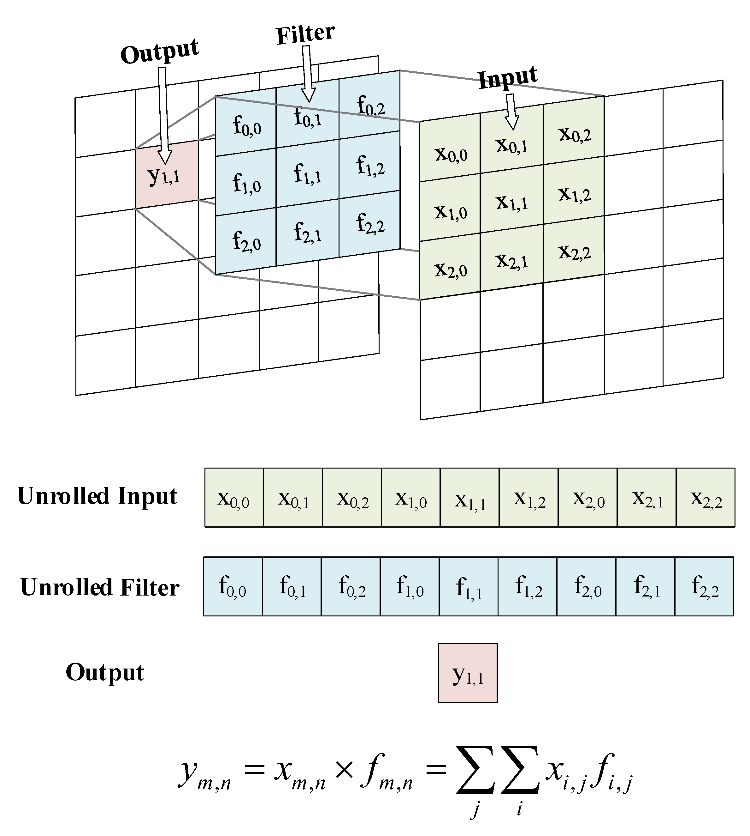
Applying the Blur: 2D Convolution
Convolution is a mathematical operation that combines a filter (kernel) with an image to compute new pixel values based on their neighbors.
The kernel slides across the image. At each position:
Multiply each kernel value with the corresponding image pixel
Sum the results → this becomes one pixel in the output image
Università di Pisa
Carlo Mazzanti | Andrea Migliore

Slide 5
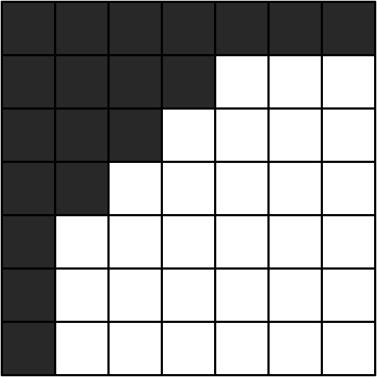
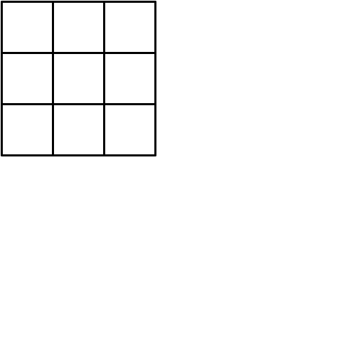
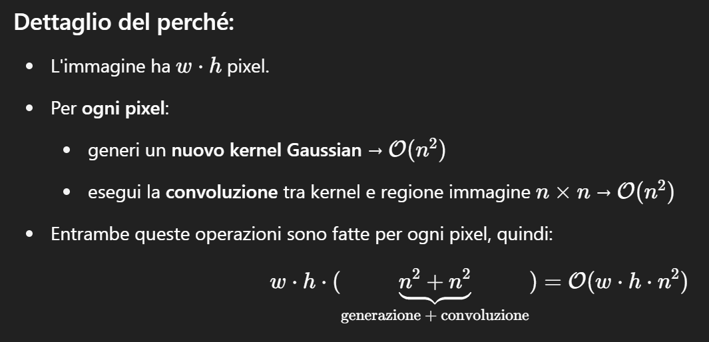


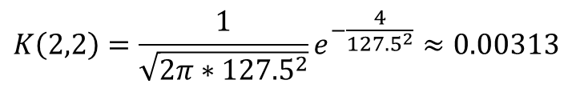
Compute the Kernel: Gaussian Formula
2
The kernel size is fixed (e.g., 3×3)
For each pixel (x, y), a Gaussian kernel is computed using the 2D Gaussian function:
The standard deviation σ is dynamically computed as:
Time complexity: 𝑂(𝑤 × ℎ × 𝑛²)
2
3
2
$$G\left(x,y\right)=\frac{1}{\sqrt{2πσ^{2}}}e^{−\frac{x^{2}+y^{2}}{2σ^{2}}}$$
Blur Control Map
Kernel in (2, 3)
$$σ=blurMap\left(x,y\right)∗σ_{MAX}$$
$$σ = blurMap\left(2,3\right) ∗σ_{MAX}= 255 ∗0.5=127.5$$
$$K\left(2,2\right)=\frac{1}{\sqrt{2π∗{127.5}^{2}}}e^{−\frac{4}{{127.5}^{2}}}≈0.00313$$
Università di Pisa
Carlo Mazzanti | Andrea Migliore

Slide 6
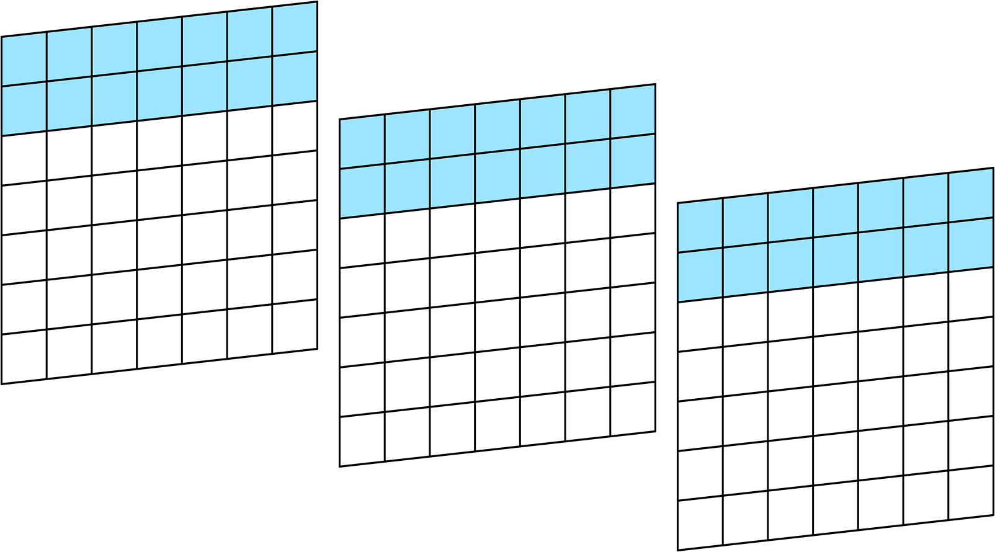
Parallelization Strategy
Each image is divided horizontally into row intervals
Each thread is assigned a range of rows to process
For example, thread 0 handles the first 2 rows of all input images
img3
img2
img1
Università di Pisa
Carlo Mazzanti | Andrea Migliore

Slide 7

Parallelization Strategy
Thread 0 – 1st image
Each thread processes its assigned row block column by column
The thread computes the Gaussian kernel and convolution for each pixel (x,y) in its submatrix
This strategy ensures no data dependencies between threads
Università di Pisa
Carlo Mazzanti | Andrea Migliore

Slide 8

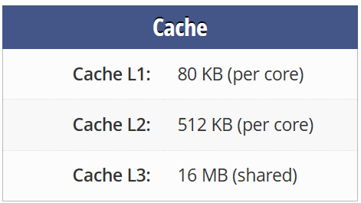
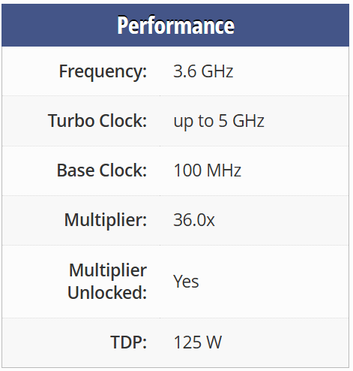
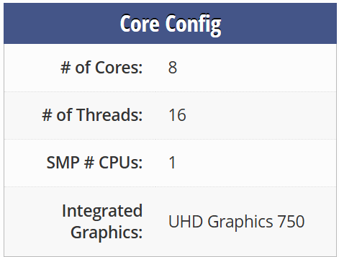
Test Setup: Platform Specifications
🧾
Intel Core i7-11700K
System Configuration
Operating System: | Windows 11
Memory: | 64 GB DDR4 @ 3200 MHz
Compiler: | GCC
Profiler: | Intel VTune
Università di Pisa
Carlo Mazzanti | Andrea Migliore

Slide 9


Test Setup: Input Data and Load Scenarios
Input images are randomly generated at runtime, filled with values from 0 to 255
Each image is of size 1440 × 2160 pixels
The same Blur Control Map is applied to all input images
Three workload levels were tested:
Low: 3 images
Medium: 15 images
High: 30 images
Target performance: process at least 10 images per second
2160
1440
Università di Pisa
Carlo Mazzanti | Andrea Migliore

Slide 10
1st Version: Mean Execution Time [ms]
143.228
71.581
13.810
14.355
Università di Pisa
Carlo Mazzanti | Andrea Migliore

Slide 11
1st Version: Speedup
Università di Pisa
Carlo Mazzanti | Andrea Migliore

Slide 12
1st Version: Performance
Image Throughput at 16 Threads
≈ 2 img/sec
Università di Pisa
Carlo Mazzanti | Andrea Migliore

Slide 13

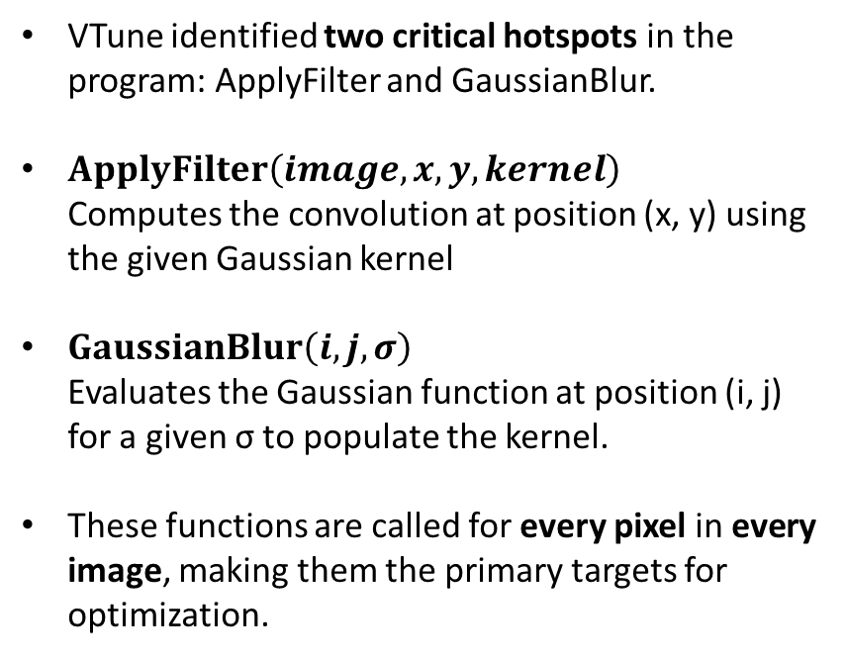
1st Version: Hotspot Analysis (HSA)
VTune identified two critical hotspots in the program: ApplyFilter and GaussianBlur.
$ApplyFilter\left(image, x, y, kernel\right)$ Computes the convolution at position (x, y) using the given Gaussian kernel
$GaussianBlur\left(i, j, σ\right)$ Evaluates the Gaussian function at position (i, j) for a given σ to populate the kernel.
These functions are called for every pixel in every image, making them the primary targets for optimization.
Università di Pisa
Carlo Mazzanti | Andrea Migliore

Slide 14
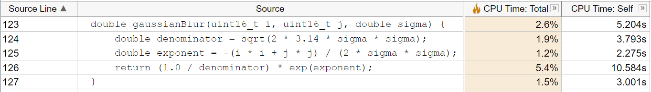
1st Version: HSA - GaussianBlur
VTune showed that a significant portion of time in GaussianBlur is spent computing the exponential function.
Solution: Replaced exp() with a custom approximation to reduce computation time.
Università di Pisa
Carlo Mazzanti | Andrea Migliore

Slide 15
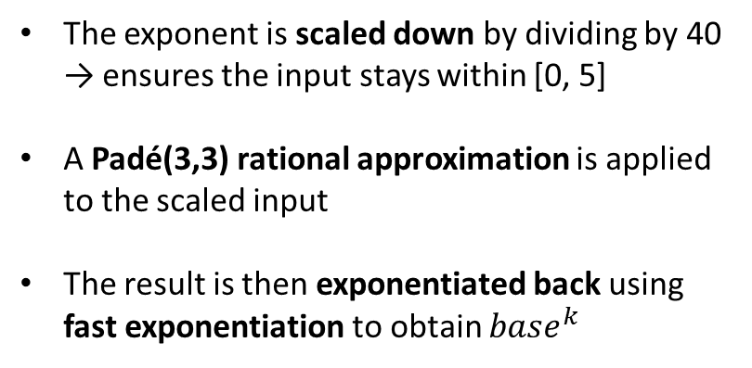
1st Version: HSA - FastExp
double fast_exp(double x) {
const int k = 40; // x/k ∈ [0, 5]
double z = x / k;
// Padé(3,3)
double z2 = z * z;
double z3 = z2 * z;
double num = 1.0 - z + 0.5 * z2 - z3 / 6.0;
double den = 1.0 + z + 0.5 * z2 + z3 / 6.0;
double base = num / den;
// base^k
double result = 1.0;
double p = base;
int n = k;
while (n > 0) {
if (n & 1) result *= p;
p *= p;
n >>= 1;
}
return result;
}
The exponent is scaled down by dividing by 40 → ensures the input stays within [0, 5]
A Padé(3,3) rational approximation is applied to the scaled input
The result is then exponentiated back using fast exponentiation to obtain $base^{k}$
Università di Pisa
Carlo Mazzanti | Andrea Migliore

Slide 16
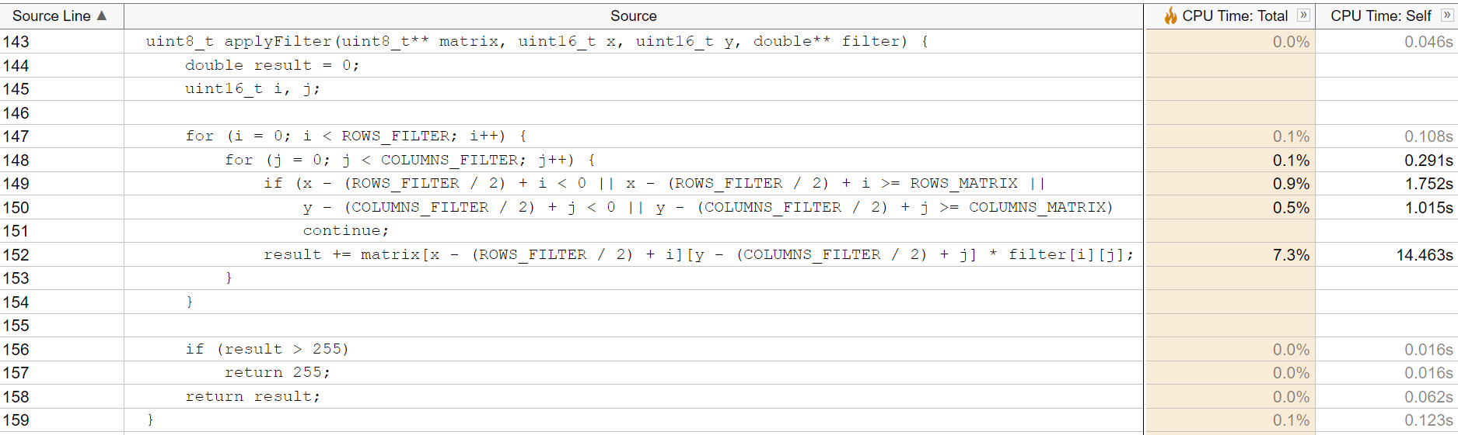
1st Version: HSA - ApplyFilter
VTune identified the main bottleneck in the core loop of ApplyFilter, specifically in the repeated computation of matrix indices and boundary checks.
Solution: Reduced matrix indexing overhead by precomputing offsets and adjusting loop bounds to avoid redundant calculations and conditionals.
Università di Pisa
Carlo Mazzanti | Andrea Migliore

Slide 17
1st Version: HSA - ApplyFilter
uint8_t applyFilter(uint8_t** matrix, uint16_t x, uint16_t y, double** filter) {
...
uint16_t startX = 0;
uint16_t startY = 0;
uint16_t HALF_ROW = (ROWS_FILTER / 2);
uint16_t HALF_COLUMN = (COLUMNS_FILTER / 2);
if(x < HALF_ROW) startX = HALF_ROW - x;
if(y < HALF_COLUMN) startY = HALF_COLUMN - y;
uint16_t endX = ROWS_FILTER;
uint16_t endY = COLUMNS_FILTER;
if(x >= ROWS_MATRIX - HALF_ROW)
endX = HALF_ROW + (ROWS_MATRIX - x - 1);
if(y >= COLUMNS_MATRIX - HALF_COLUMN)
endY = HALF_COLUMN + (COLUMNS_MATRIX - y - 1);
uint16_t k = x - HALF_ROW + startX;
for (i = startX; i < endX; i++) {
uint16_t h = y - HALF_COLUMN + startY;
for (j = startY; j < endY; j++) {
result += matrix[k][h] * filter[i][j];
h++;
}
k++;
}
...
}
Loop bounds are adjusted dynamically, eliminating the need for if conditions and continue statements
Base row index for matrix access is precomputed before the loops
Università di Pisa
Carlo Mazzanti | Andrea Migliore

Slide 18
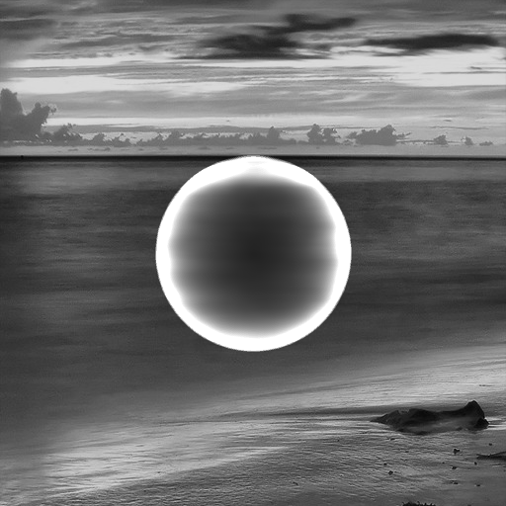

2nd Version: Output Check
1st Version Output
2nd Version Output
Università di Pisa
Carlo Mazzanti | Andrea Migliore

Slide 19


2nd Version: Output Check
1st Version Output
2nd Version Output
Università di Pisa
Carlo Mazzanti | Andrea Migliore

Slide 20
2nd Version: Mean Execution Time [ms]
143.228 → 27.197
71.581 → 13.505
13.810 → 3.757
14.355 → 2.761
Università di Pisa
Carlo Mazzanti | Andrea Migliore

Slide 21
2nd Version: Speedup
Università di Pisa
Carlo Mazzanti | Andrea Migliore

Slide 22
2nd Version: Performance
Image Throughput at 16 Threads
≈ 8 img/sec
Università di Pisa
Carlo Mazzanti | Andrea Migliore

