Slide 1

Università
di Pisa
Bidimensional Convolution
Università di Pisa
Carlo Mazzanti | Andrea Migliore

Slide 2
What is 2D Convolution
🟨 What it is and what it's used for
A mathematical operation used in image processing
It combines an image with a small filter (kernel)
Common applications:
Edge detection
Blurring / Sharpening
Feature extraction
🟨 How it works
The kernel slides across the image
At each position:
Multiply each kernel value with the corresponding image pixel
Sum the results → this becomes one pixel in the output image
Università di Pisa
Carlo Mazzanti | Andrea Migliore

Slide 3
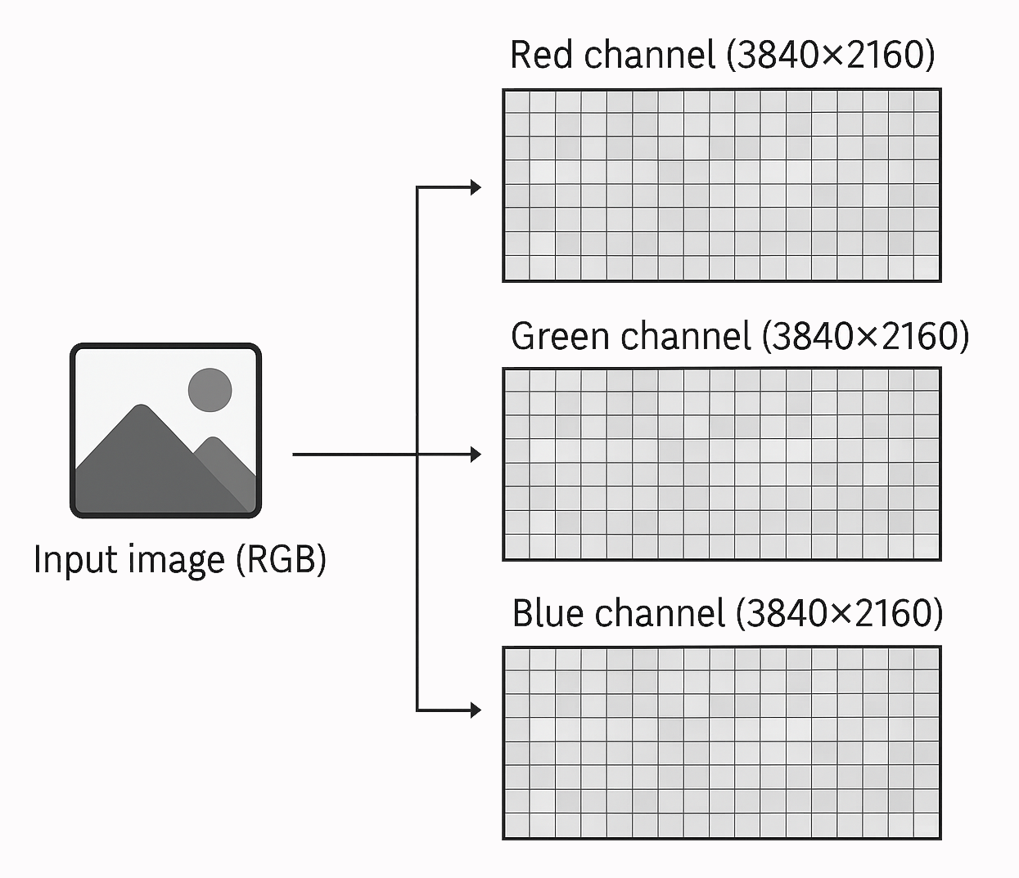
Image Representation
🟨 Image structure
Each image is represented as three separate matrices
Each matrix has size 3840 × 2160 (4K resolution)
The three matrices represent the RGB color channels
🟨 Processing approach
Convolution is applied individually to each color channel
The same kernel is used on R, G, and B matrices
Each image is divided into horizontal slices, and each thread processes a specific slice
The final image is reconstructed from the processed channels
🟨 Performance measurement
Performance is expressed in images per second
Focus of the project: optimize convolution to maximize throughput, with a target of 30 images per second
Università di Pisa
Carlo Mazzanti | Andrea Migliore

Slide 4

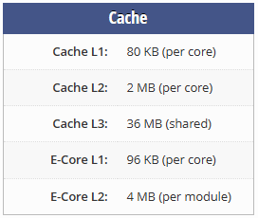
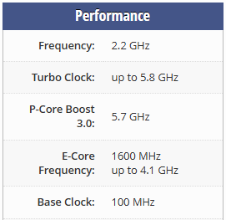
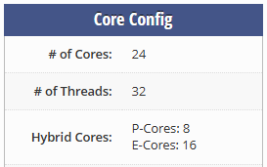
Test Platform Specifications
🧾
Intel Core i9-14900HX
System Configuration
Operating System: | Windows 11
Memory: | 16 GB DDR5 @ 5600 MHz
Compiler: | GCC
Profiler: | Intel VTune
Università di Pisa
Carlo Mazzanti | Andrea Migliore

Slide 5
1st Version Performance
🟨 1sec execution time at 20 threads
Università di Pisa
Carlo Mazzanti | Andrea Migliore

Slide 6
1st Version Performance
🟨 Curve behavior
Speedup curves for 10 and 20 images increase smoothly with thread count
The 1-image curve shows a sharp drop after 32 threads, then flattens
🟨 Why the Drop Occurs
The CPU has 24 physical cores / 32 hardware threads (8 P + 16 E cores)
Beyond 32 threads, additional threads exceed hardware capacity
This causes scheduling overhead, reducing performance
Università di Pisa
Carlo Mazzanti | Andrea Migliore

Slide 7
1st Version Performance
Image Throughput at 32 Threads
≈ 22 img/sec
Università di Pisa
Carlo Mazzanti | Andrea Migliore

Slide 8

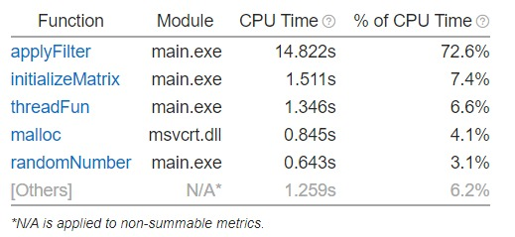
Performance Bottleneck: ApplyFilter
🟨 Context
Each image is split into horizontal slices
Each thread processes one slice using the applyFilter function
Convolution is applied independently to each RGB channel
🟨 Observed Issue
Performance analysis shows that the majority of the time is spent inside the applyFilter function
VTune indicates approximately XX% of CPU time is concentrated in this function
🟨 Why it matters
This makes applyFilter the primary target for performance optimization
Università di Pisa
Carlo Mazzanti | Andrea Migliore

Slide 9
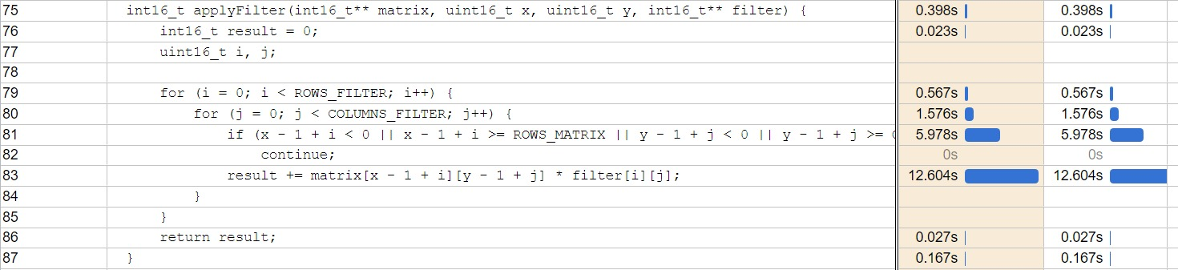
1st Optimization
for (i = 0; i < ROWS_FILTER; i++) {
int k = x - 1 + i;
if (k < 0 || k >= ROWS_MATRIX)
continue;
for (j = 0; j < COLUMNS_FILTER; j++) {
int h = y - 1 + j;
if (h < 0 || h >= COLUMNS_MATRIX)
continue;
result += matrix[k][h] * filter[i][j];
}
}
Università di Pisa
Carlo Mazzanti | Andrea Migliore

Slide 10
2nd Version Performance
🟨 Observations
Single-threaded time
10,201.74 ms → 7,843.49 ms
32-thread time
892.21 ms → 690.91 ms
Optimization yields improvement across all thread counts
Università di Pisa
Carlo Mazzanti | Andrea Migliore

Slide 11
2nd Version Performance
Università di Pisa
Carlo Mazzanti | Andrea Migliore

Slide 12
2nd Version Performance
Image Throughput at 32 Threads
≈ 28 img/sec
Università di Pisa
Carlo Mazzanti | Andrea Migliore

Slide 13
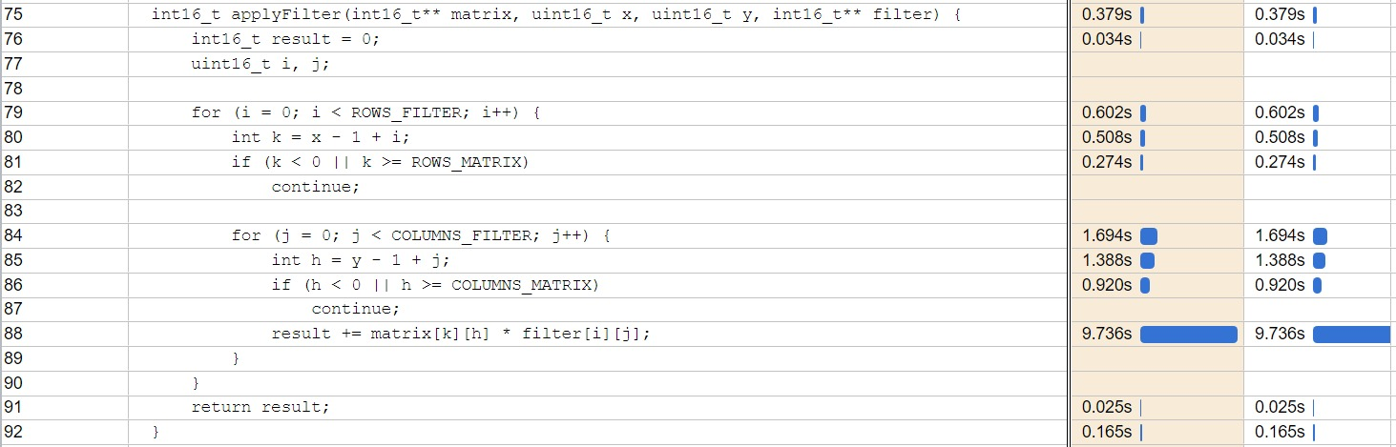
2nd Optimization
🟨 Problem Identified
🟨 Optimization Approach
VTune highlighted that the most time-consuming operation is still the convolution core
Focused on improving control flow by removing "if" statements inside the loops
Università di Pisa
Carlo Mazzanti | Andrea Migliore

Slide 14
2nd Optimization
int8_t applyFilter(…) {
int8_t result = 0;
uint16_t i, j;
uint16_t startX = 0;
uint16_t startY = 0;
if(x == 0) startX = 1;
if(y == 0) startY = 1;
uint16_t endX = ROWS_FILTER;
uint16_t endY = COLUMNS_FILTER;
if(x == ROWS_MATRIX - 1) endX = ROWS_FILTER - 1;
if(y == COLUMNS_MATRIX - 1) endY = COLUMNS_FILTER - 1;
int k = x - 1 + startX;
for (i = startX; i < endX; i++) {
int h = y - 1 + startY;
for (j = startY; j < endY; j++) {
result += matrix[k][h] * filter[i][j];
h++;
}
k++;
}
return result;
}
int16_t applyFilter(…) {
int16_t result = 0;
uint16_t i, j;
for (i = 0; i < ROWS_FILTER; i++) {
int k = x - 1 + i;
if (k < 0 || k >= ROWS_MATRIX)
continue;
for (j = 0; j < COLUMNS_FILTER; j++) {
int h = y - 1 + j;
if (h < 0 || h >= COLUMNS_MATRIX)
continue;
result += matrix[k][h] * filter[i][j];
}
}
return result;
}
Università di Pisa
Carlo Mazzanti | Andrea Migliore

Slide 15
3rd Version Performance
🟨 Observations
Single-threaded time
7,843.49 ms → 7,565.35 ms
32-thread time
690.91 ms → 635.86 ms
The gain is modest but consistent across thread counts
Università di Pisa
Carlo Mazzanti | Andrea Migliore
Notes:
✅ Even small changes in control flow can lead to meaningful improvements in performance-critical code.

Slide 16
3rd Version Performance
Università di Pisa
Carlo Mazzanti | Andrea Migliore

Slide 17
3rd Version Performance
Image Throughput at 32 Threads
≈ 31 img/sec
Università di Pisa
Carlo Mazzanti | Andrea Migliore

Slide 18
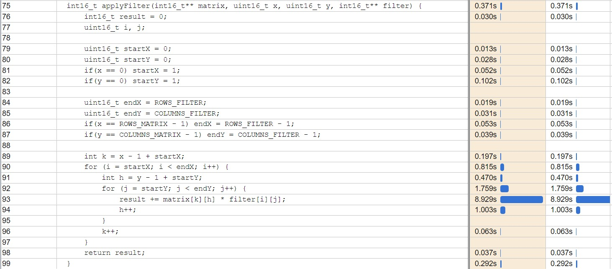
3rd Optimization
🟨 Observation
🟨 Hypotesis
The only significant time consumption remains in the core convolution operation
High cache miss rate and/or thread inactivity during execution
Università di Pisa
Carlo Mazzanti | Andrea Migliore

Slide 19
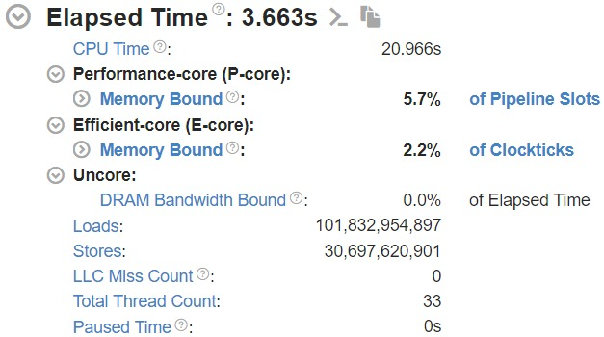
3rd Optimization: Cache Analysis
🟨 Observation
🟨 Conclusion
VTune analysis shows 0 Last Level Cache (LLC) misses
Hardware prefetching efficiently loads data into the cache preventing cache misses
Cache usage is already optimal
No cache-related optimizations are necessary
Università di Pisa
Carlo Mazzanti | Andrea Migliore

Slide 20
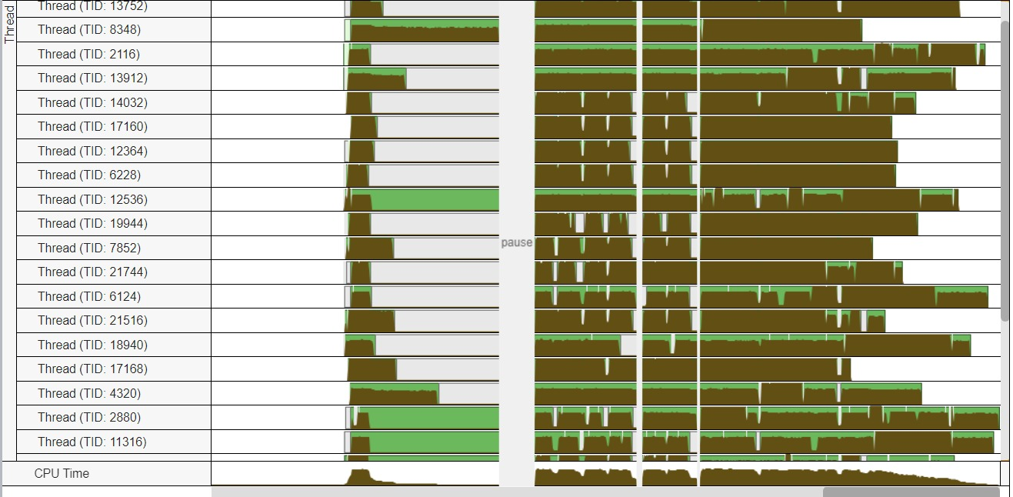
3rd Optimization: Thread Analysis
🟨 Problem Identified
🟨 Solution
Threads experience an idle period during convolution processing
Increase thread scheduling priority
Università di Pisa
Carlo Mazzanti | Andrea Migliore

Slide 21
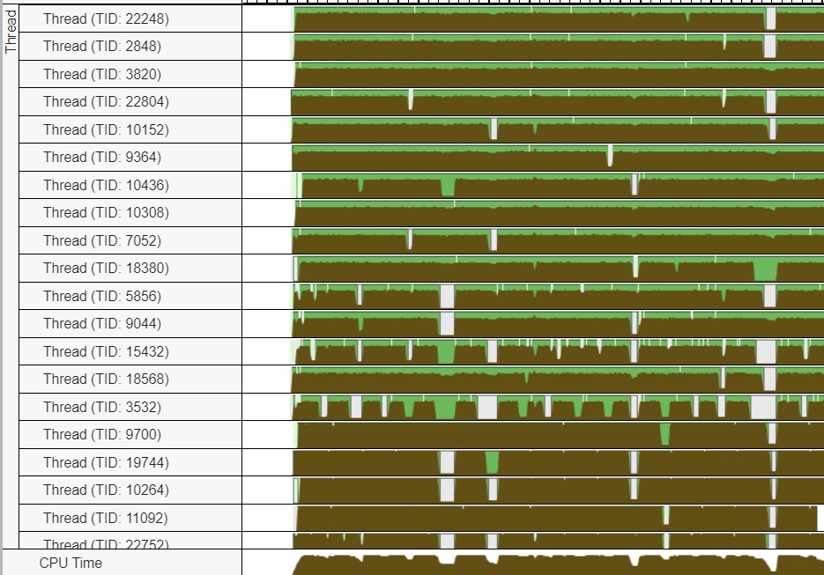
3rd Optimization: Thread Analysis
DWORD WINAPI threadFun(LPVOID lpParam) {
uint16_t i, j, k;
struct parameters* params = (struct parameters*)lpParam;
SetThreadPriority(GetCurrentThread(), REALTIME_PRIORITY_CLASS);
for(i = 0; i < LAYERS_NUM; i++) {
for(j = params->startIndex; j < params->endIndex; j++) {
for(k = 0; k < COLUMNS_MATRIX; k++) {
results[i][j][k] = applyFilter(...);
}
}
}
return 0;
}
Università di Pisa
Carlo Mazzanti | Andrea Migliore

Slide 22
4th Version Performance
🟨 Observations
Single-threaded time
7,565.34 ms → 7,181.17 ms
32-thread time
635.86 ms → 548.09 ms
The gain is modest but consistent across thread counts
Università di Pisa
Carlo Mazzanti | Andrea Migliore

Slide 23
4th Version Performance
Università di Pisa
Carlo Mazzanti | Andrea Migliore

Slide 24
4th Version Performance
Image Throughput at 32 Threads
≈ 36 img/sec
Università di Pisa
Carlo Mazzanti | Andrea Migliore

Slide 25
Performance Recap
🟨 1st Version
🟨 3rd Version
Throughput at 32 Threads ≈ 22 img/sec
Throughput at 32 Threads ≈ 31 img/sec
🟨 2nd Version
🟨 4th Version
Throughput at 32 Threads ≈ 28 img/sec
Throughput at 32 Threads ≈ 36 img/sec
Università di Pisa
Carlo Mazzanti | Andrea Migliore

