Slide 1

Università
di Pisa
Custom Gaussian Blur
Controlled by a Blur Map
Università di Pisa
Carlo Mazzanti | Andrea Migliore

Slide 2


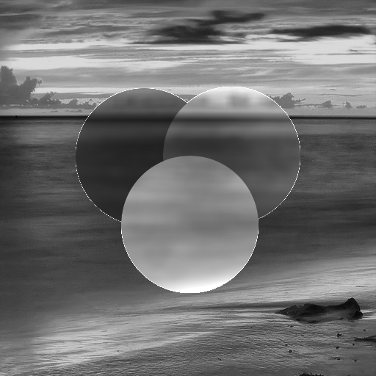
Project Idea
Blur an image based on a control map
Blur only selected areas of the image and modulate brightness depending on pixel values in the map:
Image
Blur Control Map
0
leave pixel unchanged
1
apply blur, increase brightness
127
apply blur, keep brightness
255
apply blur, reduce brightness
Output
Università di Pisa
Carlo Mazzanti | Andrea Migliore

Slide 3

Input Format: PGM – P2
Input images are in PGM (Portable Gray Map) ASCII format (P2)
File structure:
Encoding type: P2 indicates ASCII format
Optional comments: start with #
Image size: width and height (in pixels)
Max gray value: usually 255
Pixel data: grayscale values from 0 (black) to max (white), separated by spaces
Simple and widely used for image processing and computer vision
P2
# Example image
4 4
255
0 255 255 0
255 0 0 255
255 0 0 255
0 255 255 0
Università di Pisa
Carlo Mazzanti | Andrea Migliore

Slide 4
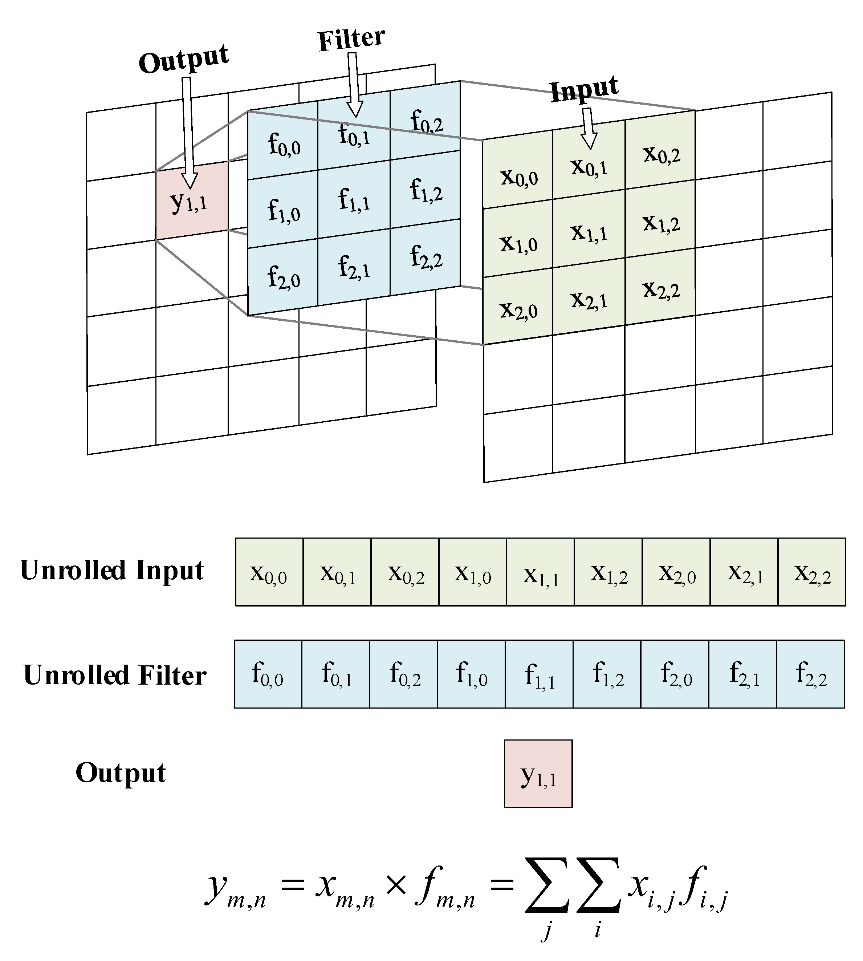
Applying the Blur: 2D Convolution
Convolution is a mathematical operation that combines a filter (kernel) with an image to compute new pixel values based on their neighbors.
The kernel slides across the image. At each position:
Multiply each kernel value with the corresponding image pixel
Sum the results → this becomes one pixel in the output image
Università di Pisa
Carlo Mazzanti | Andrea Migliore

Slide 5
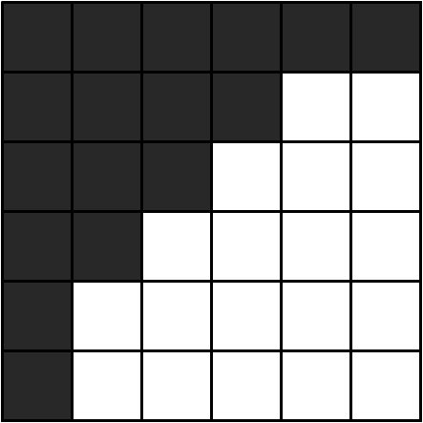
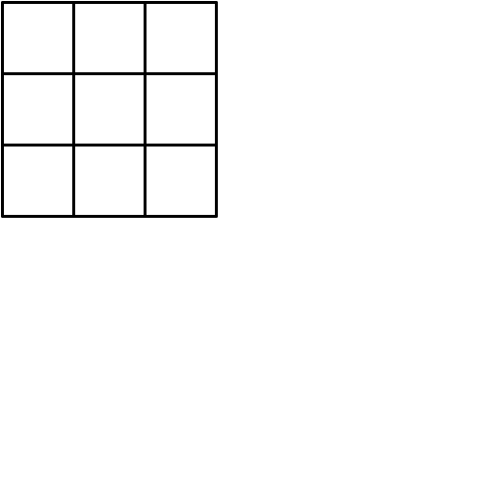
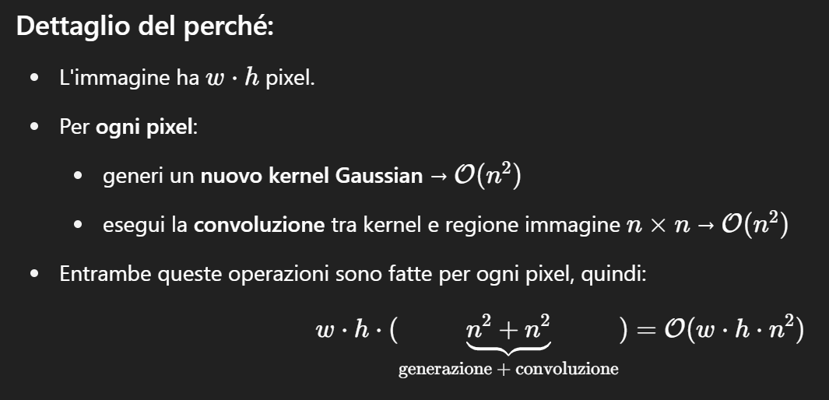


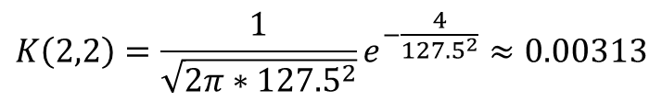
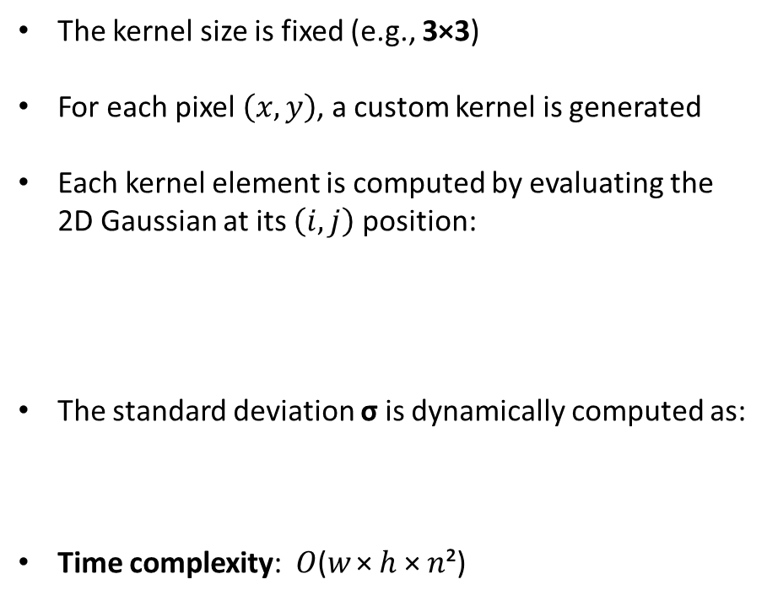
Compute the Kernel: Gaussian Formula
2
The kernel size is fixed (e.g., 3×3)
For each pixel $\left(x, y\right)$, a custom kernel is generated
Each kernel element is computed by evaluating the 2D Gaussian at its $\left(i, j\right)$ position:
The standard deviation σ is dynamically computed as:
Time complexity: 𝑂(𝑤 × ℎ × 𝑛²)
2
3
2
$$G\left(i,j\right)=\frac{1}{\sqrt{2πσ^{2}}}e^{−\frac{i^{2}+j^{2}}{2σ^{2}}}$$
Blur Control Map
Kernel in (2, 3)
$$σ = blurMap\left(2,3\right) ∗σ_{MAX}= 255 ∗0.5=127.5$$
$$σ=blurMap\left(x,y\right)∗σ_{MAX}$$
$$K\left(2,2\right)=\frac{1}{\sqrt{2π∗{127.5}^{2}}}e^{−\frac{4}{{127.5}^{2}}}≈0.00313$$
Università di Pisa
Carlo Mazzanti | Andrea Migliore

Slide 6
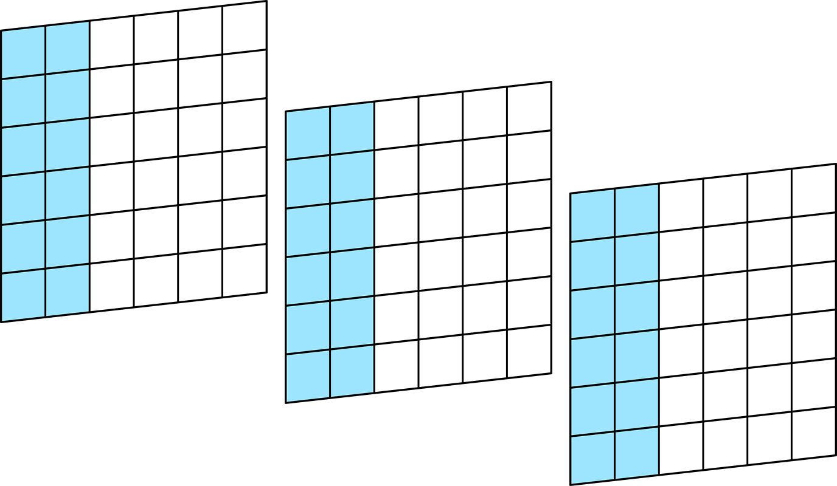
Parallelization Strategy
img3
Each image is divided vertically into columns intervals
Each thread is assigned a range of columns to process
For example, with a 6×6 image and 3 threads
Each thread handles 2 columns (6 ÷ 3)
Thread 0 processes the first 2 columns of every input image
img2
img1
Università di Pisa
Carlo Mazzanti | Andrea Migliore

Slide 7

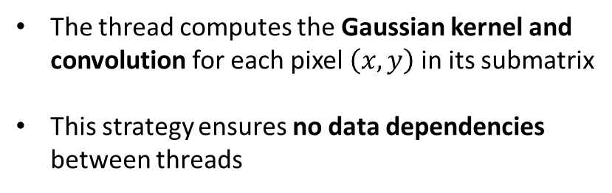
Parallelization Strategy
The thread computes the Gaussian kernel and convolution for each pixel $\left(x,y\right)$ in its submatrix
This strategy ensures no data dependencies between threads
Thread 0 – 1st image
Università di Pisa
Carlo Mazzanti | Andrea Migliore

Slide 8

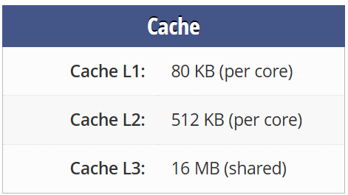
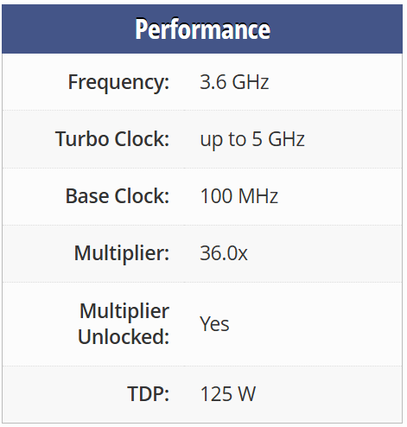
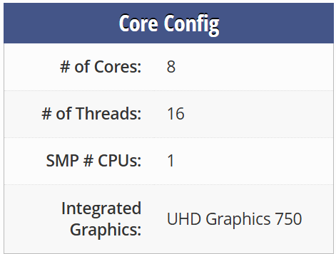
Test Setup: Platform Specifications
🧾
Intel Core i7-11700K
System Configuration
Operating System: | Windows 11
Memory: | 64 GB DDR4 @ 3200 MHz
Compiler: | GCC
Profiler: | Intel VTune
Università di Pisa
Carlo Mazzanti | Andrea Migliore

Slide 9


Test Setup: Input Data and Load Scenarios
Input images are randomly generated at runtime, filled with values from 0 to 255
Each image is of size 1440 × 2160 pixels
The same Blur Control Map is applied to all input images
Three workload levels were tested:
Low: 3 images
Medium: 15 images
High: 30 images
Target performance: process at least 20 images per second
2160
1440
Università di Pisa
Carlo Mazzanti | Andrea Migliore

Slide 10
1st Version: Mean Execution Time [ms]
143.228
71.581
13.810
14.355
Università di Pisa
Carlo Mazzanti | Andrea Migliore

Slide 11
1st Version: Speedup
Università di Pisa
Carlo Mazzanti | Andrea Migliore

Slide 12
1st Version: Performance
Image Throughput at 16 Threads
≈ 2 img/sec
Università di Pisa
Carlo Mazzanti | Andrea Migliore

Slide 13
1st Version: Code Optimization
DWORD WINAPI threadFun(LPVOID lpParam) {
uint16_t i, j, k;
struct parameters* params = (struct parameters*)lpParam;
double** kernel = initializeDoubleMatrix(KERNEL_DIM, KERNEL_DIM);
for(i = 0; i < IMGS_NUM; i++) {
for(j = params->startIndex; j < params->endIndex; j++) {
for(k = 0; k < IMG_COLUMNS; k++) {
if(blurMap[j][k] == 0) {
results[i][j][k] = images[i][j][k];
continue;
}
computeKernel(kernel, j, k);
results[i][j][k] = applyKernel(images[i], j, k, kernel);
}
}
}
free(kernel);
return 0;
}
To reduce computation, we skip filtering for pixels with a depth value of 0 and simply copy the original pixel
The visual output remains the same, but the overall execution time is reduced
However, this introduces a potential load imbalance: if a thread is assigned a region with mostly zero-depth pixels, it will finish much earlier than others
Università di Pisa
Carlo Mazzanti | Andrea Migliore

Slide 14
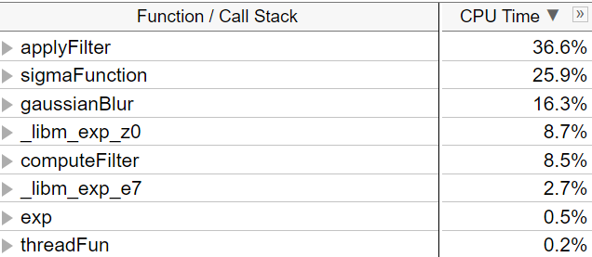
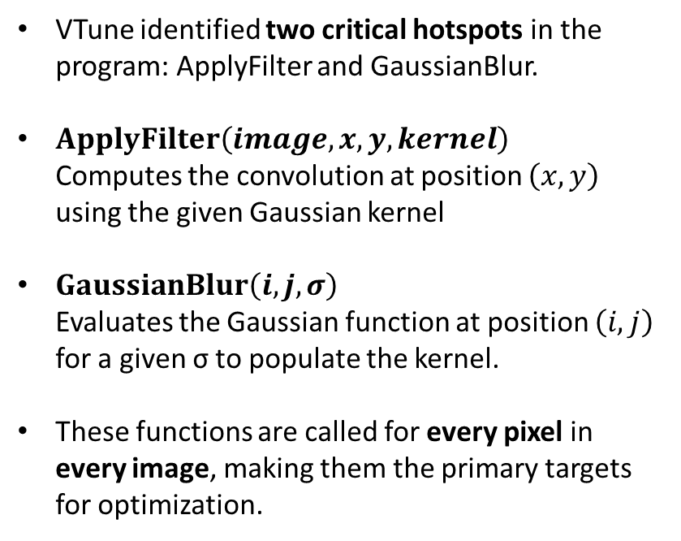
1st Version: Hotspot Analysis (HSA)
VTune identified two critical hotspots in the program: ApplyFilter and GaussianBlur.
$ApplyFilter\left(image, x, y, kernel\right)$ Computes the convolution at position $\left(x, y\right)$ using the given Gaussian kernel
$GaussianBlur\left(i, j, σ\right)$ Evaluates the Gaussian function at position $\left(i, j\right)$ for a given σ to populate the kernel.
These functions are called for every pixel in every image, making them the primary targets for optimization.
Università di Pisa
Carlo Mazzanti | Andrea Migliore

Slide 15
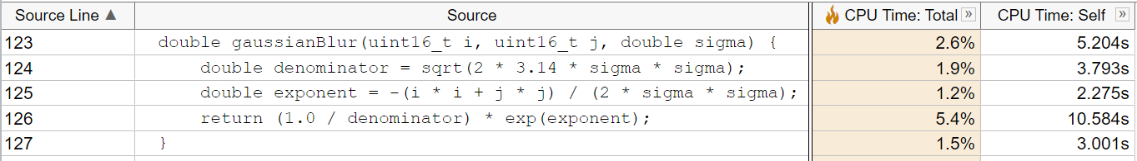
1st Version: HSA – GaussianBlur
VTune showed that a significant portion of time in GaussianBlur is spent computing the exponential function.
Solution: Replaced exp() with a custom approximation to reduce computation time.
Università di Pisa
Carlo Mazzanti | Andrea Migliore

Slide 16
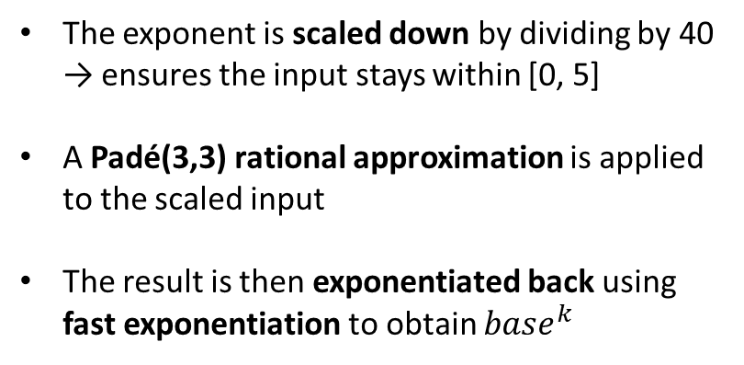
1st Version: HSA – FastExp
double fast_exp(double x) {
const int k = 40; // x/k ∈ [0, 5]
double z = x / k;
// Padé(3,3)
double z2 = z * z;
double z3 = z2 * z;
double num = 1.0 - z + 0.5 * z2 - z3 / 6.0;
double den = 1.0 + z + 0.5 * z2 + z3 / 6.0;
double base = num / den;
// base^k
double result = 1.0;
double p = base;
int n = k;
while (n > 0) {
if (n & 1) result *= p;
p *= p;
n >>= 1;
}
return result;
}
The exponent is scaled down by dividing by 40 → ensures the input stays within [0, 5]
A Padé(3,3) rational approximation is applied to the scaled input
The result is then exponentiated back using fast exponentiation to obtain $base^{k}$
Università di Pisa
Carlo Mazzanti | Andrea Migliore

Slide 17
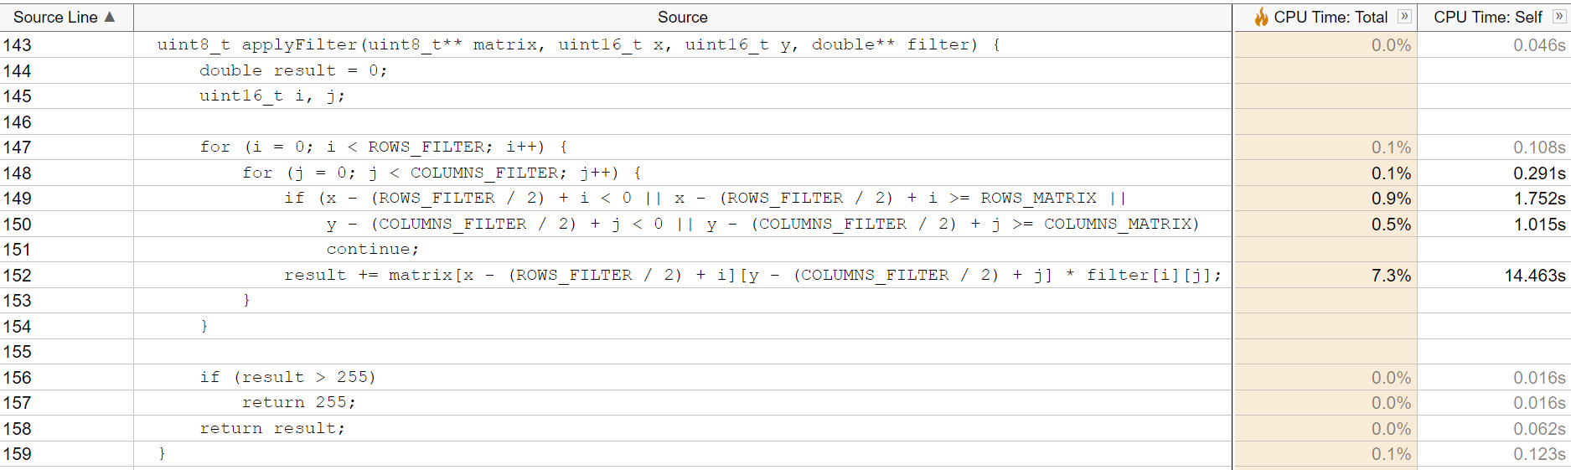
1st Version: HSA – ApplyFilter
VTune identified the main bottleneck in the core loop of ApplyFilter, specifically in the repeated computation of matrix indices and boundary checks.
Solution: Reduced matrix indexing overhead by precomputing offsets and adjusting loop bounds to avoid redundant calculations and conditionals.
Università di Pisa
Carlo Mazzanti | Andrea Migliore

Slide 18
1st Version: HSA – ApplyFilter
uint8_t applyFilter(uint8_t** matrix, uint16_t x, uint16_t y, double** filter) {
...
uint16_t startX = 0;
uint16_t startY = 0;
uint16_t HALF_ROW = (ROWS_FILTER / 2);
uint16_t HALF_COLUMN = (COLUMNS_FILTER / 2);
if(x < HALF_ROW) startX = HALF_ROW - x;
if(y < HALF_COLUMN) startY = HALF_COLUMN - y;
uint16_t endX = ROWS_FILTER;
uint16_t endY = COLUMNS_FILTER;
if(x >= ROWS_MATRIX - HALF_ROW)
endX = HALF_ROW + ROWS_MATRIX - x;
if(y >= COLUMNS_MATRIX - HALF_COLUMN)
endY = HALF_COLUMN + COLUMNS_MATRIX - y;
uint16_t k = x - HALF_ROW + startX;
for (i = startX; i < endX; i++) {
uint16_t h = y - HALF_COLUMN + startY;
for (j = startY; j < endY; j++) {
result += matrix[k][h] * filter[i][j];
h++;
}
k++;
}
...
}
Loop bounds are adjusted dynamically, eliminating the need for if conditions and continue statements
Base row index for matrix access is precomputed before the loops
Università di Pisa
Carlo Mazzanti | Andrea Migliore

Slide 19
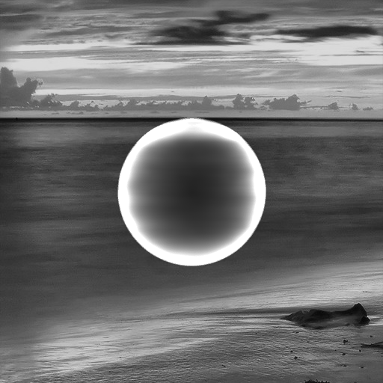

2nd Version: Output Check
1st Version Output
2nd Version Output
Università di Pisa
Carlo Mazzanti | Andrea Migliore

Slide 20


2nd Version: Output Check
1st Version Output
2nd Version Output
Università di Pisa
Carlo Mazzanti | Andrea Migliore

Slide 21
2nd Version: Mean Execution Time [ms]
143.228 → 21.604
71.581 → 10.848
13.810 → 3.159
14.355 → 2.180
Università di Pisa
Carlo Mazzanti | Andrea Migliore

Slide 22
2nd Version: Speedup
Università di Pisa
Carlo Mazzanti | Andrea Migliore

Slide 23
2nd Version: Performance
Image Throughput at 16 Threads
≈ 9 img/sec
Università di Pisa
Carlo Mazzanti | Andrea Migliore

Slide 24
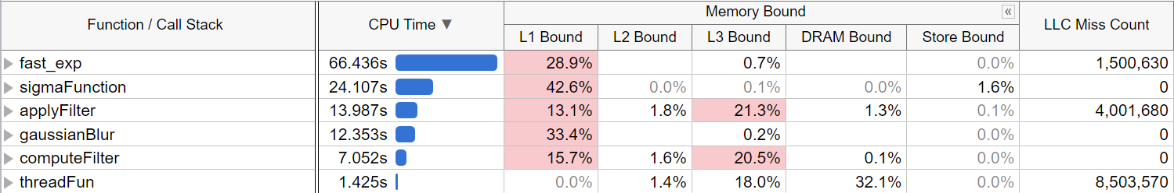
2nd Version: Memory Analysis (MA)
According to VTune analysis, the second version suffers from a strong cache-bound behavior
This indicates frequent memory stalls due to non-contiguous access to image data.
Università di Pisa
Carlo Mazzanti | Andrea Migliore
Notes:
.
This indicates frequent memory stalls due to non-contiguous access to image data.

Slide 25
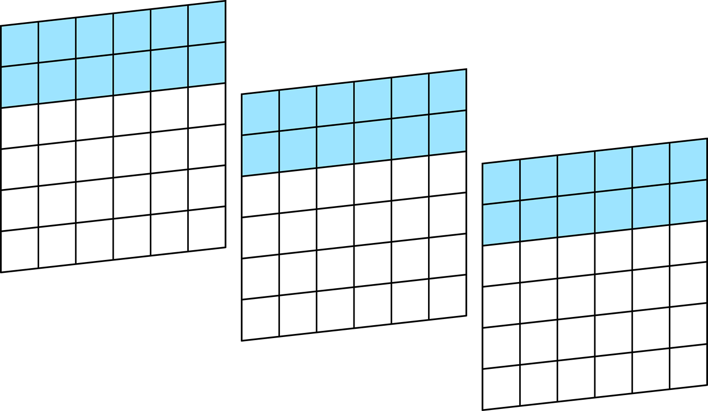
2nd Version: Row Assignment
Column assignment: Poor locality
Row assignment: Good locality
Original strategy: Assigning blocks of columns to threads, resulting in inefficient memory access and slower processing due to poor data locality
Optimized strategy: Assigning blocks of rows to threads, improving memory access patterns and enhancing data locality
Università di Pisa
Carlo Mazzanti | Andrea Migliore
Notes:
.
This indicates frequent memory stalls due to non-contiguous access to image data.

Slide 26
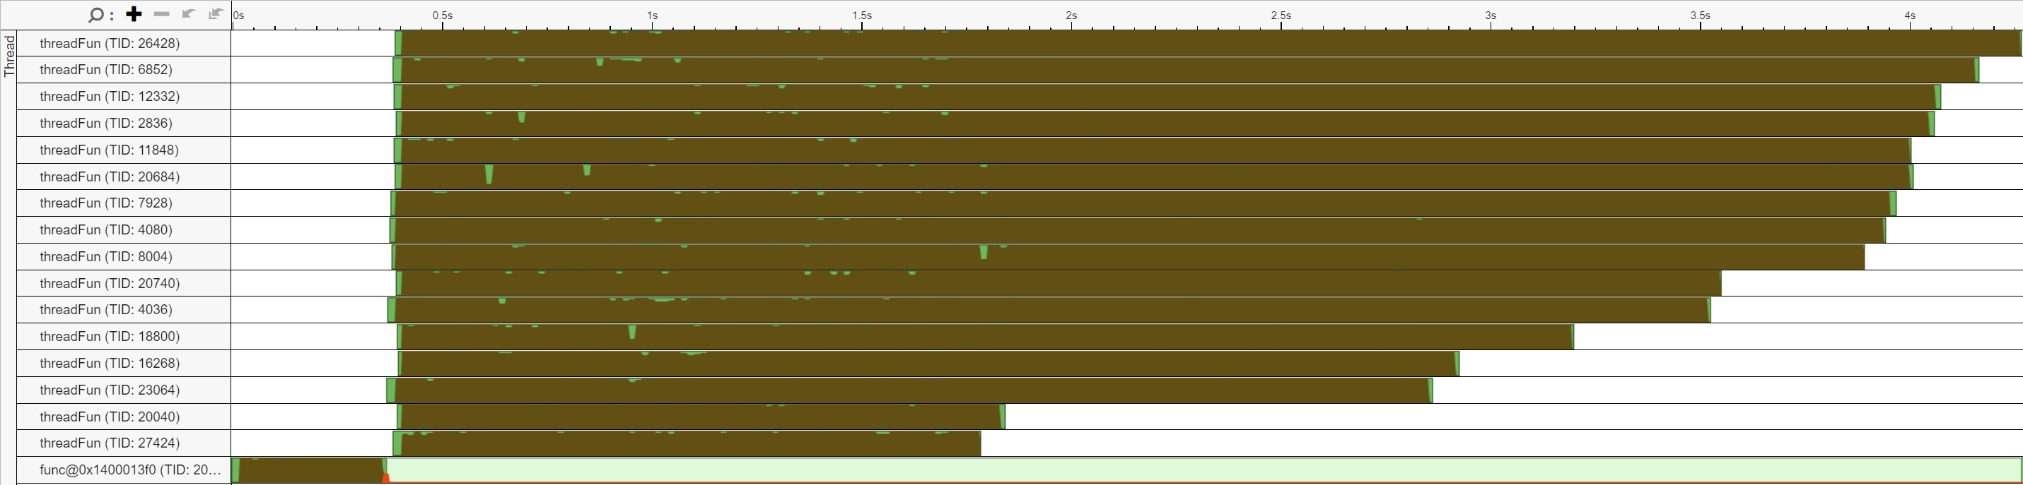
2nd Version: Workload Imbalance
VTune shows an uneven workload distribution where some threads complete much earlier than others
This results in underutilization of CPU cores and reduced parallel efficiency
Università di Pisa
Carlo Mazzanti | Andrea Migliore

Slide 27
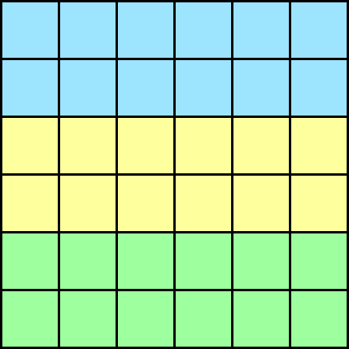
2nd Version: Static Assignment
In the static assignment, each thread receives a fixed block of rows at startup
This strategy assumes that all rows require similar computation time
However, several rows in the Blur Map may be filled with zero-depth pixels
Threads assigned to such rows finish early, while others remain active
Thread 0
Thread 1
Thread 2
Input Image 0
Blur Control Map
Università di Pisa
Carlo Mazzanti | Andrea Migliore

Slide 28
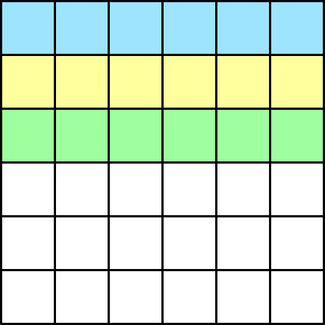
2nd Version: Dynamic Assignment
TH 0
TH 1
TH 2
In the dynamic assignment, each thread requests a row to process at startup
Once it finishes, it immediately requests another, ensuring continuous workload
This avoids resource underutilization caused by static assignment to mostly "empty" rows
Despite the synchronization overhead, this strategy leads to significantly better load balancing
Startup Assign.
Input Image 0
Blur Control Map
Thread 0 finishes early and requests the next available row to process
Università di Pisa
Carlo Mazzanti | Andrea Migliore

Slide 29

2nd Version: Compiler Flags
To further enhance performance, specific compiler flags were applied
O3: Enables aggressive optimizations for better speed
ffast-math: Allows faster floating-point calculations, sacrificing strict IEEE compliance
march=native: Optimizes code for the specific architecture of the host machine
Università di Pisa
Carlo Mazzanti | Andrea Migliore

Slide 30
3rd Version: Mean Execution Time [ms]
21.604 → 1.450
10.848 → 733
3.159 → 170
2.180 → 150
Università di Pisa
Carlo Mazzanti | Andrea Migliore

Slide 31
3rd Version: Speedup
Università di Pisa
Carlo Mazzanti | Andrea Migliore

Slide 32
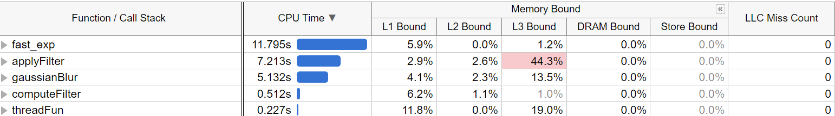
3rd Version: Row Assignment in Action
Università di Pisa
Carlo Mazzanti | Andrea Migliore

Slide 33
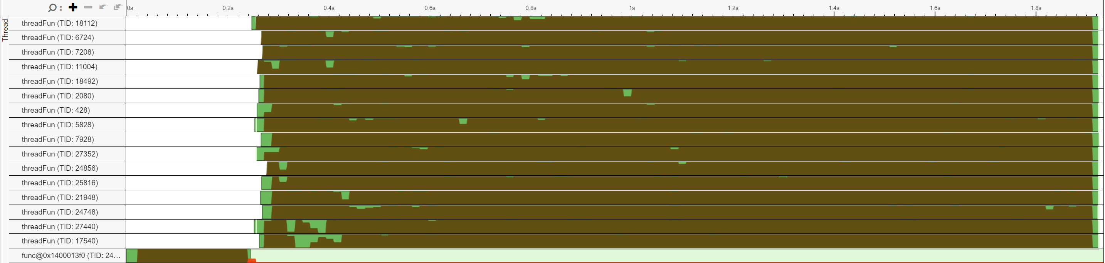
3rd Version: Load Balancing in Action
Università di Pisa
Carlo Mazzanti | Andrea Migliore

Slide 34
3rd Version: Performance
Image Throughput at 16 Threads
≈ 175 img/sec
Università di Pisa
Carlo Mazzanti | Andrea Migliore

Slide 35
3rd Version: Batch Row Assignment
Assigning one row at a time causes frequent accesses to the critical section
Introduced batch row assignment to reduce synchronization overhead
Each thread now processes a chunk of consecutive rows before re-entering the critical section
Empirical results show no performance gain beyond batch size 20
Final implementation uses a batch size of 45
This strategy maintains load balance while improving parallel efficiency
Thread 0
Thread 1
Thread 2
Input Image 0
Università di Pisa
Carlo Mazzanti | Andrea Migliore

Slide 36

3rd Version: Image-wise Processing
img3
TH 0
img2
TH 1
img1
img1
img2
Same rows across images: Poor locality
One image at a time: Good locality
Original strategy: Each thread processed the same row blocks across all images, causing poor memory locality due to non-contiguous accesses
Optimized strategy: threads now complete all rows of one image before moving to the next, improving spatial locality and cache performance
Università di Pisa
Carlo Mazzanti | Andrea Migliore

Slide 37

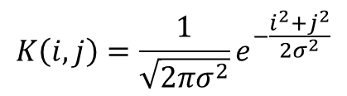
3rd Version: Kernel Caching
x
The Gaussian kernel depends only on the value of the center pixel of the Blur Control Map
Since pixel values range from 0 to 255, the number of possible kernels is finite
A shared array of matrices is used to cache the computed kernels
When a thread needs a kernel, it checks the shared array of matrices:
If the kernel is already present, it reuses it
This avoids redundant kernel computations
i
y
j
Blur Control Map
Kernel in (x, y)
$$σ = blurMap\left(x,y\right) ∗σ_{MAX}$$
$$K\left(i,j\right)=\frac{1}{\sqrt{2πσ^{2}}}e^{−\frac{i^{2}+j^{2}}{2σ^{2}}}$$
Università di Pisa
Carlo Mazzanti | Andrea Migliore

Slide 38
3rd Version: Compiler Flags
To further enhance performance, additional compiler flags were applied
funroll-loops: Unrolls loops to reduce overhead and increase instruction-level parallelism
fno-tree-pre: Disables partial redundancy elimination, which in this case avoided unnecessary transformations
ftree-vectorize: Enables automatic vectorization, allowing the compiler to use SIMD instructions
Università di Pisa
Carlo Mazzanti | Andrea Migliore

Slide 39
4th Version: Mean Execution Time [ms]
1.450 → 825
733 → 421
170 → 86
150 → 87
Università di Pisa
Carlo Mazzanti | Andrea Migliore

Slide 40
4th Version: Speedup
Università di Pisa
Carlo Mazzanti | Andrea Migliore

Slide 41
4th Version: Performance
Image Throughput at 16 Threads
≈ 347 img/sec
Università di Pisa
Carlo Mazzanti | Andrea Migliore

Slide 42
Summary
Version | 16-Thread Throughput | Improvements
1st | 2 img/sec | Initial implementation No optimizations applied
2nd | 9 img/sec | Eliminated calculations for pixels with value 0 Reduced redundant matrix index calculations Exponential approximation
3rd | 175 img/sec | Switched from column to row assignment Static to dynamic assignment Compiler optimizations
4th | 347 img/sec | Switched to batch row assignment From Row-wise to Image-wise Processing Kernel caching Compiler optimizations
Università di Pisa
Carlo Mazzanti | Andrea Migliore

