Slide 1

Università
di Pisa
Custom Gaussian Blur
Controlled by a Blur Map
Università di Pisa
Carlo Mazzanti | Andrea Migliore

Slide 2

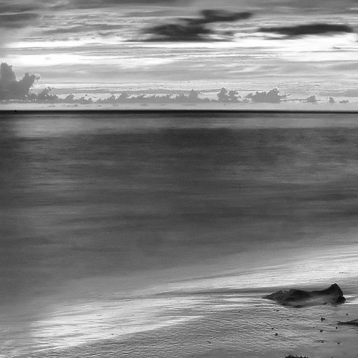
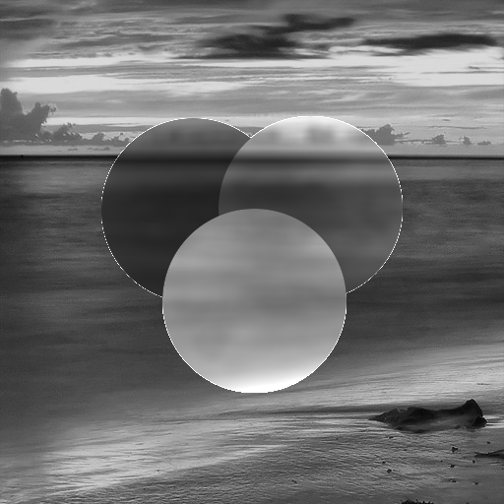
Project Idea
Apply a Gaussian blur to an image based on a control map
Blur only selected areas of the image and modulate brightness depending on pixel values in the map
Goal: create a selective blur effect using image processing techniques
Università di Pisa
Carlo Mazzanti | Andrea Migliore

Slide 3
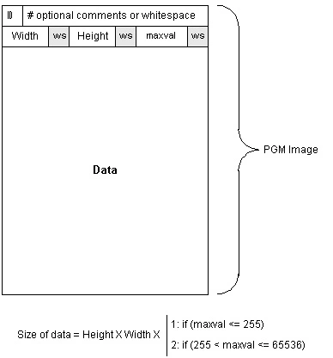
Input Format: PGM Images
Input images are in PGM ASCII format (Portable Gray Map)
Two inputs:
The main image to be blurred
A Blur Control Map that determines how each pixel is processed
Grayscale format: easy to parse and process pixel values directly.
Università di Pisa
Carlo Mazzanti | Andrea Migliore

Slide 4
The Blur Control Map
Each pixel in the map guides the filter behavior:
0
leave pixel unchanged
1
apply Gaussian blur, increase brightness
127
apply Gaussian blur, keep brightness
255
apply Gaussian blur, reduce brightness
Università di Pisa
Carlo Mazzanti | Andrea Migliore
Notes:
Each pixel in the map guides the filter behavior:
0 (black): leave pixel unchanged.
127 (gray): apply Gaussian blur, keep brightness.
255 (white): apply blur, reduce brightness.
> 0 and < 127 (dark gray): apply blur, increase brightness.

Slide 5
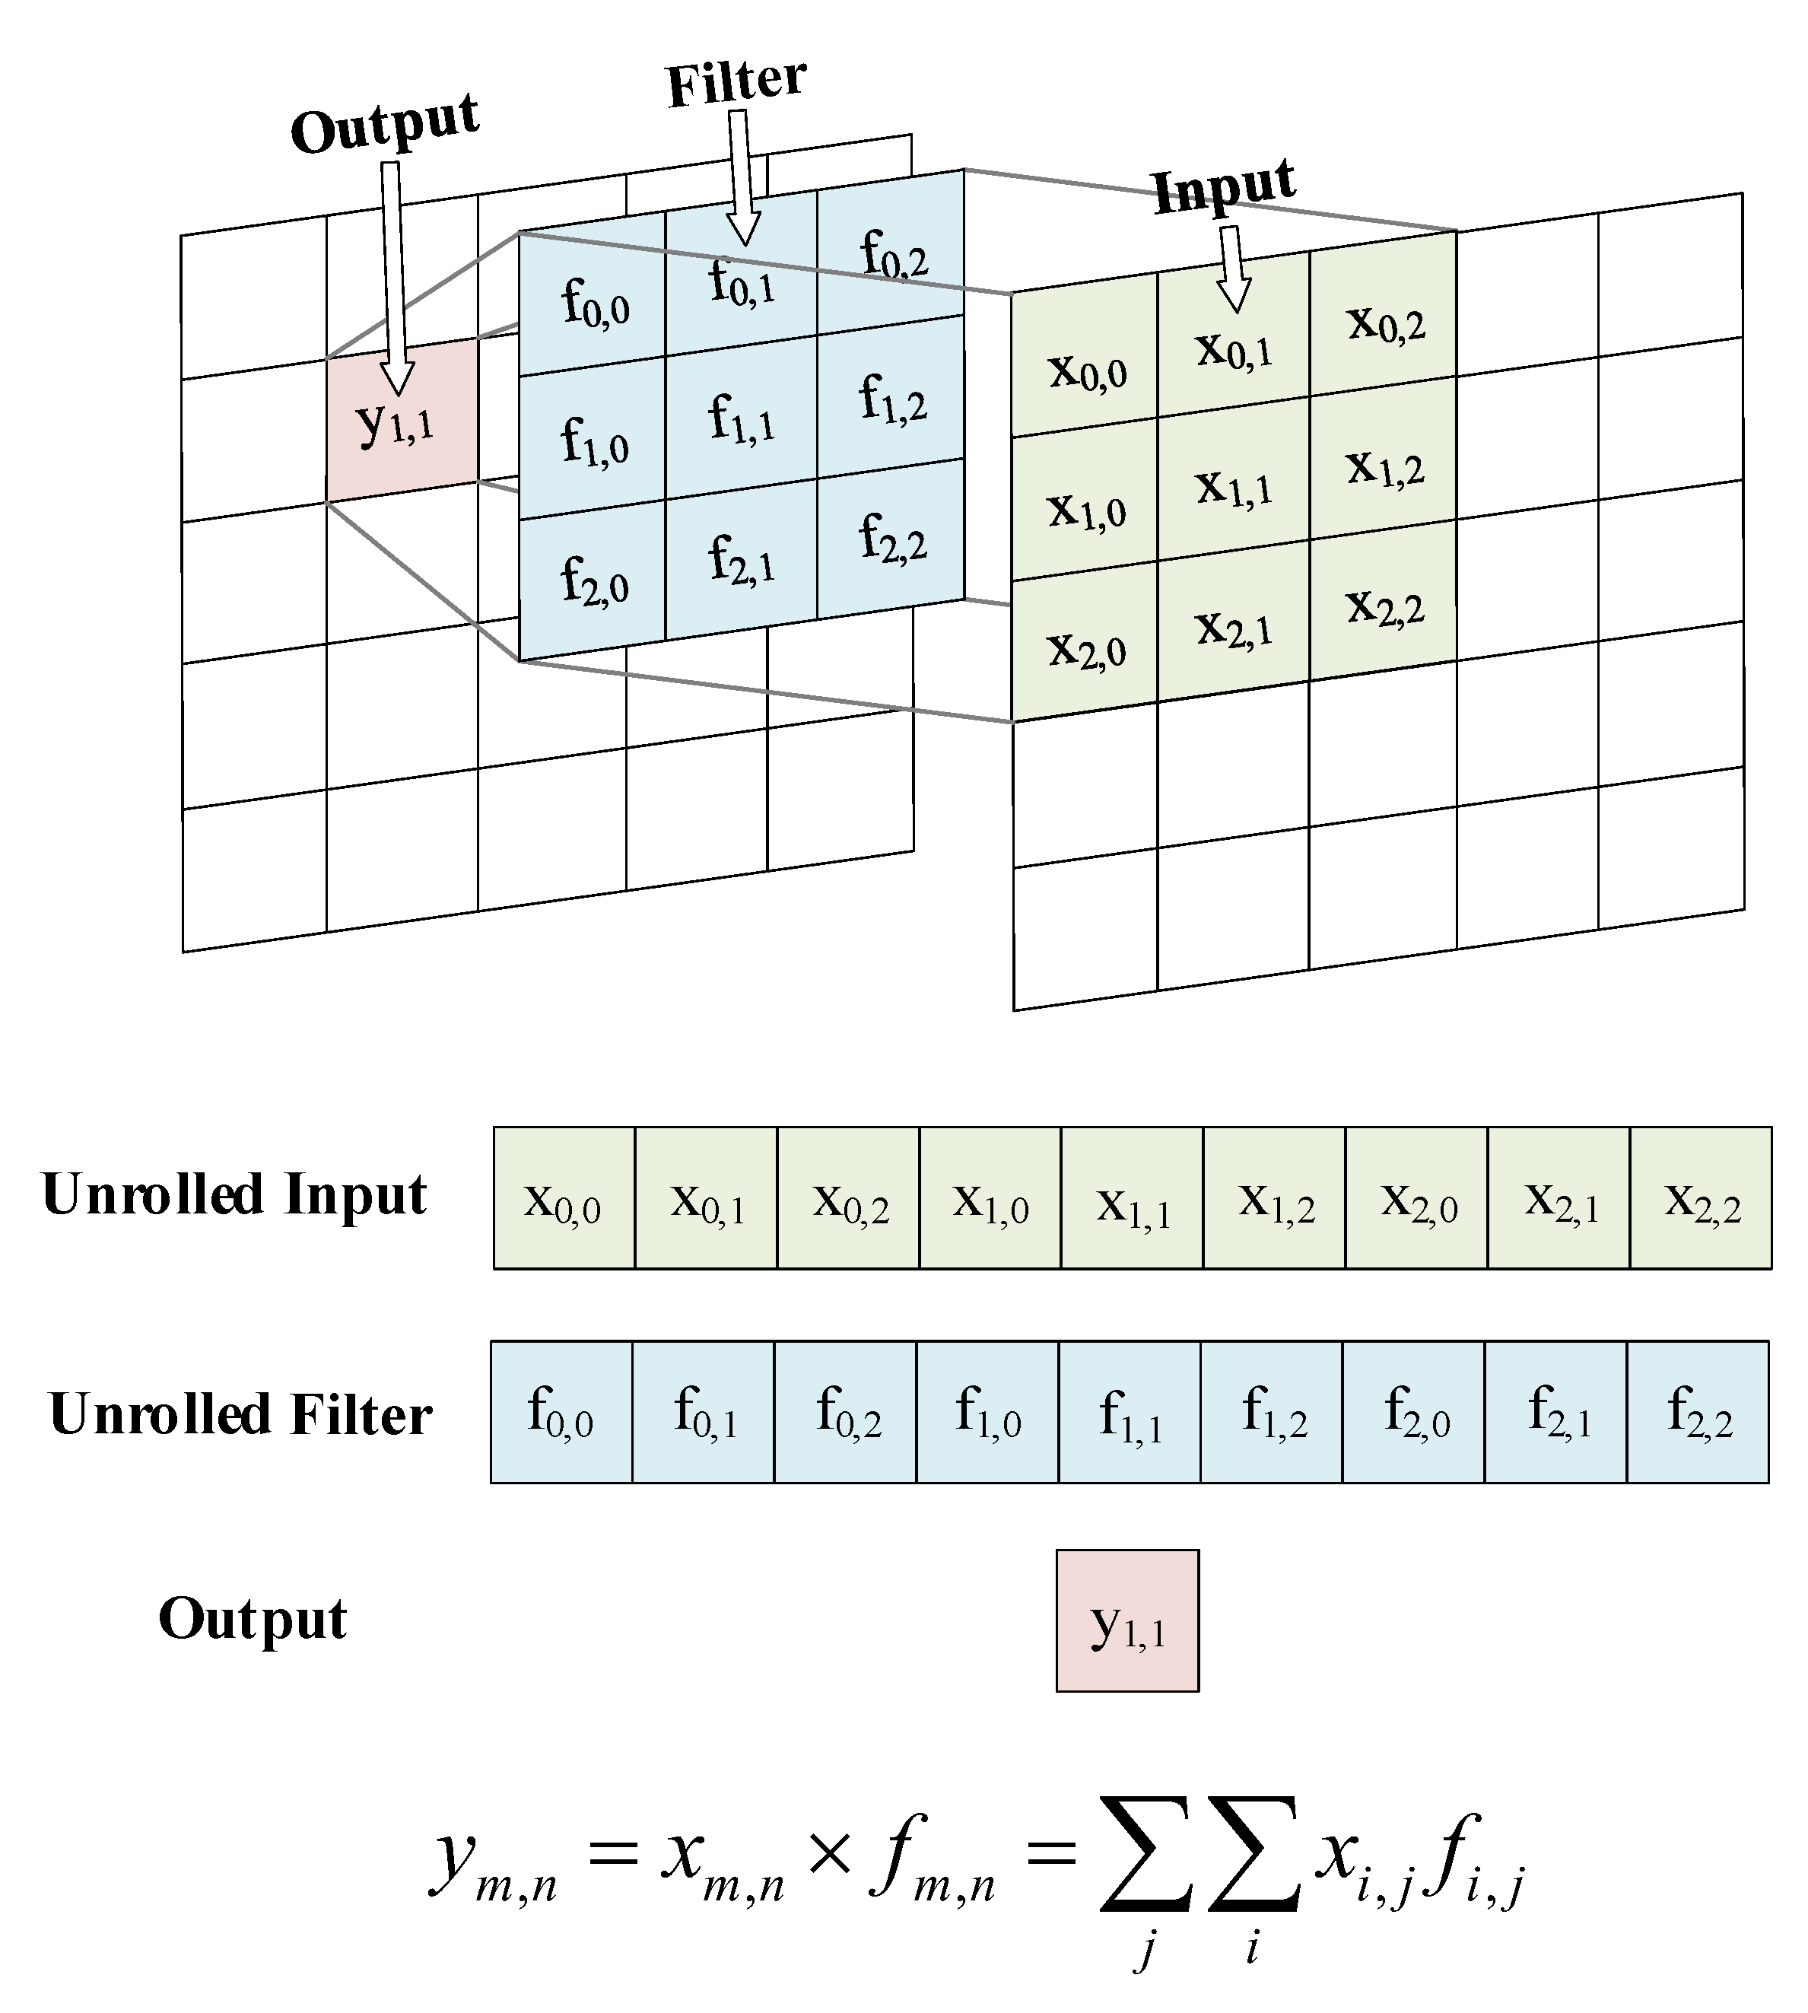
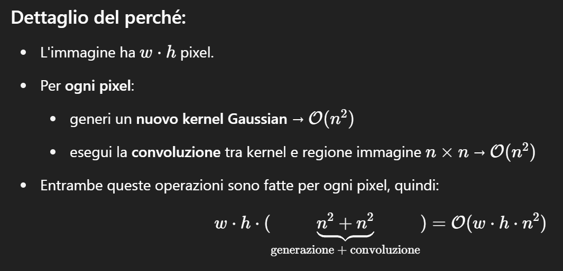
Applying the Filter: 2D Convolution
Convolution is a mathematical operation that combines a filter (kernel) with an image to compute new pixel values based on their neighbors.
The kernel slides across the image. At each position:
Multiply each kernel value with the corresponding image pixel
Sum the results → this becomes one pixel in the output image
In the implemented filter, a unique Gaussian kernel is dynamically computed for each pixel, centered at its position.
Time complexity: 𝑂(𝑤 × ℎ × 𝑛²)
Università di Pisa
Carlo Mazzanti | Andrea Migliore

Slide 6
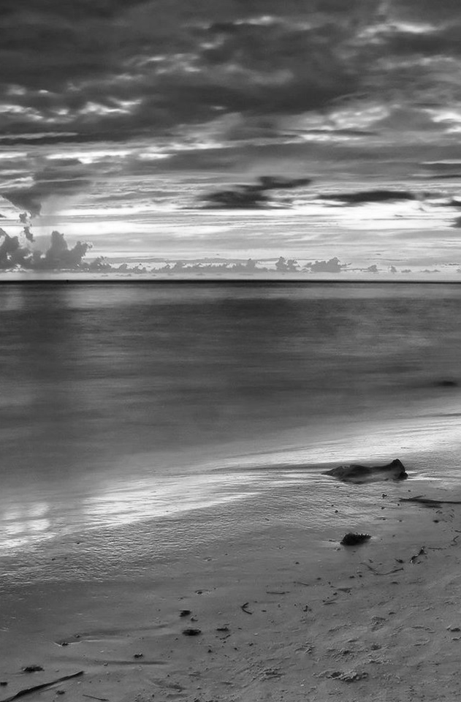

Test Setup: Input Data and Load Scenarios
Input images are randomly generated at runtime, filled with values from 0 to 255
Each image is of size 1440 × 2160 pixels.
Three workload levels were tested:
Low: 3 images
Medium: 15 images
High: 30 images
Target performance: process at least 10 images per second
2160
1440
Università di Pisa
Carlo Mazzanti | Andrea Migliore

Slide 7
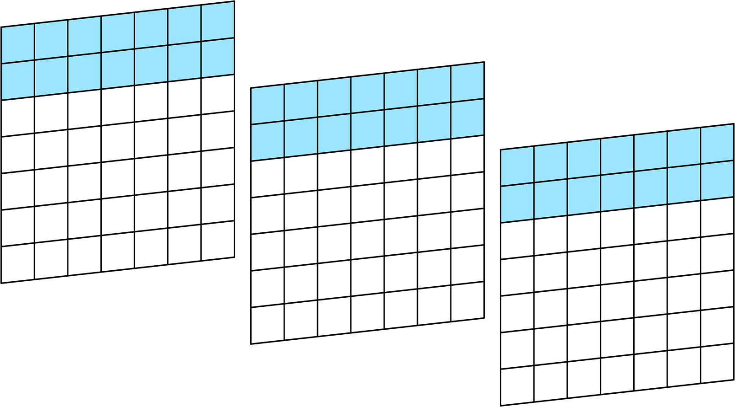
Parallelization Strategy
Each image is divided horizontally into row intervals
Each thread is assigned a range of rows to process
For example, thread 0 handles the first 2 rows of all input images
This strategy ensures no data dependencies between threads
img3
img2
img1
Università di Pisa
Carlo Mazzanti | Andrea Migliore

Slide 8

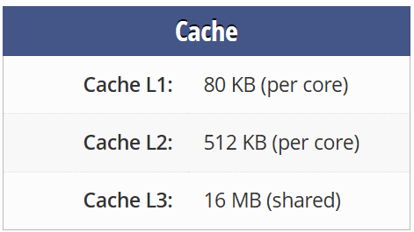
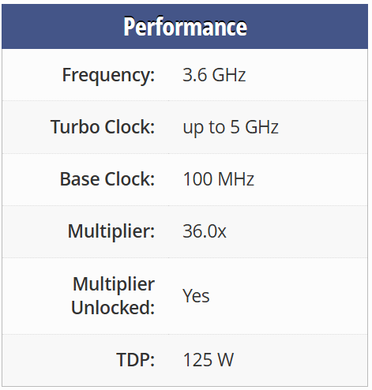
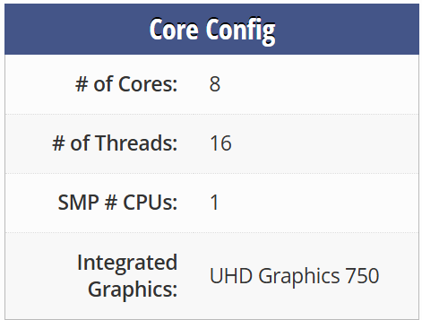
Test Platform Specifications
🧾
Intel Core i7-11700K
System Configuration
Operating System: | Windows 11
Memory: | 64 GB DDR4 @ 3200 MHz
Compiler: | GCC
Profiler: | Intel VTune
Università di Pisa
Carlo Mazzanti | Andrea Migliore

Slide 9
1st Version Performance
Università di Pisa
Carlo Mazzanti | Andrea Migliore

