Slide 1

Università
di Pisa
Custom Gaussian Blur
Controlled by a Blur Map
Università di Pisa
Carlo Mazzanti | Andrea Migliore

Slide 2

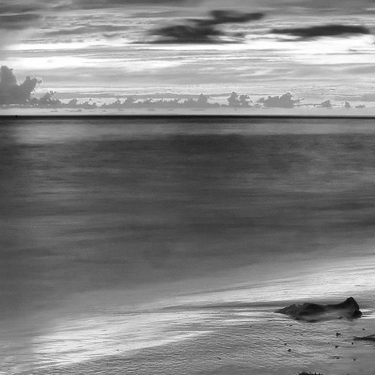
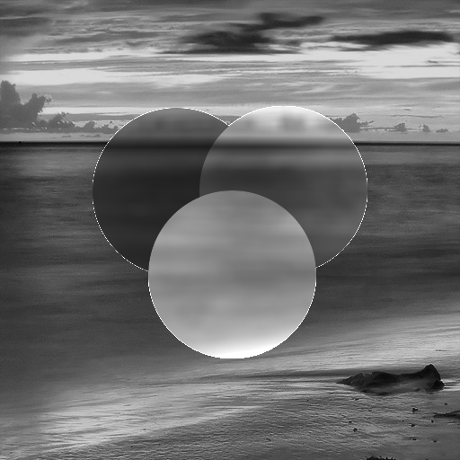
Project Idea
Blur an image based on a control map
Blur only selected areas of the image and modulate brightness depending on pixel values in the map:
0
leave pixel unchanged
1
apply blur, increase brightness
127
apply blur, keep brightness
255
apply blur, reduce brightness
Università di Pisa
Carlo Mazzanti | Andrea Migliore

Slide 3
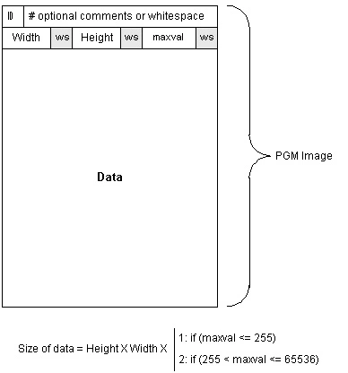
Input Format: PGM Images
Input images are in PGM ASCII format (Portable Gray Map)
Two inputs:
The main image to be blurred
A Blur Control Map that determines how each pixel is processed
Grayscale format: easy to parse and process pixel values directly.
Università di Pisa
Carlo Mazzanti | Andrea Migliore

Slide 4
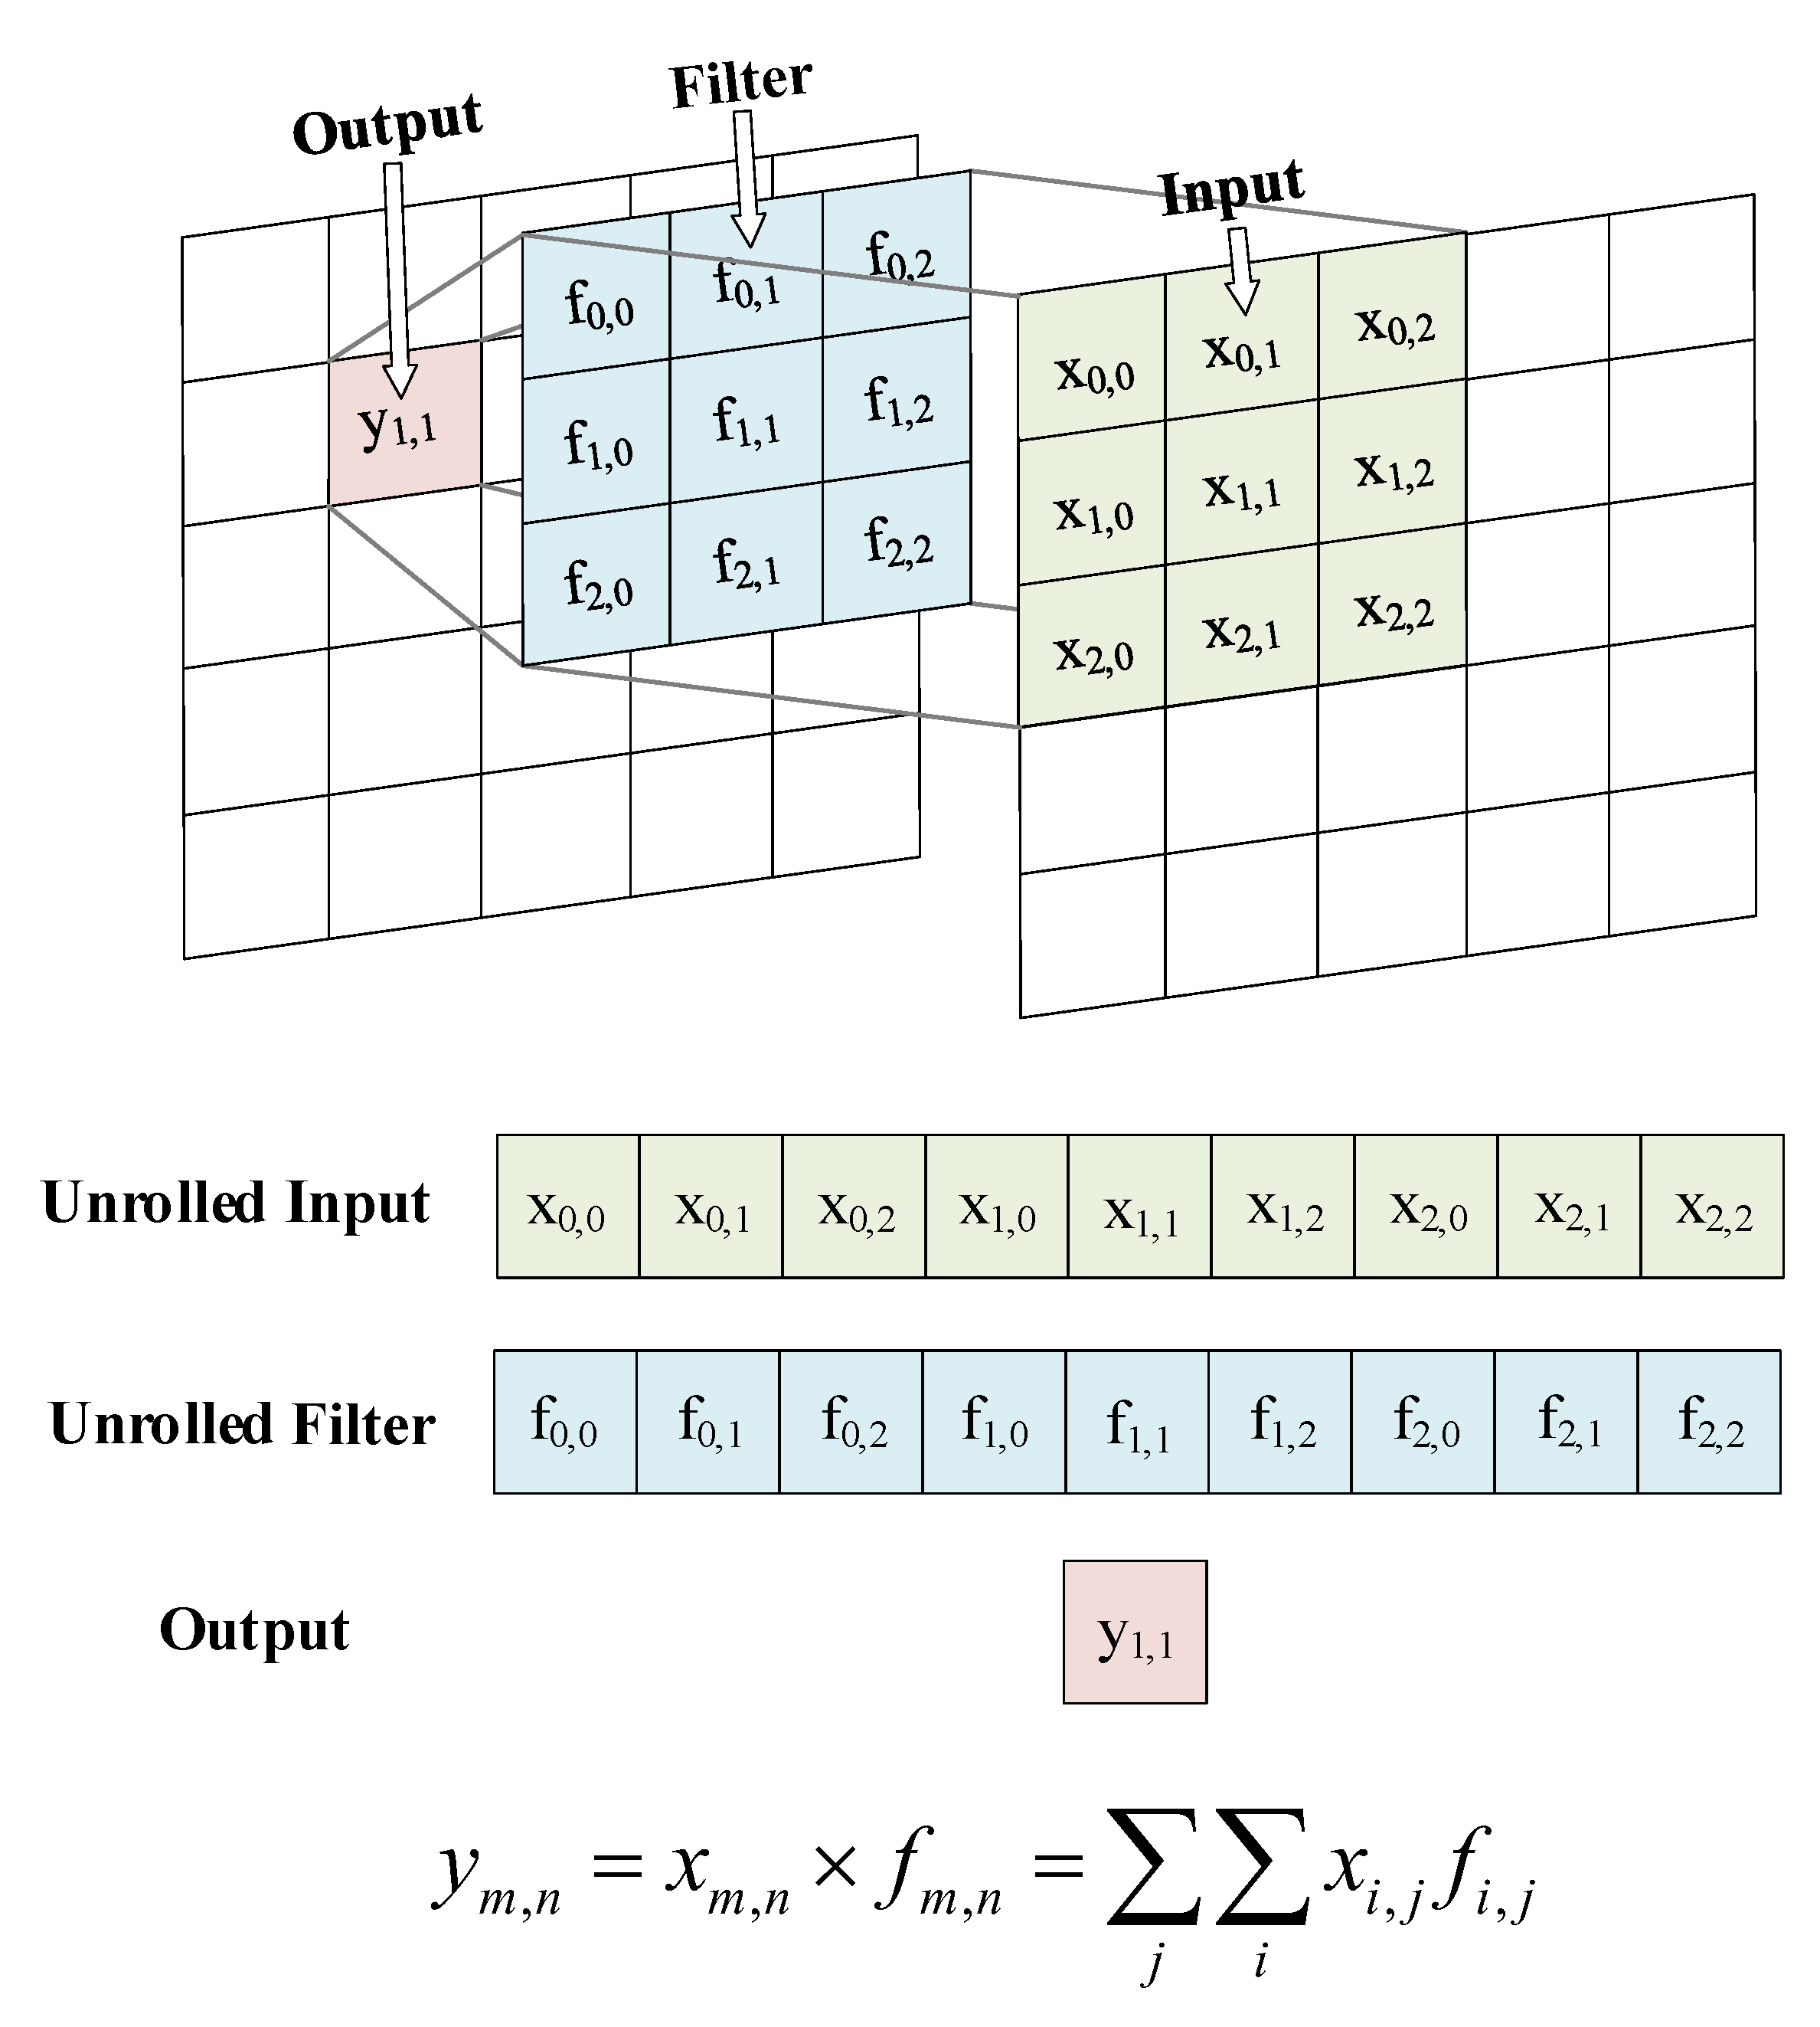
Applying the Blur: 2D Convolution
Convolution is a mathematical operation that combines a filter (kernel) with an image to compute new pixel values based on their neighbors.
The kernel slides across the image. At each position:
Multiply each kernel value with the corresponding image pixel
Sum the results → this becomes one pixel in the output image
Università di Pisa
Carlo Mazzanti | Andrea Migliore

Slide 5


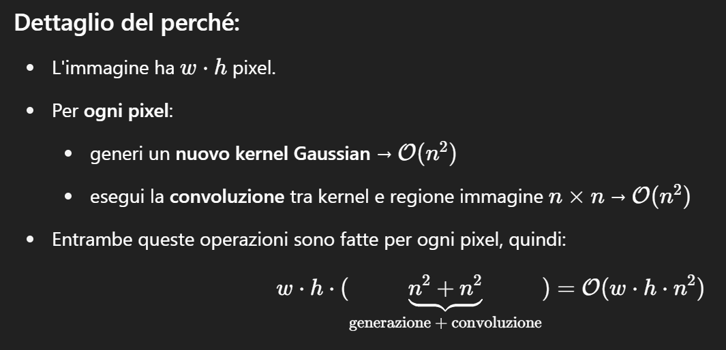


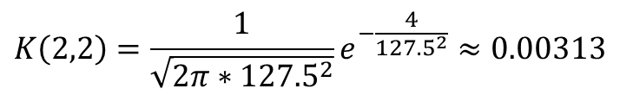
Compute the Kernel: Gaussian Formula
2
The kernel size is fixed (e.g., 3×3)
For each pixel (x, y), a Gaussian kernel is computed using the 2D Gaussian function:
The standard deviation σ is dynamically computed as:
Time complexity: 𝑂(𝑤 × ℎ × 𝑛²)
2
3
2
$$G\left(x,y\right)=\frac{1}{\sqrt{2πσ^{2}}}e^{−\frac{x^{2}+y^{2}}{2σ^{2}}}$$
Blur Control Map
Kernel in (3, 2)
$$σ=blurMap\left(x,y\right)∗σ_{MAX}$$
$$σ=blurMap\left(2,3\right)∗σ_{MAX}=255∗0.5=127.5$$
$$K\left(2,2\right)=\frac{1}{\sqrt{2π∗{127.5}^{2}}}e^{−\frac{4}{{127.5}^{2}}}≈0.00313$$
Università di Pisa
Carlo Mazzanti | Andrea Migliore

Slide 6
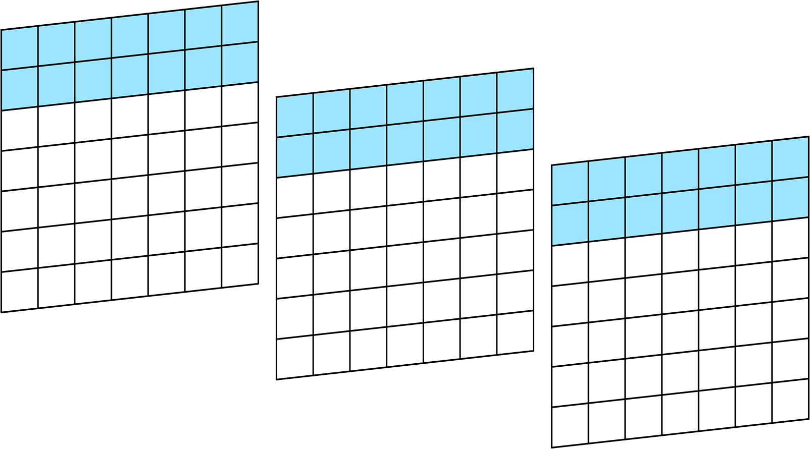
Parallelization Strategy
Each image is divided horizontally into row intervals
Each thread is assigned a range of rows to process
For example, thread 0 handles the first 2 rows of all input images
This strategy ensures no data dependencies between threads
img3
img2
img1
Università di Pisa
Carlo Mazzanti | Andrea Migliore

Slide 7

Parallelization Strategy
Thread 0 – 1st image
Each thread processes its assigned row block column by column
The thread computes the Gaussian kernel and convolution for each pixel (x,y) in its submatrix
Università di Pisa
Carlo Mazzanti | Andrea Migliore

Slide 8
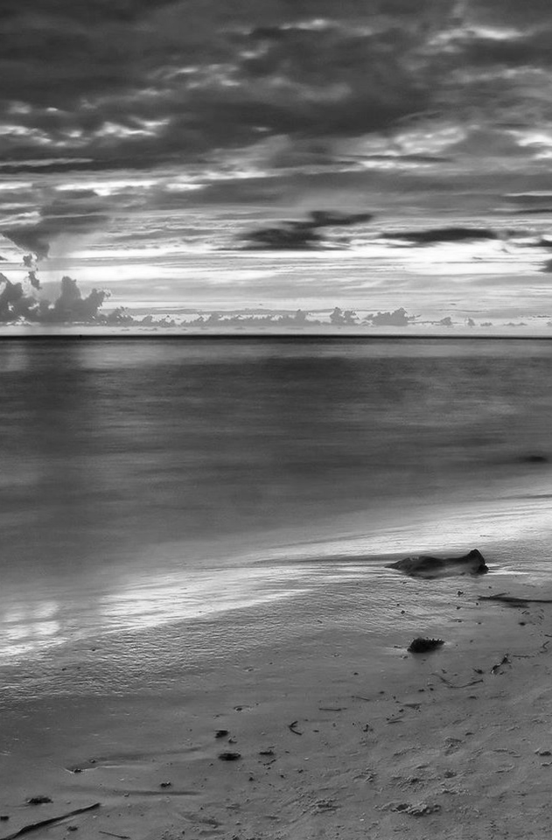

Test Setup: Input Data and Load Scenarios
Input images are randomly generated at runtime, filled with values from 0 to 255
Each image is of size 1440 × 2160 pixels.
Three workload levels were tested:
Low: 3 images
Medium: 15 images
High: 30 images
Target performance: process at least 10 images per second
2160
1440
Università di Pisa
Carlo Mazzanti | Andrea Migliore

Slide 9

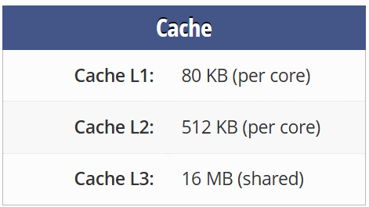
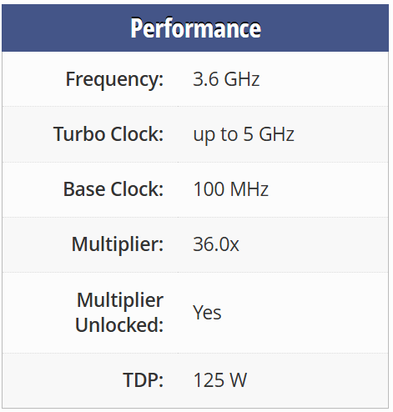
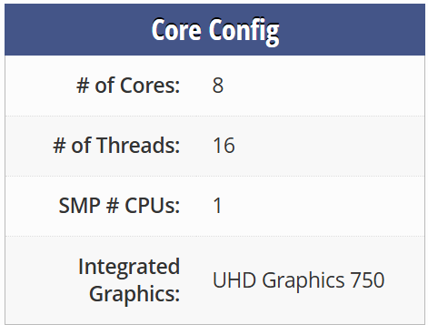
Test Platform Specifications
🧾
Intel Core i7-11700K
System Configuration
Operating System: | Windows 11
Memory: | 64 GB DDR4 @ 3200 MHz
Compiler: | GCC
Profiler: | Intel VTune
Università di Pisa
Carlo Mazzanti | Andrea Migliore

Slide 10
1st Version Performance
Università di Pisa
Carlo Mazzanti | Andrea Migliore

