Slide 1
Creating an NREN in a Commercial World
Brian Nisbet
Network Operations Manger
HEAnet
@natural 20

Slide 2
HEAnet Mission
To realise Ireland's education and research goals in partnership with our clients by providing advanced infrastructure and services
Source: HEAnet Strategic Plan
2017 - 2018 “Collaboration – The key to Development and Success”
Notes:
NRENs exist to serve the education community in their country
All about collaboration & partnership
In Ireland we’re funded by both our members (all HEIs, around 30 other companies/agencies (ESRI, EPA, Houses of the Oireachtas)) and by the HEA

Slide 3
Shared Services
Connectivity
Brokerage
Hosting
Identity & Access
Multimedia
Security
Schools
Notes:
- This is what we do right now. Connectivity at the core of it all, the original shared service

Slide 4
Notes:
This talk is a counterfactual, playing with the history of which we’re all keenly aware
What if, in the 80s/90s, various countries around the world *hadn’t* decided to create National Research & Education Networks?
What if they’d decided that commercial providers could do all they needed?

Slide 5
Notes:
Counter factuals need assumptions
So I’m going to assume that it ultimately doesn’t matter if the NREN was set up by a government (eg BdREN) or by a group of universities (most older European NRENs)
I’m also not going to worry too much about funding sources, let’s assume a mix of membership & central government funding
All other conditions are as is. So senior university stakeholders are increasingly CIOs rather than ex-technical staff
Money is no more abundant than it is in the real world
So, NREN can’t be ”too technical” and must look at saving money for its clients

Slide 6
Assumption!
All ends up the same, regardless of setup system!
Notes:
- I’m going to assume that it ultimately doesn’t matter if the NREN was set up by a government (eg BdREN) or by a group of universities (most older European NRENs)

Slide 7
Assumption!
There isn’t a lot of money, but there’s enough. It can come from members or government (or both).
Notes:
- I’m also not going to worry too much about funding sources, let’s assume a mix of membership & central government funding

Slide 8
Assumption!
University IT Departments run by CIOs & Service Managers
Notes:
- All other conditions are as is. So senior university stakeholders are increasingly CIOs rather than ex-technical staff
- So, NREN can’t be ”too technical” and must look at saving money for its clients

Slide 9
NREN Teams
Brokerage
Client Services
Communications & Marketing
Notes:
Starting teams, Brokerage, Client Services and Communications & Marketing
Brokerage at the core, saving money for the NREN, but the dedicated client services are also vital. Initial USP
Client services is channelling demand, interacting with stakeholder groups
Communications & marketing are similarly vital because this is a new & different venture
Could even be three people!
No technical staff?!

Slide 10
Initial Steps
Brokerage
Group Procurement
Shared (Cloud?) Services
???
Partnership!
Notes:
Brokerage teams, working closely with Client Services need to identify their Client needs now & in the future
Extensive work to put deals in place, especially as initial take up may be small, needs to be driven by Marketing
Cost recovery basis after initial state funding?
Not about turning a profit, about partnership

Slide 11
What’s Next?
Notes:
Like our real life NREN experience the first services aren’t enough
Once that elusive partnership is embedded the clients will be interested in an expanding portfolio of services

Slide 12
Mobility
Identity
Professional Services
Notes:
- Mobility and Identity are still going to be very important
This may well begin as deals and brokerage, but it’s likely to be where the technical staff will first emerge
Federated identity
eduroam
Either following on from that or at the same time experts could be hired to provide professional services for security, cloud services, firewalling, campus networking
This is all on the basis of a trusted third party
Professional Services would be technical staff, but *only* doing PS, not working on NREN internal systems

Slide 13
24/7
Education
Notes:
Everything the new NREN does/supports would have to be supported 24/7
How is this achieved?

Slide 14
Everything!
Notes:
- Everything is in the cloud, or at least anything that isn’t on premise/nailed down
No reason for NREN DCs, storage or compute
Migration is important, consultancy (GDPR?)

Slide 15
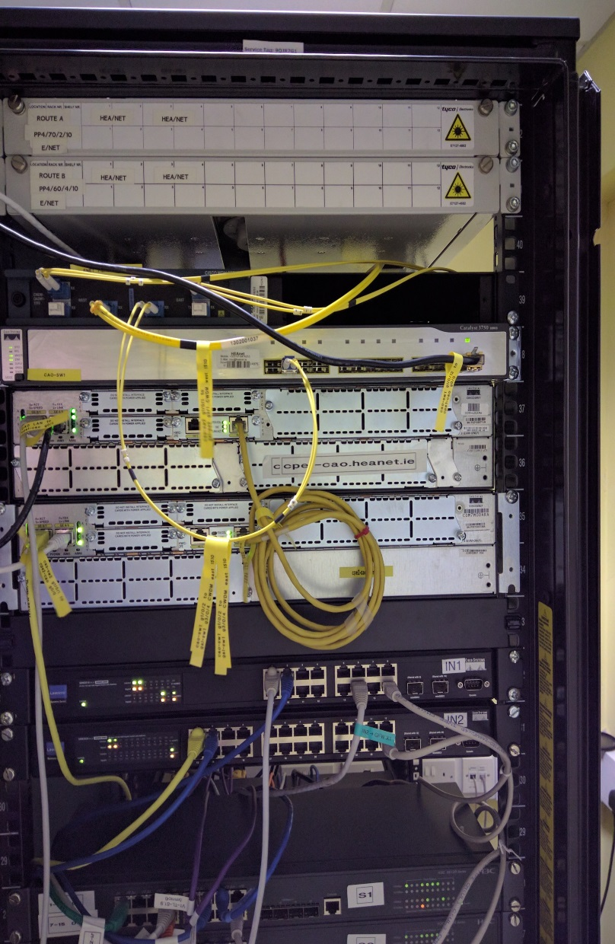
Notes:
Would there ever be a network?
Would there be a need if the NRENs were happy with their commercial providers?
Quite possibly for something like a primary & secondary schools network
And maybe. If the quality of service could be shown to be above what the commercial providers could provide and if an entity like GEANT came into being, and the price was right… then maybe.

Slide 16
Tech
Services
Brokerage
Notes:
The NREN exists, but with a very different hierarchy
It’s all about saving money first, about brokerage
Then services, professional and managed
Tech is important, vital, but it’s not the base, it’s almost an add-on

Slide 17
brian.nisbet@heanet.ie
@natural20

