Slide 1
Do we need to rethink monitoring?
Kemal Sanjta
ThousandEyes

Slide 2
Nature of the troubleshooting
REACTIVE
PROACTIVE?

Slide 3
Troubleshooting life cycle
Issue
Troubleshooting
Conclusion based on the RCA

Slide 4
Troubleshooting tools
Ping and traceroute good as starting point, but we realized we need something more
MTR
Paris traceroute
Dublin traceroute
NLNOG RING
… but we are still reactive and quite possibly late to the party!

Slide 5
Back to alerting
Various sources (wrapper for end user reports)
SYSLOG
SNMP
Lately streaming telemetry solutions

Slide 6
Now that we have alerts and the tools to troubleshoot the problems…
WHAT IS THE PROBLEM?

Slide 7
What is the problem?
TIME
We are too slow to respond to alerts!

Slide 8
Improvement?
AUTOMATION

Slide 9
We discovered…
Python (and countless libraries)
Go Programming Language (and its concurrency)
And few frameworks along the way like Ansible

Slide 10
Once automation provided results…
Are $vendors telling the full truth about performance of the networks?

Slide 11
How many times have you heard?
Linecards rebooting as a result of solar flares? (No root cause analysis)
Counters for _exactly that_ issue are not user exposed?
Counters exist, but you need to be linecard level wizard to get to them? (involves knowing good piece about architecture and silicon/ASIC type)
Backplane was hit with this specifically crafted package that took your fully redundant backplane down?
Control plane can not handle it?

Slide 12
Automation gave us product called…
VENDOR DISTRUST

Slide 13
ACTIVE NETWORK MONITORING

Slide 14
Challenges with active network monitoring
Large scale/enterprise networks moved to CLOS Fabric Designs
CLOS Fabric Designs to de-aggregate large chassis, depend on smaller scale devices (limit the “blast radius”)
Smaller scale devices, in turn, suffer from smaller RIB/FIB sizes and weak Control planes

Slide 15
Are they really smaller scale devices?
Juniper PTX1000: 24X100GbE, 72X40GbE, 288X10GbE = 2.88Tbps
Cisco NCS5000 series: 32X100GbE, 32X40GbE, 128X25GbE, 128X10GbE = 3.2Tbps
Arista 7170 series: 32X100GbE, 64X50GbE, 32X40GbE, 128X25GbE, 130x10GbE = 6.4Tbps
Depends on the angle… Better to lose 2.8Tbps – 6.4Tbps capacity compared to fully loaded ASR 9022 taking down 160Tbps

Slide 16
Some more challenges…
Label switched networks (backbone networks) utilizing features like auto-bw are not that straight forward to implement active network monitoring on

Slide 17
That implies…
NO 100% ACTIVE NETWORK MONITORING COVERAGE

Slide 18
Did we forget about something?

Slide 19
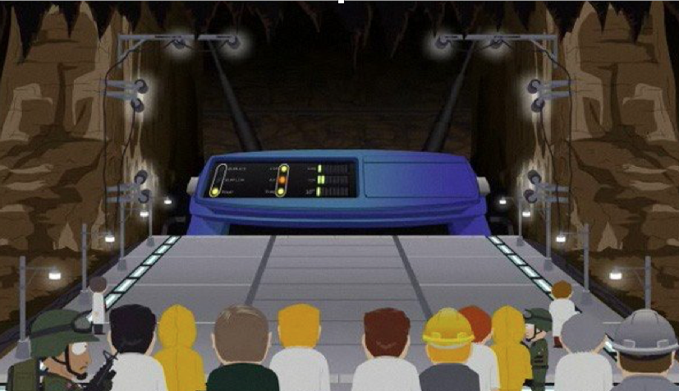
THE
INTERNET

Slide 20

The Internet
Packet Loss
Latency
Jitter
BGP advertisements/withdrawals
Prefix hijacks

Slide 21
Some more challenges…
SERVICES
Don’t be that person that shunts the issue(s) to SREs and says:
“Not my problem”

Slide 22
Solution?
Learn how to code (as your job might depend on it)
Utilize research papers on data center and backbone design not to repeat someone else’s mistakes
Utilize both active and passive network monitoring regardless of how hard that might be… or just buy off the shelf solution that does it
Extend active network monitoring solutions to achieve 100% active network monitoring coverage
Monitor performance of your internet paths as life of your packets, and patience of your customers depends on it!
Know/Monitor/Alert on your services and don’t play the blame game!

