Slide 1

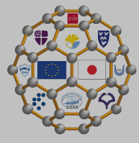
ICTP-LEMSUPER Conf. on Mechanisms
and Developments in Light-element Based and Other Novel Superconductors, Trieste, 25 Sept 2013
Carbon-based vs transition-metal superconductors
--- a theoretical outlook
Hideo Aoki
Dept Physics, Univ Tokyo

Slide 2
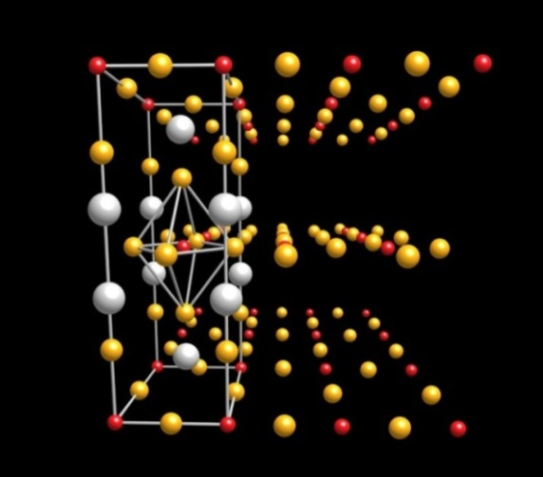
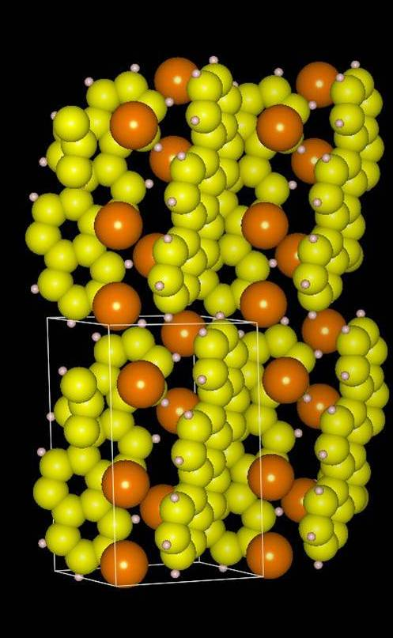
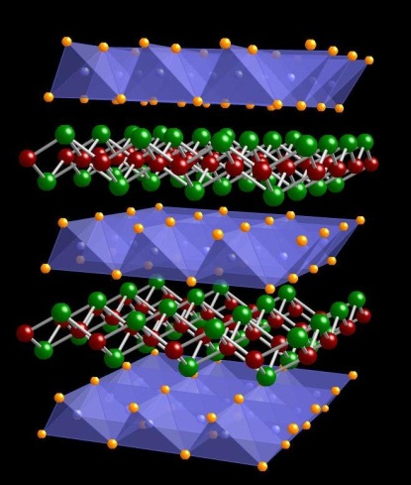
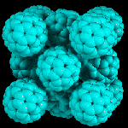
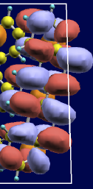
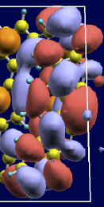
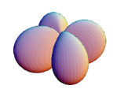
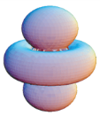
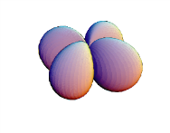




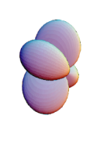


Cuprates Iron-based Fullerene Aromatic
Tc / pairing symmetry:
∼ 130 K / d ∼ 50 K / s±, mat-dep ∼ 33 K / s ∼ 30 K / ?
d-orbitals d-orbitals molecular orbitals
(dx²-y², dz²) (dxy, dyz, dz²) ((near) deg LUMO's)
Multi-orbital SC

Slide 3

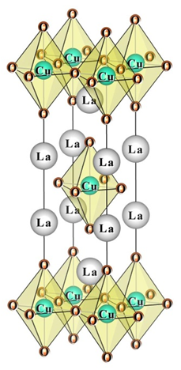
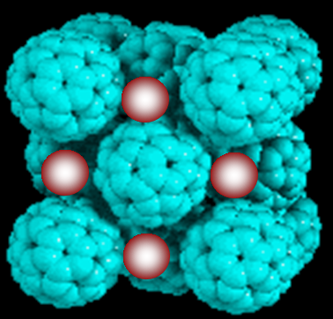
Cuprates
Fullerene
p_{x}
p_{y}
p_{z}

Slide 4
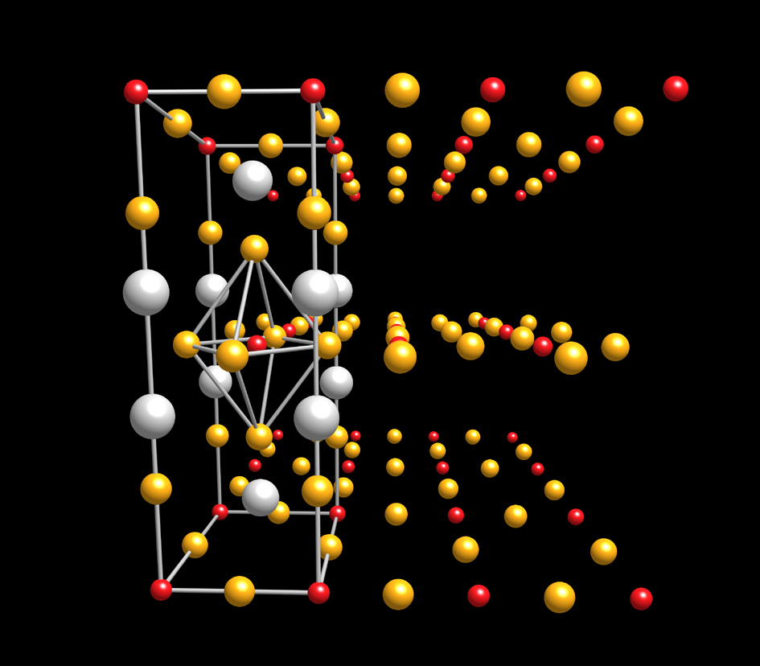
Cuprates: still a lot of puzzles
Wgy
La₂CuO₄: Tc ~ 40K
HgBa₂CuO₄: Tc ~ 90K
A long-standing puzzle
Why so much
different T_{c}'s?
Cu
O

Slide 5
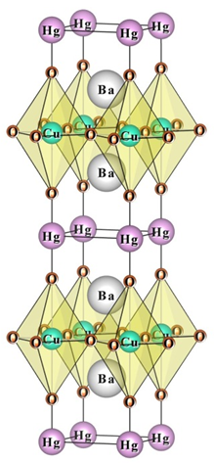
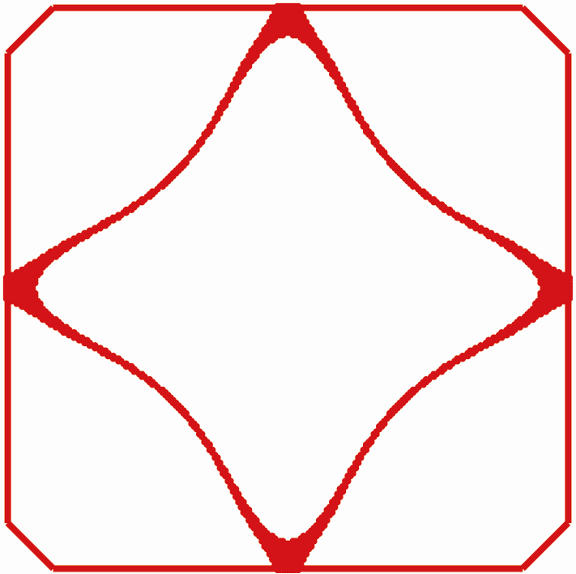
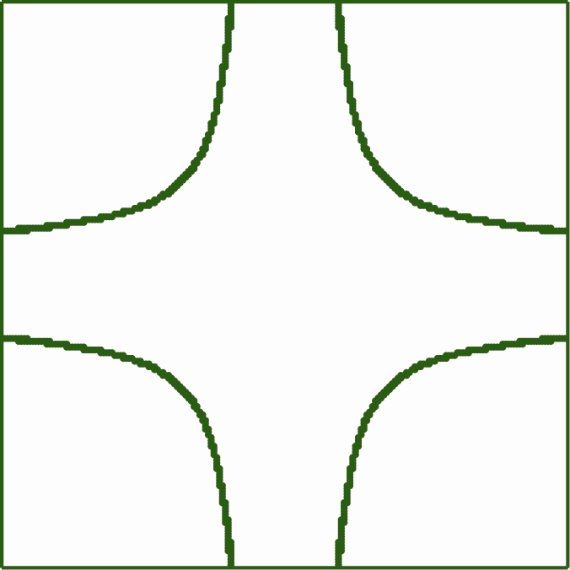
experiment
La: Tc ~ 40K
<
Hg: Tc ~ 90K
contradiction!
theory
Fermi surface
(Pavarini et al, PRL 2001)
← well nested
Tc (La) Tc (Hg)
>
[FLEX (Bickers et al, PRL 1989);
DCA (Maier et al, PRL 2000;
Kent et al, PRB 2008 (O(p) included))
for realistic values of U ]
cf. t-J model: enhanced SC for rounded FS
(Shih et al, PRL 2004; Prelovsek & Ramsak, PRB 2005)

Slide 6
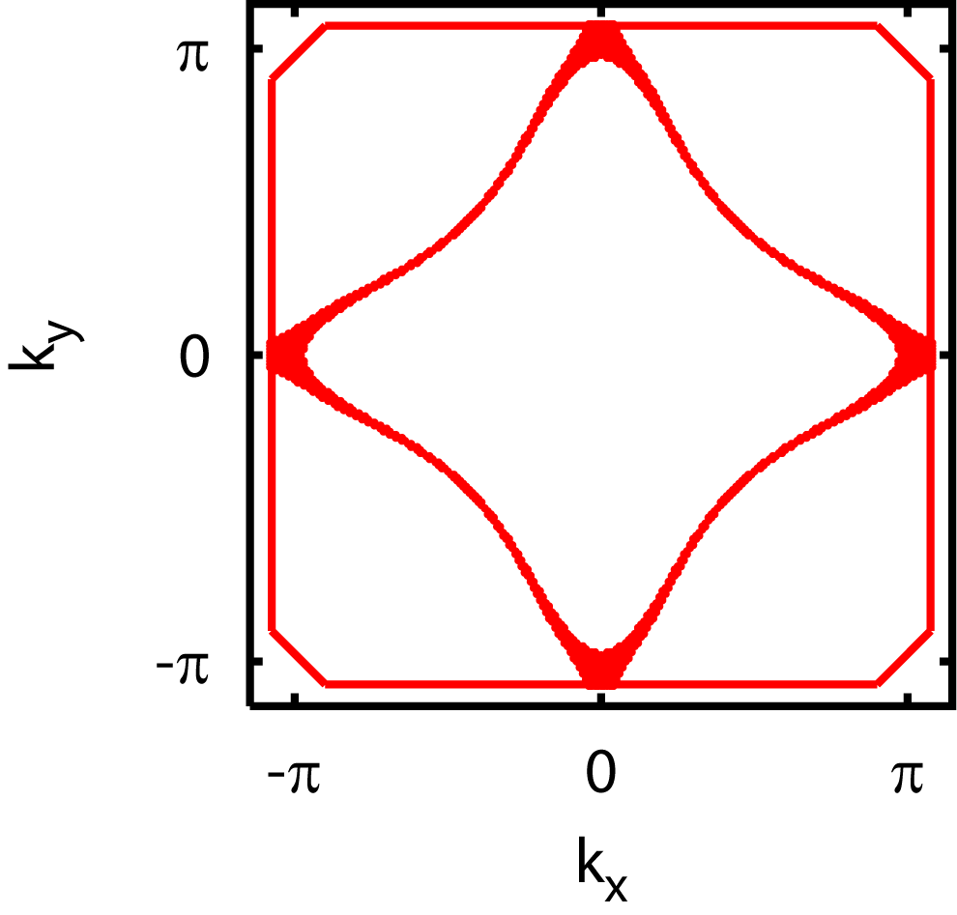
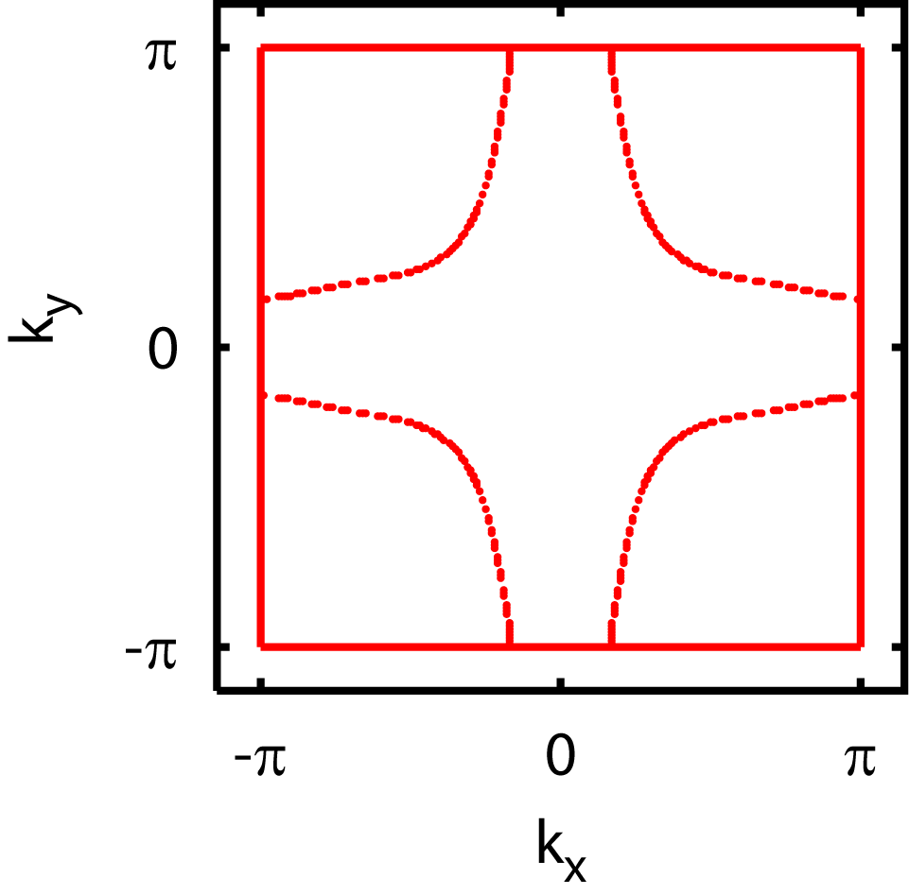
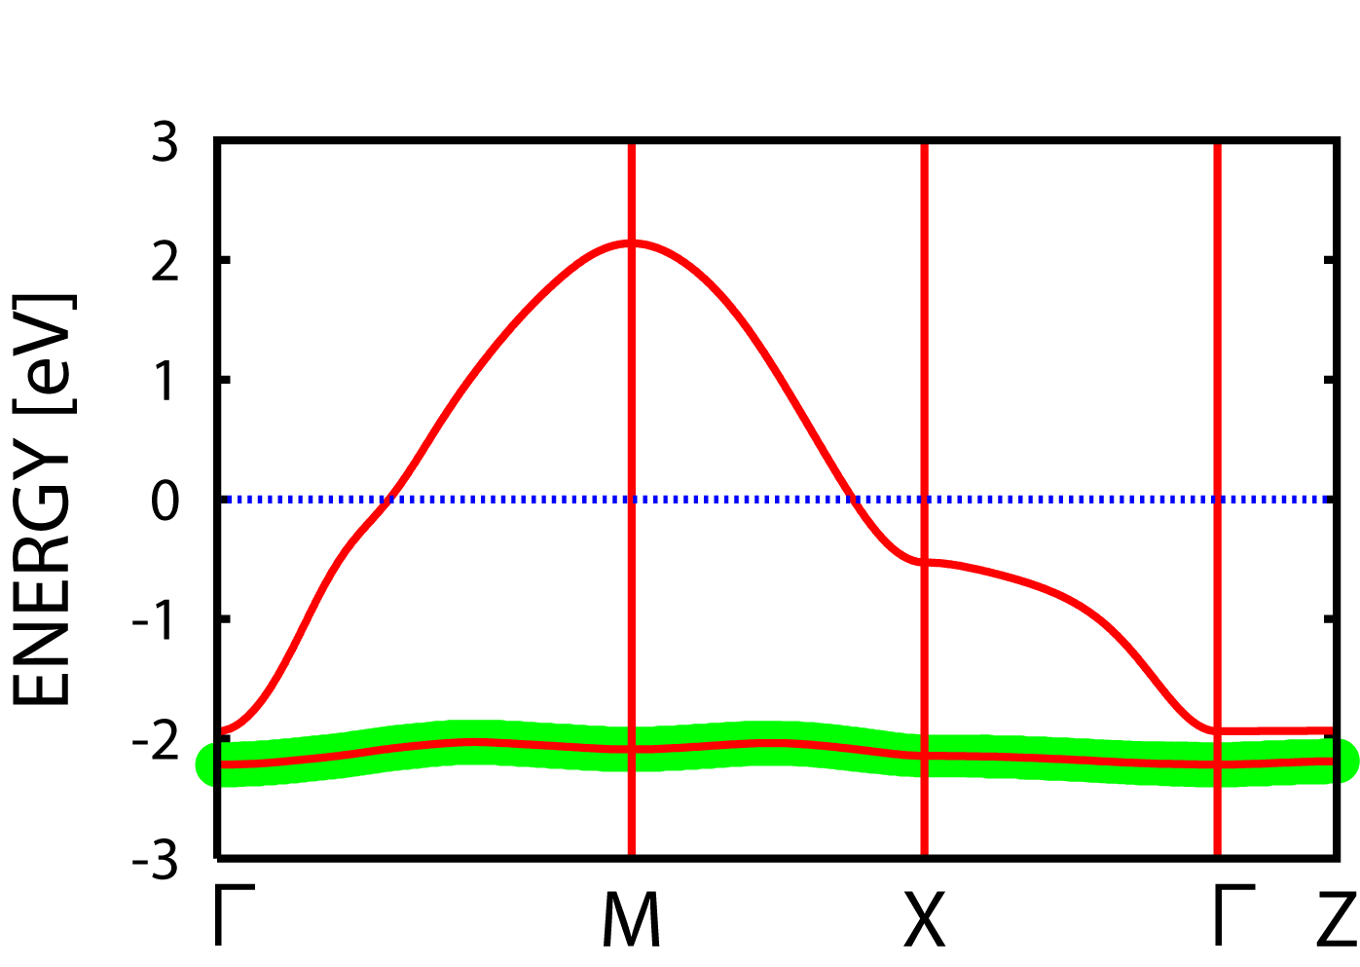
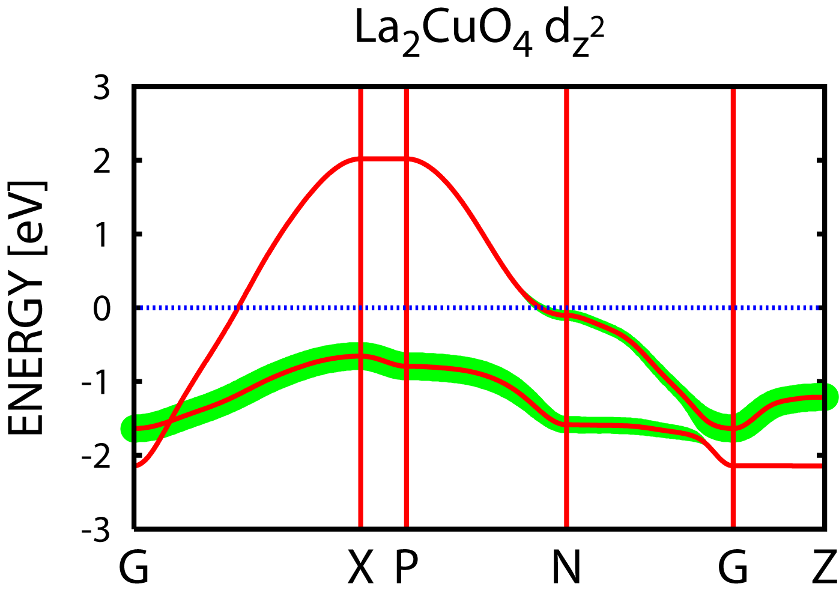
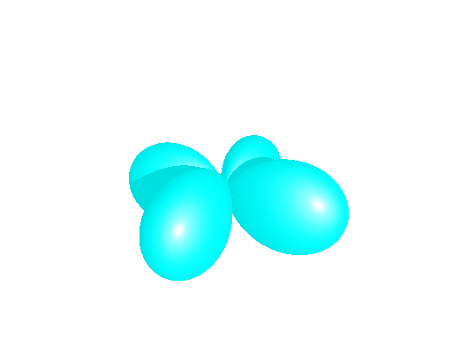
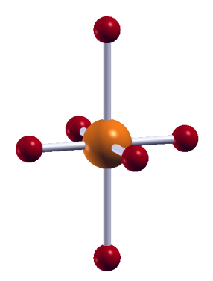
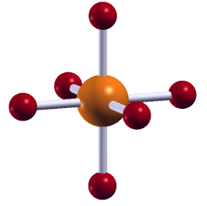
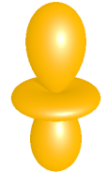

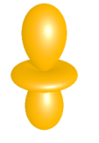
La (40K)
Hg (90K)
(Sakakibara et al, PRL 2010)
d_{x}2_{-y}2
d_{x}2_{-y}2
O
2.42Å
2.78Å
smaller
xtal field
Cu
d_{z}2
Γ
Γ
d_{z}2
d_{x2-y2}
d_{x2-y2}
(Freeman et al, 1988;
Di Castro et al, 1991)
d_{x2-y2}
d_{z2}
0.91 eV
d_{z2}
2.19 eV
d_{z2}

Slide 7
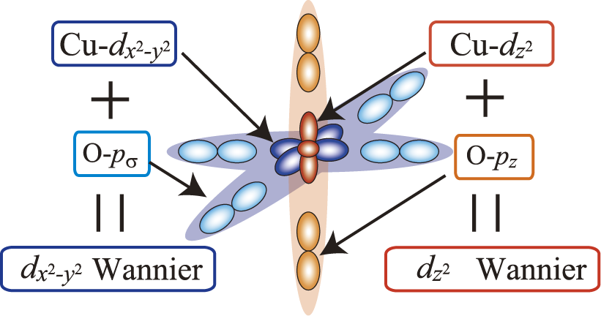
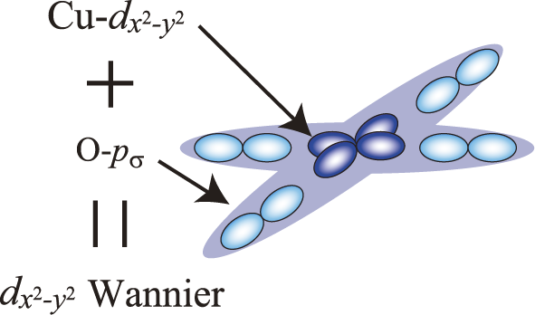
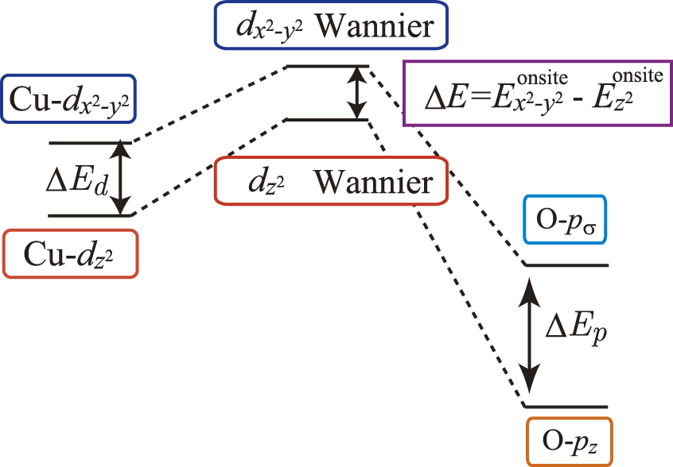
(Sakakibara et al, PRL 2010)

Slide 8
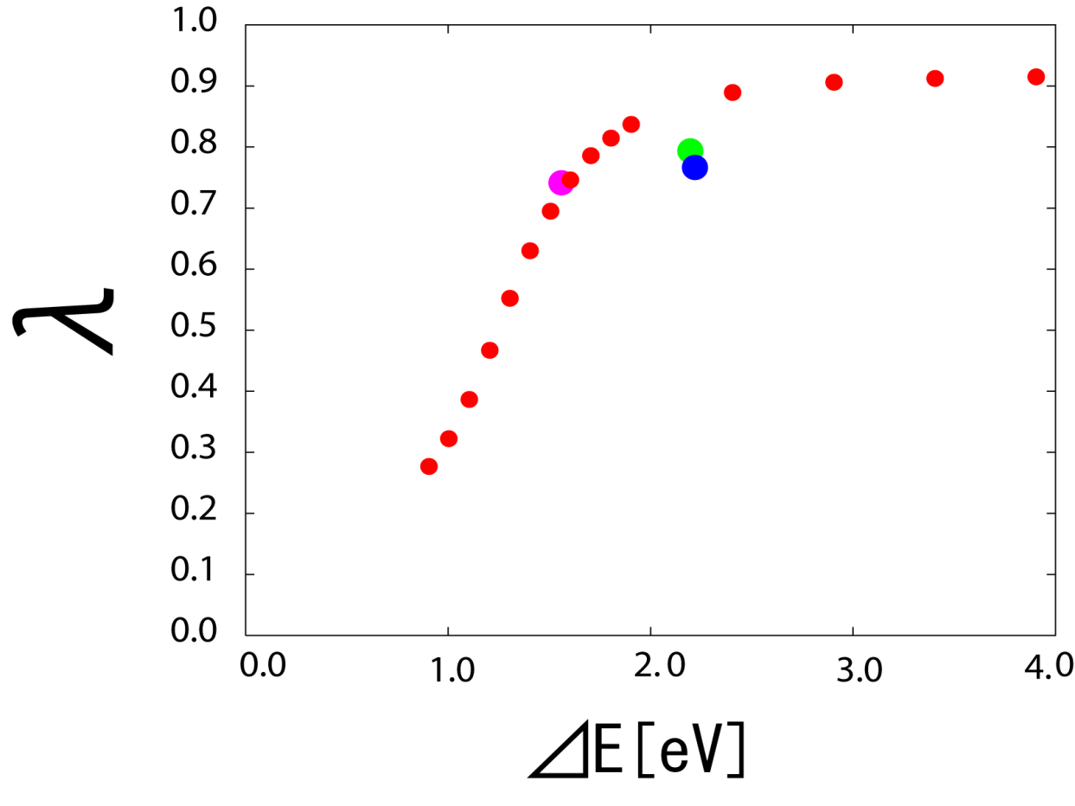
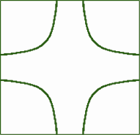

Multi-band FLEX result: key parameter = ΔE
(Sakakibara et al, PRL 2010)
Hg(90K)
Tl(90K)
nesting < 1-band character
La(40K)
d_{x2-y2}
better nesting
d_{z2}
single-band

Slide 9
Why the second band tends to suppress Tc ?
Sign-reversed Δ
Sign-preserved Δ

Slide 10
What determine the FS shape?
single-orbital
two-orbital
opposite signs
d_{z2}
hence
controlls the FS
Notes:
10

Slide 11
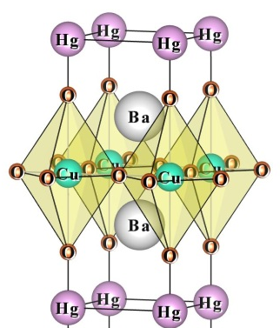
Material dependence of ΔE_{d}
Crystal field

Slide 12
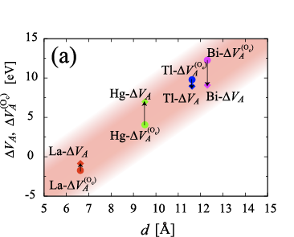
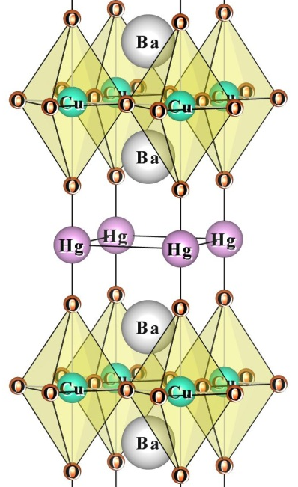
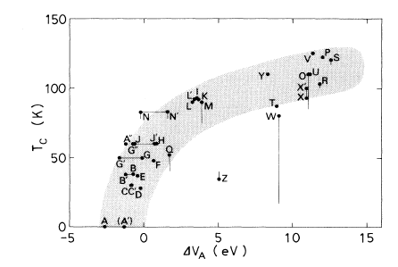
ΔE_{p}
O_{in-plane}
O_{apical}
cf. Ohta et al, PRB, 1991;
Di Castro et al, PRL 1991

Slide 13
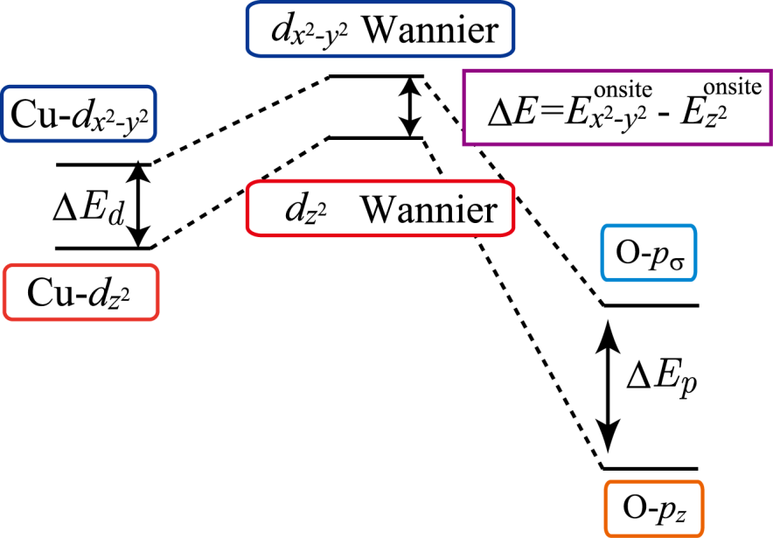
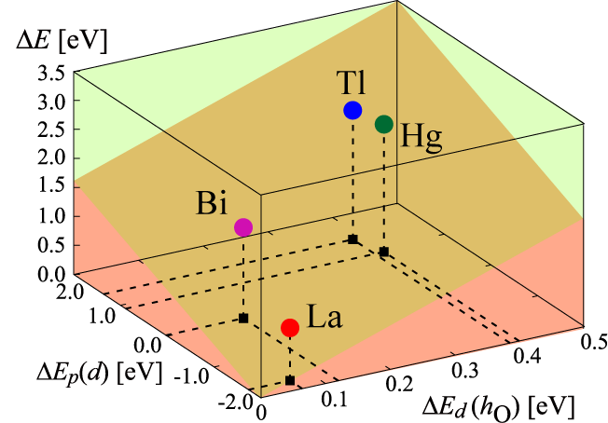
Summary of the material dependence of ΔE
(Sakakibara et al, PRB 2012)
Wannier
Wannier
ΔE = E_{x 2-y 2} - E_{z 2}
Δ

Slide 14
Science 2011
Pressure effect

Slide 15
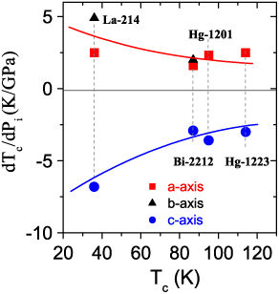
Pressure effect in cuprates: Exp results
T_{c} ↑
T_{c ↓}
(Hardy et al. PRL 2010)
hyrostatic p + axis-resolved thermal exp.
→ Ehrenfest relation → uniaxial p effects

Slide 16
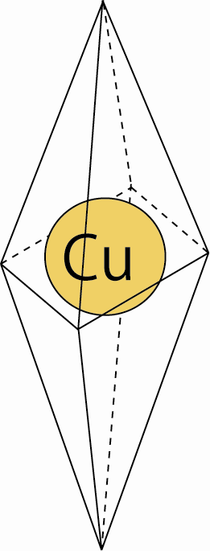
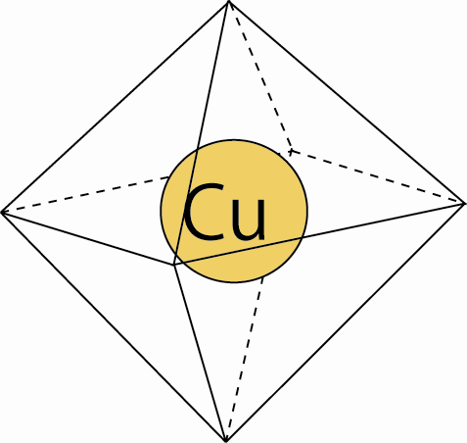

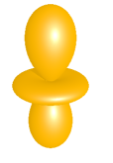

Pressure effect in cuprates: theoretical view
(Sakakibara, Suzuki, Usui, Kuroki, Arita, Scalapino & Aoki, PRB 2012)
c -axis
a -axis
T_{c} ↓
T_{c} ↑
d_{x2-y2}
ΔE
d_{z2}

Slide 17
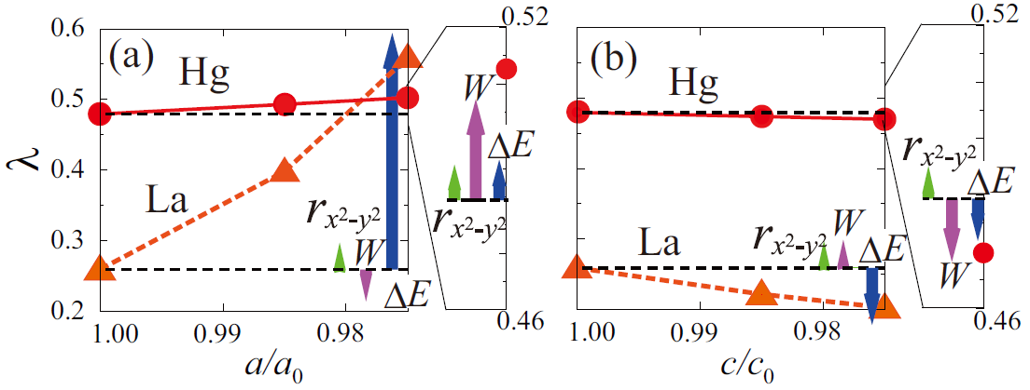

Uniaxial pressure
(Sakakibara et al, PRB 2012)
a - uniaxial
c - uniaxial
Hg
Hg
La
La
p effect decomposed → (1) FS shape through
(2) band width W
(3)
Wannier
Wannier
ΔE = E_{x 2-y 2} - E_{z 2}

Slide 18
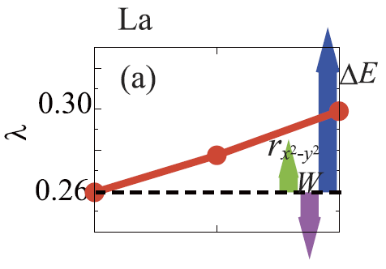
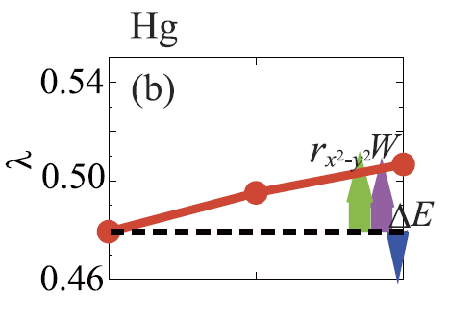


Hydrostatic pressure
(Sakakibara et al, PRB 2012)

Slide 19
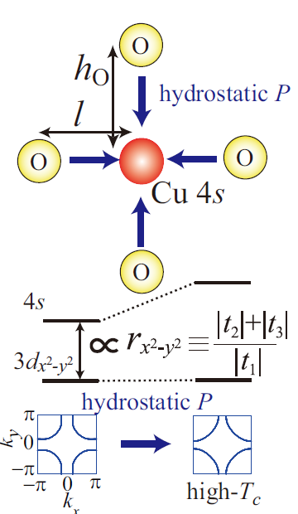
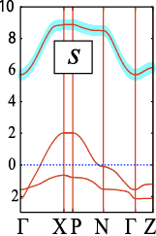

Effect of Cu (4s)
(Sakakibara et al, PRB 2012)
cf. in-plane O distance
(Jorgensen et al 1996;
Bianconi et al, 2001;
Poccia et al, 2010)

Slide 20

FS warping in the three-band model
(Sakakibara et al, PRB 2012)
3dx²-y²
4s
ΔE_{s} >> U
3dx²-y²
ΔE_{d} < U
3dz²
contribute to t’
with opposite signs
(Sakakibara et al,
Proc. ISS 2012)
Notes:
20

Slide 21
Use this for a materials design
Nesting ↑ by a stronger Cu(dz²) hybrid. → Tc ↓
Nesting ↓ by a stronger Cu(4s) hybrid. → Tc ↓
Nesting ↓ by a weaker Cu(dz²) hybrid. → Tc ↑
Nesting ↑ by a weaker Cu(4s) hybrid. → Tc ↑
Materials design
(e.g., use d_{xy} orbits)
X
s
Notes:
21

Slide 22
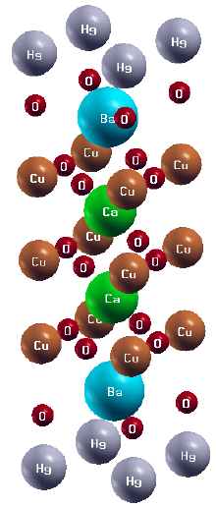
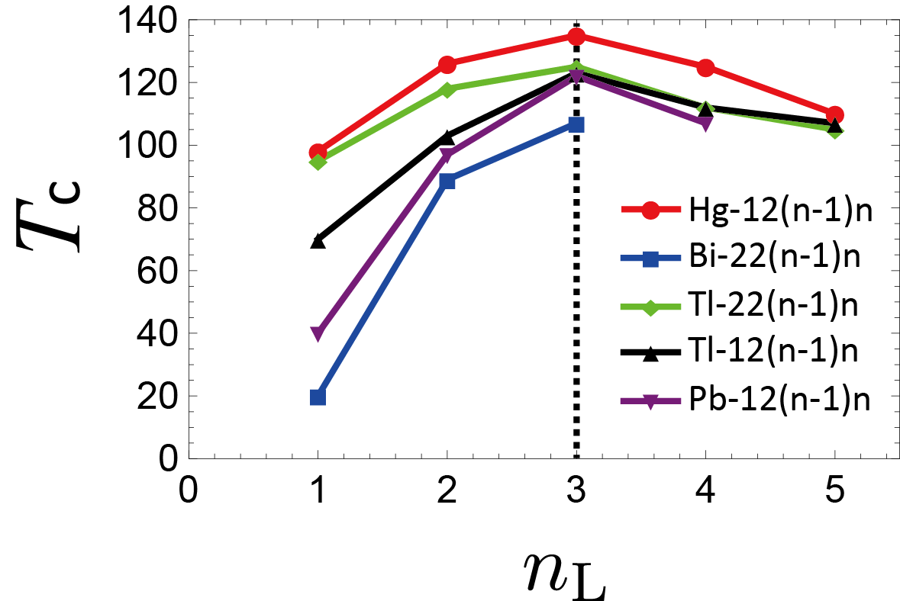
Cuprates: still a lot of puzzles (2)
HgBa₂Cu_{n-1}O_{n}: Tc ~ 98 → 135 K
n = 1 n = 2 n = 3
summary of experimental results

Slide 23
Theory for multi-layered cuprates
s± wave pairing
(Bulut & Scalapino, PRB 1992)
Cooper pair tunneling
(Chakravarty et al, Nature 2004)
Proximity effect of layers
(Leggett, PRL 1999)
…
⇒Microscopically ?

Slide 24
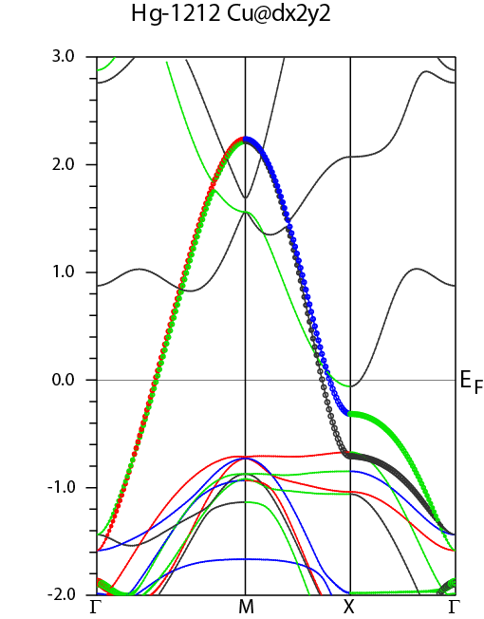
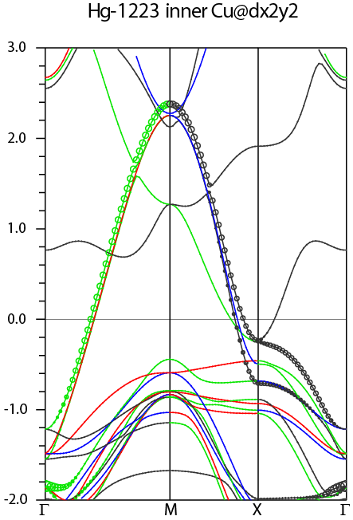






First-principles bands are similar
(Nishiguchi, PhD thesis 2013)
n = 1
(Hg-1201)
n = 2
(Hg-1212)
n = 3
(Hg-1223)

Slide 25

Inter-layer pair hopping
(Nishiguchi et al, PRB 2013)
First-principles estimate of the interlayer pair hopping ~ 30 - 60 meV (Kusakabe, JPCS 2012)

Slide 26





(Nishiguchi et al, PRB 2013)
Double-layer model:
U=2.5eV, U’=2|U’’|=0.5eV, k_{B}T=0.01
inter-layer pairing int.
(k-dep)
increased self-energy

Slide 27



n_{L} -dependence
(Nishiguchi et al, PRB 2013)
First-principles estimate of the interlayer pair hopping ~ 30-60 meV
(Kusakabe, JPCS 2012)
inter-layer pairing int.
increased self-energy

Slide 28



Carbon-based superconductors
room T
Fullerene:
Still the highest
Tc ∼ 40 K among C-based
liq N
oxides
LaOFFeAs
conventional
pentacene
Tc (K)
picene
CaC₆
liq ⁴He
GIC:
1st carbon-based,
Tc ∼ 12 K
organics
Aromatic SC
with Tc ∼ 30 K
KC₈
2008
2010
year

Slide 29
Strongly correlated
Fullerene Aromatic

Slide 30





Fullenene / aromatic --- strongly correlated !
(Nomura, Nakamura & Arita, PRB 2012)
0.5
band width W (eV)
0
cf. HTC cuprates:
U/W ∼ 1 - 2
U ∼ 1 eV from momentum-dep
EELS(Roth et al,
PRB 2011)
correlation (U-V)/W
1
phenanthrene
picene
coronene
Cs₃C₆₀
K₃C₆₀ Rb₃C₆₀
0
fcc A₃C₆₀
A15 Cs₃C₆₀
aromatic
lattice p
small
large
small
large

Slide 31
Fullerene Aromatic

Slide 32



(Tosatti, Science 2009)
Universal "Tc dome" for A₃C₆₀'s
(Takabayashi et al, Science 2009;
Ganin et al, Nature 2010)

Slide 33


Electronic band structure of A₃C₆₀
Undoped
(Saitoh & Oshiyama, PRL 1991)
t_{1g}
t_{1u}
h_{u}
g_{g} h_{g}
3-fold deg LUMO
cb
E (eV)
vb
3-fold deg t_{1u} ∼
p_{x} p_{y} p_{z}

Slide 34



Tc vs correlation strength in A₃C₆₀
fcc A₃C₆₀
A15 Cs₃C₆₀
"Tc dome"(Ganin et al, 2010)
(Nomura et al, 2012)
p
p

Slide 35




Conventional or unconventional SC?
ー Density functional theory for superconductors(SCDFT)
← Kohn-Sham formalism for SC orders
(Lüders et al, PRB 2005; Marques et al, PRB 2005)
□ EXPT
□ SCDFT
EXPT
Tc [K]
SCDFT
K₃C₆₀ Rb₃C₆₀ Cs₃C₆₀
unconventional SC
(Akashi & Arita, arXiv:1303.5138)
conventional SC
unconv
(Akashi et al, PRB 2012)
but s-wave ← Hebel-Slichter peak

Slide 36




strong el-el + strong el-ph
W (0.5 eV) ～ ℏω(0.2 eV) ～ U (1 eV)
adiabatic / antiadiabatic
Hg
Saito & Oshiyama, 1991
Hebard 1992
Durand et al, 2003
electron-phonon coupling
Holstein-Hubbard model:
(DMRG: Tezuka et al, PRL 2005; Baueret al, PRB 2010.
DMFT: Werner & Millis PRL 2007)
phonon freq
electron-electron int

Slide 37


SC in Holstein-Hubbard model
* Depends on band str
t ’
(Tezuka, Arita & Aoki, PRL 2005)

Slide 38
Science 2011
Effects of retardation in phonon-mediated interaction?

Slide 39

Tc (U) dome
Attractive Hubbard
BEC
BCS
Holstein-Hubbard ?
QMC result
Repulsive Hubbard
Weak coupling
Strong coupling
∼ 1
U/W

Slide 40



SC in Holstein-Hubbard model
U _{eff} = U - (ph-mediated attr) can be a bad measure
(Murakami, Werner, Tsuji & Aoki, PRB, in press)
Tc dome shifts with ω₀
Tc dome shifts with U
BEC
BEC
12
unretarded
BCS
BCS
3
6
U=8
4
1
0
ω₀=1.4
= 2g²/ω₀
= - (U - 2g²/ω₀₎)
organic SCs
(ω₀ ~ W/4)

Slide 41



Mass-renormalised Tc dome
(Murakami et al, PRB, in press)
Eliminate phonons
(Lang-Firsov tr; exact for ω₀ → ∞)
→ renormalised electron hopping

Slide 42



Superfluid density; 2Δ/k_{B}T_{c}
(Murakami et al, PRB, in press)
ω₀ → ∞
unretarded
BCS (=3.528)
ω₀ → ∞
unretarded
BCS (=3.528)

Slide 43


(Science 2012)
nonequilibrium fs spectroscopy
+ frequency resolution
electronic strong-coupling phonon other phonons
(λ ∼ 1.1 λ ∼ 0.4 λ ∼ 0.2)

Slide 44

Can we dynamically control U
(in both electron & cold-atom systems)?
©Esslinger, Annu. Rev. Condens. Matter Phys. 2010
attraction ← repulsion
(cold atom: Feshbach res)
U < 0
U > 0
Notes:
The motivation of the present study is to find a way to control the electron-electron interaction with external fields, such as lasers. What will happen if I can effectively change the interaction?
Here is the schematic phase diagram of interacting electron systems. On the right hand side, the interaction is repulsive, that is U>0. On the left hand side, the interaction is attractive.

Slide 45




Repulsive Hubbard + laser
-(non-equilibrium)→ attractive Hubbard
(Tsuji, Oka, Werner & Aoki, PRL 2011)
t _{eff} / t
Bessel function
cb
vb
amplitude / Ω of ac
Positive U, negative T
←→ Negative U, positive T
(T < 0)

Slide 46




all superconducting
(when doped)
fullerene
aromatic
graphite
diamond

Slide 47


GIC
SC in graphene?
Chiral SC?
(Nandkishore et al, nature phy 2012)
CaC_{6,} 1st principles DFT
(Gross’s group, PRB(R) 2007)
Bilayer CaC₆ -- a thinnest GIC
(Kanetani et al, PNAS 2012)

Slide 48



cf. Superconductor β-MNCl (M=Hf, Zr)
●: M, ○: N
1st BZ
E_{F}
+ e^{iπ/3}
+ e^{i2π/3}
(Kuroki, 2008)
= d + id
(same as that proposed for graphene)

Slide 49
Science 2011
Anything peculiar in 3-band SCs?

Slide 50


Three-band SCs with all repulsive g_{ij} can be exotic
(Ota, Machida & Aoki, PRB(R) 2011)
Nambu-Goldstone (phase) mode
→ multiple Leggett modes for 3-bands
g₃₁
g₁₂
All repulsive g_{ij}'s
Δ⁽¹⁾
Δ⁽²⁾
mass difference
g₃₁
g₂₃
Δ⁽³⁾
g₁₂
g₂₃=-0.07

Slide 51


“Frustration” in three-band SC
→ complex (T-reversal broken) Δ
(Stanev & Tesanovic, PRB 2010;
Ota et al, PRB(R) 2011)
when |g₁₂| ～ |g₂₃| ～ |g₃₁|
← a candidate: A15
(Mukherjee et al, PRB 2011)
Im Δ
Δ₁
g₃₁
Δ₃
g₁₂
Re Δ
g₂₃
Δ₂
A15 fullerene

Slide 52


Iron-based: subtlely from three-orbital components
(Kuroki et al, PRB 2009)
dYZ
(dxz)
β₂
dX²-Y²
(dxy)
dXZ
(dyz)
α
β₁

Slide 53






Iron-based: subtlely from three-orbital components
Fernandes & Millis, PRL 2013
s+id
s+- d s+-
s+d

Slide 54





Hydrogen doping for the iron-based
(Iimura, …, Hosono, nature commun 2012)
F-doping
H-doping
(Suzuki, …, Hosono, JPSJ 2013)
Spin-fluctuation mediated s±

Slide 55

Iron-based: Dirac points → Spin Hall effect
(Pandey, Kontani, Hirashima,
Arita and Aoki, PRB(R) 2012)
Spin-orbit → mass gap
→ SHE as large as in Pt

Slide 56
Science 2011
Higgs (amplitude) mode

Slide 57


Higgs mode in BCS (low-T) SC by THz pulse excitation
(Matsunaga et al, PRL 2013)

Slide 58
Fullerene Aromatic

Slide 59


K-doped picens: Electronic structure
Kosugi et al (JPSJ 2009; PRB 2011)
picene
K₃picene
cb
CB4
CB3
CB2
CB1

Slide 60




Theoretically optimisation → multiple metastable structures
(Kosugi et al, PRB, 2011;
Kariyado & Aoki, arXiv:1307.5954,
for the latest exptl lattice parameters)
K₂K₁picene
K₃picene
FS: very sensitive to multiple metastable structures

Slide 61




Pressure effects
K2K1picene
(Kariyado & Aoki, arXiv:1307.5954)
p
K3picene
Lifshitz transition
100%
96%
p

Slide 62





How orgaics differ from inorganis? --- large flexibility
Distance between
molecules
2. Multiple MO’s
3. Non-rigid bands against
doping / pressure
a
p
b
p
p
(Okada et al, CPL 2004)

Slide 63
Summary
Cuprates Iron-based Fullerene Aromatic
Multi-orbital SC
*
* manipulated by p, nonequilibrium, etc
Future problems
✔ Further comparison between various classes of SCs
✔ Materials design / control
. . .

Slide 64








Kazuhiko Kuroki, Hidetomo Usui now at Osaka Univ
Hirofumi Sakakibara, Katsuhiro Suzuki,
Univ Electro-Communications
Ryotaro Arita Univ Tokyo
Douglas J Scalapino UC Santa Barbara
Toshikaze Kariyado Univ Tokyo, now at Univ Tsukuba
Yuta Murakami, Naoto Tsuji Univ Tokyo
Philipp Werner Univ Fribourg

