Slide 1


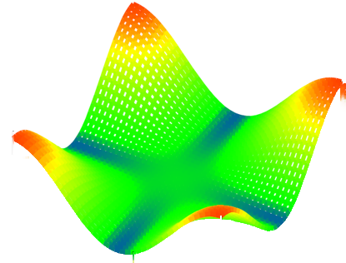
Superstripes2019
Ischia, 23 June 2019
Theoretical possibilities for flat-band superconductivity
Hideo Aoki
Dept Physics, Univ Tokyo, Japan
&
AIST, Tsukuba, Japan
Notes:
Thank you for the introduction. I'd first like to thank Prof. Esslinger for giving me a chance to talk here in this renowned colloquium. So let me talk about "Condensed-matter systems shaken, not stirred: non-equilibrium avenue to novel quantum phases". You might first wonder what this strange phrase "shaken, not stirred" means.

Slide 2
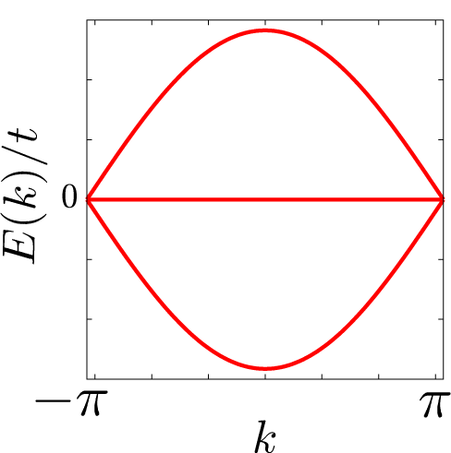
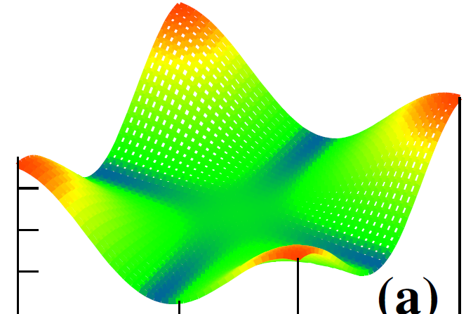
Today's talk
✔ Topological flat-band SC
(multi-band, 1D)
✔ Partially flat-band SC
(one-band, 2D)

Slide 3
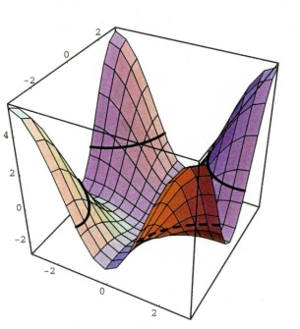
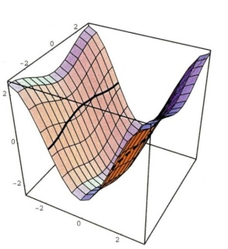
SC (pairing symm, Tc) sensitively depends on band structures
→ * How to engineer them ?
* Different pairing symmetries simultaneously ?
✔ My thesis: An interesting arena = flat-band systems

Slide 4


Which is most favourable for SC?
One-band
E
k
Multi-band
multi-orbital single-orbital
colour: orbital character

Slide 5
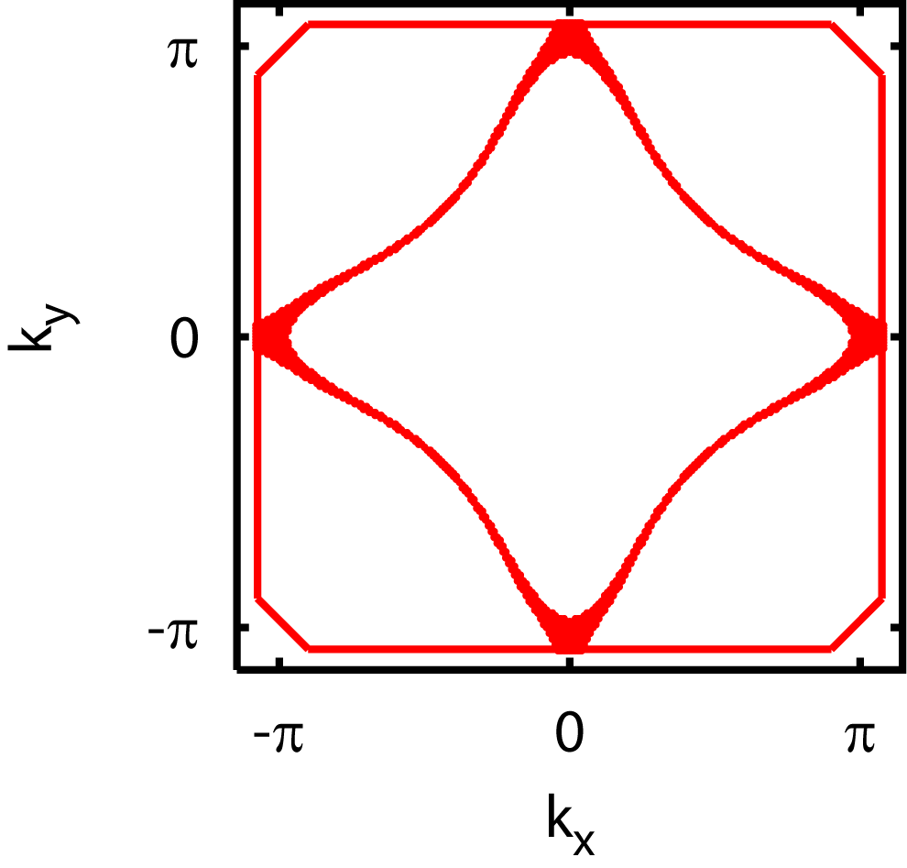
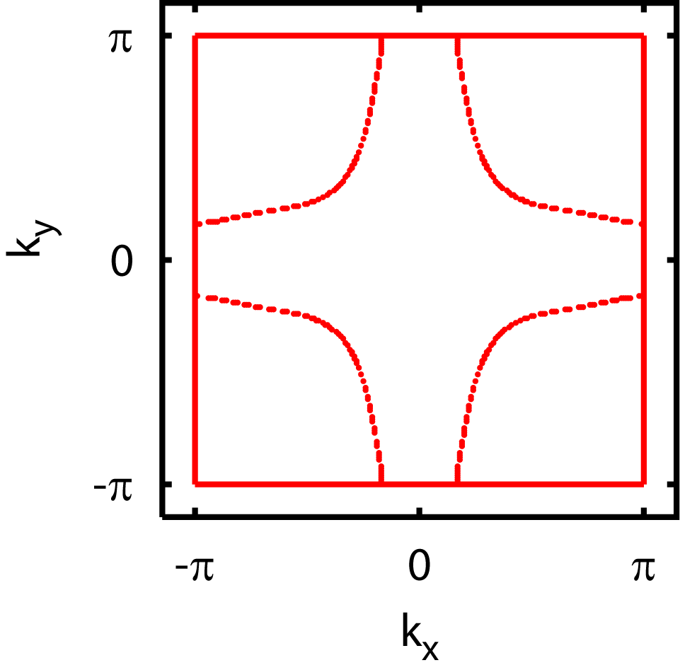
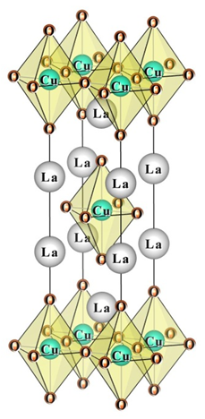
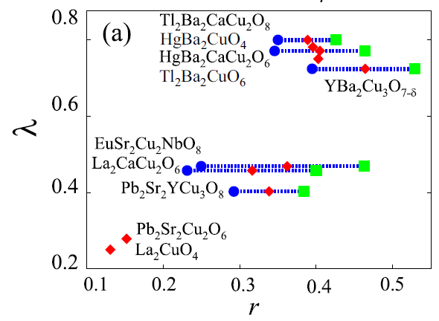
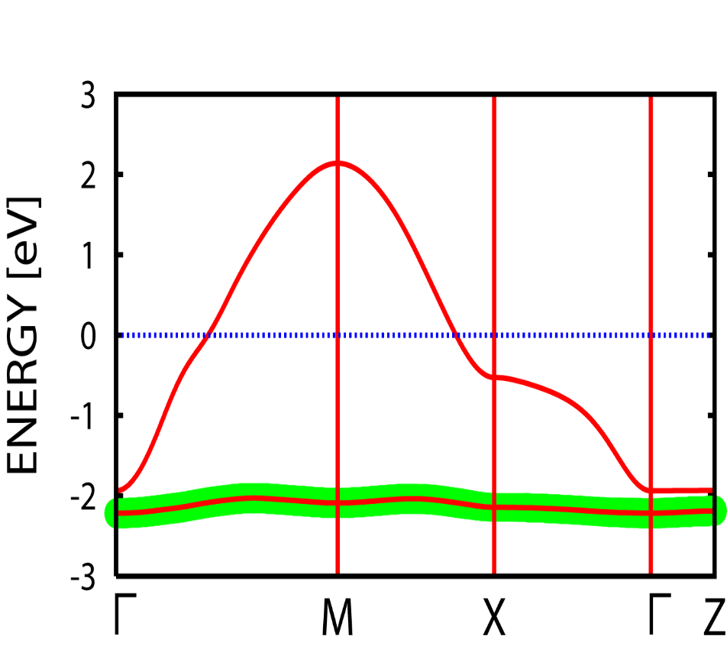
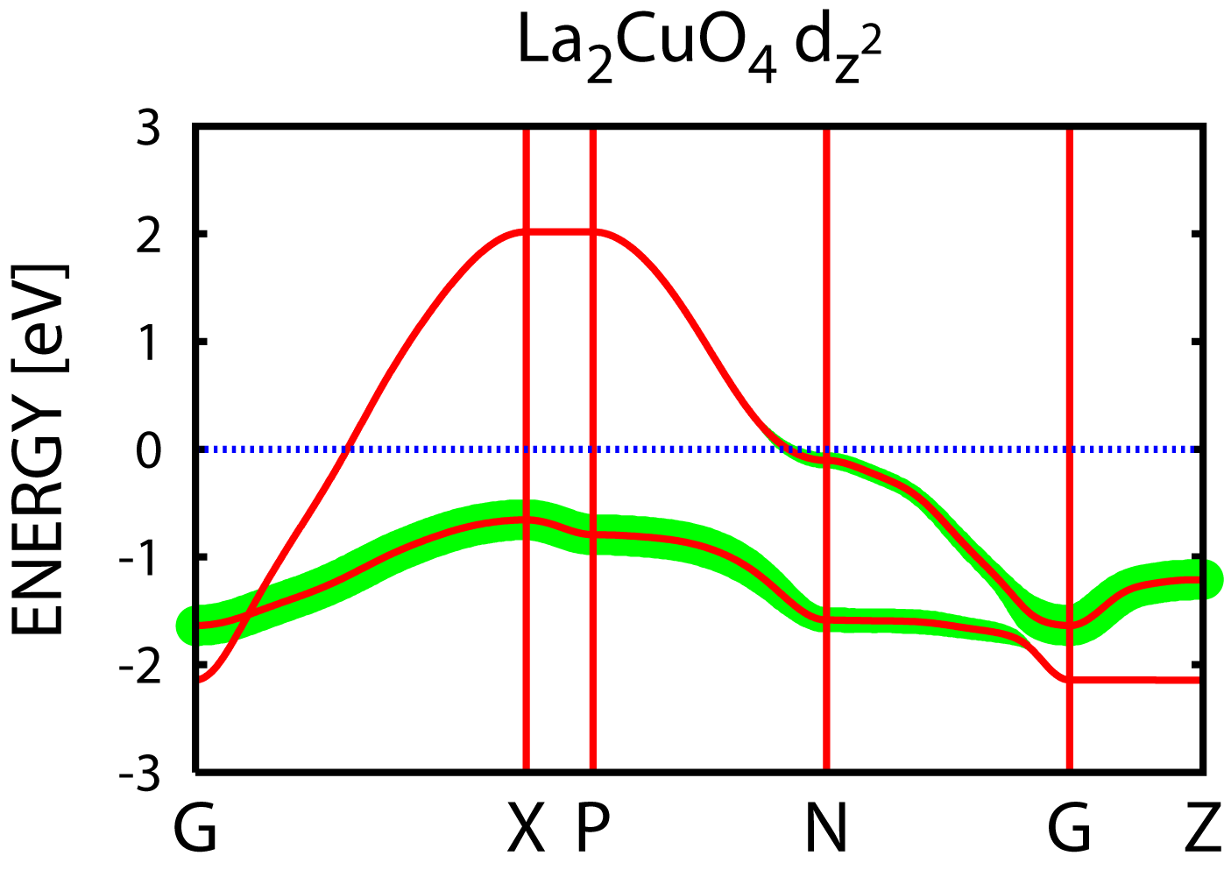
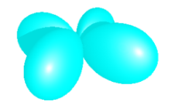

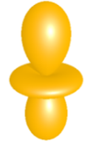
La
HTC cuprates
Hg
Tc = 40 K
<
Tc = 90 K
(Sakakibara et al, PRL 2010)
d_{x}2_{-y}2
d_{x}2_{-y}2
(1-band character)
(Sakakibara et al, PRB 2014)
d_{z}2
Γ
Γ
d_{z}2

Slide 6
When multi-orbital,
opt for one-band
When single-orbital,
opt for multi-band
E_{F}
colour: orbital character
✔ Multi-bands: should not be confused with
Multi-orbital systems
(single-orbital systems can be multi-band
depending on lattice structures, e.g., non-Bravais)

Slide 7
My question here:
What if
flat-band
(highly-entangled)
→ pairing interactions?

Slide 8
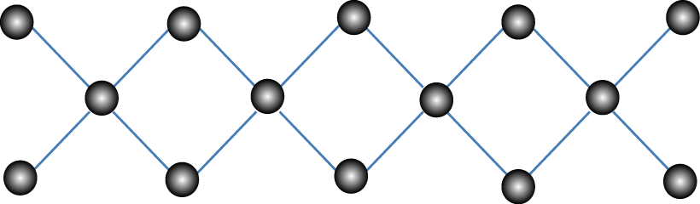
Flat-band SC in
repulsive Hubbard model
on diamond chain
(a simplest possible 1D flat-b)
(Kobayashi et al, PRB 2016)
"Narrow-wide band system"
(Kuroki et al, PRB 2005; Matsumoto et al, PRB 2018)

Slide 9

Pair-pair correlation (DMRG result)
(Kobayashi et al, PRB 2016)
Enhanced pairing when the flat band is incipient
at intermediate U ∼ 4
Unusually large m = 1500 required in DMRG
(anomalously large entanglement)

Slide 10
Phase diagram (DMRG)
(Kobayashi et al, PRB 2016)
0
1/3
1/2
2/3
1
SC adjacent to a topological phase
Flat-b F
TI
band filling
E_{F}

Slide 11

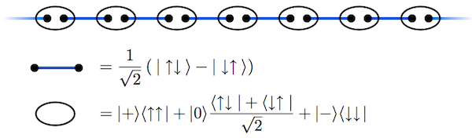
Topological when exactly 1/3 filled (ED result)
(Kobayashi et al, PRB 2016)
Entanglement spectra
Edge states
system
environment
cf. Haldane's S=1 AF chain
© H. Aoki
(Affleck et al, RPL 1987)

Slide 12
(Matsumoto, …, Kuroki, PRB 2018)
Flat-band SC ー rather general ?
E _{F} @ flat band
- dep on U, m *, model
(lattice, 2D or 3D, etc)
- related with Im Σ, …,
or outside the FLEX ?

Slide 13
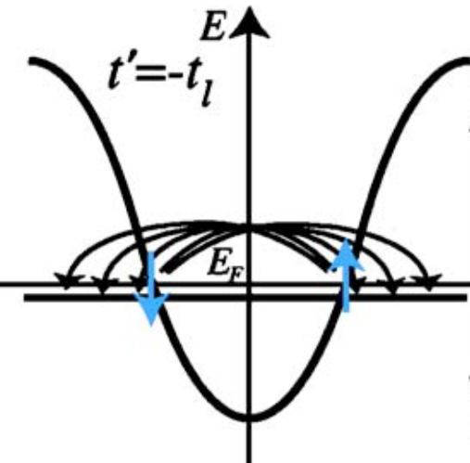
In more general terms, "incipient bands"
as in FeSe (Qian et al, PRL 2011; …)
E _{F}
+
+
+
+
-
incipient s±
Effective pairing interaction
in an incipient band(DCA: Maier, …, Scalapino, arXiv:1901.10563)
Originally, the concept of incipient bands introduced by
Kuroki et al's narrow/wide, PRB 2005

Slide 14
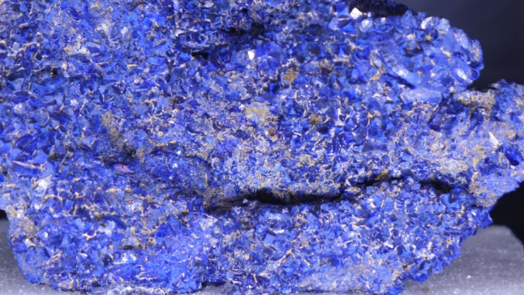
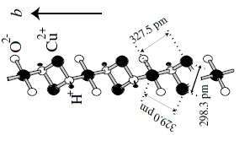
Real materials?
Mineral azurite "Hidden ladders" in Sr₃Mo₂O₇
∼ diamond chain
(Kikuchi et al, PRL 2005)
(Ogura et al, PRB 2017)
Can we dope this?
© H. Aoki
Eliashberg λ similar to
HgBa₂CuO₄ (Tc ∼ 90 K)

Slide 15
Today's talk
✔ Topological flat-band
superconductivity
(multi-band, 1D)
✔ Partially flat-band
superconductivity
(one-band, 2D)

Slide 16


Can we do even better than ?
--- partially-flat one-band systems
(Sayyad..., Aoki, arXiv:1903.09888)

Slide 17
A general idea
single-orbital
one-band
multi-orbital
one-band
single-orbital
multi-band
What if
Simplest possible
→ still, many
pair-scattering channels
E_{F}
colour: orbital character
(Sayyad et al,
arXiv:1903.09888)

Slide 18

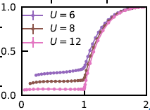
Truncated flat band
Hubbard model with DQMC
--- SC for attractive U, Mott insulation for repulsive U
(Huang, ..., Vaezi, arXiv:1811.08848)
cosine band

Slide 19
SC for repulsive U with FLEX+DMFT
(Sayyad et al, arXiv:1903.09888)
t-t' model
Truncated(iPFB) model
t
t'

Slide 20



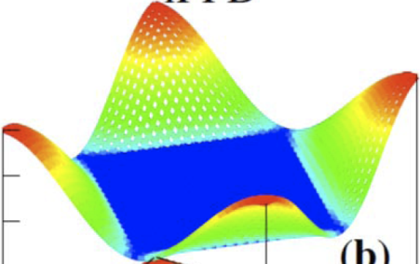
Double occupancy
FLEX+DMFT, DQMC (Sayyad et al, arXiv:1903.09888)
t-t' model
correlation (DO) emerges
(i)well below half-filling
(ii)even for small U
electrons crammed
into the flat portion
iPFB model

Slide 21
Spin susceptibility χ_{s}
t-t' model
k_{y}
iPFB model
(Sayyad et al, arXiv:1903.09888)

Slide 22

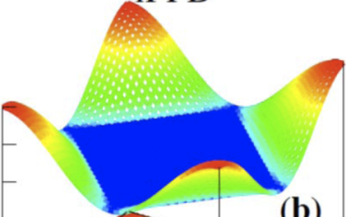
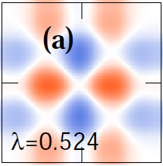
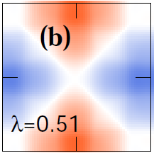
Eliashberg λ
iPFB, singlet
cosine band, singlet
t-t', singlet
Eliashberg
iPFB, triplet
t-t', triplet
(Sayyad et al, arXiv:1903.09888)

Slide 23


Singlet
Gap function
Triplet
t-t' model
iPFB model
(Sayyad et al, arXiv:1903.09888)

Slide 24

Singlet
Triplet
t-t' model
Pairing in real space
(Sayyad et al, arXiv:1903.09888)

Slide 25

Singlet
Triplet
iPFB model
Pairing in real space:
unusually extended
(Sayyad et al, arXiv:1903.09888)

Slide 26


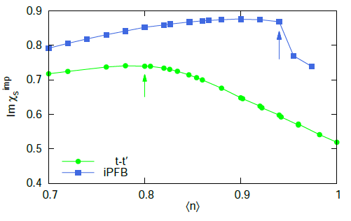
Non-Fermi liquid properties
(Sayyad et al, arXiv:1903.09888)
α = 1
(a bad metal has α < 0.5)
cf. Werner et al (PRB 2016)
on a cuprate model
n
iPFB
t-t'
Spin susceptibility

Slide 27
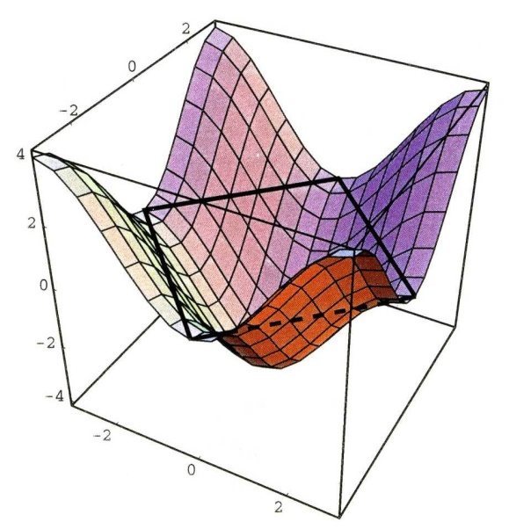
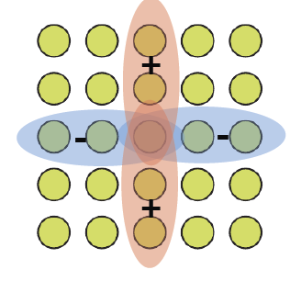
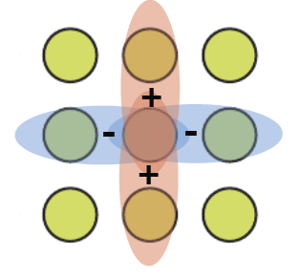
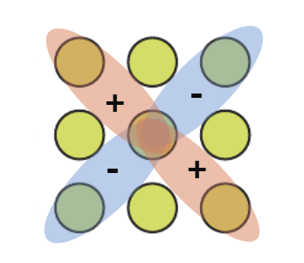
Pairing in k- and real-spaces
(Sayyad et al,
arXiv:1903.09888)
single-orbital, multi-o, flat-band,
one-band multi-b single-o, one-b
k -
space
real
space
"hot-spot" mom-transfer
"flat-part" transfer
I
I
d s+-
(Hosono & Kuroki, Physica C 2015)

Slide 28
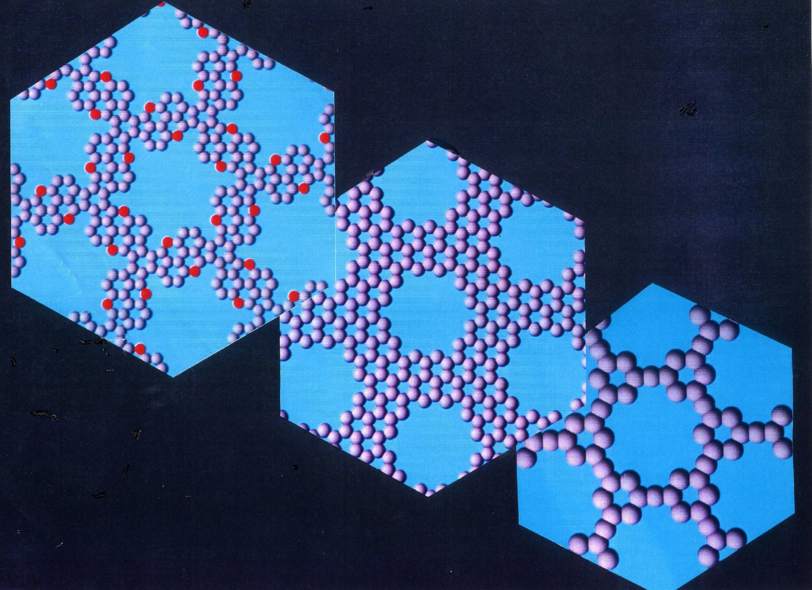
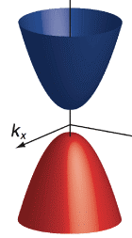
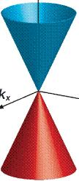
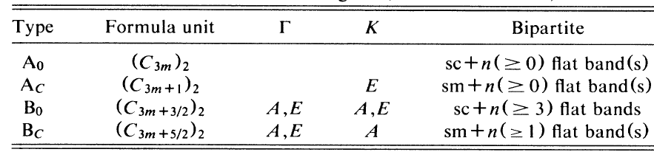
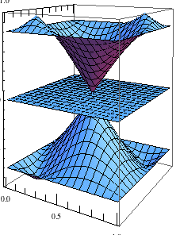
Long-period graphene (graphene nanomesh)
α
A₀
α
A_{C}
(Shima & Aoki,
PRL 1993)
β
β
semic
Dirac cone
α
B₀
B_{C}
manipulation
α
β
semic
flat band
1D rep
E
A, E
A, E
2D rep
A, E
A, E
β
flat band
Dirac cone

Slide 29

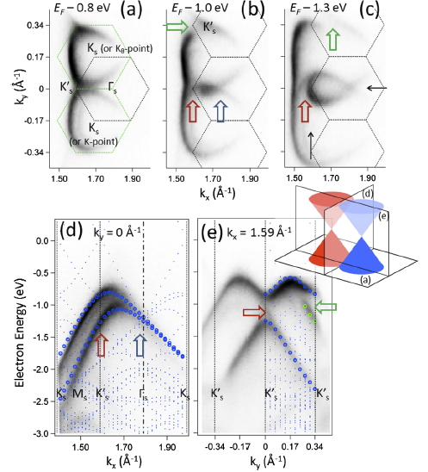
Subsequent refs on graphene nanomesh
* Bai et al, nature nanotech 2010: graphene nanomesh
* Naumov et al, PRB(R) 2012: 1st principles el str of graphene nanomesh
* Liu et al, Small 2013: chiral symmetry in nanomesh
* Petersen et al, Physica E 2012: Clar sextet (a measure of aromaticity)
* Pedersen et al, PRL 2008: spin qubit
* Ouyang et al, ACS Nano 2011: classification of graphene antidot lattice
* Ohta et al, PRL 2012: Moire periodicity in twisted bilayer graphene

Slide 30
Superconductivity in bilayer graphene
(Cao…, Jarillo-Herrero, nature 2018)
k_{x}
(Po, ..., Vishwanath, PRB 2019)

Slide 31

v_{group} = 0 at a point: van Hove sing. → topological SC (d+id, etc)
(Liu et al, PRL 2018)
+ i
v_{group} = 0 in finite areas in partially-flat band
d ↔ p can occur
(Sayyad et al, arXiv:1903.09888)
possibility of topological(p+id, etc)SC ?
esp. for hexagonal lattices

Slide 32
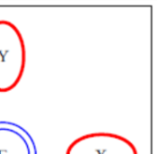
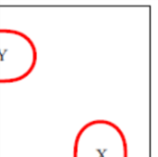
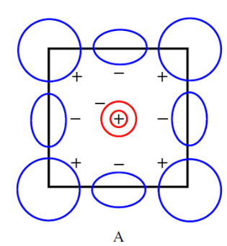
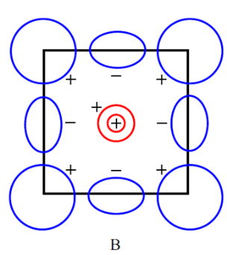
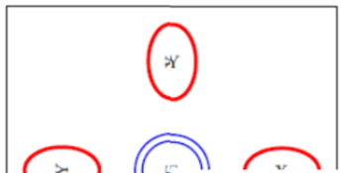
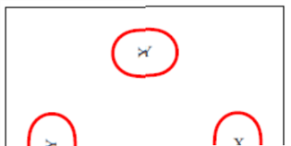
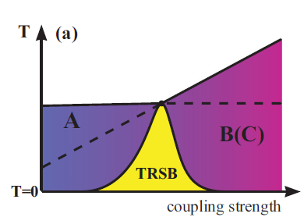
Coexisting pairing symmetries → T-broken SC
- Examples from iron-based SCs
s+- d
s+-(A) s+-(B)
"122": Fernandes & Millis, PRL 2013
LiFeAs: Ahn et al, PRB 2014

Slide 33
Can flat bands really favour SC ?
(1)

Slide 34
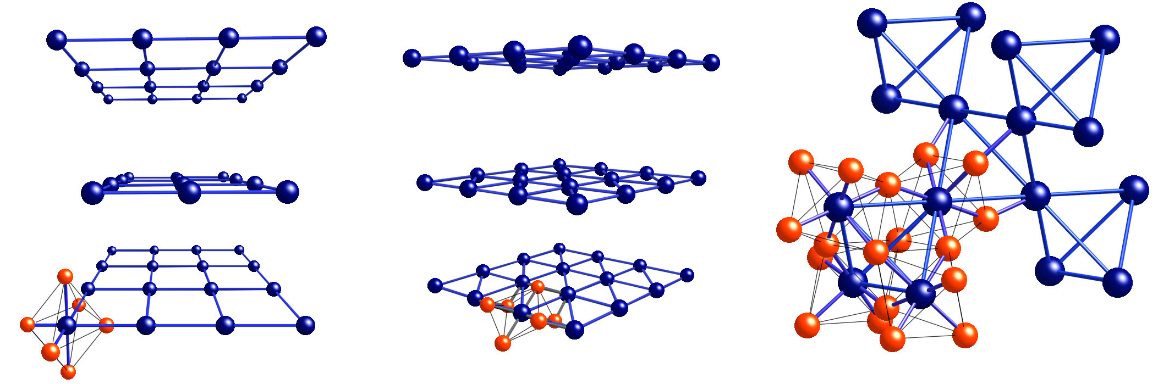
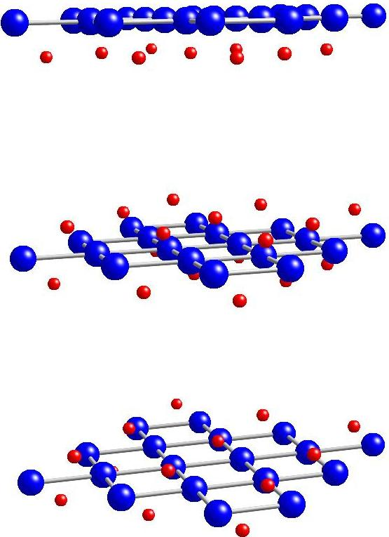
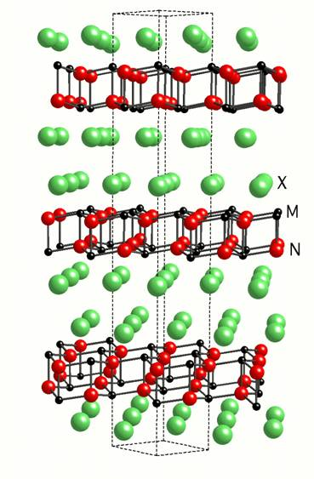
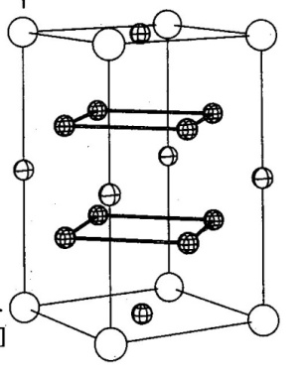
Usually, SC from el-el repulsion works better in 2D
Large spin-fluct mediated
pairing int.
q2D 3D
+
-
+
-
-
+
>
-
-
+
Q_{z}
+
k_{y}
k_{y}
+
-
k_{z}
Q_{x}
Q_{x}
(Arita et al, 1999;
Monthoux & Lonzarich, 1999)
Usual HTC
Cu, Ru compounds Co compound Hf compound Ce compound Fe compound

Slide 35
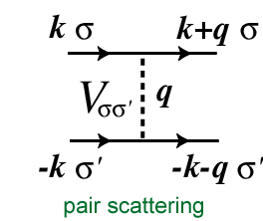
Spin- and charge-fluctuation mediated pairing
⊗ Green's f
V_{singlet} :
ー
＋
V_{triplet} :
＋
＋

Slide 36
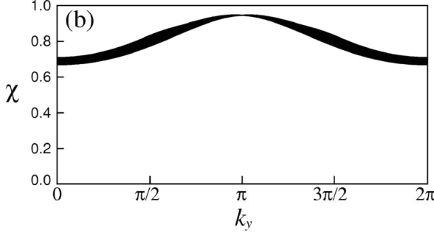
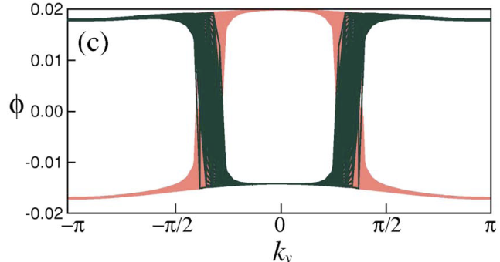

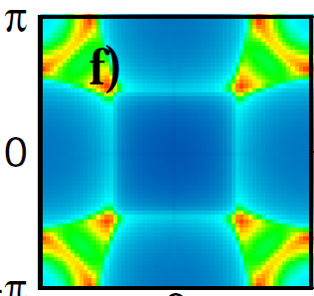
Flat-band SC and dimensionality
1D
Narrow-wide band system(Kuroki et al, PRB 2005)
dispersive band
+
s pairing
spin susc featureless
-
flat band
2D
Partially-flat band(Sayyad et al, arXiv:1903.09888)
flat portion
3D
→ Speciality of the flat-band SC:
→ 3D as good as 2D
(outside Arita's theorem)
Q_{z}
Q_{y}
Q_{x}

Slide 37
2D flat bands
(Shima & Aoki, PRL 1993)
manipulation
1D rep
E
A, E
A, E
2D rep
A, E
A, E
2D → 3D: Weyl
(Brandlyn et al, Science 2018)

Slide 38
Can flat bands really favour SC ?
(2)

Slide 39

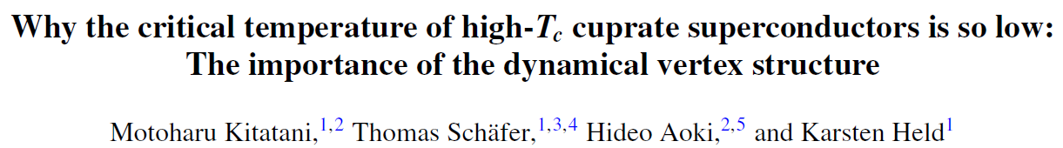

Conventional Unconventional
phonon
el-el repulsion
ω_{D} → Tc ～ 0.1ω_{D}
t → Tc ～ 0.01t
100K → 10K
10000K → 100K
Why 1/100 reduction ?

Slide 40


Vertex corrections usually neglected
glue
RPA,FLEX,TPSC
vertex corrections
=
+ ・・・
V_{eff}(q)
Γ_{pp}(k,k',q)
・If vertex corr at work for SC → non-bosonic exchange
cf. Sakai et al, PRL 2016, CDMFT on Σ^{anomalous}(ω)
main reason why Tc is so low
in electron mechanisms
DΓA (Rohringer, …, Held, RMP 2018)
extended to SC(Kitatani, …, Aoki, Held, PRB(R) 2019)
Full 2-particle vertex
Fully irreducible vertex
Particle-hole
Transverse particle-hole
Particle-particle

Slide 41
Vertex corr suppresses Tc ← any way out ?
✔ Off-site (extended-Hubbard) interactions
→ Frequency-dep (local) interactions as suggested from
dual-boson[Lichtenstein's group],
extended-DMFT [Georges' group; Kotliar's group]
✔ Band structure designing:
* Multi-band models A candidate: Flat-band systems
* One-band models A candidate:
Partially-flat one-band systems
→ vertex corr in flat-band systems
(future problem)

Slide 42
Can flat bands really favour SC ?
(3)

Slide 43
What can happen for U → ∞ ?
AF Heisenberg magnet on "2D Creutz" lattice
(Murakami, Oka & Aoki, PRB 2013)
J₀
J₁
supersolid
J₁+J₂

Slide 44
Can flat bands really favour SC ?
(4)

Slide 45


Topological → can favour superconductivity ?
D_{s} ≥ (U/h²)|C|
"Topologically-protected superfluid weight"
in the mean field
D_{s} : superfluid weight (σ₁(ω) = D_{s} δ(ω) + …)
C : Chern # of the flat band
Attractive Hubbard
(see also Kopnin, Heikkila & Volovik, PRB 2011;
Tovmasyan, …, Huber, RPB 2016;
Julku et al PRL 2016; Liang et al, PRB 2017)
Repulsive case ?

Slide 46
A numerical result beyond mean-field
Attractive Hubbard model with DMRG + ED
(Mondaini et al, PRB 2018)
Creutz lattice
for |U |/t → 0
→ Repulsive Hubbard model ?

Slide 47
Optical analogues ?

Slide 48
Topological photonics
Topological superhoneycomb structures
← mirror winding number
(Wu & Hu, PRL 2015; Sci Rep 2016; Kariyado & Hu, Sci Rep 2017; PRB 2018)
Photonic analogues of
topological electronic states ?
→ interesting future work
band inversion
Topological
edge modes
(observed in
Photonic crystals)

Slide 49
Summary
Flat-band superconductivity
✔ Multi-band, 1D ✔ One-band, 2D
- Flat-band SC does occur in some cases
- Some of them involve topological flat bands
- d ↔ p can occur
Future works
Detailed criterion for flat-band SC
- Possibilities for topological SC ?

Slide 50






Keita Kobayashi, Masahiko Okumura,
Masahiko Machida Japan Atomic Energy Agency
Sharareh Sayyad Univ Tokyo
Abolhassan Vaezi, Edwin Huang Stanford
Mohammad-Sadegh Vaezi Pasargad Institute
Zohar Nussinov Washington Univ
Motoharu Kitatani TU Wien

