Slide 1

Causes of Alcoholism
Dean Daley
Harinee Madhusudhan
Craig Taflin

Slide 2
Executive Summary
Problem
Alcohol is a major problem in the US and is classified as on of 7 Chronic diseases that an important public health problem.
The chronic disease indicators (CDIs) are a set of surveillance indicators developed by consensus among CDC and tracked on a yearly basis.
Questions
1.) What is the Definition of Alcoholism?
2.) Who is affected by Alcoholism?
3.) What are the underlying causes of Alcoholism?
Notes:
1.) Harinee will discuss the definition of Alcholism
2.) I will talk about who is affected by this Disease
3.) Dean will then discuss the underlying causes

Slide 3
Data Collection & Cleansing
Data Sources
1.) CDC U.S. Cancer Statistics Technical Notes
2.) Eater.com- Number of people per bar in each state
3.) Median Income by State for 2017
Data Cleaning
Isolated alcoholism in CDC report and merged other sources
Concatenate and divided columns into multiple columns
  Break out age, sex, and drinking categories (binge, heavy)
Grouping, mean , conditional, filtering, & change data types
Notes:
Data set we chose was very complicated. 5 sources with multiple column headings
One data field with multiple fields
Overall, Sex, Ethnicity

Slide 4
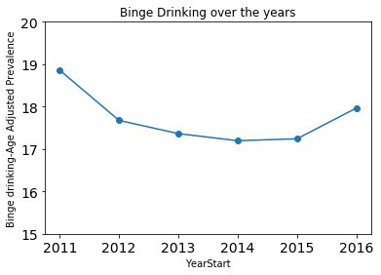
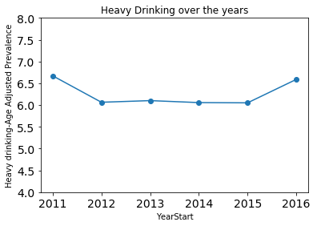
Definition of Alcoholism
Binge Drink + Heavy Drink = Alcoholism
Notes:
Revised

Slide 5
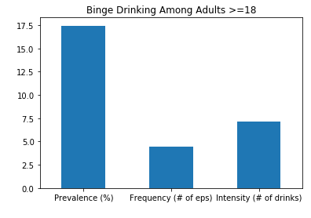
Binge vs. Heavy
a.) Binge Drinking:
Prevalence (%): Drinks at an occasion / Last 30 days (M- 5+, W- 4+)
Intensity: Largest Number at an Occasion / Last 30 days
Frequency: Binge episodes / Last 30 days
b.) Heavy Drinking: Total drinks per week / Last 30 days (M-15+ W-7+)
Notes:
Revised

Slide 6
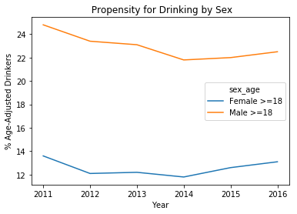
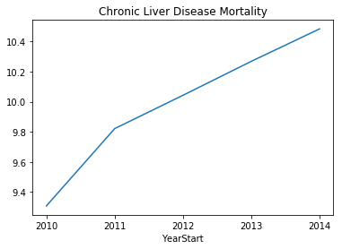
Propensity to Drink ➔ Chronic Liver Disease
Disease as a lagging indicator
Notes:
Limitation of Chronic Liver Disease
Limitations of indicator Because alcohol-related disease can have a long latency, changes in behavior or clinical practice affecting population mortality might not be apparent for years. Not all chronic liver disease deaths are alcohol-attributable. However, in 2009, almost 70% of cirrhosis deaths in the United States were alcohol-attributable (5), and the proportion of cirrhosis deaths coded as 100% alcohol attributable has increased dramatically during 1970–2009 among United States adults aged 25–64 years (5)

Slide 7
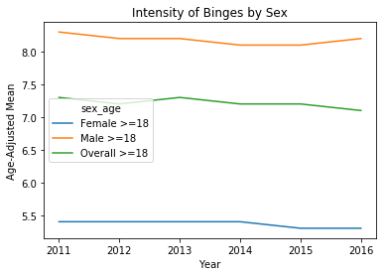
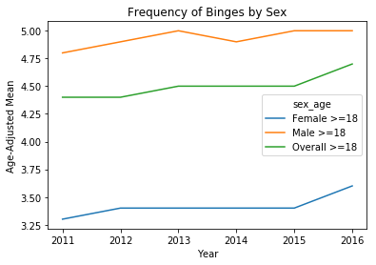
Intensity vs. Frequency

Slide 8

Underlying Factors
Several Obvious Hypotheses
Gather Data External to the Target Dataset
Looking for Correlations and Empirical Data
Indicators for Next Steps

Slide 9
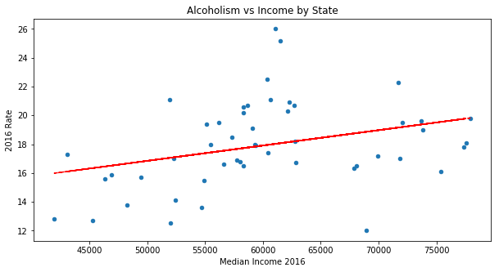
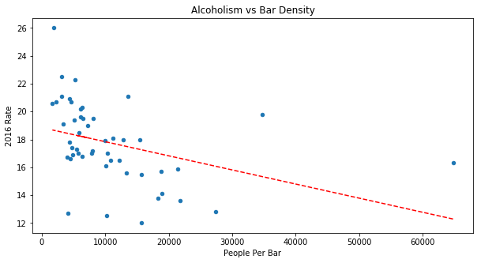
Correlation

Slide 10
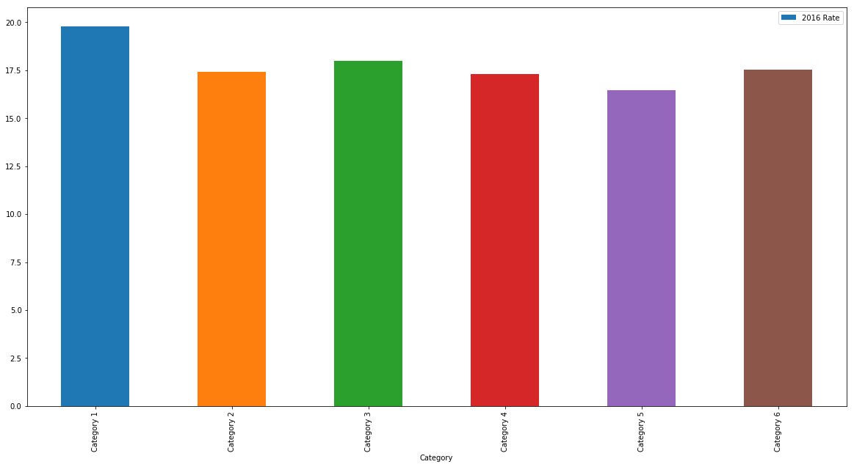
Effects of Regulation
Category 1 - State had exclusive local alcohol retail licensing | 8
Category 2 - State had joint local and state alcohol retail licensing | 10
Category 3 - State had exclusive state alcohol retail licensing but with local zoning authority | 16
Category 4 - State had mixed alcohol retail licensing policiesÂ | 8
Category 5 - State had nearly exclusive state alcohol retail licensing | 2
Category 6 - State had exclusive state alcohol retail licensing | 6

Slide 11
Challenges / Open Questions Remaining
Unaccounted Mortality
  DUIs are actually also being caused by Alcoholism
  Suicides
  Gateway Drug
Figuring out the lag between drinking and chronic diseases
Would be great to see urban consumption vs rural
  Need for zip code level data
  Stereo Types of ghettos with corner/liquor store
Are people drinking at home or in the bars?

Slide 12
Thank you!
Any Questions?

Slide 13
Year | State | Data Source | Question | unit | Data Value Type | Data Value | Data Value Alt | StratificationCategory1 | Stratification1
2016 | CA | BRFSS | Binge drinking prevalence among adults aged >= 18 years | % | Crude Prevalence | 16.3 | 16.3 | Overall | Overall
2016 | CA | BRFSS | Binge drinking prevalence among women aged 18-44 years | % | Crude Prevalence | 15.7 | 15.7 | Gender | Overall
2016 | CA | BRFSS | Binge drinking frequency among adults aged >= 18 years who binge drink | # | Mean | 3.9 | 3.9 | Gender | Male
2016 | CA | BRFSS | Binge drinking intensity among adults aged >= 18 years who binge drink | # | Mean | 7.1 | 7.1 | Overall | Overall
2016 | CA | BRFSS | Heavy drinking among adults aged >= 18 years | % | Crude Prevalence | 5.9 | 5.9 | Gender | Male
2016 | CA | BRFSS | Heavy drinking among women aged 18-44 years | % | Crude Prevalence | 6.2 | 6.2 | Overall | Overall
2016 | CA | BRFSS | Alcohol use among youth | % | Crude Prevalence | 28.9 | 28.9 | Race/Ethnicity | White, non-Hispanic
2016 | CA | BRFSS | Binge drinking prevalence among youth | % | Crude Prevalence | 15.1 | 15.1 | Race/Ethnicity | White, non-Hispanic
2016 | CA | BRFSS | Amount of alcohol excise tax by beverage type (beer) | $ | US Dollars | 0.2 | 0.2 | Race/Ethnicity | Black, non-Hispanic
2016 | CA | BRFSS | Amount of alcohol excise tax by beverage type (wine) | $ | US Dollars | 0.2 | 0.2 | Race/Ethnicity | Black, non-Hispanic
2016 | CA | BRFSS | Amount of alcohol excise tax by beverage type (distilled spirits) | $ | US Dollars | 3.3 | 3.3 | Race/Ethnicity | Hispanic
2016 | CA | BRFSS | Commercial host (dram shop) liability laws | 0 | Commercial host (dram shop) liability status for alcohol service | Category 2 | 0 | Race/Ethnicity | Hispanic
2016 | CA | BRFSS | Local authority to regulate alcohol outlet density | 0 | Local control of the regulation of alcohol outlet density | Category 3 - | 0 | Race/Ethnicity | Other, non-Hispanic
2016 | CA | BRFSS | Chronic liver disease mortality | 0 | Number | 5013 | 5013 | Race/Ethnicity | Other, non-Hispanic
2016 | CA | BRFSS | Per capita alcohol consumption among persons aged >= 14 years | Gal. | Per capita alcohol consumption | 2.3 | 2.3 | Race/Ethnicity | Multiracial, non-Hispanic

Slide 14
State | Category
Hawaii | Category 1
Minnesota | Category 1
Nevada | Category 1
New Jersey | Category 1
Rhode Island | Category 1
South Dakota | Category 1
Wisconsin | Category 1
Wyoming | Category 1
Arkansas | Category 2
Colorado | Category 2
Georgia | Category 2
Idaho | Category 2
Illinois | Category 2
Louisiana | Category 2
Massachusetts | Category 2
North Dakota | Category 2
Tennessee | Category 2
Utah | Category 2
Alaska | Category 3
California | Category 3
Connecticut | Category 3
Florida | Category 3
Indiana | Category 3
Iowa | Category 3
Kansas | Category 3
Maryland | Category 3
Montana | Category 3
Nebraska | Category 3
New Mexico | Category 3
Ohio | Category 3
Oklahoma | Category 3
Pennsylvania | Category 3
South Carolina | Category 3
Virginia | Category 3
State | Category
Alabama | Category 4
Maine | Category 4
Michigan | Category 4
Mississippi | Category 4
Missouri | Category 4
Texas | Category 4
Vermont | Category 4
West Virginia | Category 4
North Carolina | Category 5
Oregon | Category 5
Arizona | Category 6
Delaware | Category 6
Kentucky | Category 6
New Hampshire | Category 6
New York | Category 6
Washington | Category 6

