Slide 1
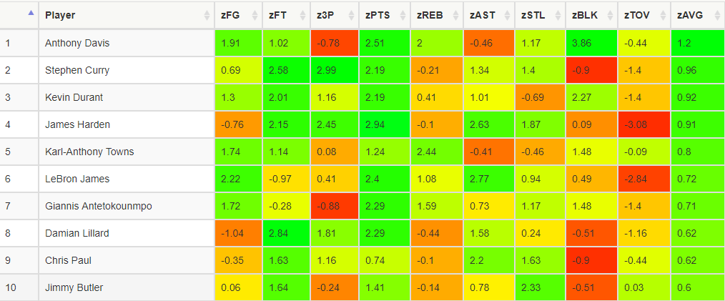

Logistic Regression Model – Fantasy Draft

Slide 2
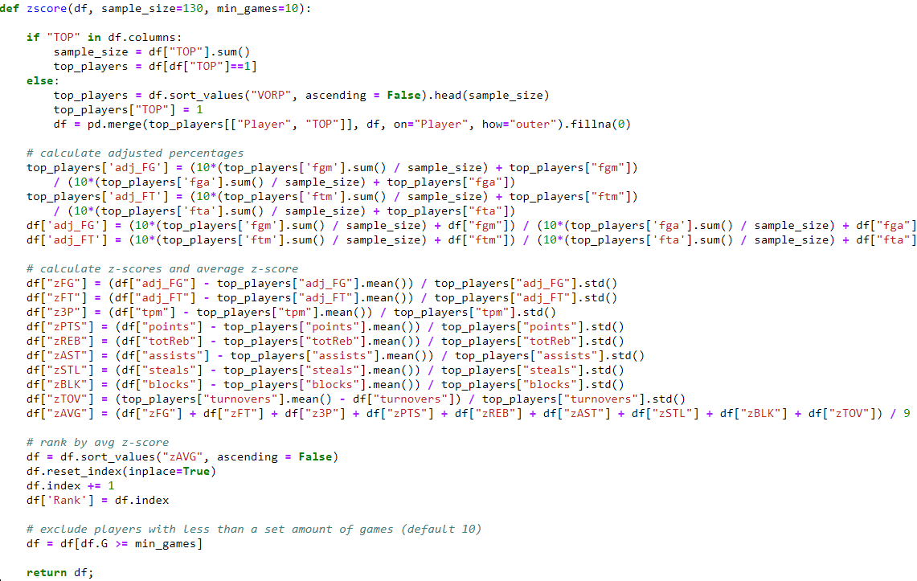
Rank Players by Z-Scores
Notes:
Decent correlation, but connections are scattered around regression line.
MATT

Slide 3
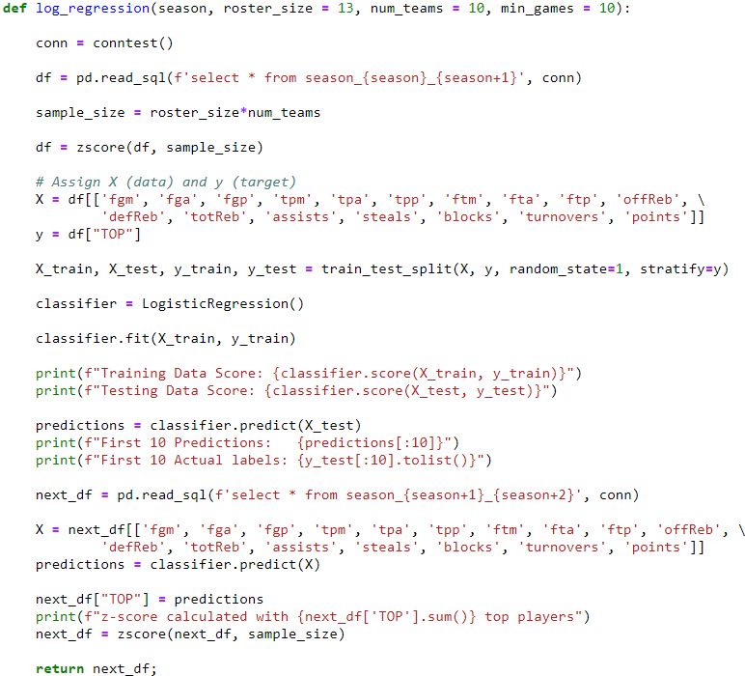
Logistic Regression Model
Our Data:
Season-long data for 9-category box-scores (FG%, FT%, Three Pointers, Rebounds, Assists, Steals, Blocks, Turnovers, Points)
Our Target:
Predict the top players for next season

Slide 4
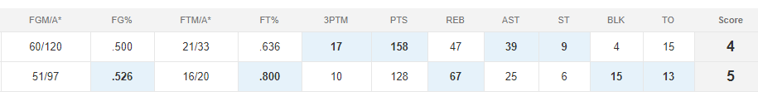
Linear Regression Model – Head to Head Matchup
Build a linear regression model to predict a player’s stats for the coming week of games, based on player’s previous box score stats as well as the opposing team stats.
Aggregate stats for all players on fantasy teams to predict the outcome of a matchup.

Slide 5
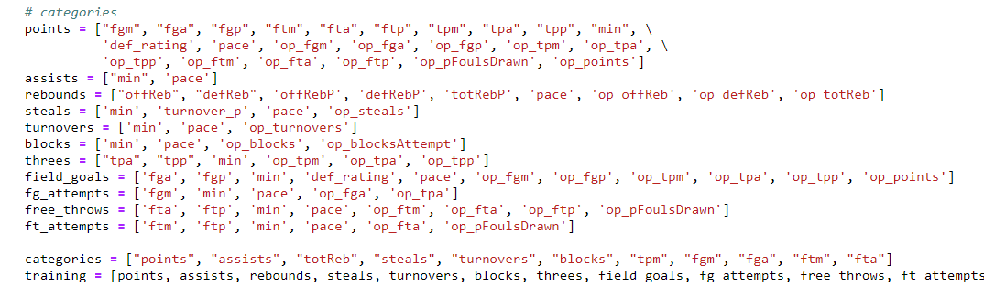
Linear Regression Model – Head to Head Matchup

Slide 6
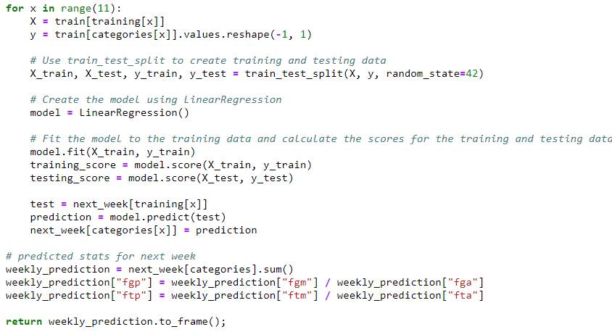
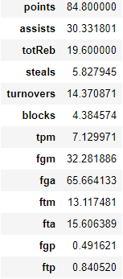
Linear Regression Model Cont.

Slide 7
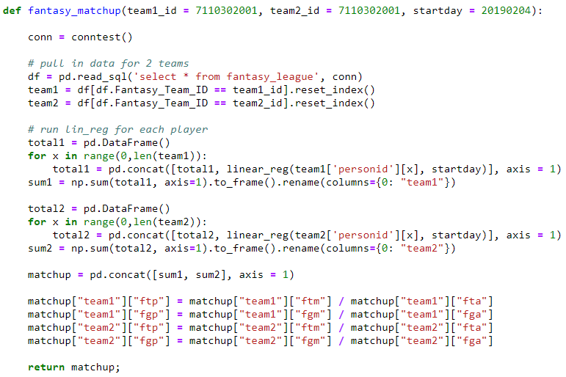
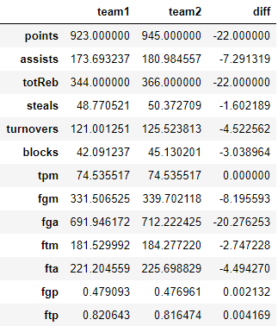
Fantasy Matchup

Slide 9
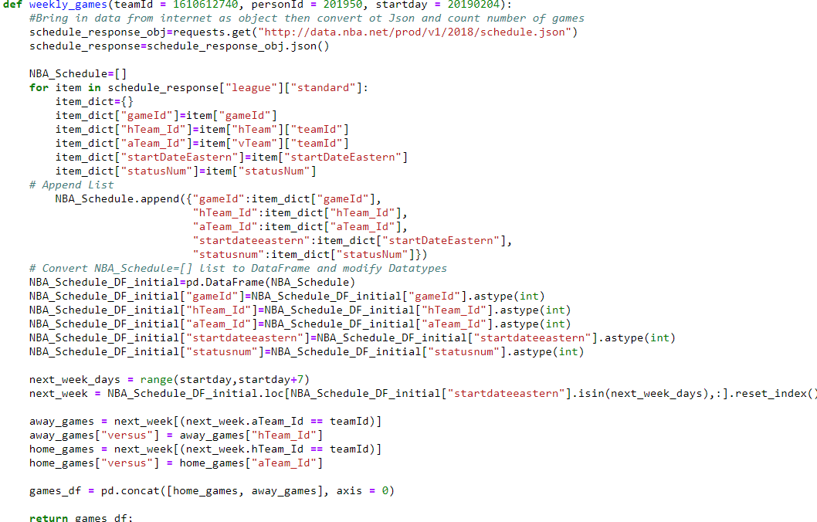

Slide 10
