Slide 1


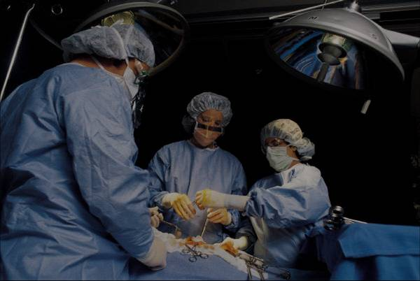
Lost In Space: Using Bluetooth Beacons to Approximate
Location in a Virtual Sonic Environment
REPLACE THIS BOX WITH YOUR ORGANIZATION’S
HIGH RESOLUTION LOGO
Chase Mitchusson
Louisiana State University, Center for Computation & Technology
ABSTRACT
INTRODUCTION
RESULTS
DISCUSSION
Click here to insert your Abstract text. Type it in or copy and paste from your Word document or other source.
This text box will automatically re-size to your text.
To change the background color of this text box: Double-click near the edge to open the Format tool, select ‘Colors and Lines’, and change the fill color to whatever you like.
To change the font style of this text box: Click on the border once to highlight the entire text box, then select a different font or font size that suits you. This text is in Arial 32pt and is easily readable up to 6 feet away on a 36” x 48” poster. Try to stay between 28pt – 40pt for best viewing.
The Web Audio API allows for complex processing and routing of audio on the web. Tone.js is an interactive music framework built on the Web Audio API. Artists and developers can take advantage of these interfaces to create applications and pieces for mobile devices. Mobile performance pieces built with the Web Audio API uncommonly attempt localizing each mobile device. Lost In Space attempts to use indoor localization techniques to allow users to explore a virtual space analogous to their physical space.
Bluetooth Low Energy beacons transmit signals that can be scanned by mobile devices. With enough beacon data, a user’s indoor location can be tracked. By tracking physical location, a virtual analogue can be positioned on the web.
Combining these elements
The lack of Web Bluetooth
The convenience of Android Studio Web View
Genigraphics has provided this template to assist in preparation of a medical or scientific research poster. The dimensions are set to 36” high by 48” wide but prints can also be scaled up proportionally as large as 54” high by 72” wide. When you order your print we will know to scale the original file to the size you specify.
For other sizes, visit us at www.genigraphics.com or send an email request to info@genigraphics.com or give us a call toll free at 1.800.790.4001.
The various elements and text boxes included in this template are examples of what we commonly see on posters of this kind. They are simply placeholders and you should feel free to add, delete, re-arrange, re-name, or re-size as best suits your needs.
Choose Genigraphics to print your poster and we will perform a free design review and advise you if we see anything that may be a concern for printing.
We print directly from PowerPoint so your poster will look just like it does on screen. Other printing outlets (Kinko’s, for example) convert your file to another format prior to printing. This can result in elements shifting, loss of effects, or altered colors. By printing from the same version of PowerPoint that your file was created in, Genigraphics gives you the most accurate reproduction available.
The audio output can be either mono or stereo, and each implementation has its benefits. Mono is the preferred output setting as not all mobile devices have stereo output and there are no conflicts between left and right channels based on user orientation. Mono is well suited for large groups of users participating in concert.
Stereo
METHODS AND MATERIALS
CONCLUSIONS
BLE Beacons/Bluetooth 4.0 are used for indoor localization. A website is built with HTML, CSS, and JavaScript to comply with web standards. The JavaScript portion heavily relies on the Web Audio API and Tone.js to create virtual speaker nodes. Android Studio is used to build a mobile application to access mobile devices’ Bluetooth in combination with a Web View to share Bluetooth data to the JavaScript in the website.
BLE beacons are placed around a room or large space. The user opens an app on their mobile device that scans for these specific beacons. Based on data such as RSSI (signal strength), an approximate distance from the mobile device to the beacon is calculated. This data is sent to the Lost In Space website’s JavaScript. When the website has the proximity to at least three beacons, trilateration is used to find the user’s location relative to the beacons. The user’s location is then mapped to the virtual sound environment built in Tone.js. The virtual sound environment is a series of virtual speaker nodes scattered about a virtual space analogous to the physical space in which the app is used. With the user’s location figured by trilateration, their relative virtual location is updated. When the user gets near virtual speaker nodes, the nodes become audible through the mobile devices speaker. It is up to the user to explore the virtual space, analogous to their physical space, to discover the audio within the virtual environment.
Click here to insert your Conclusions text. Type it in or copy and paste from your Word document or other source.
Click on the border once to highlight and select a different font or font size that suits you. This text is in Arial 32pt and is easily readable up to 6 feet away. Try to stay between 28pt – 40pt for best viewing.
REFERENCES
Figure 1. Label in 24pt Arial.
Figure 2. Label in 24pt Arial.
Click here to insert your References. Type it in or copy and paste from your Word document or other source.
Click on the border once to highlight and select a different font or font size that suits you. This text is in Arial 24pt and is easily readable up to 4 feet away. Try to stay between 18pt – 28pt for best viewing.
The line spacing is set to add one-half of a line height after each entry. Select ‘Format, Line Spacing’ to adjust this setting.
CONTACT
 | A | B | C | D
Patient 1
Patient 2
Patient 3
Patient 4
Chase Mitchusson
Louisiana State University
Email: cmtchssn@gmail.com
Website: chasemitchusson.wordpress.com
Chart 1. Label in 24pt Arial.
Table 1. Label in 24pt Arial.

