Slide 1
Lost In Space
Indoor Localization for Virtual Environment Exploration
Chase Mitchusson
Experimental Music & Digital Media
Louisiana State University

Slide 2
Web Audio
Web Audio API – modular routing and processing for audio on the web
Tone.js – framework for interactive music
Mobile performance pieces

Slide 3
Bluetooth
Bluetooth Low Energy (BLE) – transmit ultrawide band frequencies, can be scanned by mobile devices
BLE Beacons – can be grouped to represent a geographic location
Indoor Localization – use beacon signal strength in a know area to trilaterate a specific point in a room

Slide 4
Bluetooth on the Web
Web Bluetooth API – currently experimental and unstable, little to no support in mobile browsers
Android Studio – Android apps can access mobile devices’ bluetooth and access websites with a Web View tool. Combining those properties will enable Bluetooth on the web.

Slide 5
Lost In Space App
Tone.js – create several speakers spread out in a virtual space
BLE Beacons – set out at least 3 beacons in a room to do indoor localization
Android App – scan for beacons, determine distance to beacons, send data to website
Website – receive beacon distance data, apply trilateration to determine indoor location, map indoor location to the virtual space created with Tone.js

Slide 6
Virtual Sound Environment
Speaker Position – mapped with Tone.js using right-hand Cartesian coordinates
Listener Position – indoor location mapped to the Tone.js virtual space
Audio – Output through mobile device speakers. As a user gets closer to a virtual speaker, the audio gets louder

Slide 7
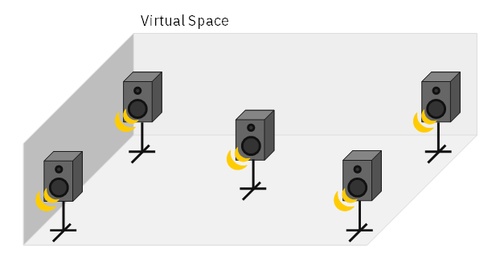

Slide 8
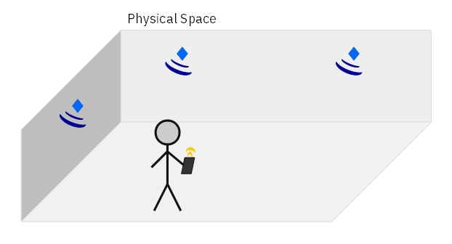

Slide 9
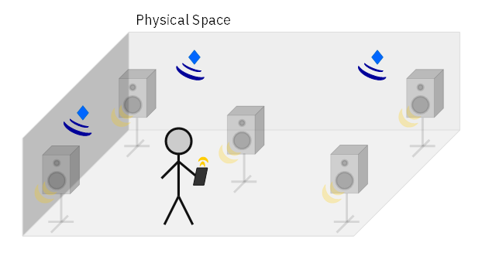

Slide 10
Why bother?
Virtual Soundwalks
Participative performances
Spatialization in challenging environments

Slide 11
Diagram for localization
Virtual vs physical to clarify
Present, but don’t read
Why use the website, not just the app

