Slide 1
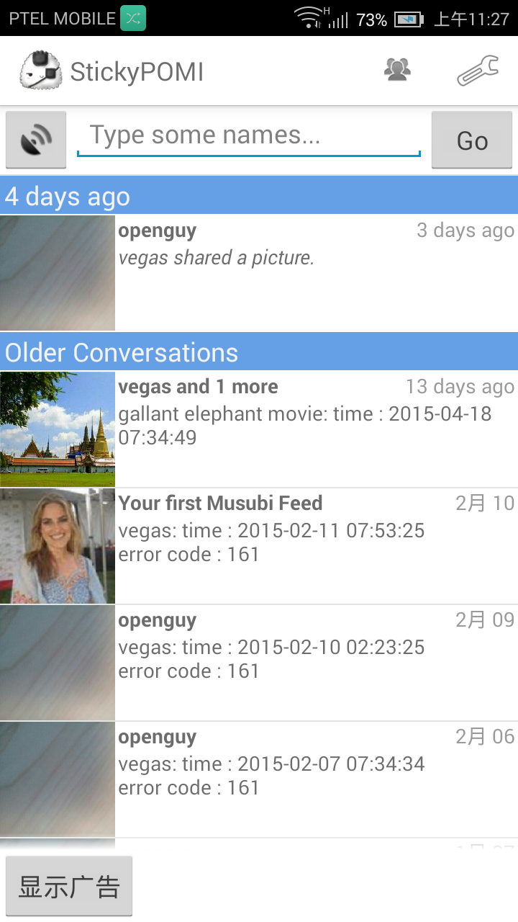
Integrate 3rd Party App into POMI
POMI has an open interface which allows 3rd parth app to be integrated into its “App Drawer”
By add different app to the “App Drawer”, users can launch apps to share different kinds of content quickly
POMI achieve this goal through Android intent filtering.

Slide 2
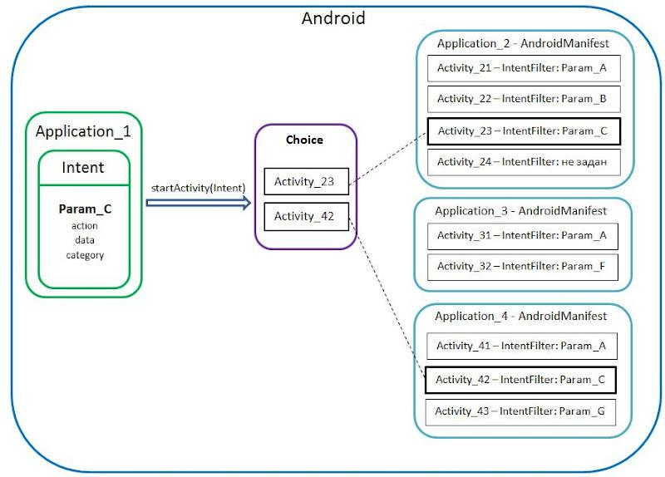
Intent filtering on Android
An intent filter is an expression in an app's manifest file that specifies the type of intents that the component would like to receive.

Slide 3
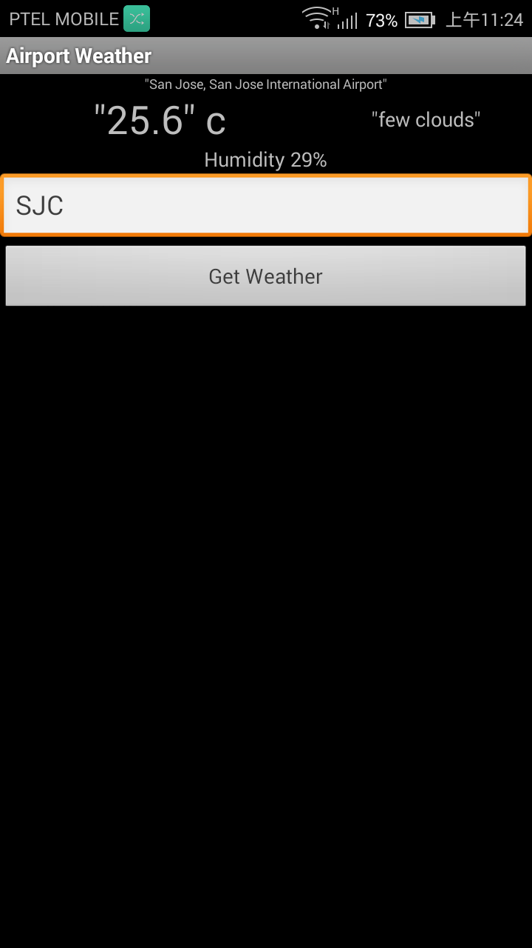
Integrate Airport Weather App
Airport Weather App was written to demo POMI's capability to integrate and launch third party apps from "app drawer".
The app allows users to view weather conditions at an airport based on the ICAO code.
The app persists the last airport a user viewed prior to closing the app and display information for that airport by default on the next launch.

Slide 4
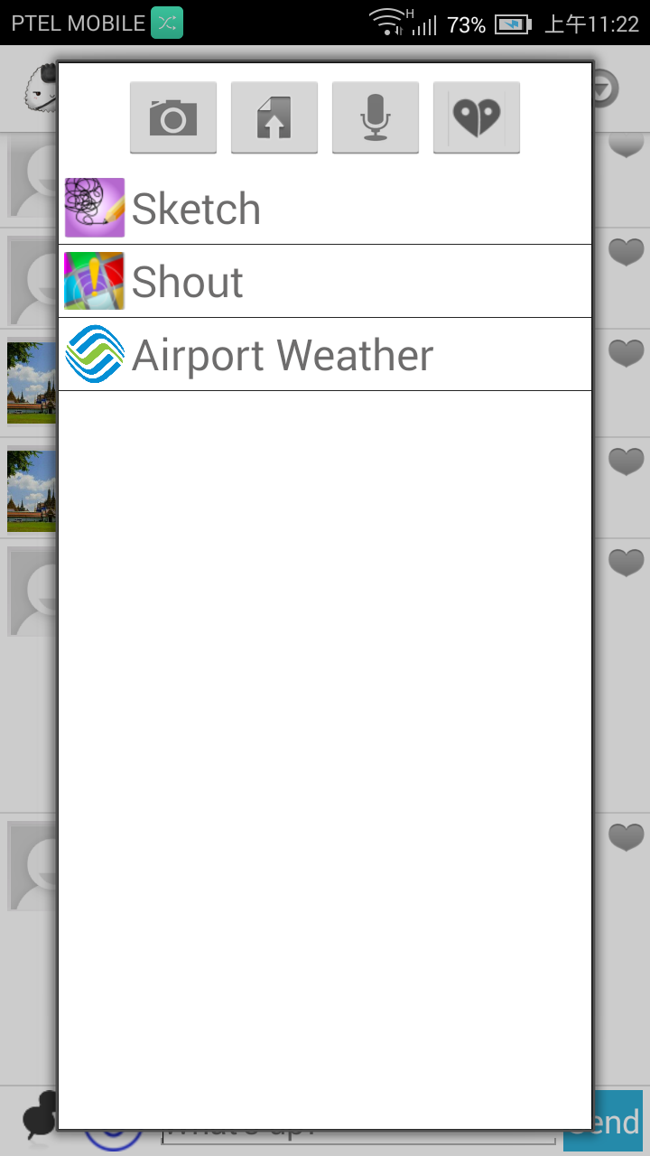
Integrate Airport Weather App
By Adding the POMI specific intent filter into Airport Weather App’s AndroidManifest file, now Airport Weather App has been integrated successfully!

