Slide 1

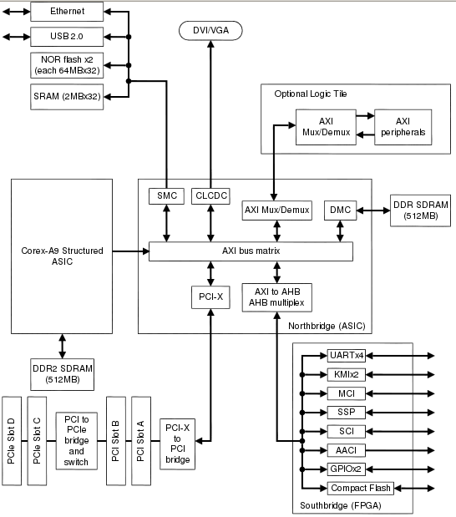
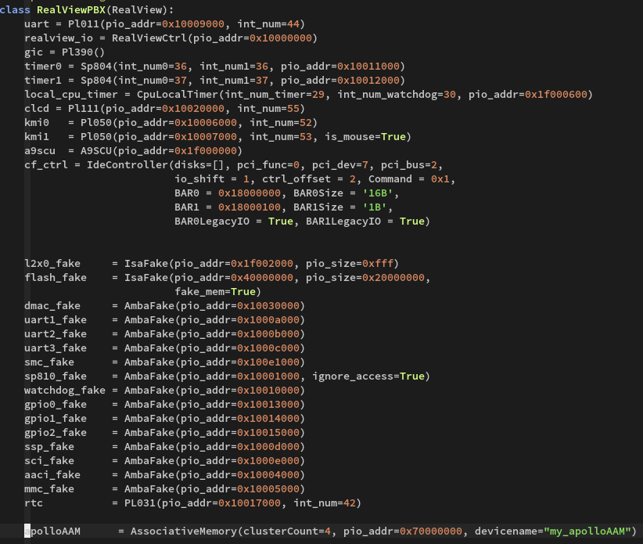
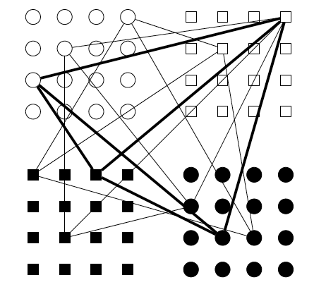
Exploring Applications of Autoassociative memories
Context
Researchers in engineering want to make a novel memory called Autoassociative Memory (AAM).
While the idea of AAMs aren't new, a novel way of implementing them might make them feasible.
The researchers suspect that this technology could have many application in computing.
They wanted to collaborate with computer scientists in order to better assess these applications.
Knowledge gained during this assessment would be used to guide development of the AAM
The plan
Starting with a mathematical model of the device, I set out to explore how we could integrate this device into a simulated computing environment.
Three steps were planned in order to accomplish this:
Find a platform upon which to simulate a computer system.
Integrate this mathematical model as a device in the computer system.
Explore how various computational problems can use the AAM.
What is an Autoassociative memory?
An AAM stores associations. Each association has a fixed number of symbols.
These symbols can be seen as integers.
While RAM is indexed by address, AAMs are indexed by their content.
Instead of providing an address, you provide an incomplete copy of the content and are returned the complete content.
0100 | x | 1010 | x | 1000
Symbol
How an AAM works
Uses neural network. Neurons are grouped in to clusters, with each cluster representing a symbol in an association.
Each neuron in a cluster represents a different symbol value (i.e. integer value).
Associations are stored by joining the neurons representing a association with binary edges. A clique is formed where every neuron is joined to every other one.
Associations are retrieved by finding the neurons in the erased clusters that are adjacent to all the known neurons.
0110 | 1001 | 1111 | 0010 | 0111
0100 | 1110 | 1010 | 1101 | 1000
...
Association
Simulation platform
Looked into QEMU. Not custom device friendly enough.
Found gem5: great computer architecture simulator.
We chose ARMv7-A as our experiment target.
Returned in O(1) time!
0100 | 1110 | 1010 | 1101 | 1000
Turning a dream into ^{(virtual)} reality
Coded up a few AAM models based on mathematical model. The model needed to be integrated in the gem5 simulated computer system in order to be experimented on.
Linux or Bare Meta?
Linux: Easy development and more featureful apps. OS overheard might skew results.
Bare-Metal: Faster simulation. Can profile from outside of simulation. No driver needed
I went with Linux but I reget it, I should've gone bare-metal.
Computing problem exploration
First thing that came to mind was databases.
Database table map very naturally to an AAM associations and the ability to search for entries based on content is one of the main features of databases. Using and AAM, an arbitrart lookup could be done in O(1) time.
Wrote database program which creates tables with random data. The nature of the data can be controlled by selecting probability funtions (uniform or normal) and specifiying wether it's ordered or not and if it's allowed duplicates.
Preliminary table lookup results:
Table lookup benchmarks
Search type | Time taken for 100
Unordered search | 4899 microseconds
Ordered search | 53 microseconds
AAM query | 44 microseconds
AAM
What next?
Finish database profiling.
Explore other algorithms.
I think compression algorithms that use dictionary decoders (most of them) might be able to benefit from the AAM. Regular expression processing too.
Do you have any algorithm ideas? Please share!

