Slide 1

Energy Consumption Prediction Application
Caleb Trimble
DSC355
Professor Frank Neugebauer

Slide 2
Application Principles
Application:
Streamlit
Language:
Python
Dataset:
EIA_DataSet.csv
Data Source:
Energy Information Administration Monthly Energy Consumption
Application Purpose: Predict future energy consumption for various energy sources in the United States.

Slide 3
Predictive Goal
Take user input (month, year) and predict energy consumption by energy type.
Utilize historical EIA data for energy consumption.
Utilize machine-learning and predictive models to predict future energy consumption.
Application provides the user with predictions for energy usage over a period of time.
Energy Types Used
Coal | Nuclear
Hydroelectric | Solar
Natural Gas | Wind

Slide 4

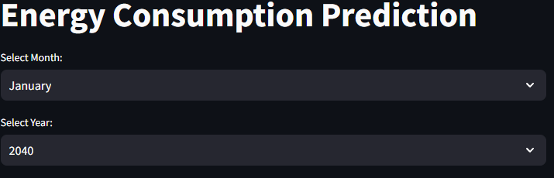
User Input
The first area of the application provides the user with two selections.
The data is formatted by month and year, allowing the user to have two variables to select.
Predictions track month and year, allowing for a more finite prediction model.

Slide 5
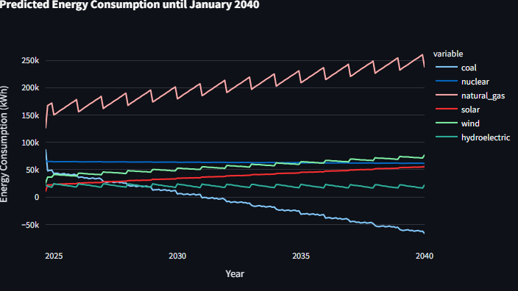
Graphic Visualization
Reflects predictive variables in a line-graph format.
Predictions show a gradual decline in coal consumption and significant increases in natural gas.
While nuclear remains constant, hydroelectric, solar, and wind have gradual increases.

Slide 6
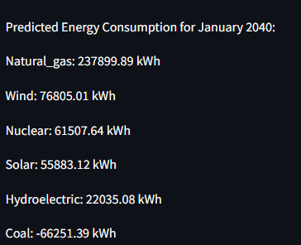
Text Results
Provide user text results with final predictions.
Predictions are ordered from highest to lowest to consumption.
Coal consumption reflects negative due to the model predicting coal usage will drop below zero between 2030 and 2035.

Slide 7
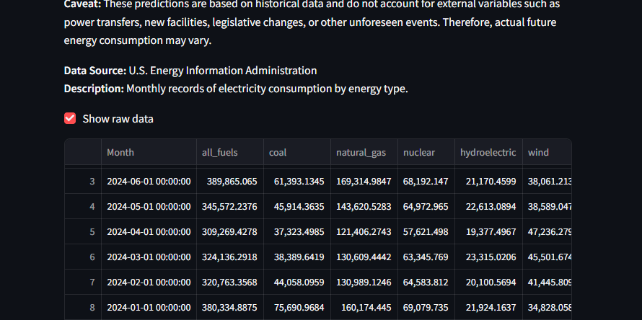
Developer Notes and Raw Data
The final section provides users with developer notes including:
caveats
data source
and raw data.
The application also provides the user with the choice to view the raw data.

Slide 8
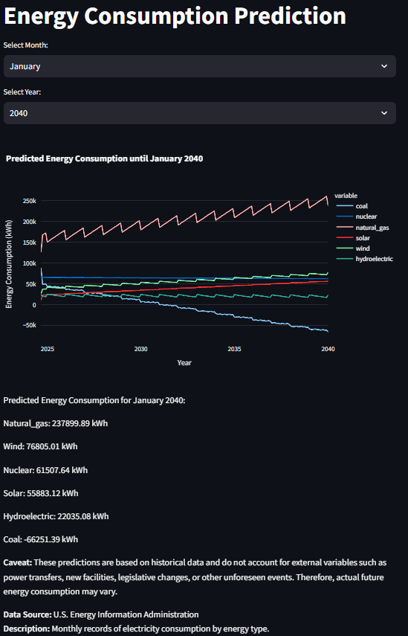
The Final Product
The application provides the user with granular results visually, and final results with the text.
Ensuring data integrity and acknowledging predictive limitations instills user confidence and sets realistic expectations.

Slide 9
Future Development for Deployment
Incorporate External Factors:
Enhance the model by incorporating additional factors such as:
policy changes
economic conditions
weather patterns.
Model Optimization:
Experiment with advanced models like:
ARIMA
SARIMA
Experiment with machine learning models such as:
Random Forest
Gradient Boosting
User Interface Improvement:
Refine the user interface for better user experience and add more interactive elements.

