Slide 1

How Not to Give
A
Bad Seminar
How to Give a Great Seminar
Alex Tabarrok
George Mason University
Notes:
The title is a lie. It takes a great paper to give a great seminar but no one has to give a bad seminar and this will help you to avoid that problem!

Slide 2
Practice!
Notes:
What looks good to the eye often doesn’t sound good to the ear. You need to listen to yourself in order to hear the stumbling blocks, the unclear phrasing, the missing arguments. Timing. You need to practice to so that you can finish on time. Never, ever go long! Especially, do not speed up at the end so that you can finish everything.
Also when you practice pay attention to cadence and rhythm. You need to practice enough so that you can hear yourself and watch the audience at the same time without losing train of thought.
Practice also means stand before an empty room; get a friend or two to listen; get a talk at the home institution or at a friendly conference. Do this before your present your job market paper for a job!

Slide 3
Practicing a Talk is Like Editing a Paper
Notes:
James Buchanan said “Writing is editing.” Practicing is editing too. You need to listen to yourself to hear what isn’t working. You wouldn’t submit a first draft of a paper. Why do you give a first draft of a talk?

Slide 4
A Good Seminar
is a
Good Story

Slide 5
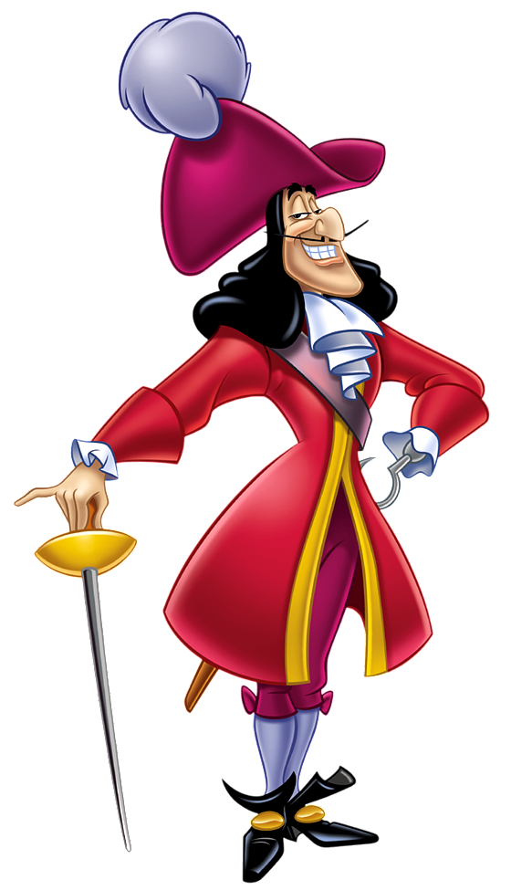
Hook Your Audience
You have five minutes to tell your audience why they shouldn’t walk out on you.
What’s the question, the puzzle, the issue?
Get curiosity on your side.
If people believe that they have a gap in their knowledge that you will fill, they will listen.
Notes:
Hook – Noel Johnson – the black death killed 40% of the European population what were the consequences for subsequent growth of cities and industry?
Hook – Cowen – Why hasn’t economic progress lowered working hours more?
Hook – Tabarrok – what is the effect of police on crime, how do we solve the endogeneity problem. Different audiences, different hooks.
Get curiosity on their side – if they feel that they have a gap in their knowledge, that you will fill people will listen.

Slide 6
How to Organize a Talk/Paper
Hook
Research Question – what is your specific question and what is your value added in terms of theory/data/technique. Brief discussion of antecedents.
Preview of main results (optional)
Data
Research Design-where is identification coming from?
Results
Robustness Tests/Limitations
The Takeaway
Notes:
Research question – crime in Washington, DC over a period of 3 years, when the terror alert level goes from yellow to orange. Terror alert is exogenous, it goes on and off multiple times, we have daily data
Preview of main results – we find that a 10% increase in police reduces crime by 3% this is a very cost effective use of police. More police on the street would more than pay for itself.

Slide 7
Every Slide Should Have a Purpose
The purpose is NOT to remind you what to say.
The purpose is to advance your story and to help your audience follow along.
If someone’s attention slips for 30 seconds can they catch up by looking at your slide?
Title the slide with the purpose.

Slide 8
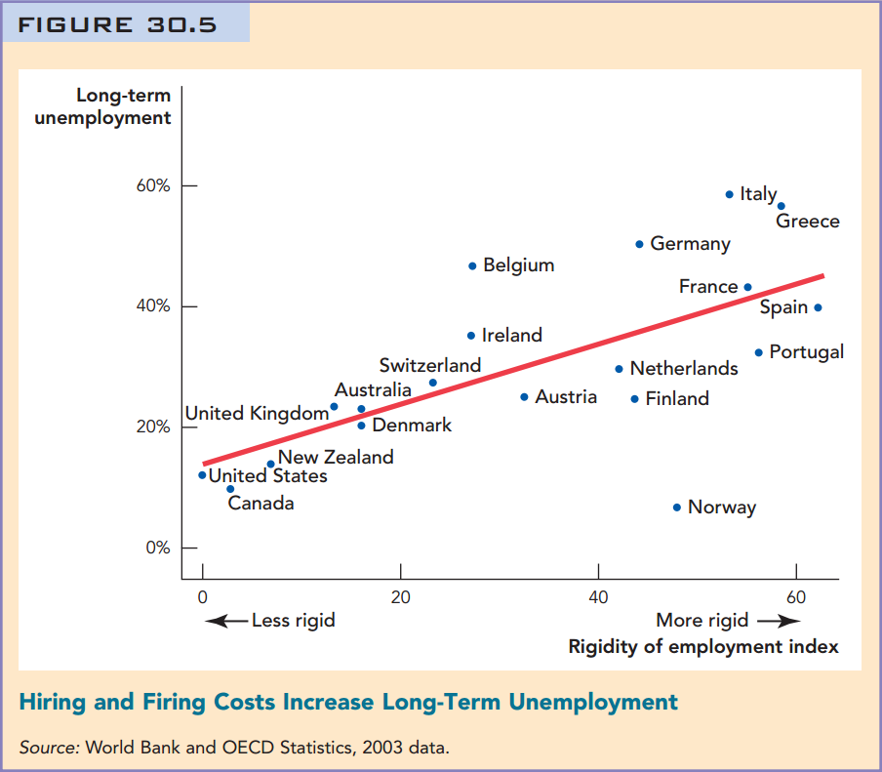
Graphs should be labelled.
Note should describe source of data and any transformations.
Graphs should be titled with the takeaway not just a description of what is graphed.
Notes:
The note here should probably have more for a paper or seminar. Sometimes tricky to give purpose without saying more than is justified.

Slide 9
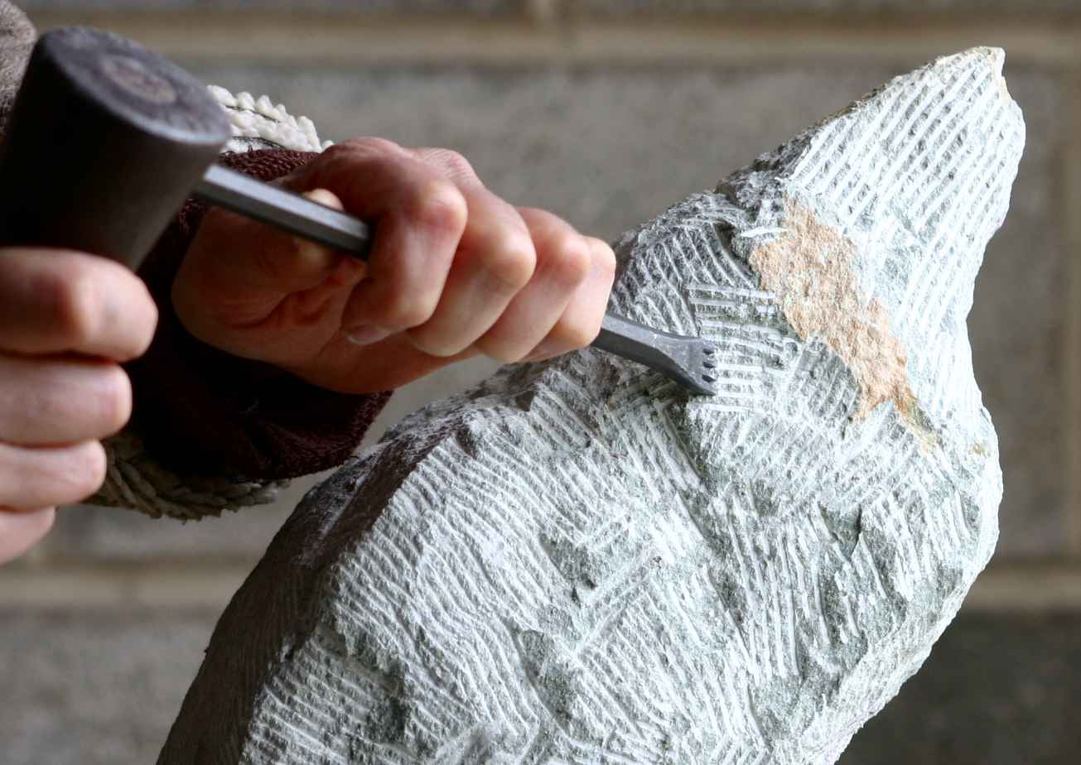
What Not to Include is as Important as What to Include
Economize on words.
Use pictures and graphs.
If you have a theorem, give an example.
If it’s not key, save the proof for the paper.
Assume you are talking to smart people but not experts.
Think Journal of Economic Perspectives not Econometrica.

Slide 10
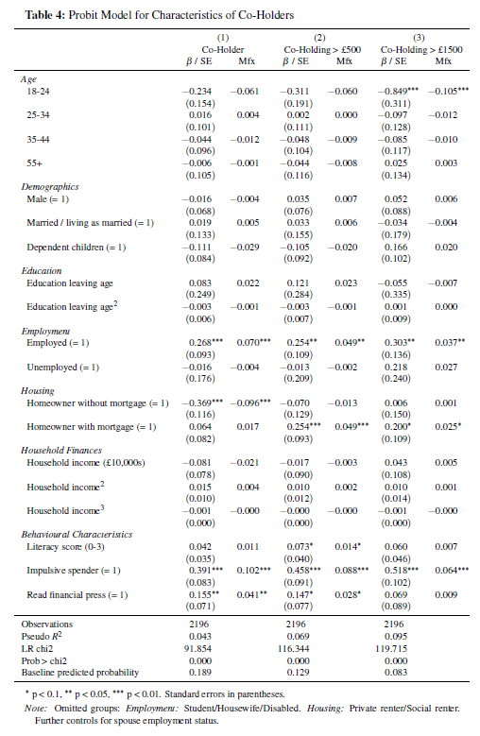
Your presentation must be readable from the back of the room.
Tables of empirical results should focus on coefficient(s) of interest.
Control Variables? Yes.
State Fixed Effects? Yes
Save full-blown results for appendix slides.
Don’t Do This

Slide 11

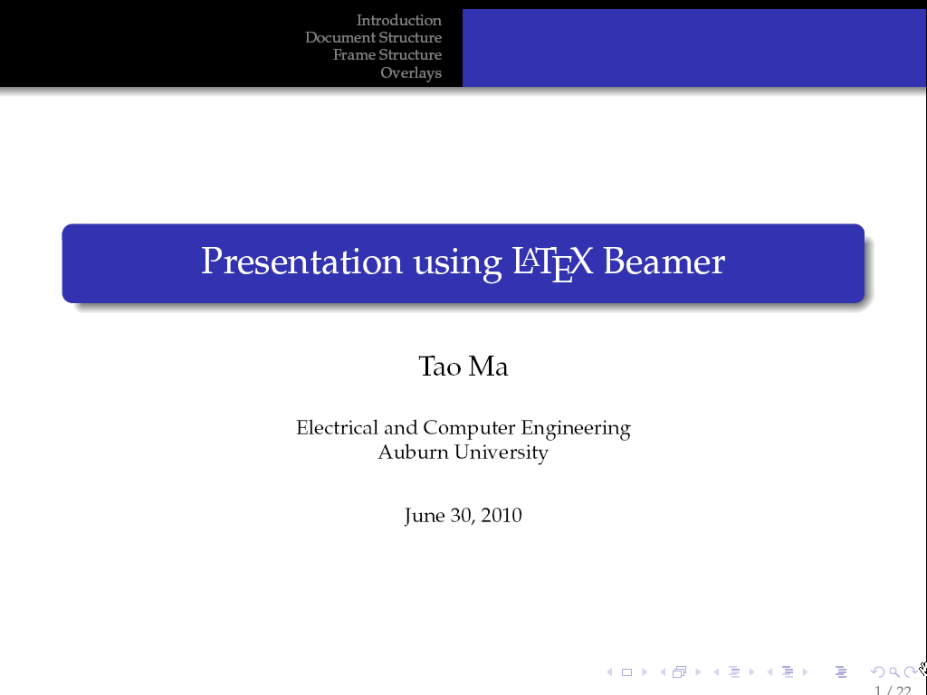
Slides
Don’t use a lot of eye candy.
These slides use too much!
At least for a job talk. Remember, know your audience.
Powerpoint is fine, the main danger is forgetting point one.
Beamer is a powerful and elegant Latex package for slides.
Not as convenient as powerpoint for pictures.
Great for equations and integration with your Latex document.
The cool kids use Beamer for job talks, maybe you should too.

Slide 12
Before the Talk
Ask in advance, How long is the seminar? Prepare appropriately.
Know your audience. Prepare appropriately.
Send your slides in advance.
Bring your slides on a USB & also have them online somewhere (I send mine to my Gmail account).
It is YOUR talk. Take property rights over anything attached to it.

Slide 13
The Day of the Talk
Arrive at the seminar room early.
Check that your slides are ready, that you have a clicker, that you know how to advance the slides, that the formatting is correct, make sure you have chalk, markers, a glass of water etc.
Be ready to have slides printed if necessary.
Do not waste your audience’s time.

Slide 14
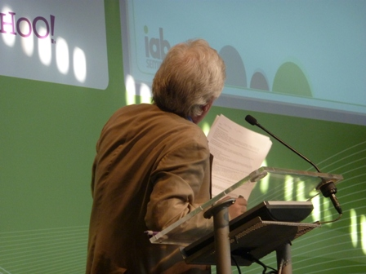
Presentation Style
Face your audience!
Practice so that you know your slides at a glance.
You are telling the story of your research not reading slides.

Slide 15
Presentation Style
Practice so that you have enough mental bandwidth to present and monitor yourself at the same time.
Be aware of verbal tics.
Be aware of pacing – you want to mix fast and slow, loud and soft.
Be aware of where you are standing. Move but do not pace.

Slide 16
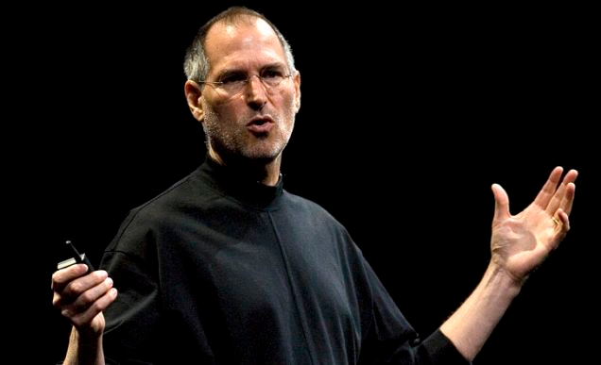
Assume the Steve Jobs Posture
Notes:
No hands in pockets. Don’t hide in the corner. Move but don’t pace.

Slide 17
Do Not Let the Audience Dominate You!
Practice so that you won’t be thrown by a question or an interruption and can quickly get back to your story.
Every dept has at least one person who asks the same question at every seminar.
Be respectful but don’t get thrown off your story. Acceptable answers include:
Good point, I’ll look at that.
Let me hold off on that until I get a bit further and then I’ll come to that.
I don’t know. Let’s discuss further afterwards.
When answering questions avoid side-discussions. Speak to your audience.
Presentations in economics can be a combat sport!

Slide 18
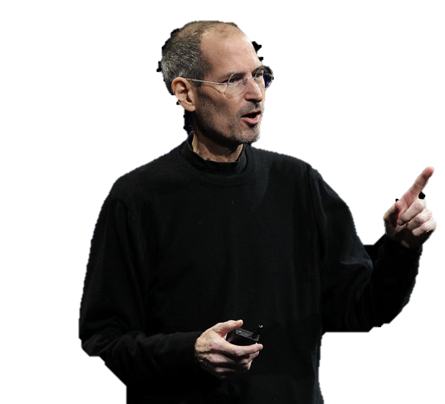
One More Thing…
As you tell the story
of
your research.
Convey your excitement!
Notes:
If you are not excited about your research no one else will be.

Slide 19
Further Resources
Some Pointers for Preparing Presentations, Florian Zettelmeyer
How to Give an Applied Micro Talk, Jesse Shapiro.
22 Tips for Conference and Seminar Presentations, Mark Bellemare,
Tips on how to avoid disasters in presentations, Monika Piazzesi.

