Slide 1
Good presenters
Have something to say
Knows his/her stuff
Care/have passion
Know the audience
Builds rapport, and is able to teach
Are professional and respectful
Appearance
Actions (louder than words)
Are confident
Have thoughtful slides
Don’t offend or exclude
Stay on topic
Remember the big picture?
Tell stories
Use emotion to reinforce memories

Slide 2
Examples
Julian Treasure
how to speak
https://www.youtube.com/watch?v=eIho2S0ZahI
Ken Robinson
humor with seriousness
https://youtu.be/iG9CE55wbtY?t=284
Tony Robbins
passion, confidence, a hook (suspense)
https://youtu.be/Cpc-t-Uwv1I?t=1073
Ernesto Sirolli
storytelling
https://youtu.be/chXsLtHqfdM?t=86
Dick Hardt
identity 2.0, visuals
https://youtu.be/RrpajcAgR1E

Slide 3
Forensic Examples
Christophe Champod
https://youtu.be/duDifM0mTz0?t=105
Arian van Asten
https://youtu.be/BCoh7OQ8IQA
Jose Almirall
https://youtu.be/QHFqSE0DsgE?t=7
Graham Cooks
https://youtu.be/DH2bPpMmCho?t=294

Slide 4
Presentation Examples
Worst presentation ever!
https://www.youtube.com/watch?v=69JZD60eR6s
Death by PPT
https://www.youtube.com/watch?v=Iwpi1Lm6dFo

Slide 5
PPT slides
Quality images
Borrowed (cite) or owned?
Readable font (if any)
Minimize words
High contrast with background
One idea at a time
Bad presentation skills coming up…

Slide 6
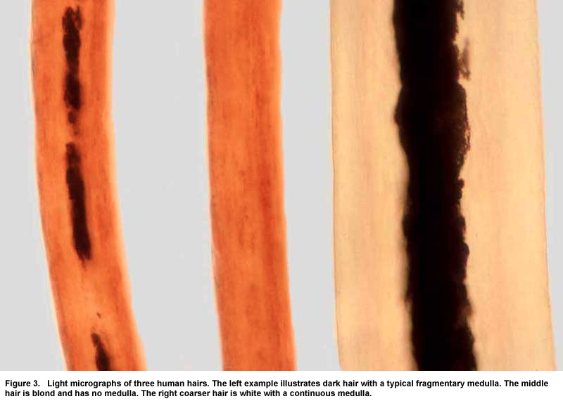
hair Analysis
Hair microscopists have well defined methods
Root appearance, tip appearance, length, shape, diameter, color, curvature, kinks, cuticle scales, thickness and color, medulla style, thickness and color, crushed, burned, chemically altered etc.
FBI Recently Found To Overstate Power of Discrimination.
Therefore, More objective methods required
_
_
Notes:
Don’t do this!

Slide 7
Problems with hair analysis
National Academy of Sciences Report stated that “there are no widely accepted statistics regarding the frequency with which particular characteristics of hair are distributed among the population”
So either better statistics are needed, or alternative techniques
NIJ recently found to have overstated probabilities of hair microscopy results.
Notes:
Don’t do this!

Slide 8
Hair as a matrix
Hair is very robust
IT stores a chronolgy of deit and activity
Its easy to store
It can be collected in front of a witness, unlike urine, so is less prone to to tampering or falsifying etc.
Notes:
Don’t do this!

