Slide 1
Chicken Chicken Chicken: Chicken Chicken
Doug Zongker
University of Washington

Slide 2
Chicken
Chicken
Chicken chicken
Chicken
Chicken chicken chicken

Slide 3
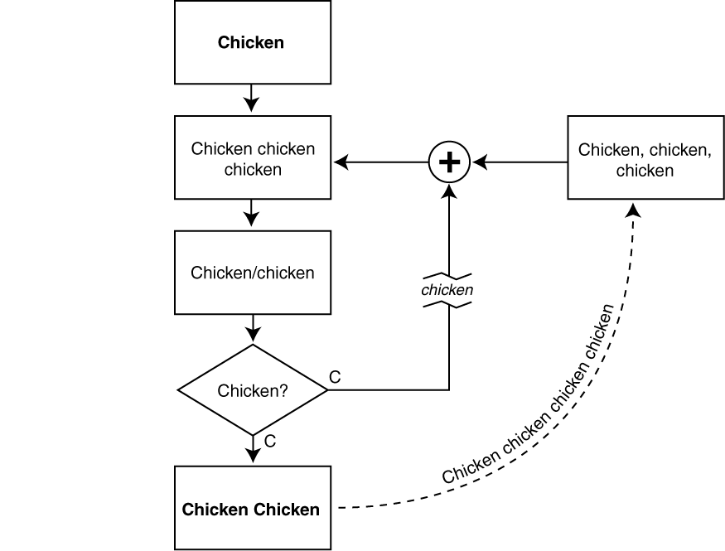
Chicken chicken

Slide 4
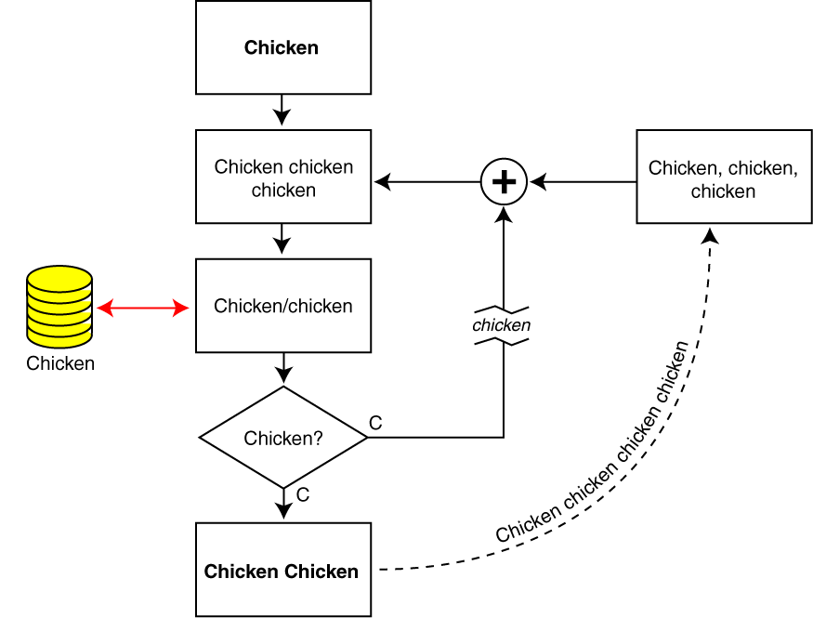
Chicken chicken

Slide 5
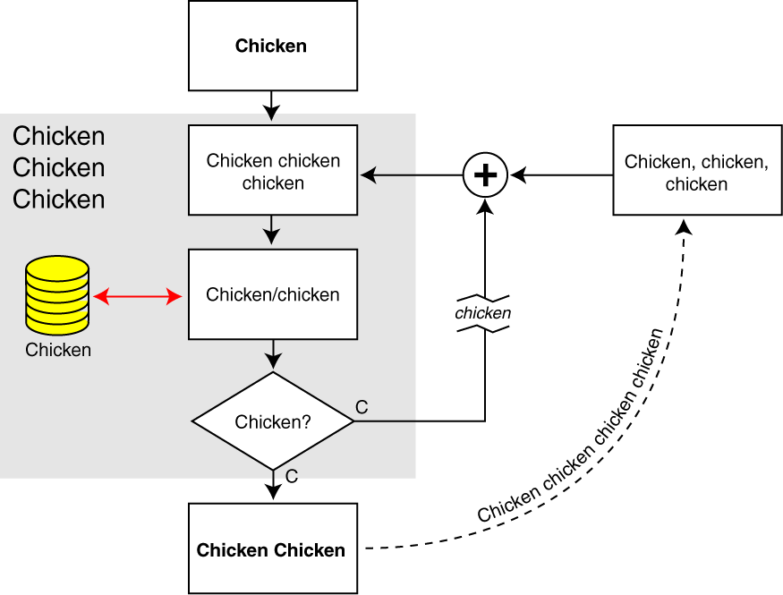
Chicken chicken

Slide 6
Chicken chicken
Chicken: Chicken chicken chicken chickens chicken?

Slide 7
Chicken
Chicken
Chicken chicken
Chicken
Chicken chicken chicken

Slide 8
Chicken chicken
Chicken chicken/chickens
Chicken-chicken [Ch ’95]
“Chickens” chickens [C&C ’97a]
Chickens chickens chickens chickens [Ch ’00]
Chickens chickens chickens
Chickens/chickens [Ch ’01]
Chicken [C. Ch ’97b]

Slide 9
Chicken
Chicken
Chicken chicken
Chicken
Chicken chicken chicken

Slide 10
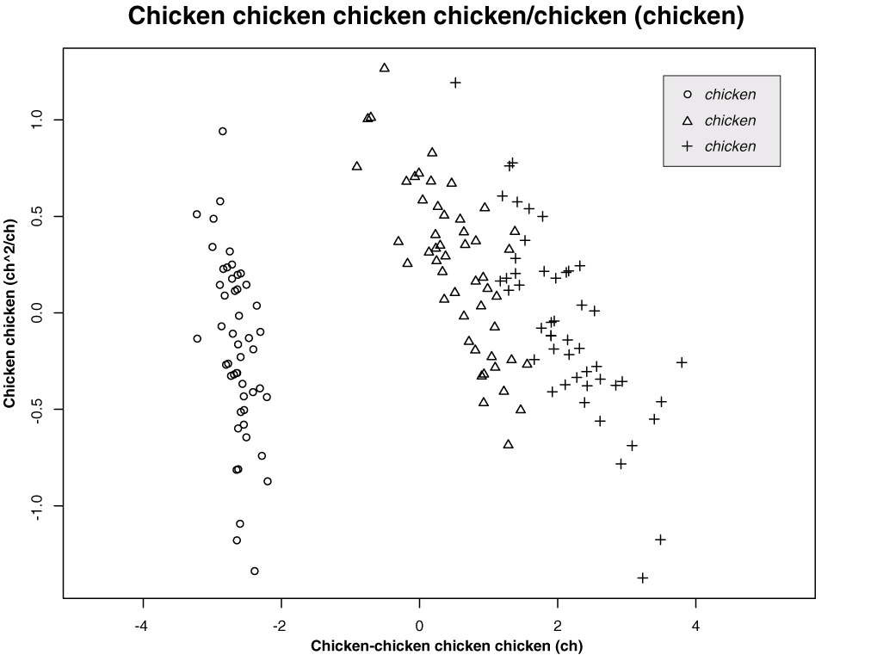

Slide 11
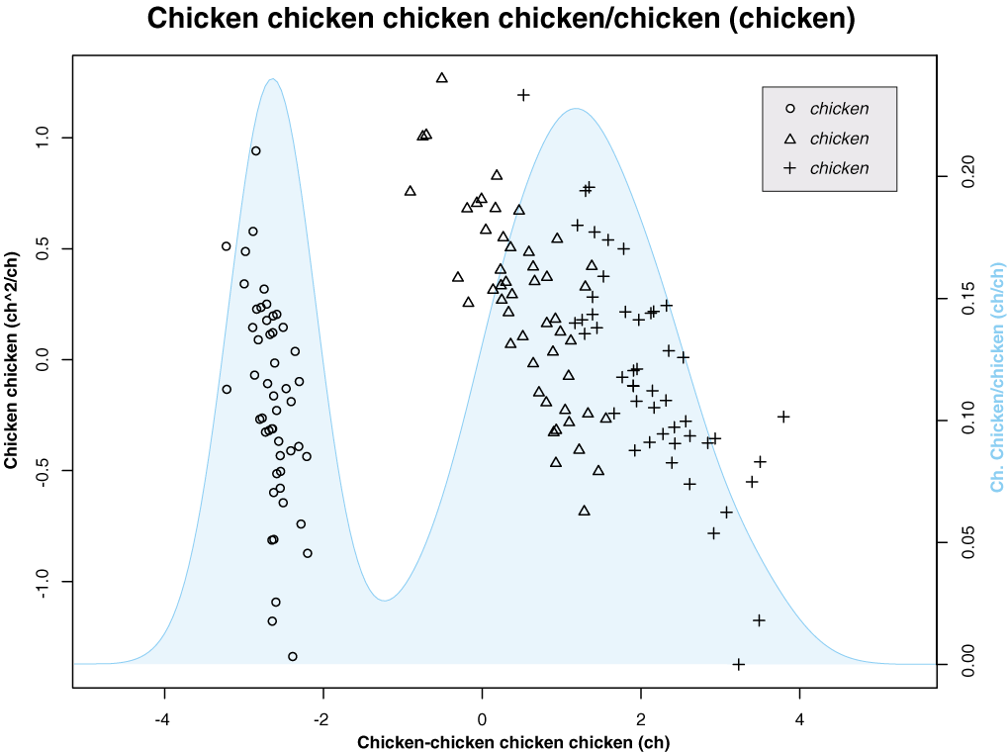

Slide 12
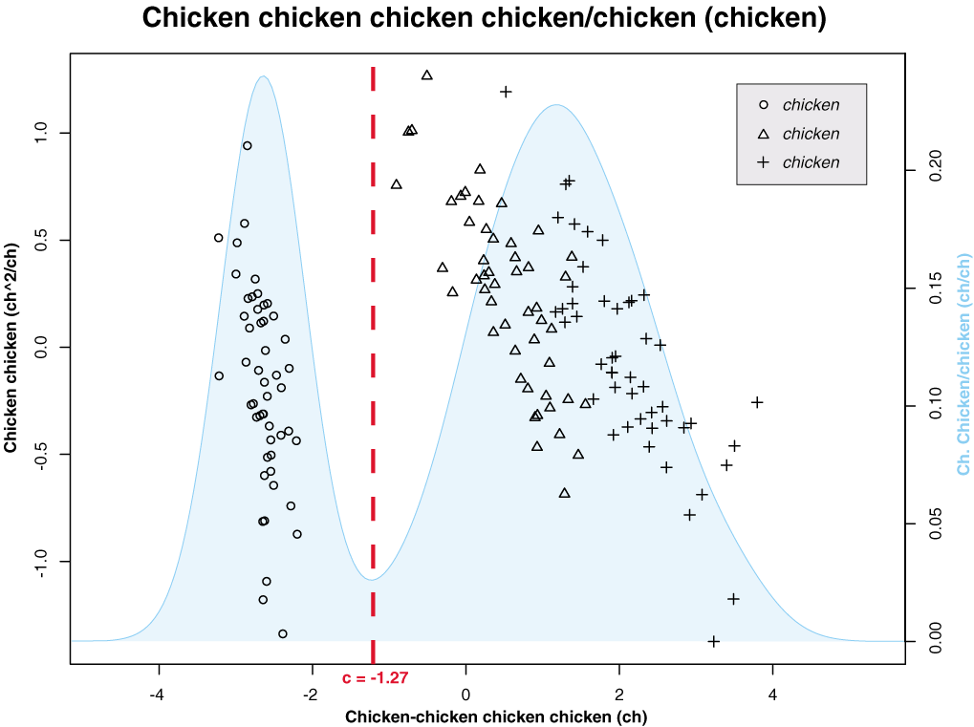

Slide 13
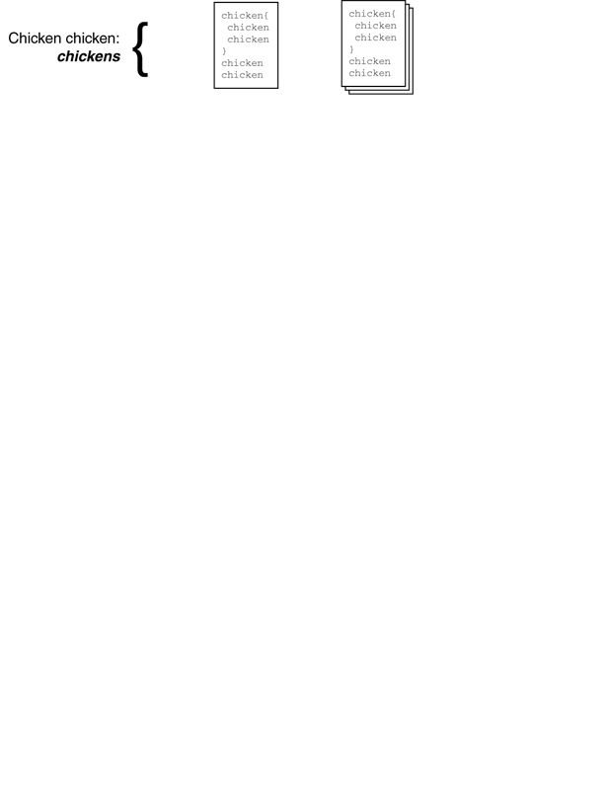

Slide 14
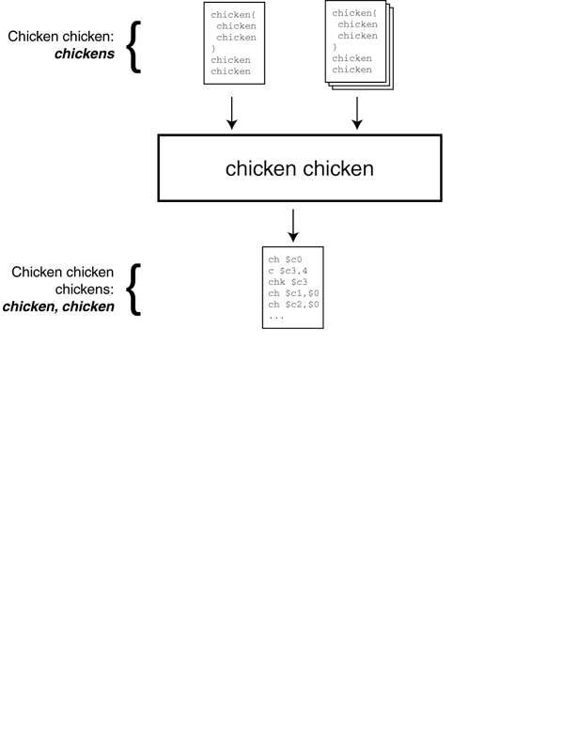

Slide 15
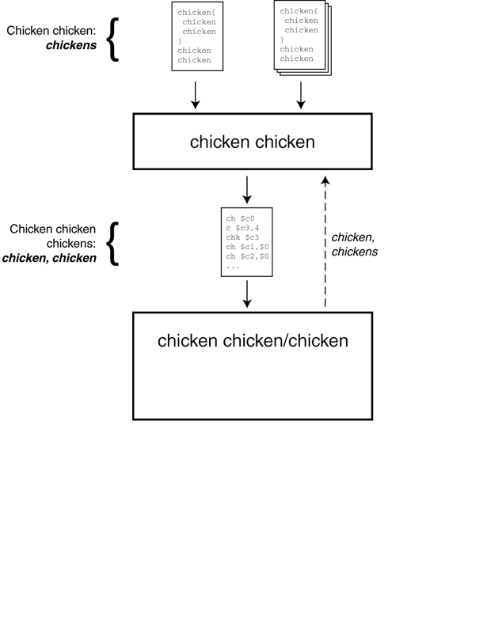

Slide 16
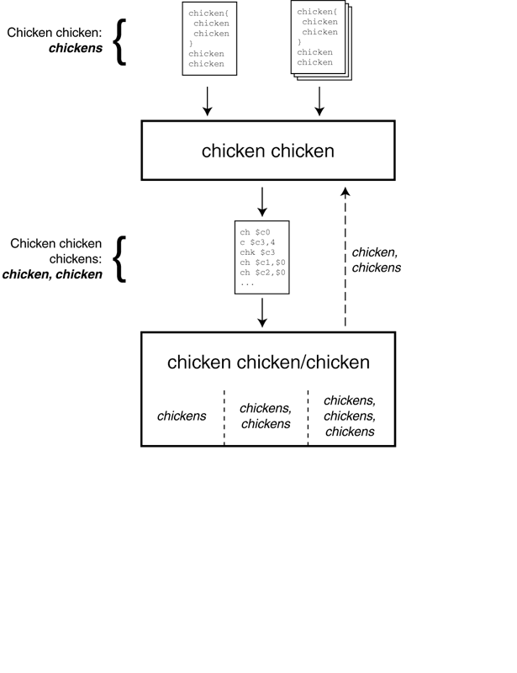

Slide 17
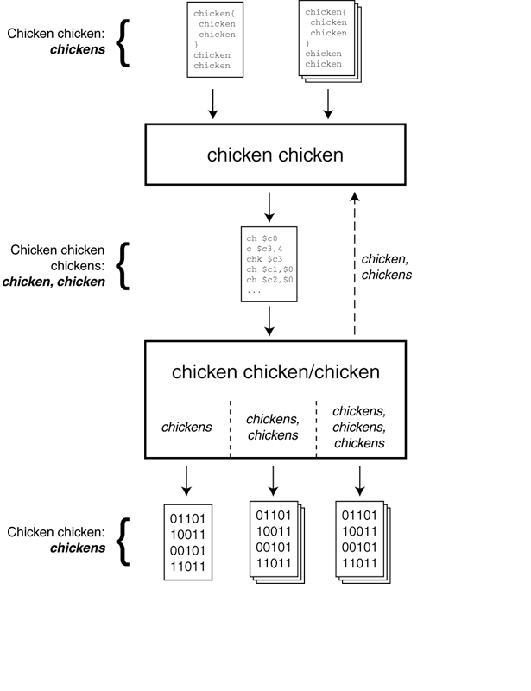

Slide 18
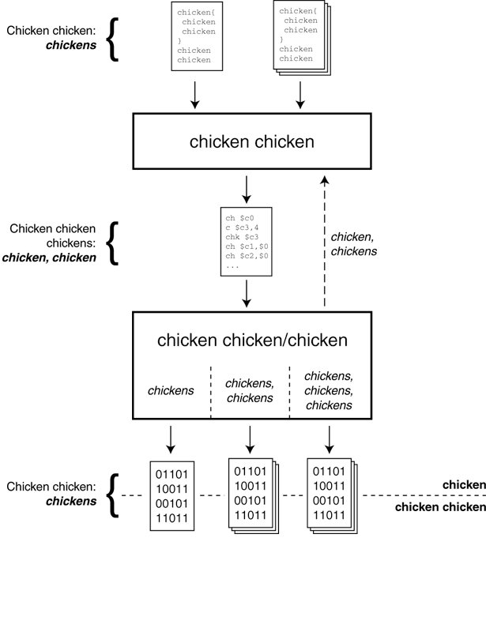

Slide 19
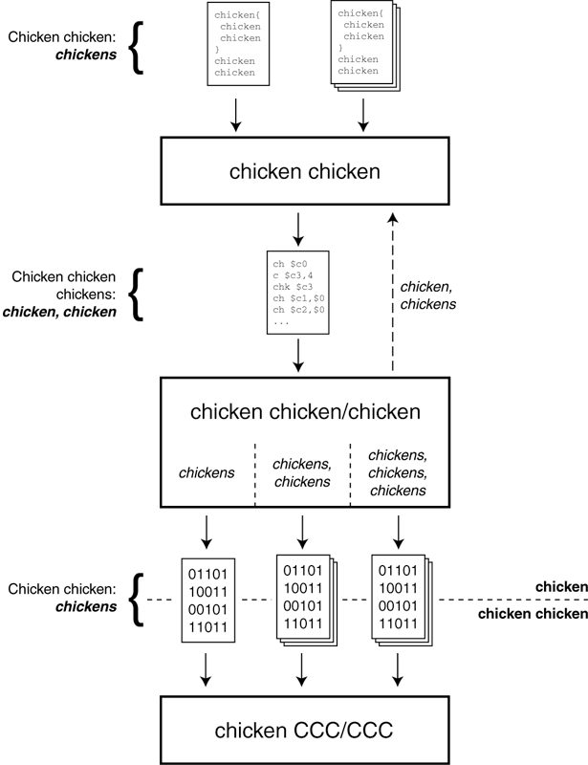

Slide 20
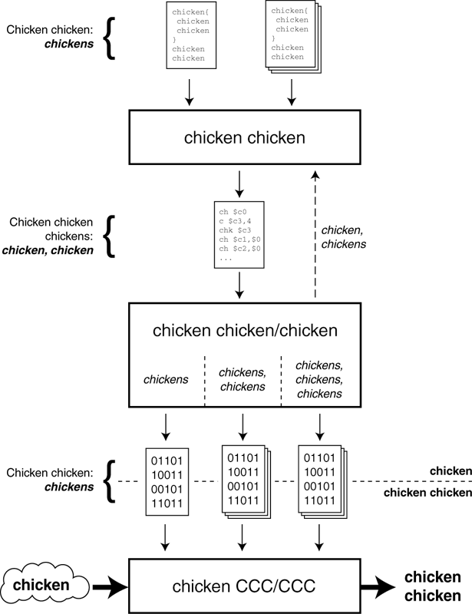

Slide 21
Chicken
Chicken
Chicken chicken
Chicken
Chicken chicken chicken

Slide 22
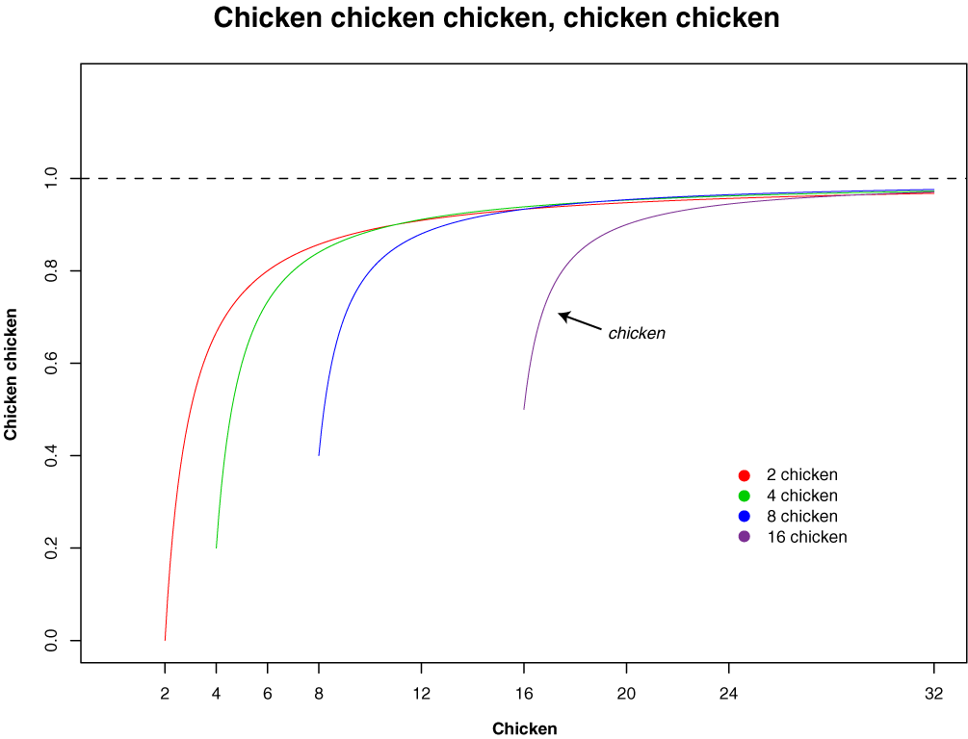

Slide 23
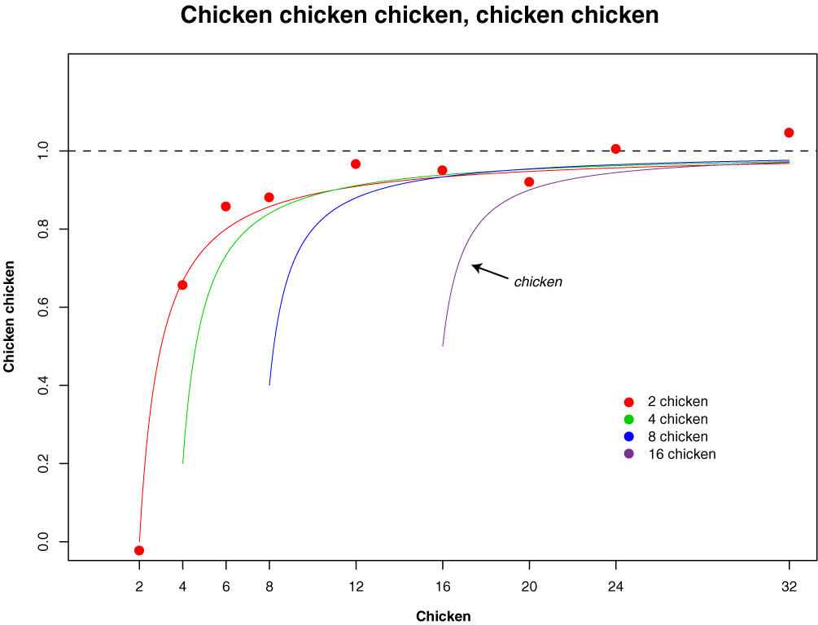

Slide 24
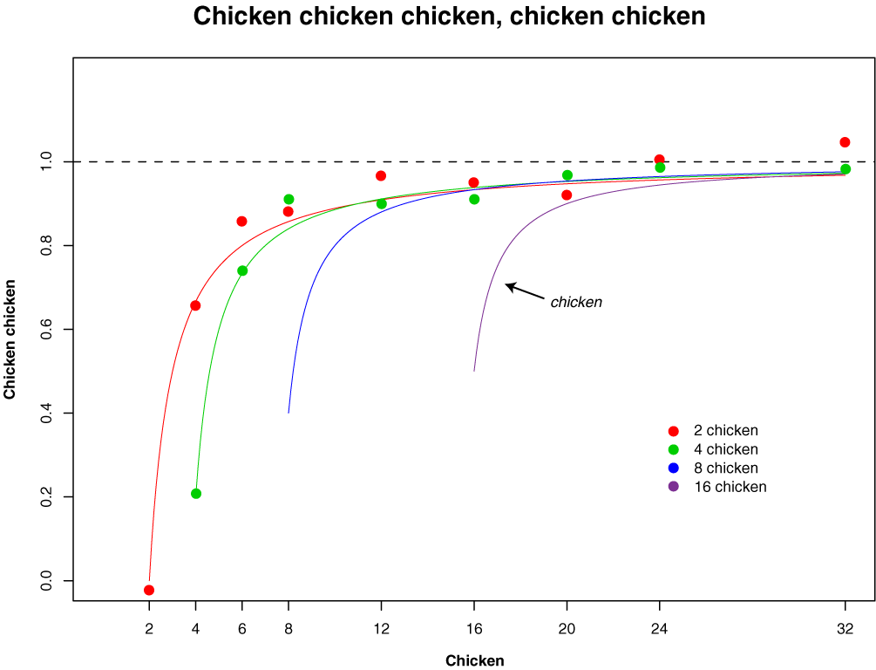

Slide 25
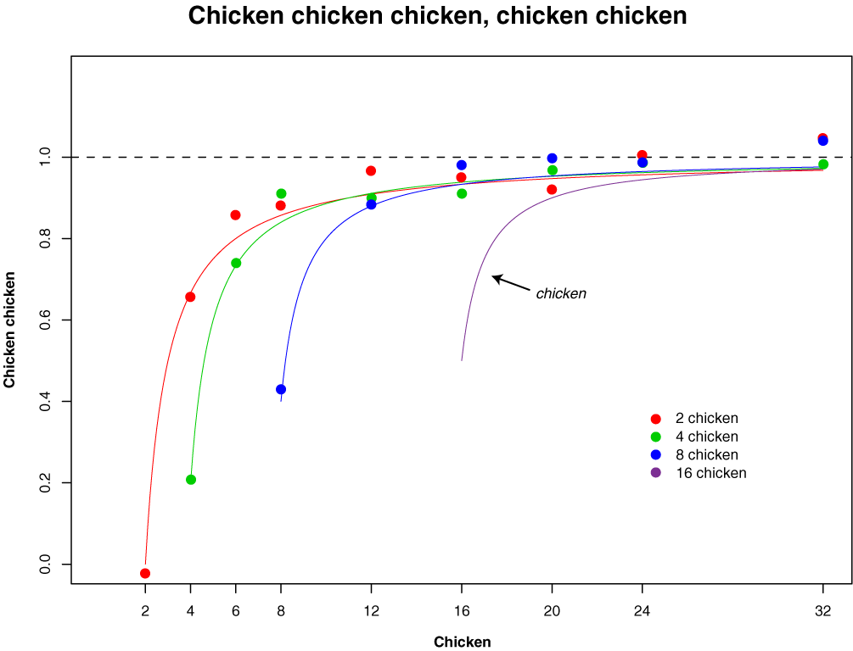

Slide 26


Slide 27
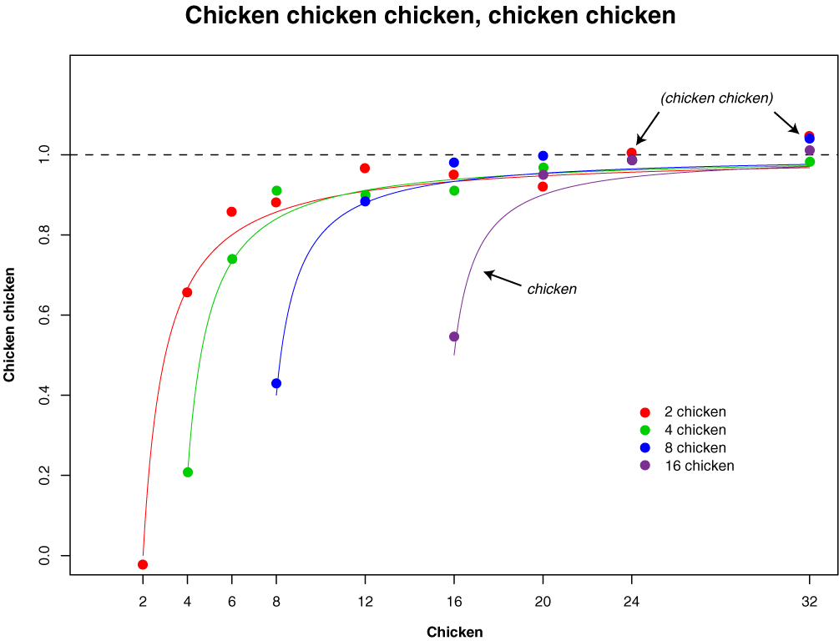

Slide 28
Chickens
Chicken chicken:
Chickens chickens
Chicken
Chicken C-1049355
Chicken chicken chickens:
cccc://chicken.chicken.chk/~chickens/

Slide 29
Chicken chicken, chicken chicken.

Slide 30
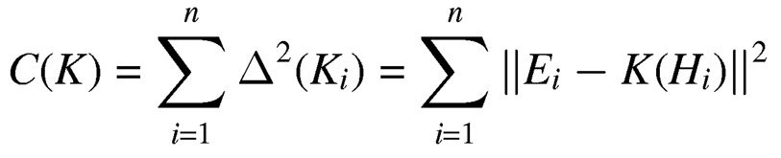
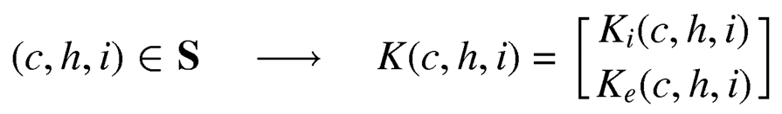

Chickens chickens chicken
Chickens chicken:
chicken:

